Slide 1
Mon 22/8 – Tue 23/8
00:07 stable beams #2040. Initial luminosities: 2.1x10³³ cm⁻²s⁻¹
18:00 Programmed dump. End of physics #2040. ~83 pb⁻¹ in ~18 hours

Slide 2
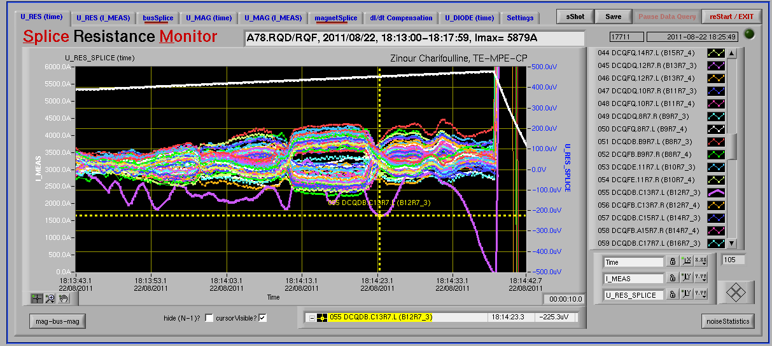
Mon 22/8 – Tue 23/8
Test of the coupling functions for the squeeze to 1 m.
Trip of Sector 78 (QD) at the start of the ramp-down (nQPS BS board B12R7_3 – RQD – Board A) - Z. Charifoulline. Noisy already during the last two ramps, so it has to be replaced during coming technical stop. For the time being we can try to survive with threshold 600μV.

Slide 3
Mon 22/8 – Tue 23/8
During Sector 78 recover after trip:
Loading of new damper firmware for controlled emittance blow-up (required to speed up loss maps in the future),
RF measurements without beams
ATLAS access
21:00 Ready for injection but problem with injection kicker (generator not charging the PFNs Beam 2) and later with LBDS (tracking fault on Beam 1)
22:45 – 02:30 Issues with the transverse damper settings

Slide 4
Mon 22/8 – Tue 23/8
Summary on the ADT problem (D. Valuch)
missing 25ns in the total one turn delay. This explains the instability followed by a dump.
It has an origin in the new firmware deployed yesterday (version 322110720). All previous firmware versions were compiled by Synplify, while the new one by Synplify Premier.
Problem could be solved in 3 out of 4 crates
As it is not possible to have different version of drivers/fesa class on the different ADT front ends we had to revert back to the previous firmware, previous driver and previous DSPU FESA and previous AbortGapCleaning class on all units (kindly done by M. Jaussi in a middle of the night)
The problem is probably related to a specific clock phase or conditions in the crate Vertical Beam 1
On top of that, driver amplifier #7A (Vertical plane, beam 1) trips on a DC power, RF and Power module fault. Access at point 4 and quickly checked the amplifier in UX45. There is no apparent problem. Switch unit OFF till the ADT power piquet will have a look.

Slide 5
Mon 22/8 – Tue 23/8
Additional problems:
2 trips of the RF Module 1 of Beam 1 (occurred already last week)
Trip of LBDS Beam 2: There is probably a GTO broken on generator B MKBV, beam 2. Masked for tonight, but an intervention is probably necessary as soon as possible.
FGC problem on RCBV33.L2B2. Access required as too large kick on that corrector
Recovered the machine at 05:30 ➔ Go for Plan B as agreed with Massi

Slide 6
Plans
RF studies in preparation of MD until 08:30
08:30 start 90 m optics, roman pot and collimator alignment, data taking for ALFA and TOTEM
If 90m optics fill is dumped prematurely:
before ~00:00 Wed: refill and continue 90m
after ~00:00 Wed: stop there, give machine to MD
04:00 tomorrow: start of the MD
Pending issues to be clarified this morning with experts: MKB beam 2 and RF Beam 1

Slide 7
Draft MD Planning Wed – Thu (24. – 25.8.)
Day | Time | MD | MP
Wed | 04:00 | Ramp down, cycle
 | 06:00 | 450 GeV → 3.5 TeV: Head-on beam-beam + 1h data taking (stable beams) – for highest pile-up | B
 | 13:00 | Ramp down, cycle
 | 15:00 | 450 GeV → 3.5 TeV: Optics setup for β*=1m (1) – Pilots through squeeze, measure and correct Q, Q’, C, orbit, measure beating and local coupling | A
 | 19:00 | Ramp down, cycle
 | 21:00 | 450 GeV → 3.5 TeV: Long bunch length – RF setup at injection, test ramp for losses in IR3, voltage change at flat top | B
Thu | 03:00 | Ramp down, cycle
 | 05:00 | 450 GeV → 3.5 TeV: Beam Instrumentation | B
 | 13:00 | Ramp down, cycle.
 | 15:00 | 450 GeV → 3.5 TeV: LR beam-beam – 2 batches, effect of number of LR interactions, effect of emittance | C

Slide 8
Draft MD Planning Fri – Sat (26. – 27.8.)
Day | Time | MD | MP
 | 23:00 | Ramp down, cycle.
Fri | 01:00 | 450 GeV: Transverse damper – beam blowup at injection | B/C
 | 07:00 | 450 GeV → 3.5 TeV: Aperture – scraping pilot beam tails in triplets, maybe test global aperture measurement with transverse damper | B
 | 15:00 | Ramp down, cycle.
 | 17:00 | 450 GeV: 25 ns studies – injection of up to 144b/288b, damper | B
Sat | 00:00 | 450 GeV: 25 ns studies – vacuum, ecloud, RF | B
 | 07:00 | 450 GeV → 3.5 TeV: Optics setup for β*=1m (2)– apply proposed beating and local coupling corrections; at 1m: measure beating and coupling, verify corrections, test collision beam process | A
 | 15:00 | Ramp down, cycle.
 | 17:00 | 450 GeV → 3.5 TeV: Collimator setup for β*=1m– tight collimation settings, set up TCT’s in IR, loss maps. Asynchronous dump, if time left. | B

Slide 9
Draft MD Planning Sun – Mon (28. – 29.8.)
Day | Time | MD | MP
Sun | 01:00 | Ramp down, cycle. | B
 | 03:00 | 450 GeV → 3.5 TeV: p-p rephasing – debunching during ring rephasing with nominal emittances
 | 09:00 | Ramp down, cycle.
 | 11:00 | 450 GeV: UFO studies – generation mechanism at MKI’s, statistics, MKQA tests (p-Pb interlock test in the shadow) | C
 | 19:00 | 450 GeV: Quench margin at injection – observation with special QPS instrumentation, losses from TCLIB collimator | C
 | 22:00 | 450 GeV → 3.5 TeV: Quench test at 3.5 TeV – test losses in other dispersion-suppressors – dropped if extra time needed for β*=1m | C
Mon | 06:00 | Technical Stop
Needs from experiments:
-Luminometers on during beam-beam MDs and in the second slot of β*=1 m

