Slide 1
MD Planning Fri – Sat (26. – 27.8.)
Day | Time | MD | MP
 | 23:00 | Ramp down, cycle.
Fri | 01:00 | 450 GeV: Transverse damper – beam blowup at injection | B/C
 | 07:00 | 450 GeV → 3.5 TeV: Aperture – scraping pilot beam tails in triplets, maybe test global aperture measurement with transverse damper | B
 | 15:00 | Ramp down, cycle.
 | 17:00 | 450 GeV: 25 ns studies – injection of up to 144b/288b, damper | B
Sat | 00:00 | 450 GeV: 25 ns studies – vacuum, ecloud, RF | B
 | 07:00 | 450 GeV → 3.5 TeV: Optics setup for β*=1m (2)– apply proposed beating and local coupling corrections; at 1m: measure beating and coupling, verify corrections, test collision beam process | A

Slide 2
Summary of MD transverse blow-up using transverse damper
Blow-up using band limited and white noise was prepared for beam 2.
Initial tests on pilot bunches (max two pilots) spaced 2 us adjusted delays, gating etc. Demonstrated selectivity (one bunch left untouched, one blown-up) largest emittance observed was about 18-20 um, then too small intensity for clean wirescanner measurement, but profile seemed to not increase beyond this; to be checked with collimator settings, but at first sight seems compatible with 5.7 sigma.

Slide 3
Summary of MD transverse blow-up using transverse damper
Used filling scheme with 2 batches of 6 bunches spaced at the nominal distance of 925 ns adjust excitation to middle of gap, then demonstrated that we can move controlled into first batch of 6 bunches; both planes checked plus loss maps done (moderate speed). It was demonstrated that it is possible to perform controlled loss maps with high intensity beam above safe limit.
Moved to single bunch; compared traditional loss map and damper loss map on single bunch, damper loss map with feedback on off. Achieved similar losses as with traditional loss maps, amplitude nicely controllable. Loss maps by the two methods show in the details some features that differ, to be analysed by collimation team.

Slide 4
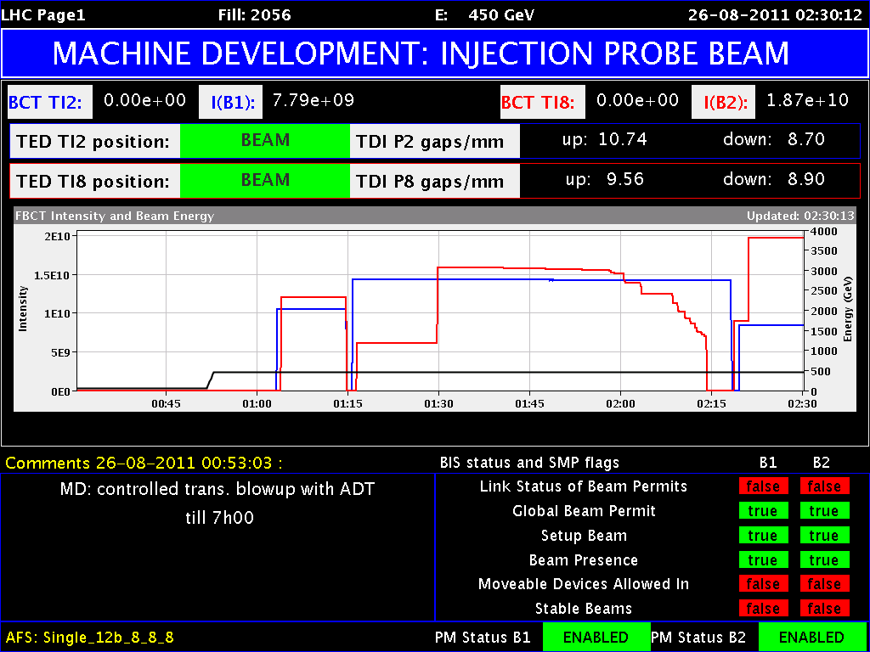
Blowup with Transverse Damper (W. Hoefle, D. Valuch et al)

Slide 5
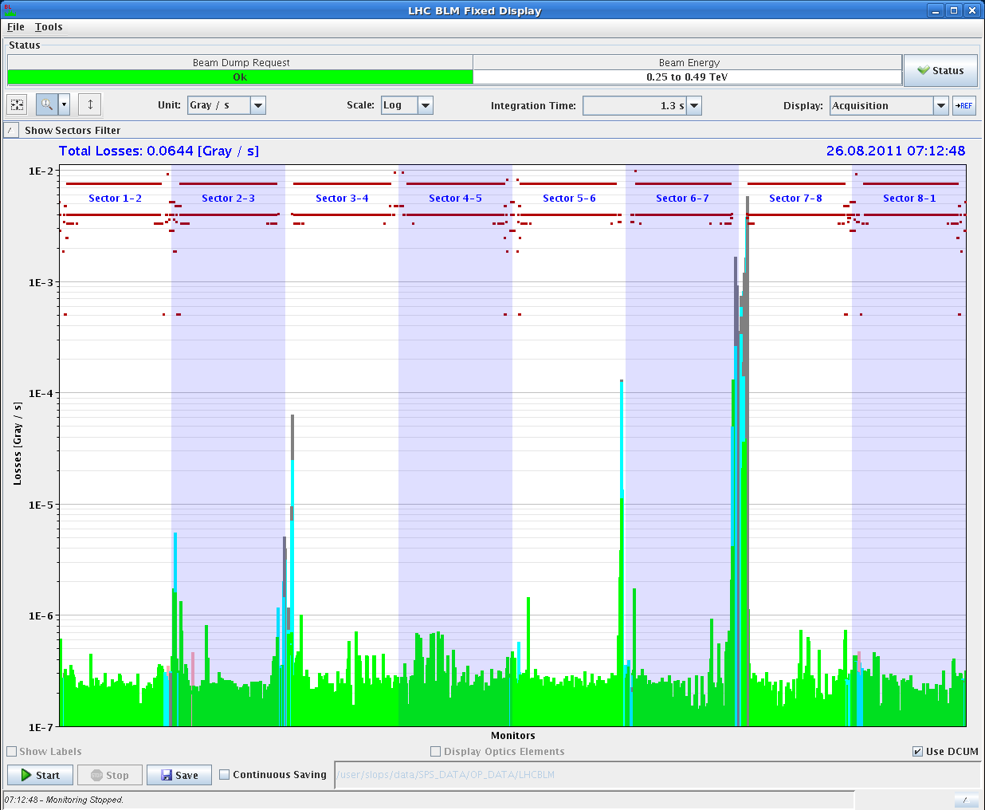
Loss Map with Transverse Damper

Slide 6
MD IR Aperture (S. Redaelli et al)
measurements at 3.5 TeV (squeezed beams to 1.5m)
started after about 1h due to a problem with a collimator in IP7 for B1. This time was given to the previous MDers, who were working on the other beam.
Real measurements at top energy, with squeezed and separated beams, could start at about 9h30.
The measurements were aimed at measuring with the beam, the retraction between TCTs and triplets in IP1 and IP5, both in crossing and separation planes. We increased appropriate crossing bumps in both planes of each IP to explore the aperture in the expected limiting locations. We started from nominal separation (+/-0.7mm) and crossing (+/-120urad).

Slide 7
MD IR Aperture
The aperture was approached with bumps, keeping the TCT at settings that exposed the triplet by 0.5 sigmas at most. The first scan took about 2 hours. Then we got more confident on the procedure and could finish measurements in the separation and crossing planes of both IP1 and IP5.
We found a good aperture in both planes and IPs. So good that we want to take more time to see if we overlooked something. Had to open the TCT aperture to the following values before seeing primary losses at the triplet: IR1 - V -> 18.3 - 18.8 sigmas IR1 - H -> 19.8 - 20.3 sigmas IR5 - V -> >= 20.3 sigmas (corrector limit reached) IR5 - H -> 19.8 - 20.3 sigmas

Slide 8
MD IR Aperture
If preliminary estimates are confirmed possibility to squeeze further than 1 m at 3.5 TeV or to run at 1.0 m without going to tight settings or reducing the crossing.
As we had 30 min left, we squeeze to 1 m keeping the 120 urad crossing in IP1/5 and keeping the presently operational settings for collimators (relaxed).
At beta*=1m, the TCTs in IP1 and IP5 were set to 11.8 sigmas for the new optics, keeping the same centre as at 1.5 m (negligible difference of orbit with respect to 1.5 m). We made loss maps in the vertical planes for both beams to preliminary address the triplet protection with these settings.
Note that in parallel, we did measurements of the tune and coupling induced by the non linear errors in the triplet magnets. Tune and coupling shifts were indeed observed. More detailed analysis is required.

Slide 9
25 ns (part I)
Start 16h20.
17h25 - Interruption from thunderstorms:
7 sectors tripped
ventilation door at UL44 opened => access
some mini-quenches seen by the cryo ( on Q9+ Q10.R2, Q9L4, Q9.R4 Q10.L5 Q9+Q10.R5, Q9+Q10.L6, Q9.R6, Q9-Q10.L8) but no loss of cryo start
19h03: Again ventilation door in UL44 opens by itself... interlock for this door seems to be in the SIS, so we mask until the door is fixed.

Slide 10
25 ns (part I)
20h16: MD continuing, beam back
Injection of up to 48b, some apparent instability leads to loss of beam after 517 turns
22h59: electrical perturbation on 3.3kV line caused a trip of the whole cryo plant at pt 2 .... first estimate for recovery: 20+ hrs

Slide 11
MD Planning Fri – Sat (26. – 27.8.)
Day | Time | MD | MP
Sat | 07:00 | 450 GeV → 3.5 TeV: Optics setup for β*=1m (2)– apply proposed beating and local coupling corrections; at 1m: measure beating and coupling, verify corrections, test collision beam process | A
 | 15:00 | Ramp down, cycle.
 | 17:00 | 450 GeV → 3.5 TeV: Collimator setup for β*=1m– tight collimation settings, set up TCT’s in IR, loss maps. Asynchronous dump, if time left. | B
Sun | 01:00 | Ramp down, cycle. | B
 | 03:00 | 450 GeV → 3.5 TeV: p-p rephasing – debunching during ring rephasing with nominal emittances
 | 09:00 | Ramp down, cycle.
 | 11:00 | 450 GeV: UFO studies – generation mechanism at MKI’s, statistics, MKQA tests (p-Pb interlock test in the shadow) | C
To be revisited

Slide 12
MD Planning Sun – Mon (28. – 29.8.)
Day | Time | MD | MP
Sun | 19:00 | 450 GeV: Quench margin at injection – observation with special QPS instrumentation, losses from TCLIB collimator | C
 | 22:00 | 450 GeV → 3.5 TeV: Quench test at 3.5 TeV – test losses in other dispersion-suppressors – dropped if extra time needed for β*=1m | C
Mon | 06:00 | Technical Stop
To be revisited
Needs from experiments:
-Luminometers on during beam-beam MDs and in the second slot of β*=1 m

