Slide 1
MD Report Thu - Fri (25. – 26.8.)
Day | Time | MD | MP
Thu | 03:00 | Ramp down, cycle
 | 05:00 | 450 GeV → 3.5 TeV: Beam Instrumentation | B
 | 13:00 | Ramp down, cycle.
 | 15:00 | 450 GeV → 3.5 TeV: LR beam-beam – 2 batches, effect of number of LR interactions, effect of emittance | C
 | 23:00 | Ramp down, cycle.
Fri | 01:00 | 450 GeV: Transverse damper – beam blowup at injection | B/C

Slide 2
MD Report 26.8.2011
Beam availability for full MD OK (8h) but issues with overheads due to changes of beam types
BI MD summary
BLM direct dump BLM system calibrated
BCT data taken while scraping high intensity bunches
BPMs:test of orbit filters and strip-lines crosstalk.
BSRT: very little data taken (bump B1V 450GeV). 90% of the programme not completed

Slide 3
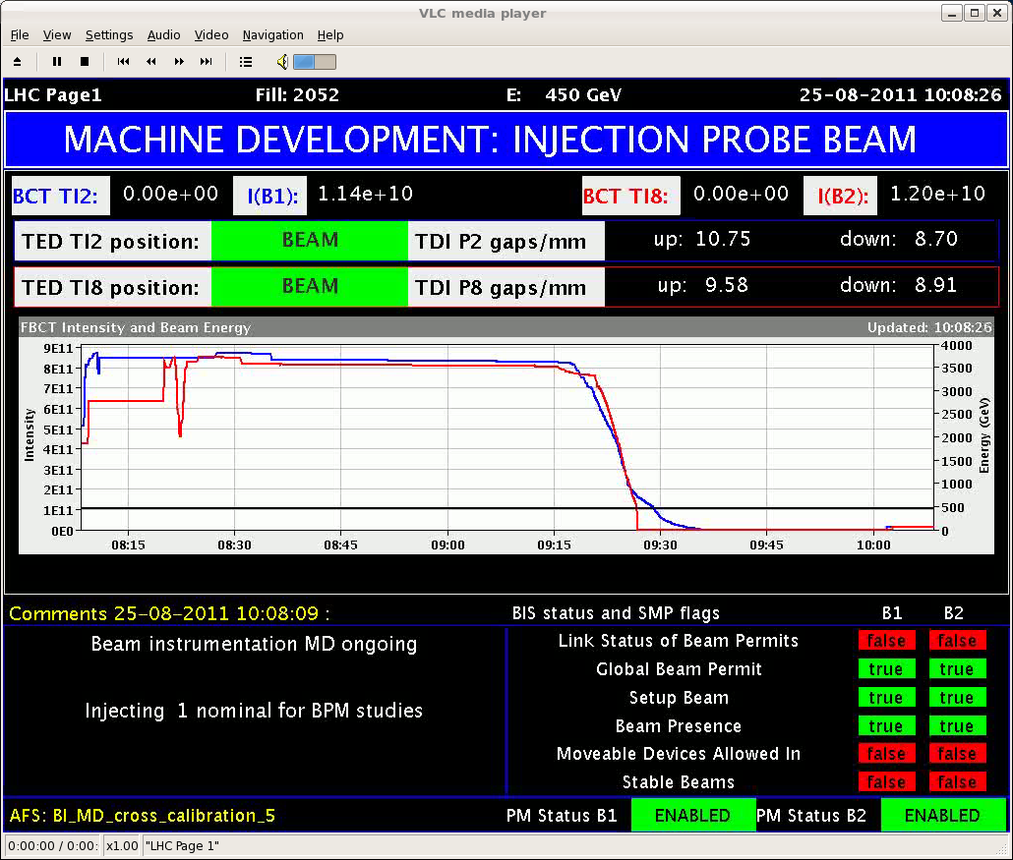
Beam Scraping for BCT Calibration

Slide 4
From BI MD to BB MD
Access for the replacement of an ADT driver module was done at 14:00, and the ADT was verified OK after the intervention.
Finished the shift with the machine almost ready to inject (for next MD) but then the triplet left of 8 due to a water fault.

Slide 5
From BI MD to BB MD
Other things to note
ATLAS Solenoid and Toroid switched off by ATLAS
LHCb dipole ramped down at request of LHCb.
The LHCb input to the injection BIC CIB.SR2.INJ1 went into an undefined state ( and so prevented injection). Tests showed that the problem was not with the CIBU itself, but is upstream at either LHCb or the interface from LHCb to the BIS. The problem went away by itself, but needs follow up by the BIS team and LHCb.
When recovering from the access, there was again a problem with the beam imminent warning, that prevented the transfer of the LHC access chain key. ... it seems that system was being worked on at the time.

Slide 6
Long-Range Beam-Beam (Werner et al)
Only 1 hour in beam-beam study at flat top:
~ 2h problems with transverse damper: cable left connected.
Trip of IR8 triplet.
One fill lost during squeeze due to tune feedback.
Special collision scheme:
12 (not colliding) + 36 + 36 bunches per beam.
Collision scheme is highly asymmetric between beam 1 and beam 2 (on purpose).
Proved very efficient to get data within short time.
Reducing crossing angle (IR1 and IR5 together) while following with tertiary collimators.

Slide 7
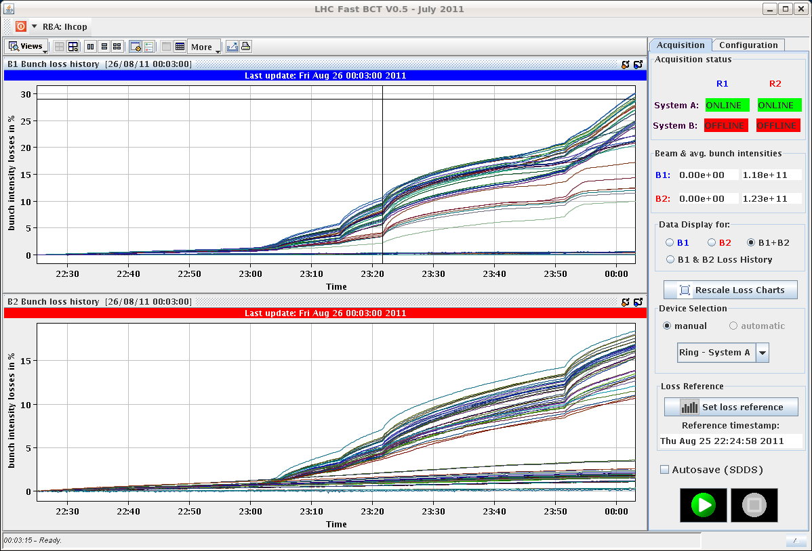
LR-BB: Losses per Bunch
Crossing angle
100% = 120 μrad
30%
35%
HD 1-2-5
Strong LR
40%
50%
HD 8
Tiny LR
Note: B2 collision scheme practically equivalent to last LR BB MD: 2 head-on
HD 1-5
Strong LR
HD 2-8
Small LR

Slide 8
LR-BB: Losses per Bunch
30%
35%
HD 1-2-5
Strong LR
40%
50%
30% of beam lost in 1 hour → strong LR effects with reduced crossing angles
HD 8
Tiny LR
HD 1-5
Strong LR
HD 2-8
Small LR

Slide 9
LR-BB: Losses per Bunch
30%
35%
HD 1-2-5
Strong LR
40%
50%
HD 8
Tiny LR
Lower losses beam2 (factor 2) could show that LR losses are enhanced by number of head-ons
To be analyzed...
HD 1-5
Strong LR
HD 2-8
Small LR

Slide 10
LR-BB: Losses per Bunch
30% (36 μrad)
HD 1-2-5
Strong LR
IR2 separated → one HD less
Better for bunches with lower than maximum LR interactions
HD 8
Tiny LR

Slide 11
How Could Head-On Drive LR BB Losses?
To be analyzed in detail...
Possible mechanism (Werner Herr):
Lower beam-beam separation creates lower dynamic aperture.
Beam tails then cut by dyamic aperture.
Losses constrained if tails are not repopulated.
Head-on collisions might provide a mechanism to feed beam into region of reduced dynamic aperture.
At the moment just a speculation...
If true, can be reduced by tune WP optimization.

Slide 12
Preliminary Conclusions for Physics
Based on results, expect 8σ BB separation with 50ns to work (setup for 1m β*):
Keep emittance small and equal.
Probably reduced margins in tune space, requiring reoptimization of tune.
Analysis for 25ns to be done, but will be interesting for beam-beam.

Slide 13
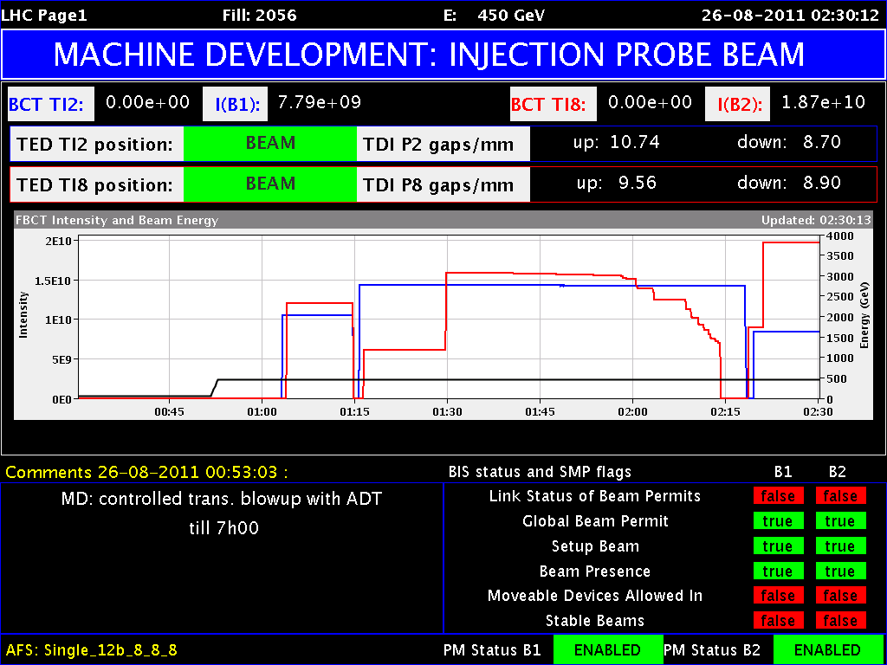
Blowup with Transverse Damper

Slide 14
Draft MD Planning Fri – Sat (26. – 27.8.)
Day | Time | MD | MP
 | 23:00 | Ramp down, cycle.
Fri | 01:00 | 450 GeV: Transverse damper – beam blowup at injection | B/C
 | 07:00 | 450 GeV → 3.5 TeV: Aperture – scraping pilot beam tails in triplets, maybe test global aperture measurement with transverse damper | B
 | 15:00 | Ramp down, cycle.
 | 17:00 | 450 GeV: 25 ns studies – injection of up to 144b/288b, damper | B
Sat | 00:00 | 450 GeV: 25 ns studies – vacuum, ecloud, RF | B
 | 07:00 | 450 GeV → 3.5 TeV: Optics setup for β*=1m (2)– apply proposed beating and local coupling corrections; at 1m: measure beating and coupling, verify corrections, test collision beam process | A
 | 15:00 | Ramp down, cycle.
 | 17:00 | 450 GeV → 3.5 TeV: Collimator setup for β*=1m– tight collimation settings, set up TCT’s in IR, loss maps. Asynchronous dump, if time left. | B

Slide 15
Draft MD Planning Sun – Mon (28. – 29.8.)
Day | Time | MD | MP
Sun | 01:00 | Ramp down, cycle. | B
 | 03:00 | 450 GeV → 3.5 TeV: p-p rephasing – debunching during ring rephasing with nominal emittances
 | 09:00 | Ramp down, cycle.
 | 11:00 | 450 GeV: UFO studies – generation mechanism at MKI’s, statistics, MKQA tests (p-Pb interlock test in the shadow) | C
 | 19:00 | 450 GeV: Quench margin at injection – observation with special QPS instrumentation, losses from TCLIB collimator | C
 | 22:00 | 450 GeV → 3.5 TeV: Quench test at 3.5 TeV – test losses in other dispersion-suppressors – dropped if extra time needed for β*=1m | C
Mon | 06:00 | Technical Stop
Needs from experiments:
-Luminometers on during beam-beam MDs and in the second slot of β*=1 m

