Slide 1
MP7 link fault 18/8/2011
Davide Bozzini, 19th of August 2011

Slide 2
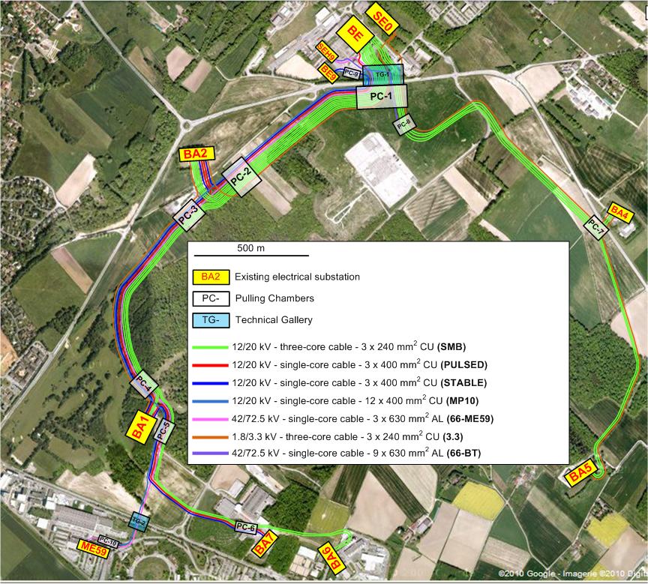
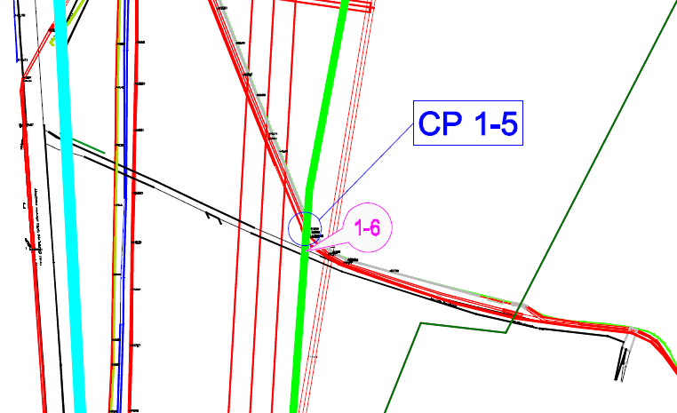
SPS power network consolidation

Slide 3
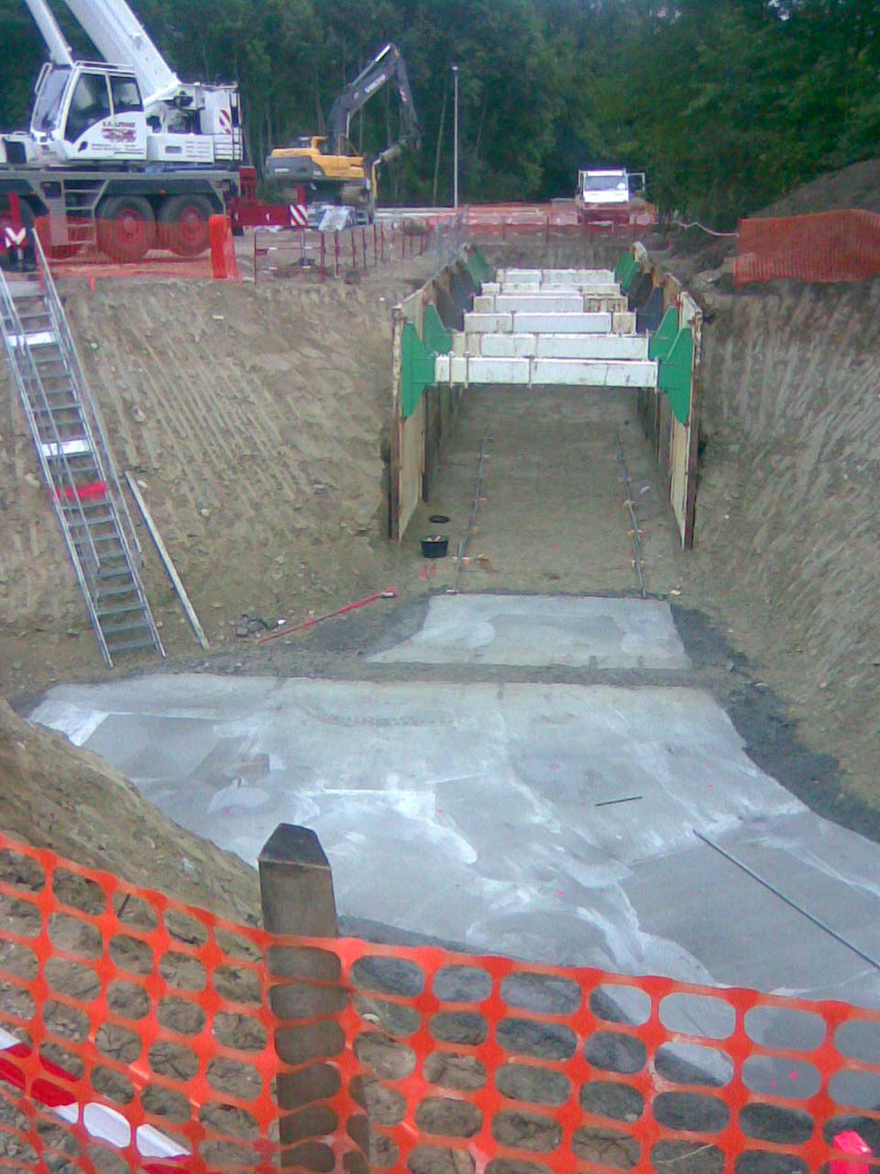
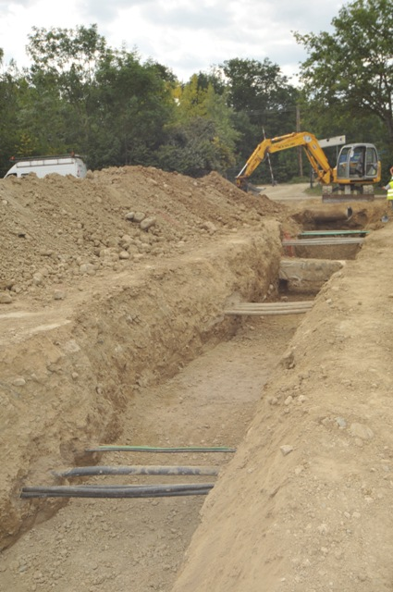
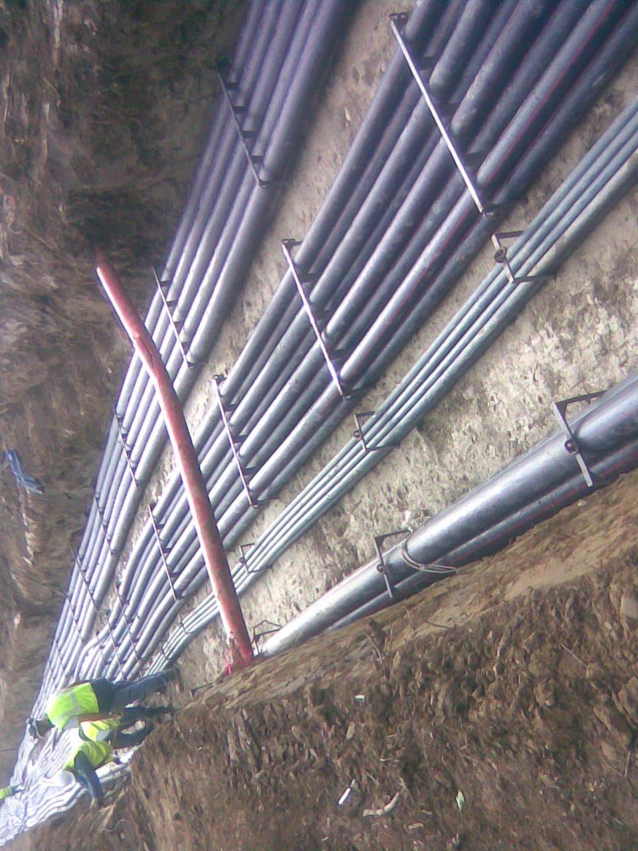
Nature of works

Slide 4
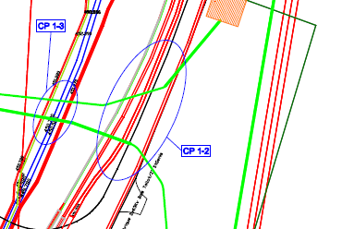
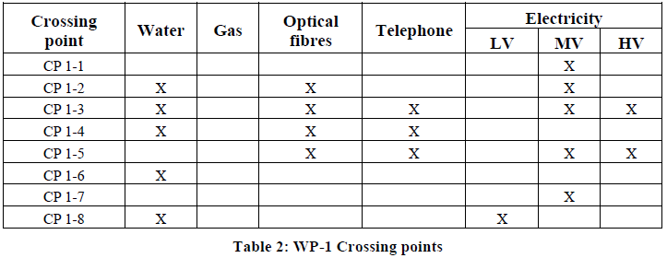
Crossing points and trial holes

Slide 5
Crossing points and trial holes
Trial holes shall be done whenever necessary to exactly localize the crossing known and unknown utilities
Trial holes shall provide information on the nature of the ground for excavating and timbering purposes
All known crossing points shall be confirmed by a trial hole
CERN known crossing points are shown in each concerned work package set of drawings
The contractor shall identify any crossed utility before starting digging

Slide 6
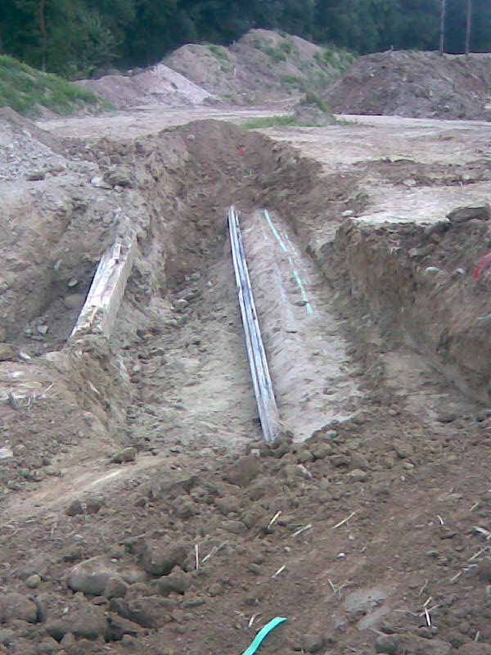
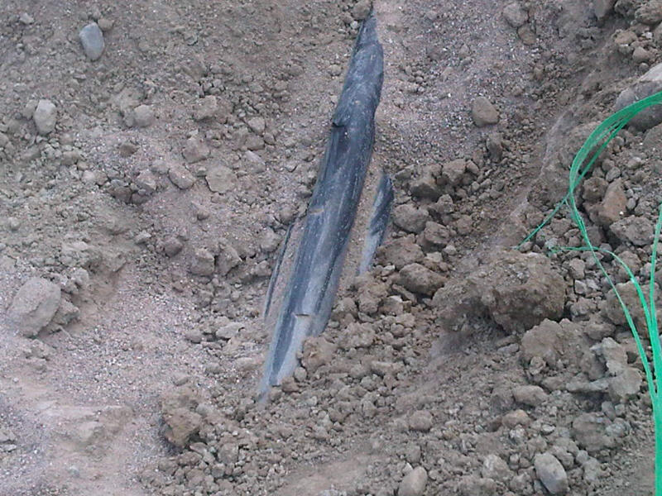
Nature of fault
Damage of a 18 kV power cable during excavation
The trial hole was done during the TS to exactly determine position and depth
Excavation to be done durin machine operation according to work status

Slide 7
Preliminary outcome
The trial hole was done during the TS to exactly determine position and depth
Excavation to be done during machine operation according to work status
BA2 18 networks crossed without any problem. Excellent execution
Today accident:
Operators ad-interim to cope with staff holidays
Supervisors absent during the accident 11h45
HSE unit inspection on site today Friday morning
Setting up of the fact finding group to be confirmed by DG
Trial holes and crossing works suspended
Normal operation of network expected by tonight

Slide 8
