Slide 1
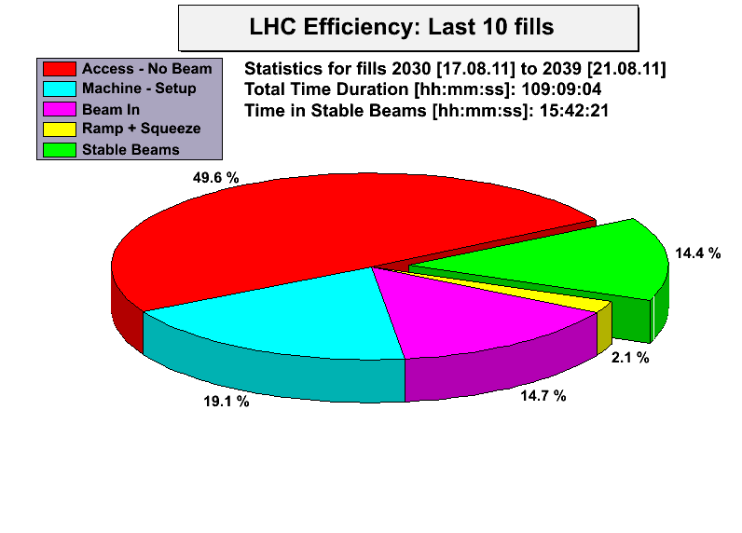
LHC Status Mo Morning 22-Aug
Bernhard Holzer, Jan Uythoven
Week 33:
6 Luminosity Runs
int luminosity: 143.6 pb ⁻¹
maximum lumi 2.4*10 ³³
major issues: LHC-b polarity
ALFA on beam
tight colli settings
electrical glitches
major power cut

Slide 2
LHC Status Mo Morning 22-Aug
Fill date length max Lumi int lumi Dump
.... recovering from cry problem: restart Tuesday
16.8. 3:06h 1.9 19.3 RF Cly fil current
2029 17.8. 4:10h 2.1 26.4 UFO Atlas
2030 17.8. 1:41h 2.2 11.7 RQX.L5 curr meas.
2031 17.8. 0:51h 2.1 6.1 EDF
18.8. 5:13h 2.4 35.5 EDF
.... the true single event upset: Spitzhacke (“Pick”)
2037 21.8. 8:00h 2.0 44.0 experts
2040 22.8. ------ 2.1 37 ...

Slide 3
Monday 15th August
Cryogenics recovery
Accesses
Tests

Slide 4
Accesses
RF - crowbar problem on module 2B1 – fixed
Noise problem on RF 4B2 – more access today
CMS, ATLAS
Collimators
Beam Dump
QPS
ISRM (Internal Splice Resistance Measurement) on RD2.R8, RQ4.R8 and RQ5.R8 done.
Fiber optics for access system
BLMs and CO for BLM timing crate

Slide 5
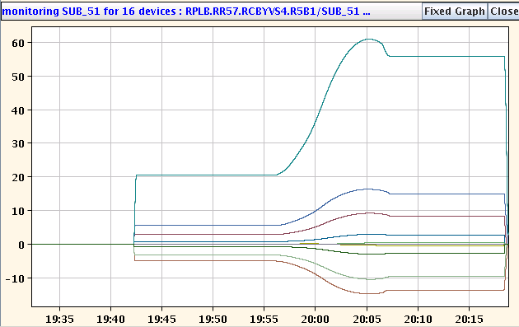
Dry-run of new functions for combined ramp & squeeze
Allows to reach 3.5m in Ip1 and IP5 at flat-top. Test only IP5 (both sides).
The functions were successfully executed until the end of the ramp!
Interesting shapes for the orbit correctors (energy scaling combined with the change of strengths during the squeeze) that will be interesting to check with beam!

Slide 6
LHC Status Tue Morning 16-Aug
Bernhard Holzer, Jan Uythoven
Tentative Planning:
Tue Morning cryo ok expected in the complete machine at 14:00h
last sector 81 switching on power converters, preparing restart
Tue 15:00h precycle, injection & ramp for luminosity
Meanwhile: access for
Blowing fibres in preparation of TS (points 7 & 8)
Access UA for RF, RF noise problem on 4B2
Access BI
SPS Machine studies:
11:00 – 14:00 TI2 tests – Q20 optics extraction
✔
... ?
✔
✔

Slide 7
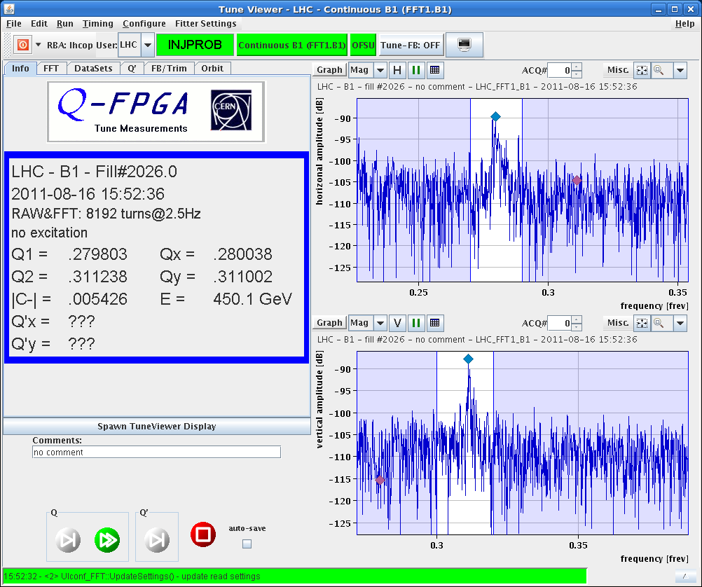
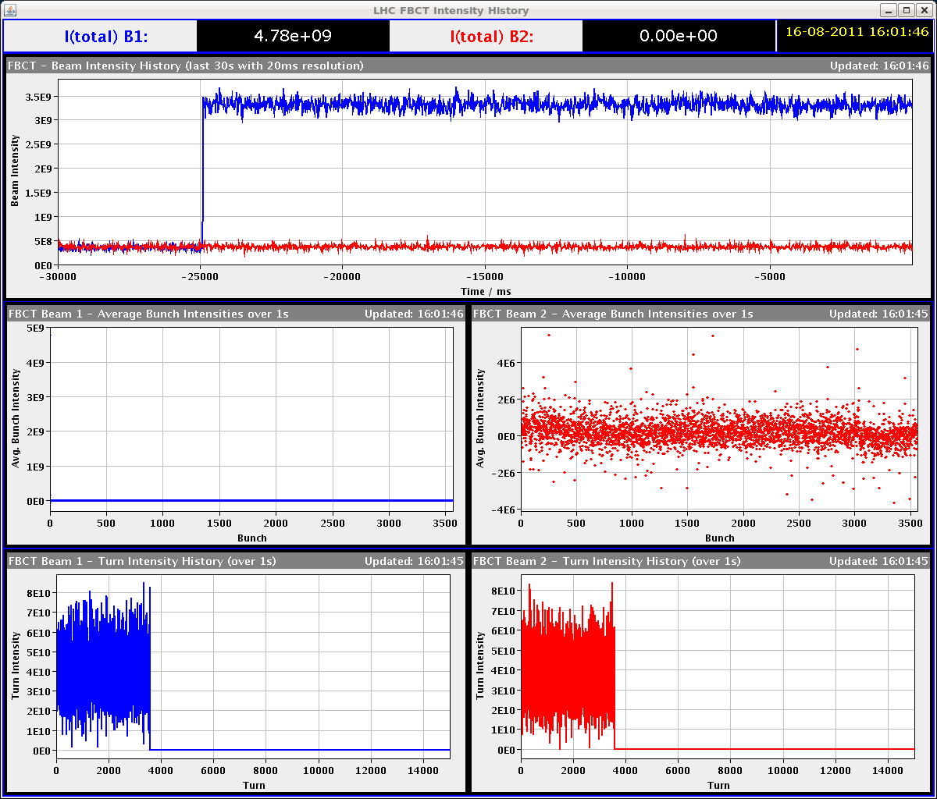
Tue late 16-Aug-2011
15:52h injection beam 1
optimising beam parameters
strong losses at SPS / Transferline
injection oscillations in LHC
“At the SPS, they found problems of injection oscillation.”

Slide 8
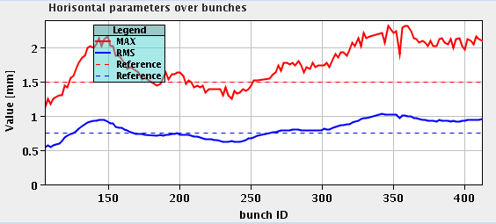
Tue late 16-Aug-2011
15:52h injection beam2
bunch by bunch oscillations ??
“Etienne C. is going to
check the kicker pulses.”
18:06h
Beam Dump by the OP switch while injecting for physics: bad inj osc for B2 requiring re-steering.
News from Etienne: he sees no problem with the SPS extraction kicker. the wave form is the same every time.

Slide 9
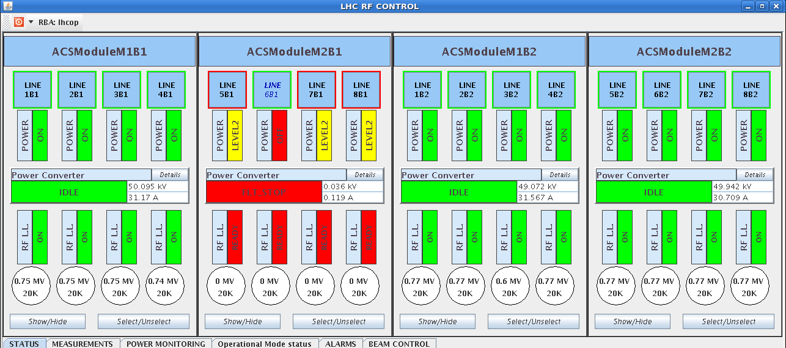
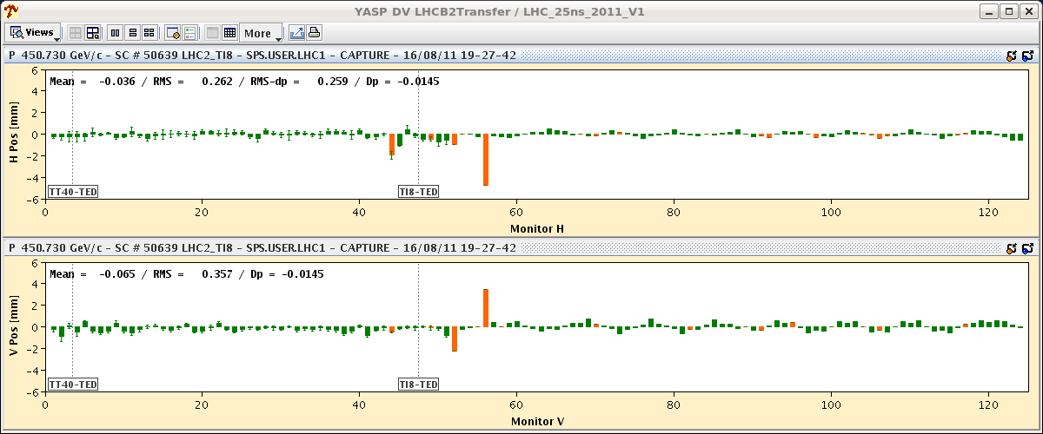
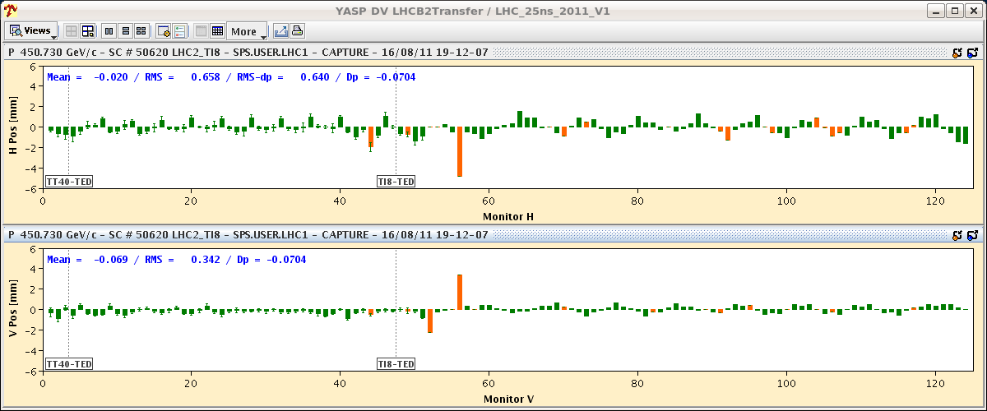
Tue late 16-Aug-2011
18:19h RF trip
The RF problem requires an access.
There is a problem with a power supply
of a B1 klystron focusing system.
Inj Optimisation / study ongoing
Etienne checked the MKE4 waveforms in BA4: for him all pulses are rock stable and the injection oscillations don't seem to be related to MKE4 waveform changed.

Slide 10
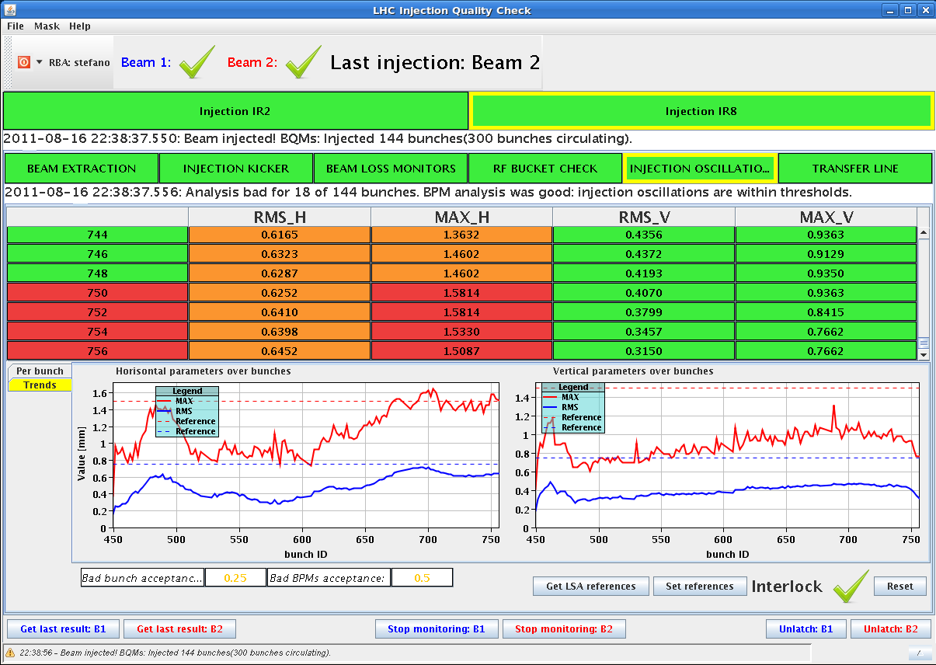
Tue late 16-Aug-2011
20:20h RF problem solved, injection for physics
still losses above warning in the ring
... in both beams
23:52h Luminosity
we are back in business !!

Slide 11
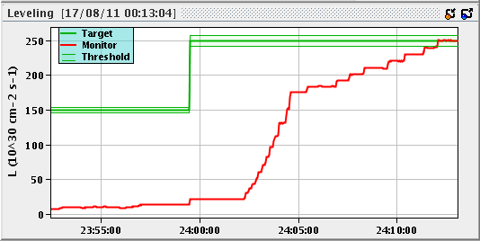
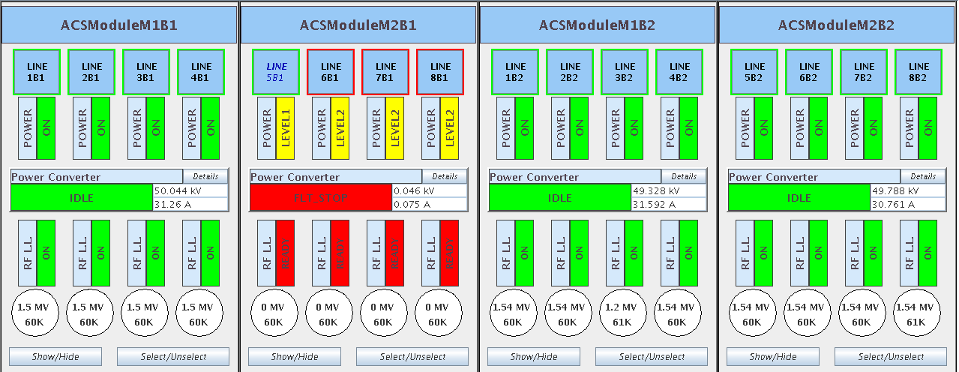
Tue night 16/17-Aug-2011
00:05h LHC-b on target lumi
02:04h Dump: Dump Classification: RF fault
(klystron filament current, possibly
bad contact according to piquet)
03:59h Injection probe beam
04:28h Injection for physics

Slide 12
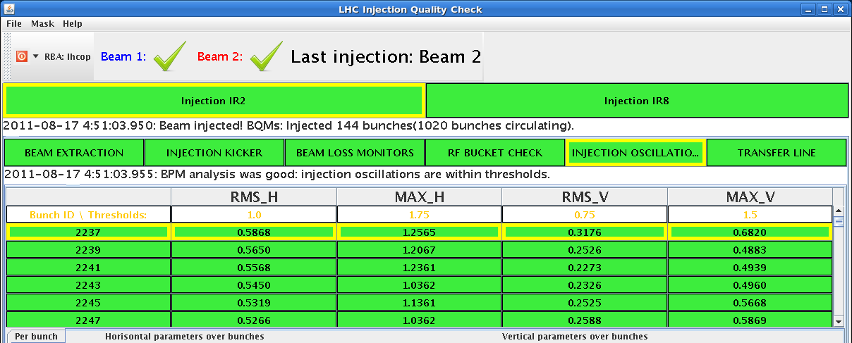
Tue night 16/17-Aug-2011
injection oscillations better now
05:45h Lumi

Slide 13
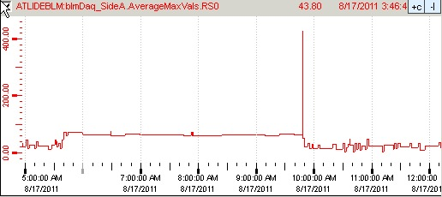
Wed, 17.Aug
On 17.8. at approximately 9:48 am the ATLAS BLM aborted the beam (fill 2029).
Both BLM sides showed a significant peak in activity in Average Max Values RS0 (40µs running sum).
Also ATLAS BCM saw large signal (totally independent detector).
Both signals are compatible with an UFO close to ATLAS (beam 1)
A-side: 2x abort threshold (thr=230)
BLM A-side 40µs running sum during the whole fill 2029
BCM high gain channel
bin-width = 5µs
Right: BCM signal from the post mortem buffer.
Big signal also seen in ATLAS BCM.
Also there the beam abort condition was reached, but ATLAS BCM is masked in the abort logic.
BCM low gain channel
bin-width = 5µs

Slide 14
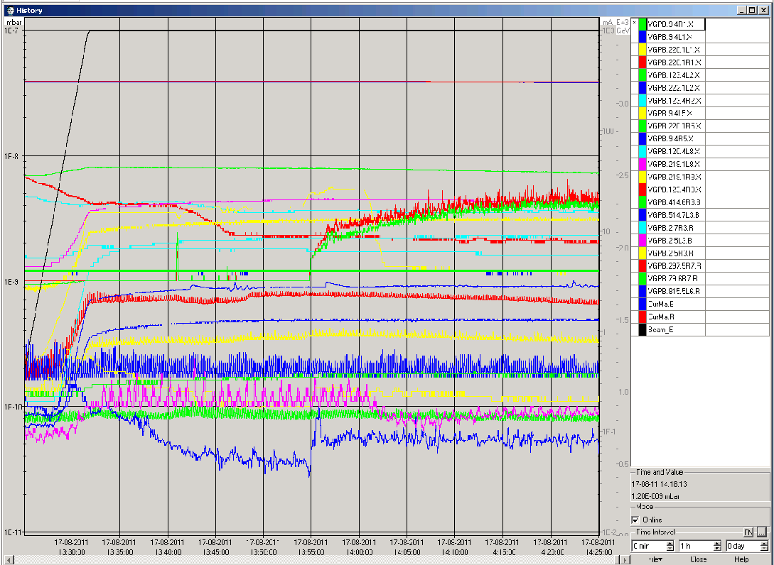
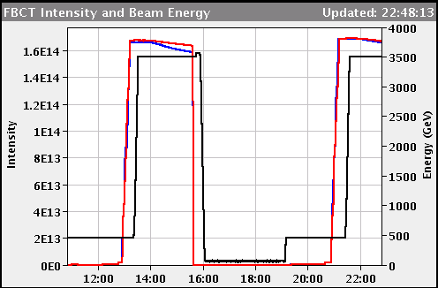
Wed, 17.Aug LHCb polarity change
LHCb polarity changed to negative
Vacuum ok
Background ok
Only slightly reduced B1 life time, but also seen on other fills before

Slide 15
Tue-Thu: Fills after cryo recovery
Tue: 23:55 Fill #2028, Stable beams, initial lumi 1.9e33.
Wed: 02:59 Fill #2028 dumped, RF interlock, int. lumi 19 pb-1.
05:41 Fill #2029 Stable beams, initial lumi 2.1e33.
09:48 Fill #2029 dumped by ATLAS after UFO near triplet R1
Change LHCb polarity.
15:37 Fill #2030 dumped, RQX.L5 tripped, could be SEU.
23:04 Fill #2031 dumped, Electrical glitch, FMCM
Thu: 01:10 Fill # 2032, Stable beams, initial lumi 2.4e33 (!) bunch intensities of 1.27e11p
06:23 Fill #2032 dumped, Electrical glitch, FMCM
08:04 another Electrical glitch during filling
11:45 the true single event upset: Major Electrical Power Cut

Slide 16
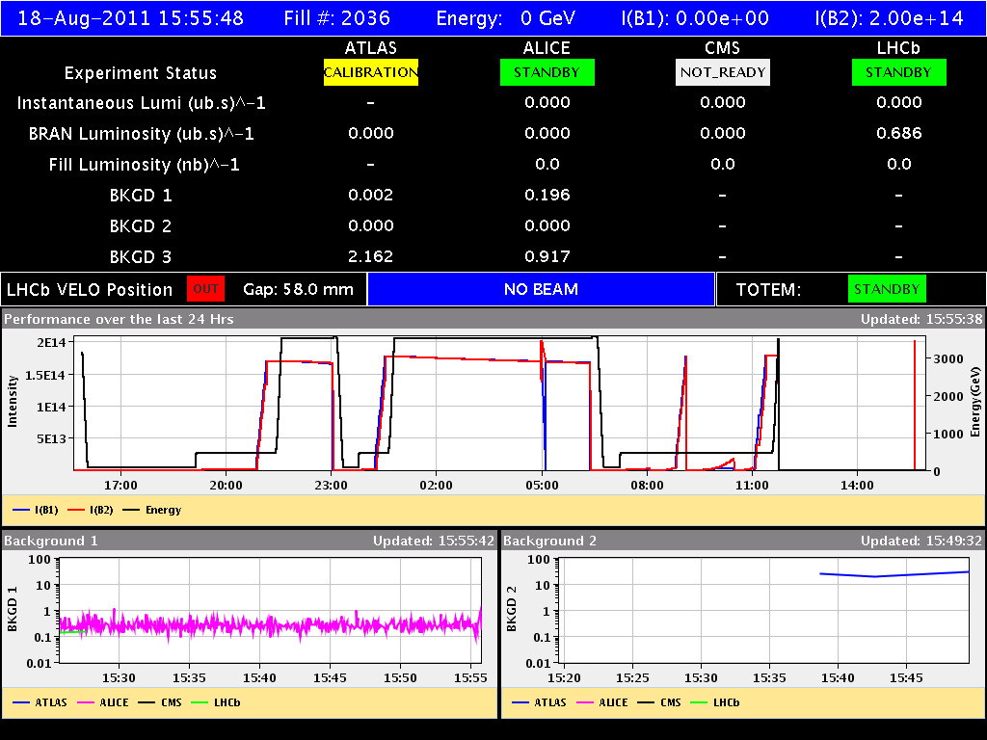
Thu 18-Aug
inj optimisation
power glitch
power glitch
power cut
rf hom alarm
(sis) 9:07
6:23, 8:04, 8:07

Slide 17
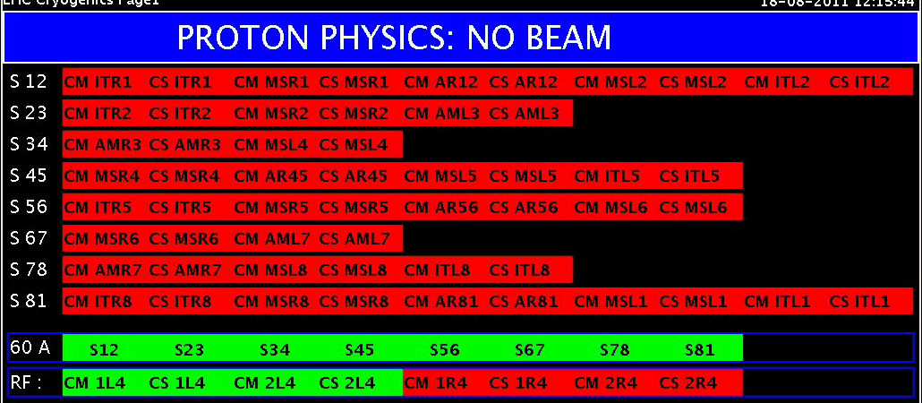
Thu Morning
11:45h during the ramp:
General power cut,
ATLAS, ALICE and LHCb tripped.
Injection kickers tripped.
All RF tripped. Undulators tripped.
Collimators seem to be in a bad state.
Dump kickers faulty.
All 8 sectors tripped.
All vacuum valves in.
Cryo: 4 sectors stopped. 23, 34
78, 81

Slide 18
LHC Status Fr Morning 19-Aug
instead:

Slide 19
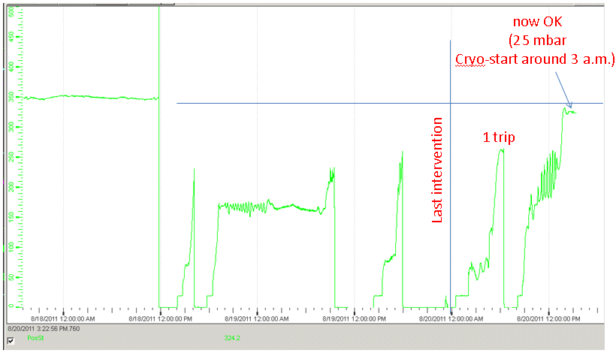
Saturday 20th August
Cryo Recovery
Yesterday’s main event:
Cold compressor speed S45
several attempts to restart
Thu, 18-Aug
power cut
Sat, 20-Aug
success
L.Tavian

Slide 20
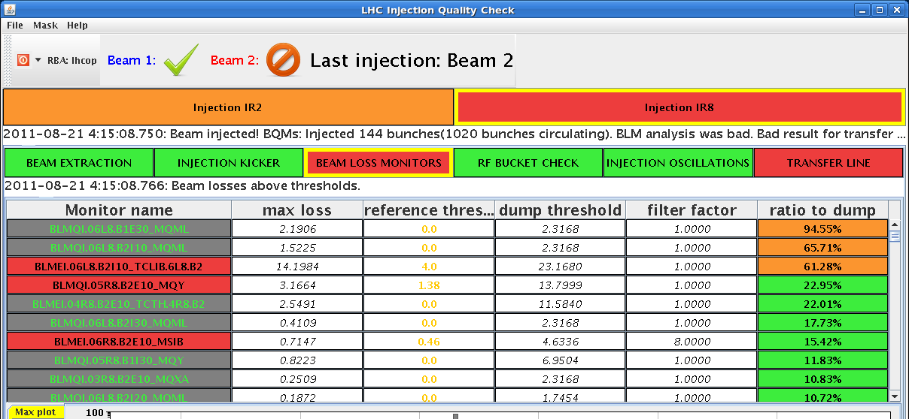
Saturday 20 August
Sunday 00:24h
injection: ... not too easy
Cryo back: precycling
06:41h: and finally luminosity
general remark: limited lifetime
during adjust in b1,
recovering to the usual level.

Slide 21
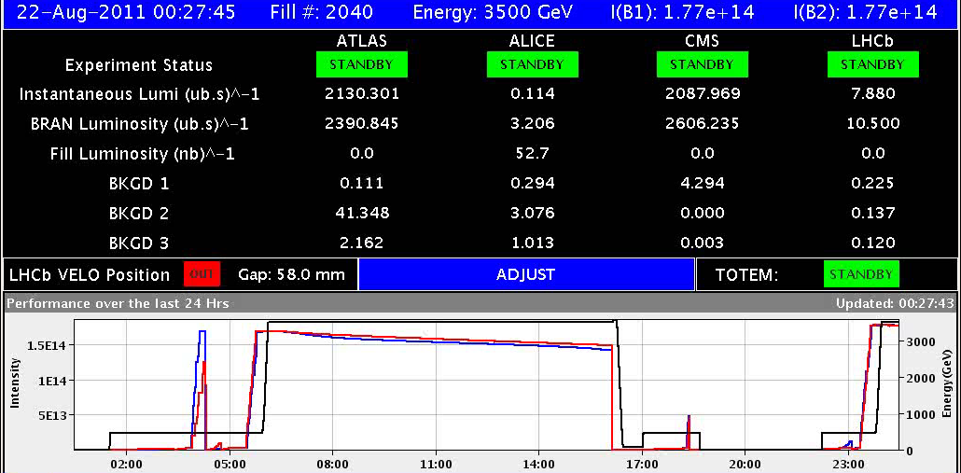
Sunday 21 August
11:00h ALFA moves roman pots to beam position: ... null problemo
15:07h Collimators put to tight settings: ... null problemo
TCP-H at 4
sigmas (both
jaws).
... well: dump due to operation failure of colli experts
00:27h lumi

