Slide 1
LHC Status Fr Morning 19-Aug
Bernhard Holzer, Jan Uythoven
Tentative Planning:
Thursday – Sunday: 1380 bunches, N_{p} ≈ 1.2... 1.35 *10^{11,}
establish stable conditions, check & optimise beam parameters
TOTEM & ALFA moving in during stable beams in
second half of the fill
end of fill studies: tight colli settings
(needed before MD period)

Slide 2
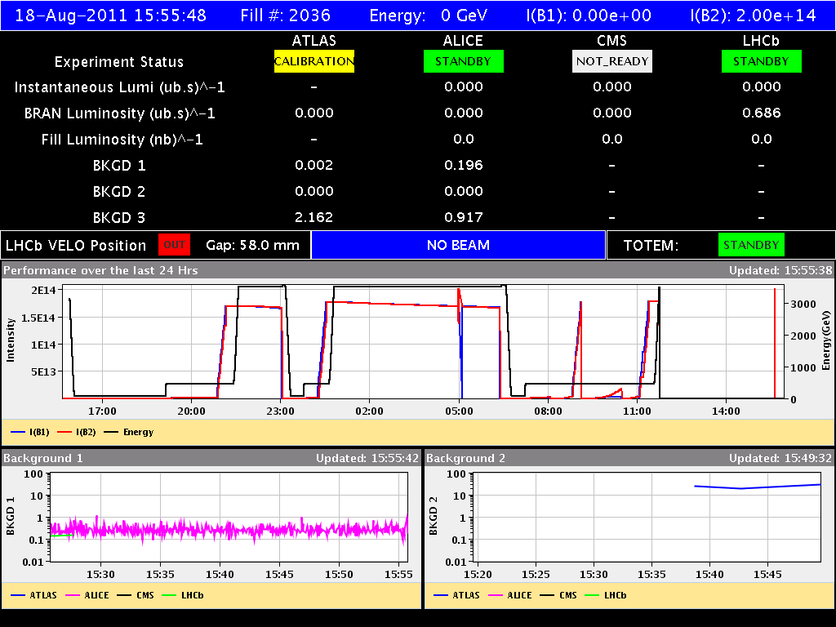
Thu 18-Aug
inj optimisation
power glitch
power glitch
power cut
rf hom alarm
(sis) 9:07
6:23, 8:04, 8:07

Slide 3
LHC Status Fr Morning 19-Aug
instead:

Slide 4
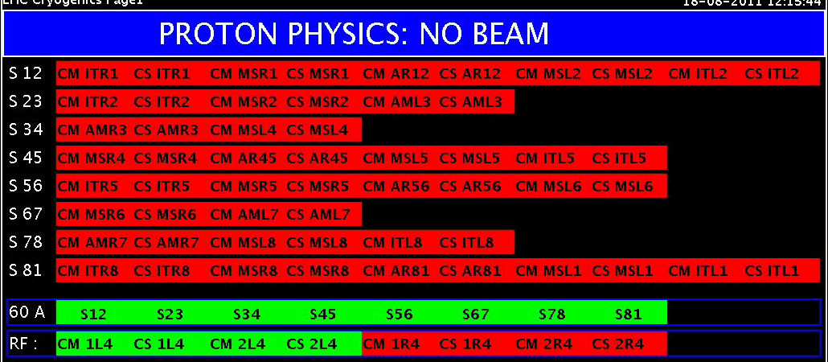
Thu Morning
11:45h during the ramp:
General power cut,
ATLAS, ALICE and LHCb tripped.
Injection kickers tripped.
All RF tripped. Undulators tripped.
Collimators seem to be in a bad state.
Dump kickers faulty.
All 8 sectors tripped.
All vacuum valves in.
Cryo: 4 sectors stopped. 23, 34
78, 81

