Slide 1
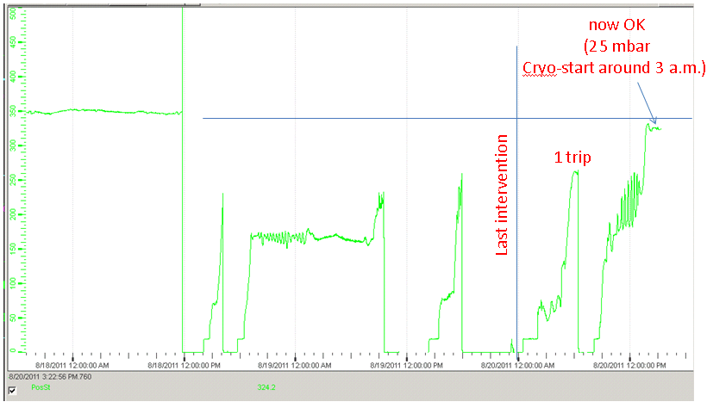
Saturday 20th August
After last intervention, compressor tripped first time, not second time.
Possibly due to missing temperature measurement on compressor. Calculated values used.
Cryo Recovery
Yesterday’s main event:
Cold compressor speed S45
L.Tavian

Slide 2
Other events....preparing for beam
Free wheel diode fault cleared in 81, one more to be checked in Inner Triplet.L5 once cryo is available.
Good to do pre-cycles as early as possible:
Precycle (excluding 45 and 78)
Replaced power converter corrector RCBV18.L4B1
Green light from MP3 to precycle sector 78
RCBWH5.L8B1 now on ok. The FGC was found in a bad state.
Another 60A converter, RCBH29.R7B1 trips, again with VS_FAULT. Informing our faithful EPC piquet again!
23:10 Pre-cycle complete machine
Some collimator issues. Called collimator piquet.
02:00 Injecting probe beams
03:30 Dump with PM for system check: OK
04:15 Beam2 injection line steering
06:41 Stable Beams !

Slide 3
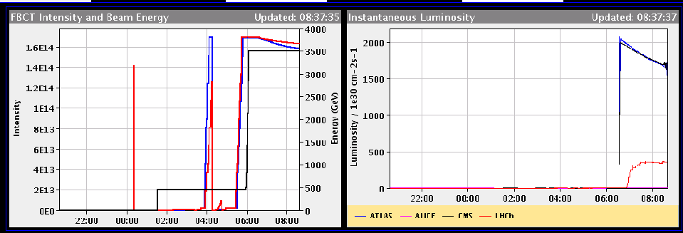
Fill #2037
Ibeam around 1.2e11, rocky filling and initial lumi around 2e33: not bad for getting back! B1 lifetime worsened when IP8 leveling kicked in

Slide 4
LHCb
“The second thing to notice is that LHCb optimum in horizontal was at 104 micros distance. We trimmed step by step close to the maximum, monitoring TCT limits and background, and everything was OK. Then we re-optimize and level as usual. “

Slide 5
Outstanding
TOTEM & ALFA moving in during stable beams
Totem: earliest on Monday
Alpha: on demand, allowed after 6h of stable beams -> soon, this fill if possible
‘End of fill’ tight collimators
After about 10 h of stable beams and during day time -> after Alpha, assuming that beams stays in
In Adjust
Transverse damper set-up at injection for higher bunch intensities
After Technical Stop
90m optics
On Tuesday afternoon, before MD period starts Wednesday morning

