Slide 1
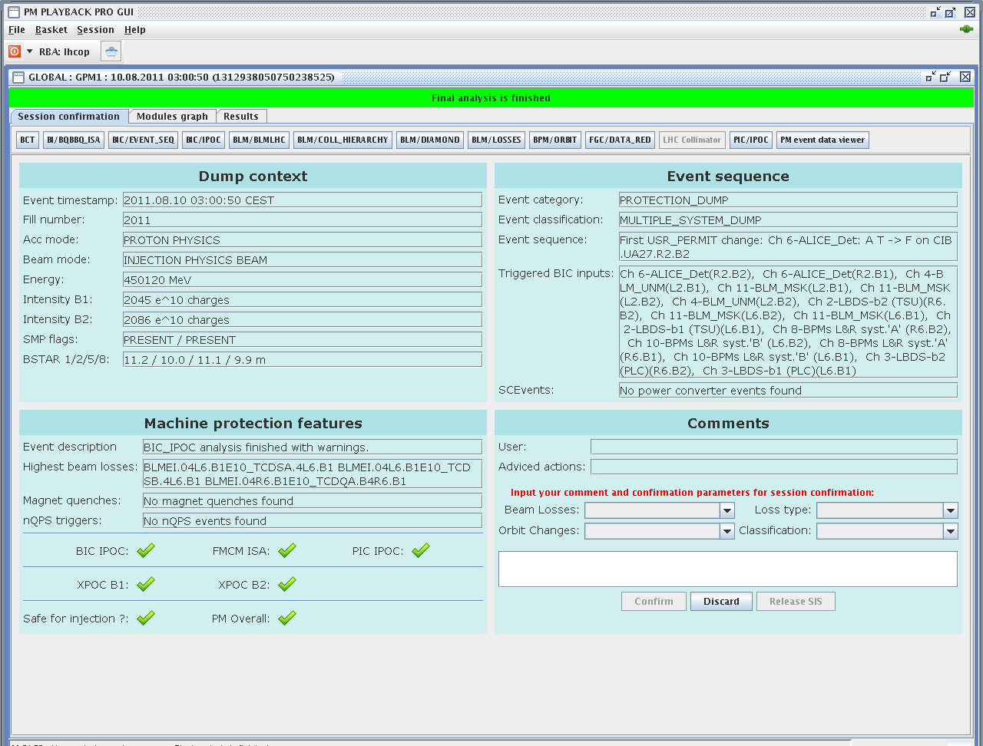
Beam dump at 03:00:50.750

Slide 2
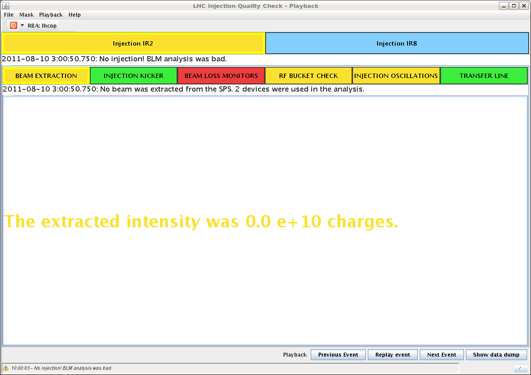
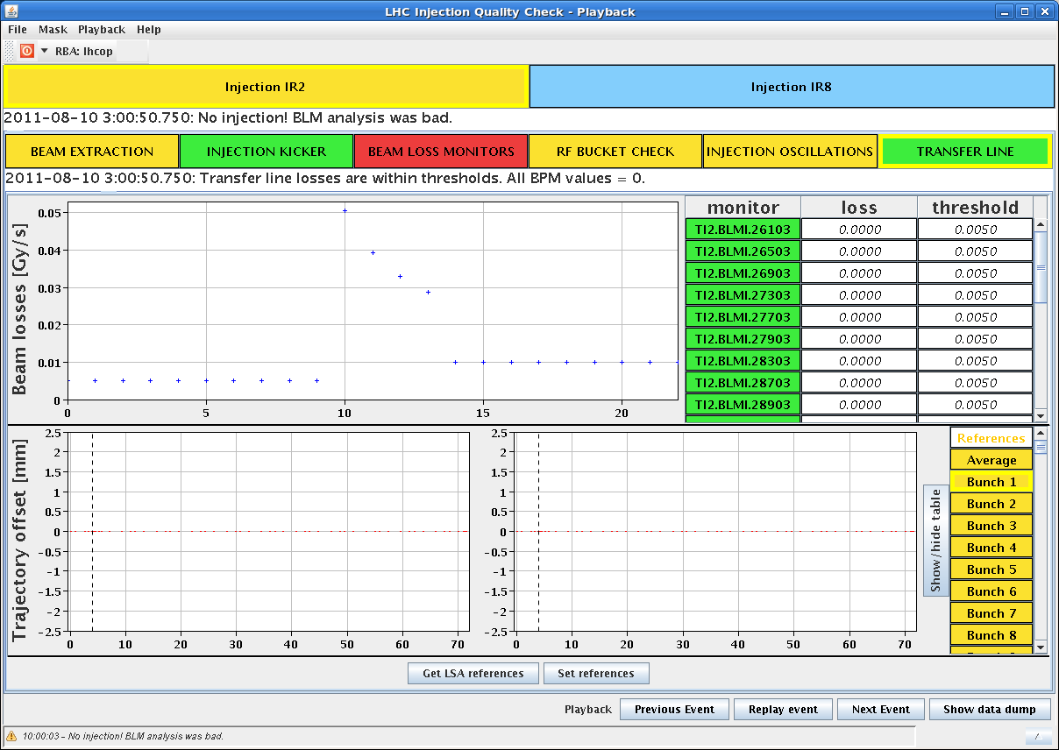
Beam dump at 03:00:50.750
The dump occurred at injection of the second train of 144 bunches of Beam 1 but no beam was extracted from the SPS (from BCT, trajectory and BLM data in TI2)
SPS BQM inhibit prevented extraction

Slide 3
Beam dump at 03:00:50.750
Consistent with beam dump observation showing only 12+144 bunches on the dump

Slide 4
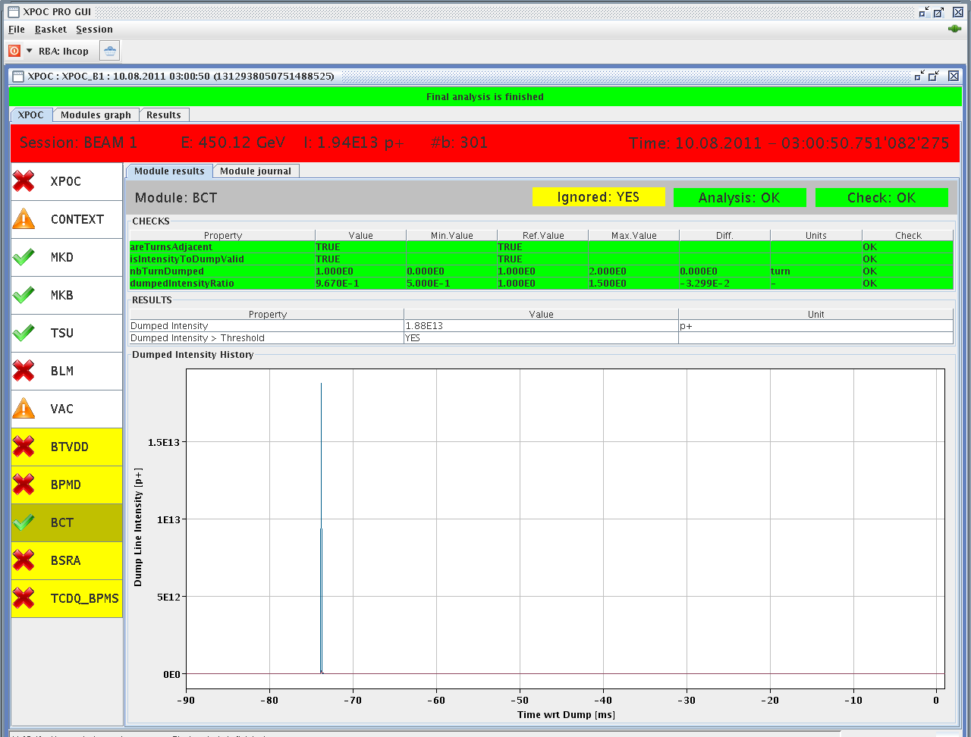
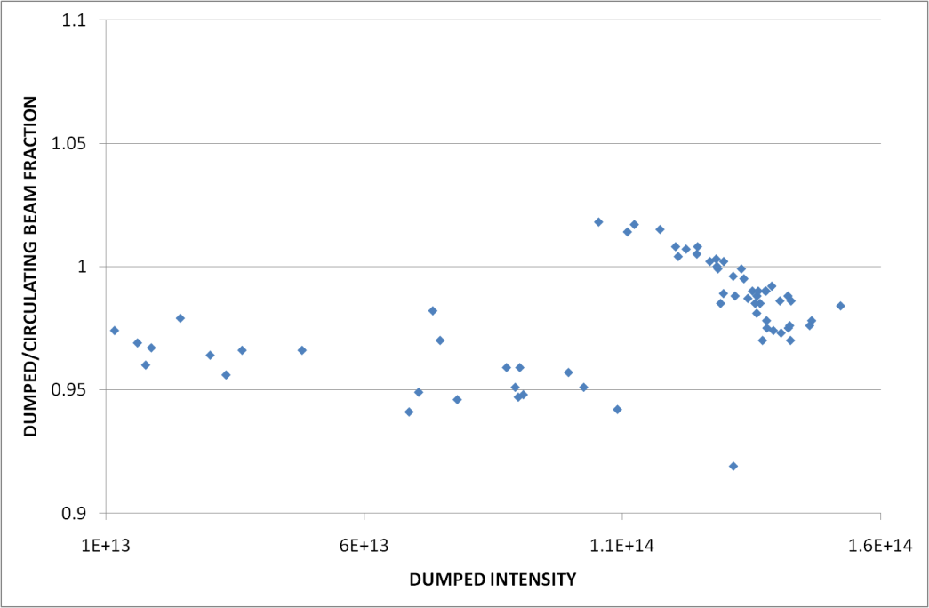
Beam dump at 03:00:50.750
Circulating intensity: 1.95x10¹³ p
Dumped intensity: 1.88x10¹³ p (96.7%)
The accuracy in the comparison is at the percent level so no clear sign of important intensity losses (see below for the last month)

Slide 5
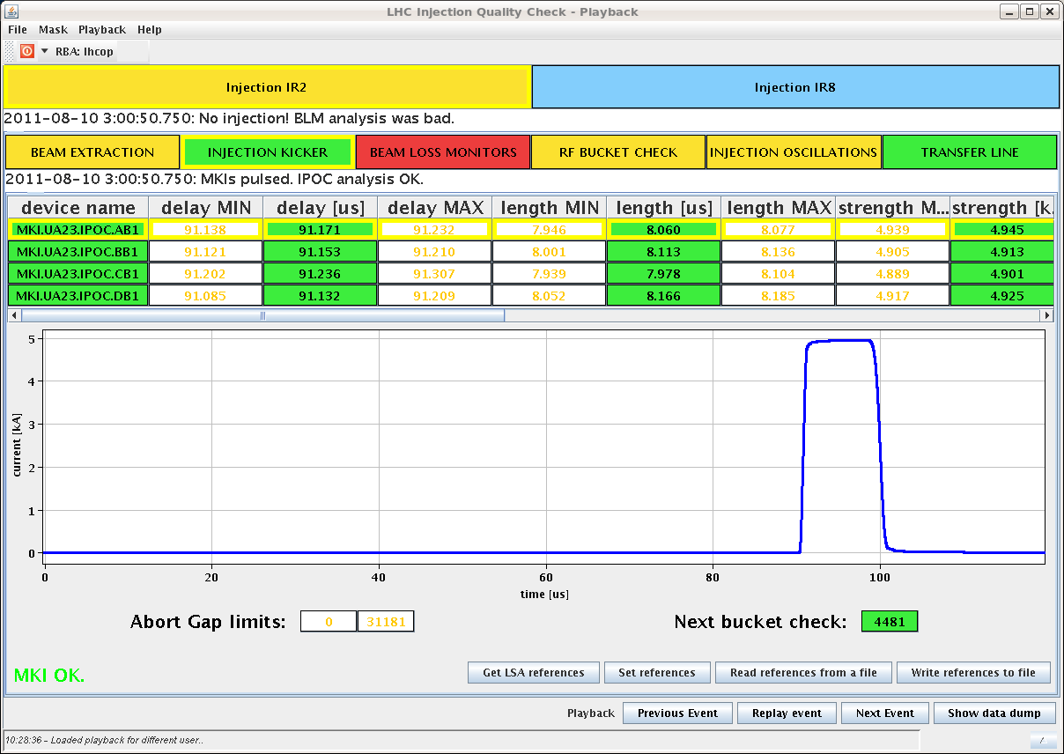
Beam dump at 03:00:50.750
Injection Kicker pulsed correctly. No error in delay, pulse shape or strength.

Slide 6
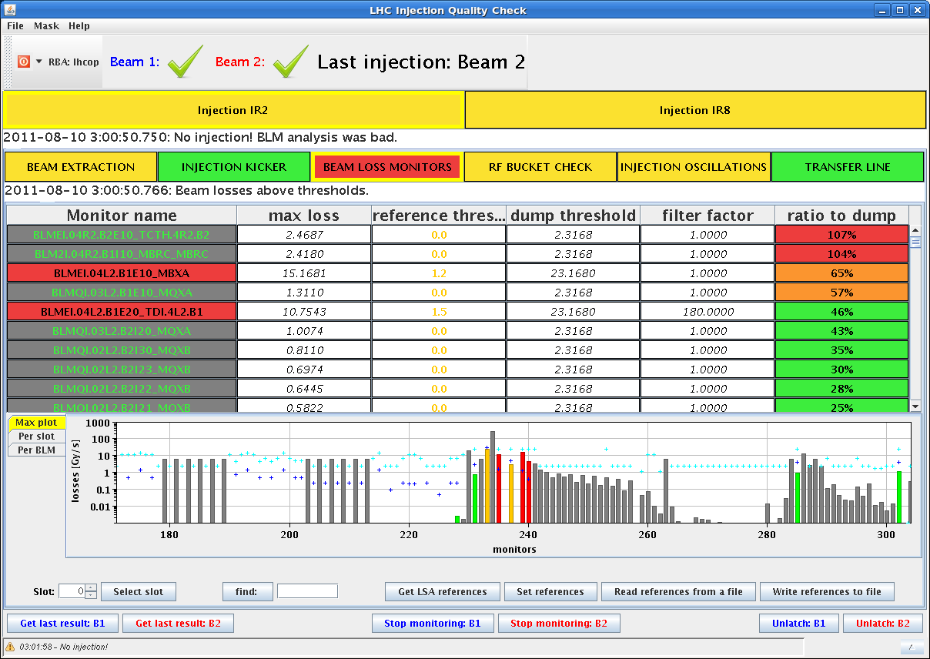
Beam dump at 03:00:50.750
But losses occurred during injection. TCTH.R2, D2.R2 above threshold, TDI losses as well. Consistent with injection kicker pulse extracting circulating beam (satellites, or un-captured beam).

Slide 7
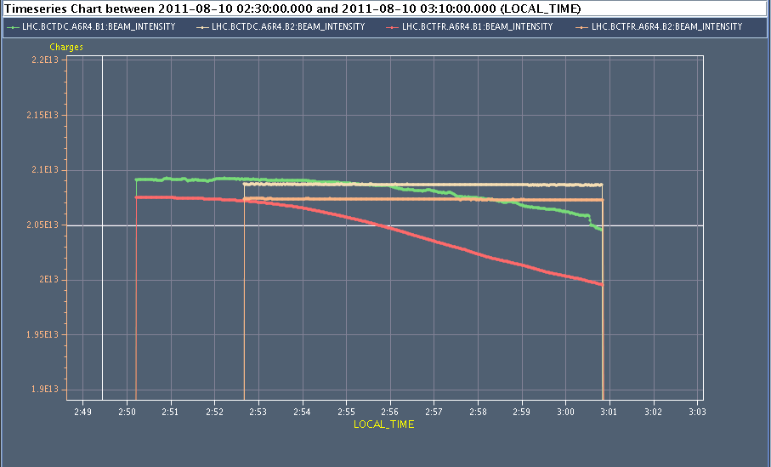
Beam dump at 03:00:50.750
Analysis of Fast BCT and DC BCT data for B1 show that the first 144 train of B1 was badly captured and beam was escaping the bucket particularly in the last part of the train

Slide 8
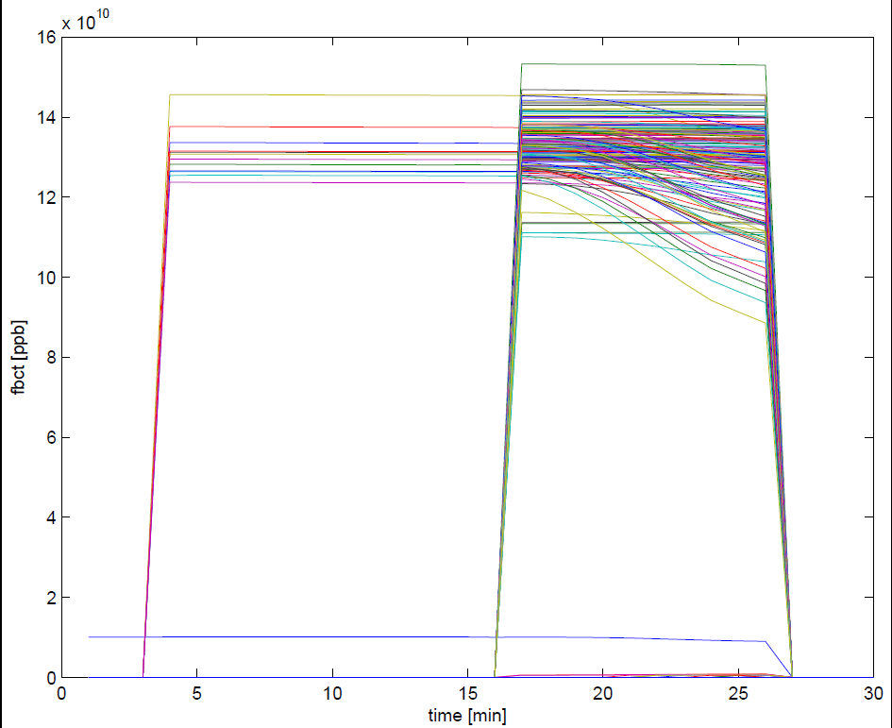
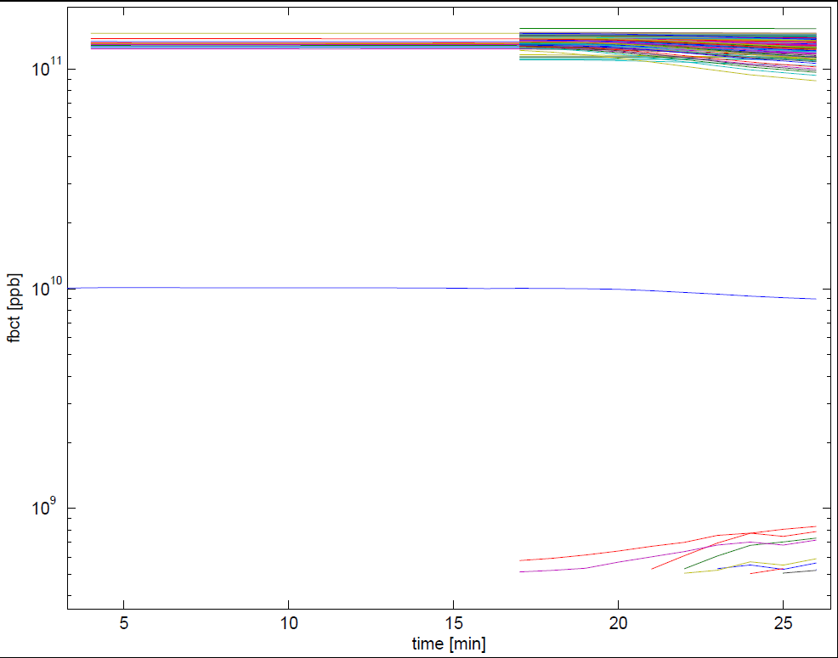
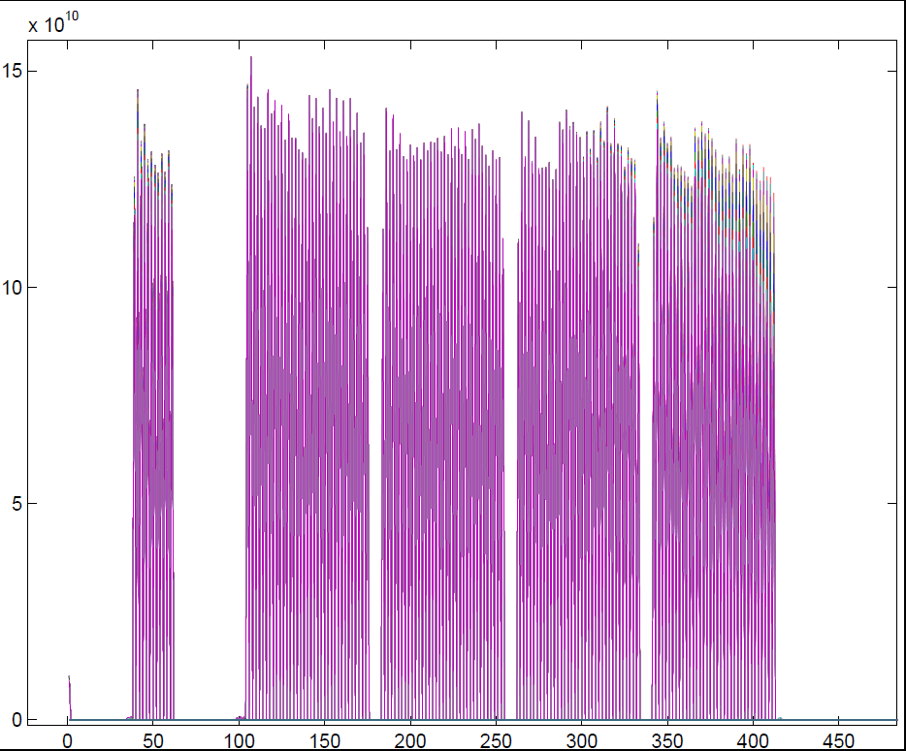
Beam dump at 03:00:50.750
The first 144 train of B1 was badly captured and beam was escaping the bucket particularly in the last part of the train
G. Papotti

Slide 9
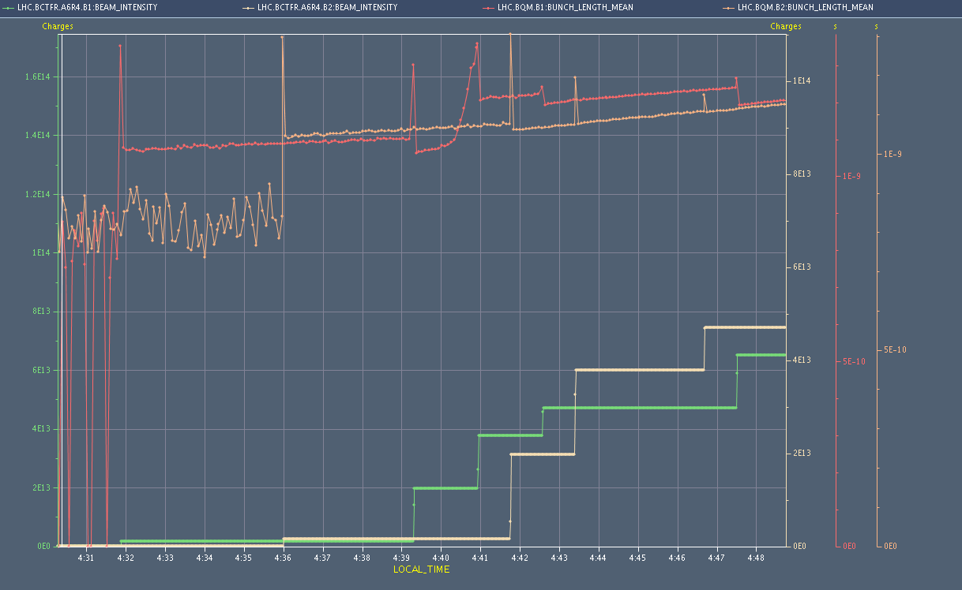
Beam dump at 03:00:50.750
Bunch length blowup for first 144 batch of beam 1 (fills 2010, 2011).
The severe de-bunching observed during the fill attempt around 3:00 last night (likely) has the same cause.
With the increased intensity per bunch, the RF front-end in the LLRF are at the saturation limit. We will change gains asap.
TIME REQUESTED (1-2 hours) before next filling.
Ph. Baudrenghien, T. Mastoridis

Slide 10
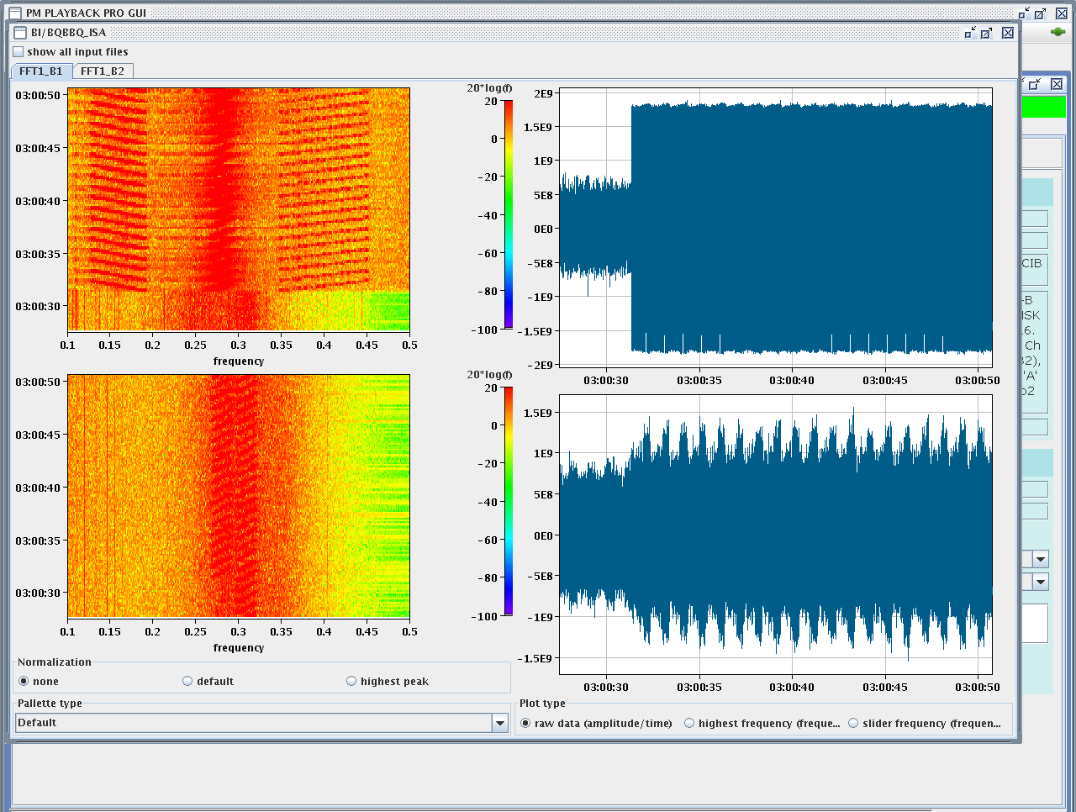
Beam dump at 03:00:50.750
Injection and abort gap cleaning were active

