Slide 1
Tue 9/8 – Wed 10/8
Stable beams #2010
18:18 RQT12.R7B1 trip. End of STABLE BEAMS #2010 - ~86 pb⁻¹ in ~19 hours
20:30 No beam from PSB (RF problem in ring 4)
Loss maps at injection with nominal bunch while waiting for RF repair in PSB
01:30-03:30 Setting-up beam in the PS Booster after repair.
Lengthy injection (injection oscillations B2, several injection inhibits due to poor beam quality, B1 injection kicker pulse length check).
An injection loss event being investigated
05:49 STABLE BEAMS #2011 - initial luminosity 2.1e33

Slide 2
RQT12.R7B1 trip (Knud, Jens)
Sequence of observations/registrations:
At 18.18.05.728: Timber reports all OK for the last time before event (I_DCCT (QPS) is stable)
At 18.18.05.889: The power converter receives a power abort command from EXTERNAL source and starts switching-off (from ∼ -73 A)
At 18.18.05.890: First indication from Timber that the circuit current has started to decay.
Large current spike observed on I_A (faster sampling rate) of power converter (but not on
I_meas as sampling is not fast enough)
At 18.18.05.891: PIC assigns its first time stamp of the event– to QPS
At 18.18.05.909: Timber shows inconsistent current reading I_DCCT (QPS)
Other remarks:
- No Post-Mortem was delivered by the quench detector at any moment, but should have been as
U_RES went largely outside the quench detection window during the first part of the current
decay
- All QPS flags remained ‘green’ in PVSS
- Some minutes after the event the QPS controller went into stalled mode and had to be power
cycled and reset before returning to operational conditions
- Monitoring was on board A
Outstanding questions:
- Did the QPS system trip before or during the current decay ?
- Why was no Post-Mortem files delivered ? Can a file be recuperated from the DQAMG-A ?
- The quench detection system is located in RR77 – an area with some SEU activity. RADMON
counts to be verified (M. Calviani) at the moment of incident.
An SEU event cannot be excluded. However, it does not have the same signature as the event on RCBXV3.R1 in UJ16 (only the calculated dI/dt figures turned abnormal for 10 ms).
-The RQT12.R7B1 was set to monitor board B to increase the chances of observation in case of repetition.

Slide 3
End of fill #2010

Slide 4
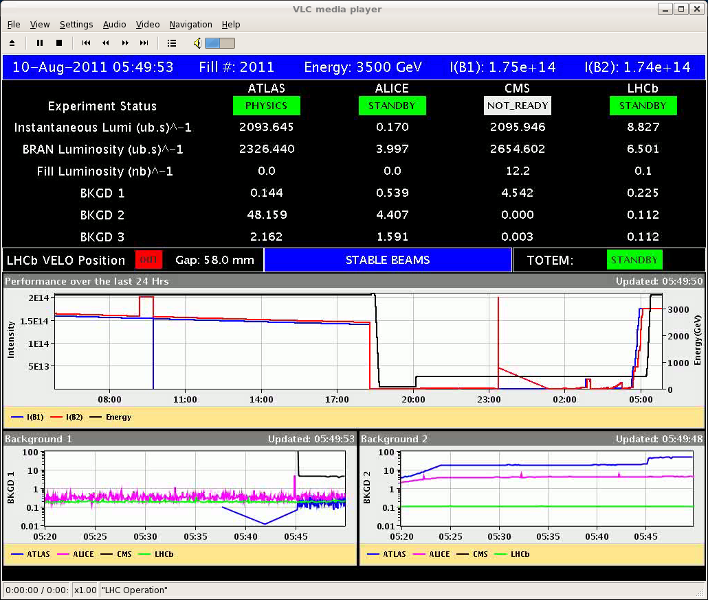
Stable Beams #2011
Bunch population still at 1.26x10¹¹ p.

Slide 5
MKI Temperatures (M. Barnes)
Temperature MKI above injection interlock level in point 8 ➔ Rise-time data at 61C measured on MKI8-D (highest temperature we have data at to date). There is no evidence that the ferrite is at its Curie temperature, so 61⁰C measured is safe here ➔ Increase of the intlk level to 62 ⁰C possible.

Slide 6
Injection losses
At 03:00 beam dump at injection of B1. ALICE triggered + losses at TCTH.R2. No extraction from SPS at that time that is why no beam visible in the BTVDD. But what dumped the beam?
Most likely explanation (tbc): satellites behind the circulating beam or bad timing of the kicker

Slide 7
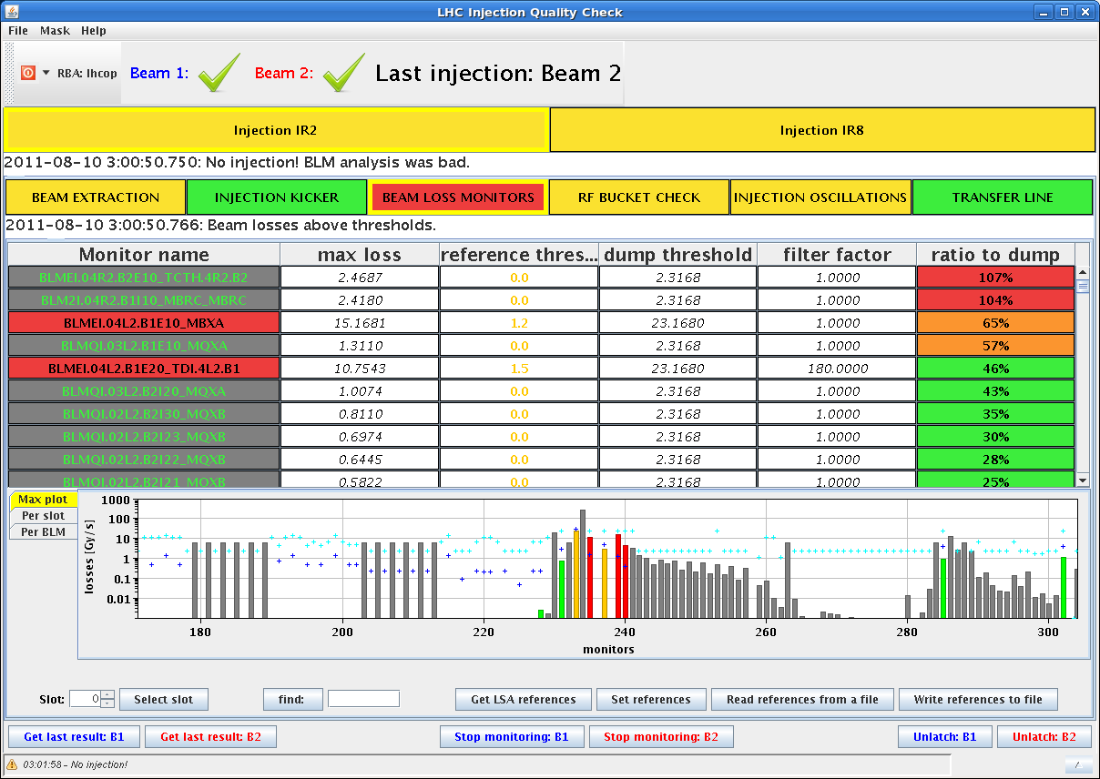
Injection losses

Slide 8
Pending
SPS magnet: vacuum leak deteriorating ➔ Another leak test performed and faulty magnet identified ➔ Magnet is going to be replaced on Thu morning starting at 07:00 (16 hours)
We will try to be in physics by that time. Interventions and most urgent accesses if the fill is dumped during the SPS intervention:
Auto reset for cryo-valves in IR5/7 (3 hours – no access)
Swap Board A➔B for nQPS QF/QD Sector 81
Oil leak warm compressor point 4 – require reconfiguration of point 4 (2-3 hours stop)
MKI2 (access – 2 hours)
RF

Slide 9
Fill Overview
Fill | Phase | Peak L [10³³ cm⁻²s⁻¹] | Length [h] | Int. L [pb⁻¹] | Dump cause
2009 | STABLE | 2.1 | 15.3 | 76 | Sector 81 trip (QPS quadrupoles)
2010 | STABLE | 2.05 | 18.8 | 85 | RQT12.R7B1 (QPS-SEU?)

Slide 10
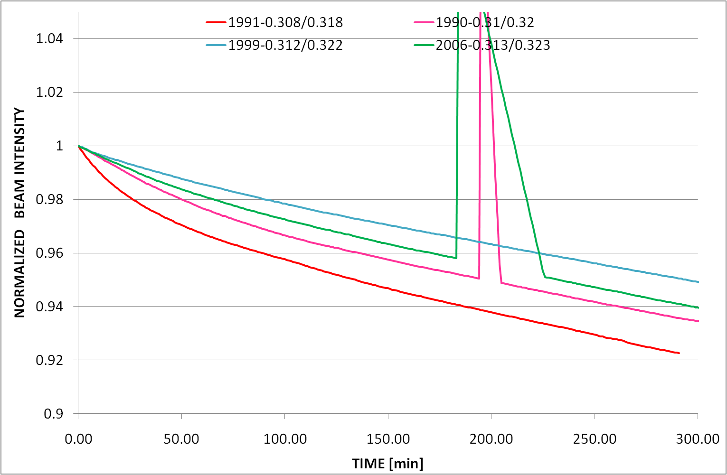
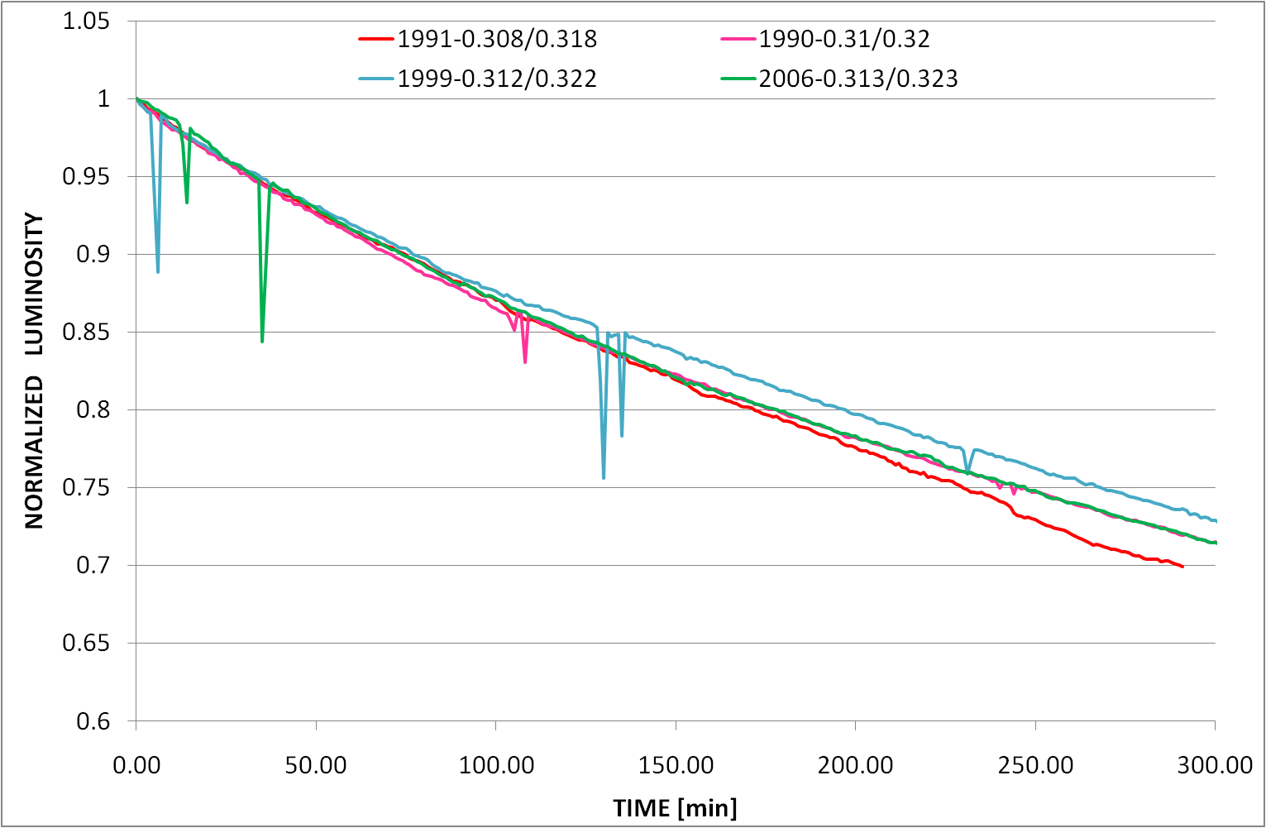
Working point

Slide 11
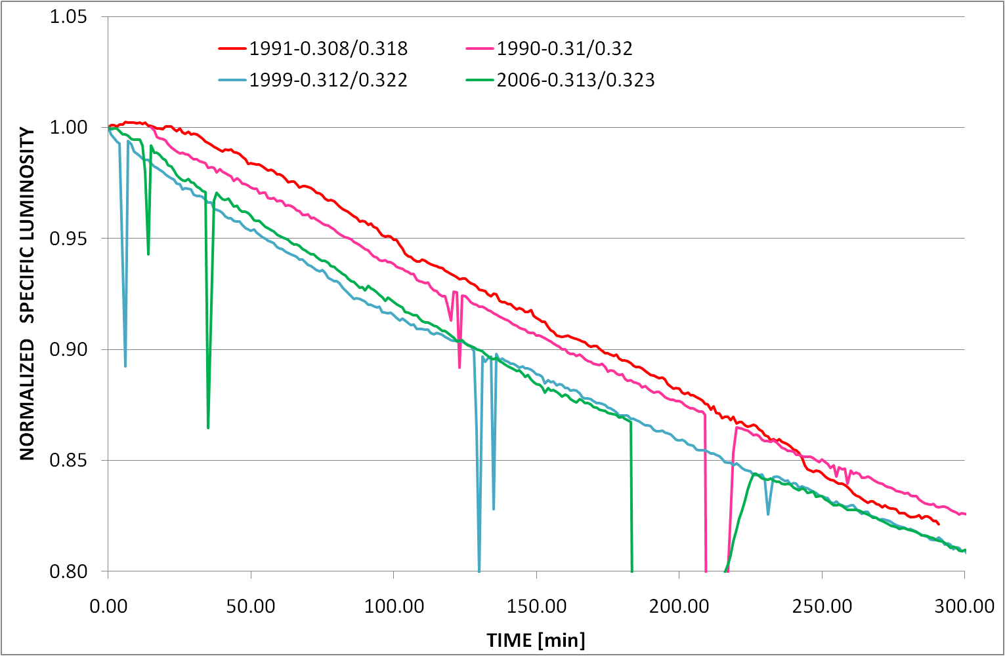
Working point

