Slide 1
Mon 8/8 – Tue 9/8
Stable beams #2009
10:20 Damper VB1 and HB2 trip ➔ Vacuum control crate for the gauges in the damper area needed reset ➔ OK
S12: lost temperature reading of heating of current leads of RQ8_R1B1/B2. But the current leads are properly cooled ➔ reset during ramp-down (SEU?)
18:10 Beam dumped, S81 trip. Integrated luminosity ~76 pb⁻¹.
Investigations on Sector 81 trip (Quadrupole loop) + reset of a BLM crate delaying refilling
23:30 STABLE BEAMS#2010. Initial luminosity 2.05x10³³

Slide 2
Sector 81 trip
From the QPS team (Knud, Mike): Conclusion: the loop of RQD.A81 opened at 18:05:46.955. This was not due to the EE switches, not due to (board A of the) nQPS, not due to the lead protection and not due to the (board A of the) oQPS (since no PM file was created). What caused the breaking of the loop then? We still do not know. It could be the board B of a QPS board. Action: leave things to board A for now. Move the whole sector to board B as soon as convenient.

Slide 3
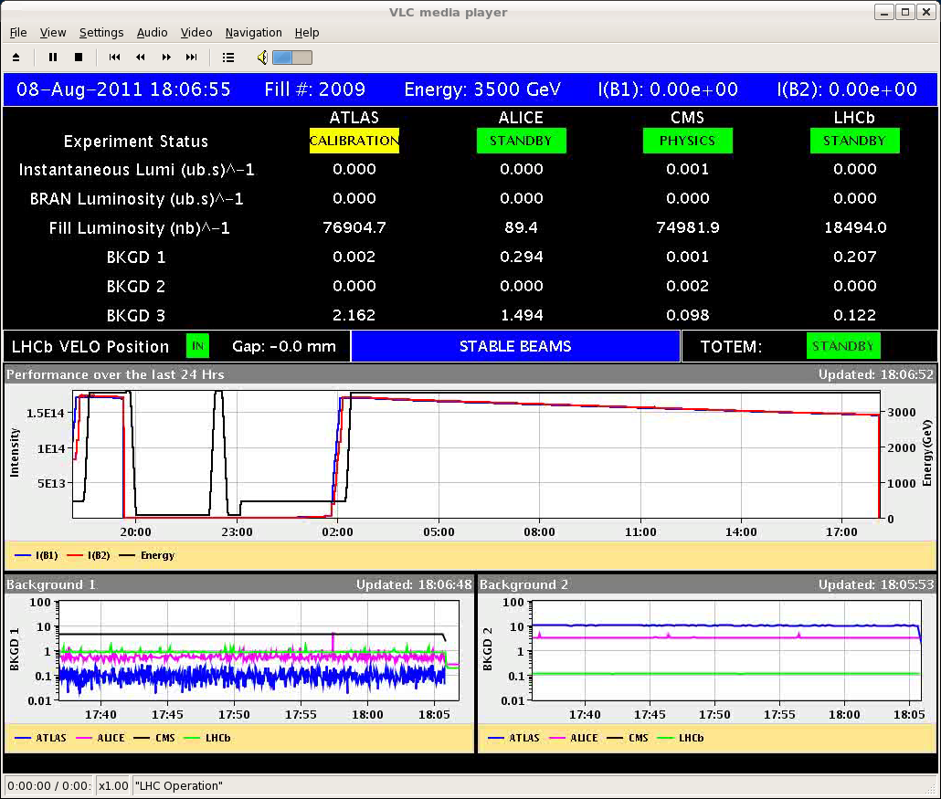
Sector 81 trip

Slide 4
Stable Beams #2010
Slightly higher bunch population (1.26x10¹¹ p). No significant increase in luminosity

Slide 5
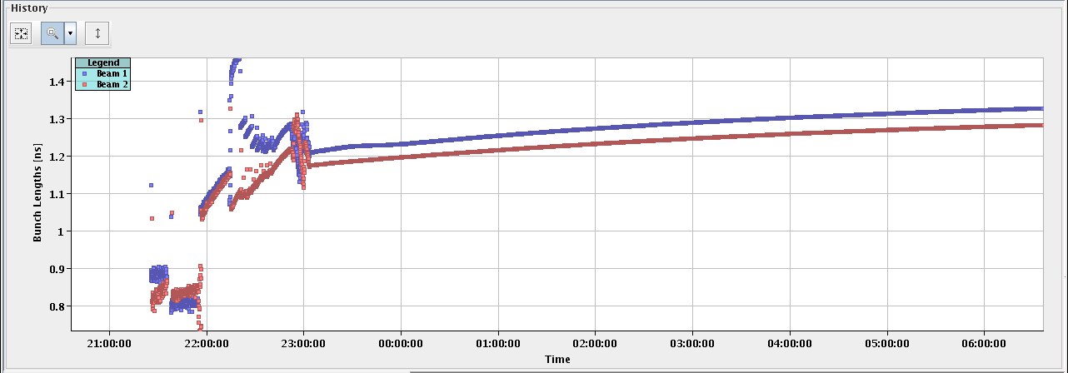
Stable Beams #2010
Lower lifetime B1
Longer bunches

Slide 6
Temperatures

Slide 7
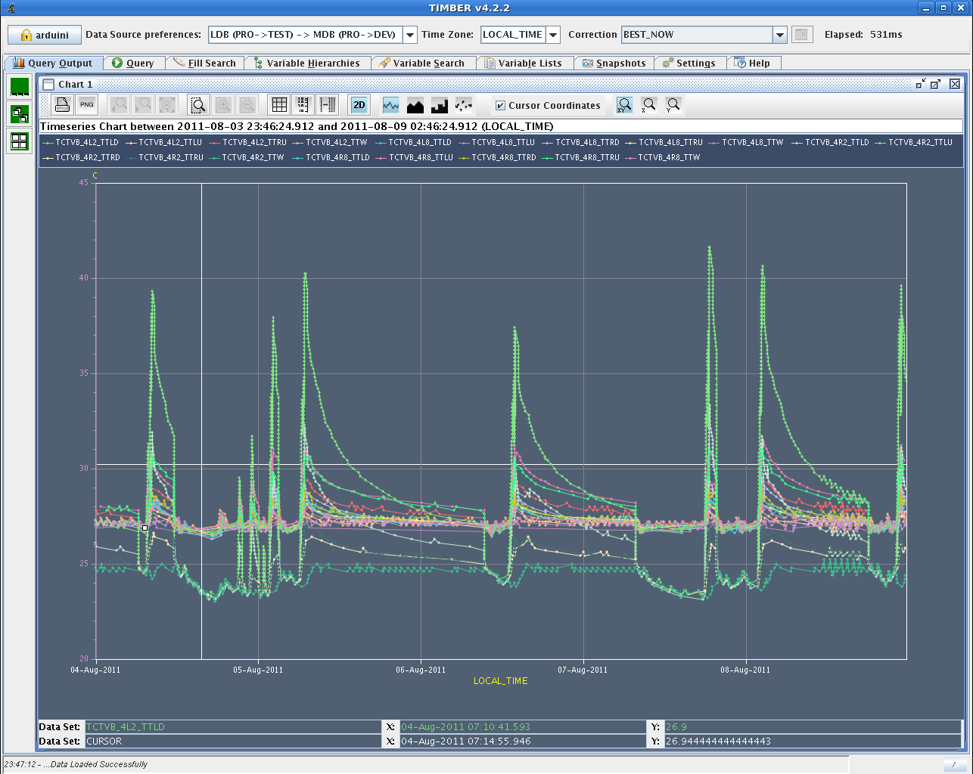
Temperatures

Slide 8
Plan
...increase adiabatically bunch intensity. Keeping an eye on temperatures....
Loss maps towards the end of the week

Slide 9
Pending
SPS magnet: could hold until the technical stop
Auto reset for cryo-valves in IR5/7 (3 hours – no access)
MKI2 (access – 2 hours)
Swap Board A➔B for nQPS QF/QD Sector 81
Oil leak warm compressor point 4 – require reconfiguration of point 4 (2-3 hours stop)

