Slide 1
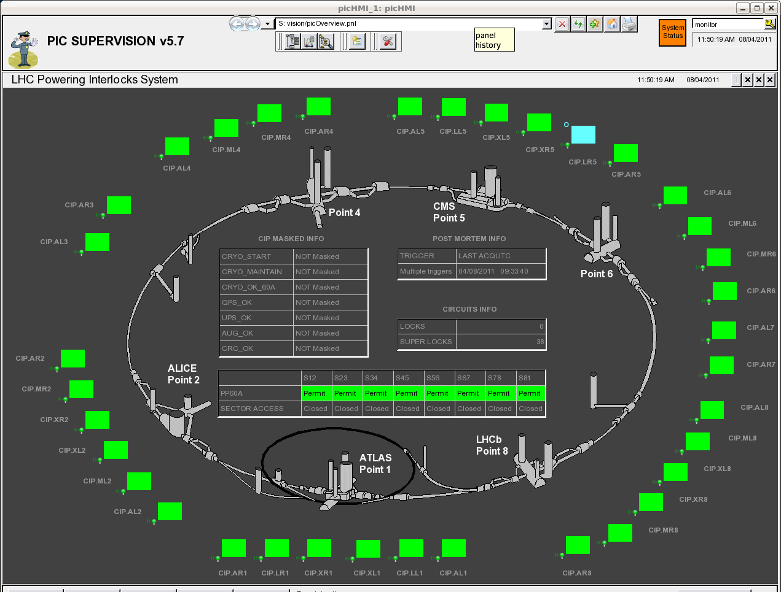
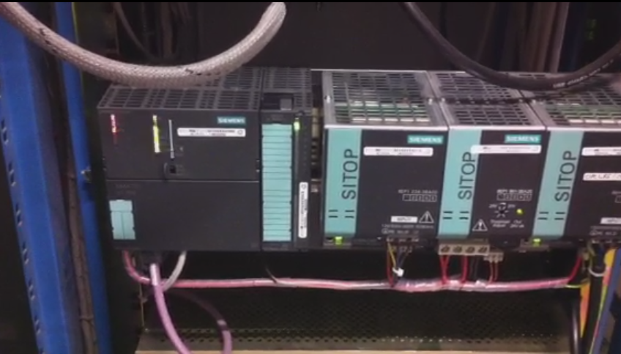
Beam dumps 4th Aug @ 11h33 and 5th Aug @ 03.01
Both beam dumps caused by a stop of a Powering Interlock PLC, located (together with 2 others) in UJ56 / UJ14
PLCs in question are interlocking circuits in matching section LR5 and XL1
PLC stoppage lead to loss of communication with remote I/O units in RR57/UJ14 and consequently initiated Fast Aborts in all protected circuits and the beam dump
Identical failure signature observed previously, pointing to an internal memory corruption (but core dump was empty for 1st event, 2nd event to be analysed)
Dump was correctly executed and clean

Slide 2
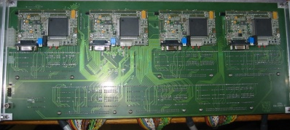
Architecture and Location of Interlock Components
PVSS server
in CCR
Ethernet
Technical Network
36 PLCs in
‘non-radiation’ area
IR1
IR2
IR3
IR4
IR5
IR6
IR7
IR8
UJ14
UA23
UJ33
UA43
UJ56
UA63
TZ76
UA83
UJ16
UA27
UA47
USC55
UA67
UA87
Profibus
Remote I/O close to clients
120 x ANYBUS + 36 x XC95144
IR1
IR2
IR3
IR4
IR5
IR6
IR7
IR8
RR13
UA23
UJ33
UA43
RR53
UA63
RR73
UA83
UJ14
UA27
UA47
UJ56
UA67
RR77
UA87
UJ16
USC55
RR17
RR57

Slide 3
Are these Radiation Induced Failures (SEUs)?
Event Timestamp Mode Fill # Energy Int B1/B2 [1e10] Operator Comment
11-AUG-10 18.00.19 ADJUST 1275 3500 7/5 Asynchronous dump test at 3.5 TeV
03-MAR-11 09.40.49 ACCESS 1529 0 0/0 Lost PLC 1 hour after beam dump!
04-AUG-11 11.33.40 SB 2001 3500 15860/16382 Lost comm with PIC PLC in UJ56
05-AUG-11 03.01.14 SB 2005 3500 16545/16582 Lost comm with PIC PLC in UJ14
4 identical events on 4 different PLCs observed in areas of higher radiation
Memory corruption is a typical radiation effect, but no hard proof (from core dumps)
Failure recoverable through (remote) power cycle, but…
Similar failures have been observed in the lab (EN/ICE) + first two events with NO or very little beam
Conclusions:
Today's events could be radiation induced, but (would) need more statistics
For all 9 PLCs in UJ14/UJ16/UJ56 relocation to US152 and USC55 is already prepared (i.e. extension cables pulled), start relocation already during next TS

