Slide 1
Monday evening - reprise
21:00 cfv-sr6-bpmb2lb not responding
Thanks to Ralph Steinhagen for biking out to point 6 just as he’d got home
VME power supply apparently had a short-circuit and has been disconnected earlier…!
Replaced module and restarted front-end.

Slide 2
Tuesday morning
08:00 Stable beams fill 1998
Initial lumi: 1.92e33 cm⁻²s⁻¹
Some orbit drifts; correction and re-optimization required
14:53 lost to RF trip B1M2
Klystron filament current went down below dump threshold for some minutes
No intervention after discussion with Luca Arnaudon
Integrated 37.3 pb-1 in 6h54m

Slide 3
Tuesday evening
19:15 Stable beams fill 1999
Initial luminosity: 1.94e33 cm⁻²s⁻¹
CMS not taking data for some of it - cooling problem
06:36 Beam lost – electrical glitch seen by FMCM
Integrated 57.2 pb⁻¹ (in Atlas) in 11h21m
94.5 pb⁻¹ in 24 hours
Total now 1.87 fb⁻¹

Slide 4
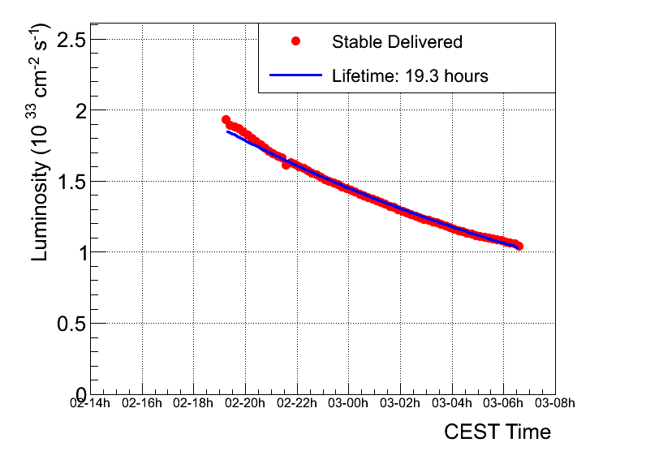
1999 Lumi lifetime

Slide 5
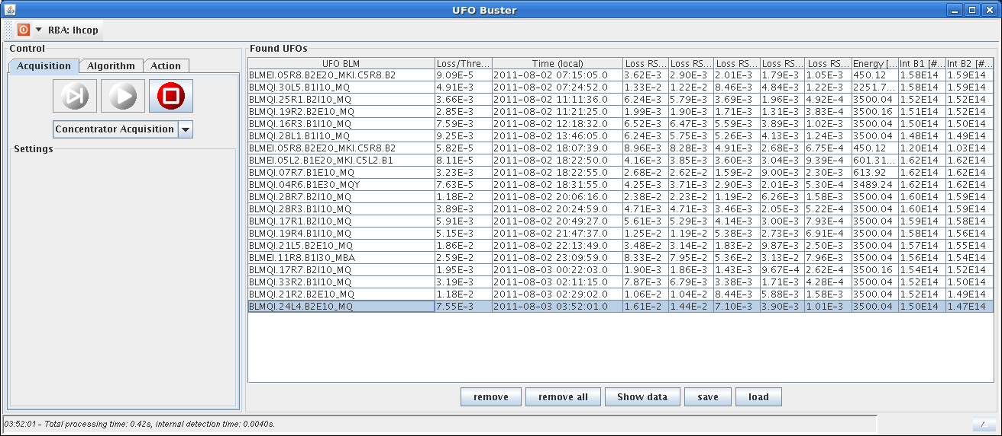
We've had only ufolinos so far...

Slide 6
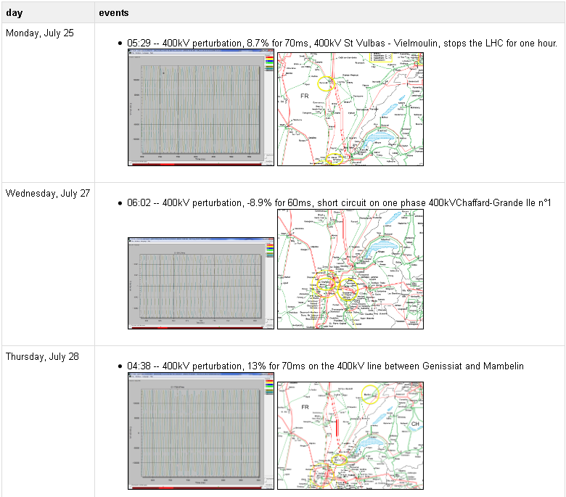
Electrical network glitches/FMCM
Does Mrs. Miggins switching on her kettle trip the LHC?
Peter Sollander

Slide 7
Misc
TCTVB.4L2.
collimator suddenly gained an offset of ~300um at ~16h30 of July 28th (motor settings that did not change).
only have <100um margin from the dump limits now
Upgrade of transverse feedback FESA – PM functionality (Daniel Valuch)
2e-3 tune shifts now in collision beam process

Slide 8
Incoming
Thursday 8 hours PS stop for POPS
starting at 9:00 provided LHC has completed filling
Will take the hit if we lose the beam before EPC have finished (possible access).
Loss maps with Roman pots
must perform loss maps before moving in the pots: this configuration has not been validated during much more than the 4 week validity period for loss maps.

