Slide 1
Fri 29/7 – Sat 30/7
09:00 End of fill 1990, PC trip RCBXV3.R1 (likely SEU on QPS). Integrated Luminosity: 41 pb⁻¹.
Access for MKI2 main switch replacement. In the shadow: CMS (tunnel), ATLAS, ALICE. Lost patrol in point 5 (PM56) once more.
13:00 Inject and dump check for MKI2.
17:50: STABLE BEAMS #1991. Initial luminosity 1.88x10³³. This fill had working point (0.308,0.318)
22:40 Lost cryo conditions for arc 12 (cryo-valve PROFIBUS controller in UJ16 – likely SEU) ==> Beam dump. End of Fill #1991. 27 pb⁻¹ in ~5 h.
23:30 Problem with nQPS card of B19R1 leading to spurious trips during precycle ➔ OK after 2 resets
04:30 trip of MKI B1 during soft-start. Piquet working

Slide 2
Injection kicker MKI2 (M. Barnes)
FPS replaced MS-3; switch was 'MELTON' (installed during last Tech Stop, at the start of July). Now switch MOULIN installed on PFN-3 (NOTE MOULIN was in this same position prior to last TS). MELTON left in UA23 as a spare.
Several electronic cards, associated with MS-3, were replaced by EC, including the following: PU.M3.G2A, TRIG M3, PU.M3.G2B, TRIG M3, PU.M3 CUR, TRIG M3 interlock thresholds adjusted as per cards removed.
EC also replaced following electronic cards: FAN OUT for triggering, and cards in erratic detection chain for M3. Kicker system was operated in local mode, in the tunnel, and shown to be OK. A SoftStart was then run from the CCC. Everything seems OK.

Slide 3
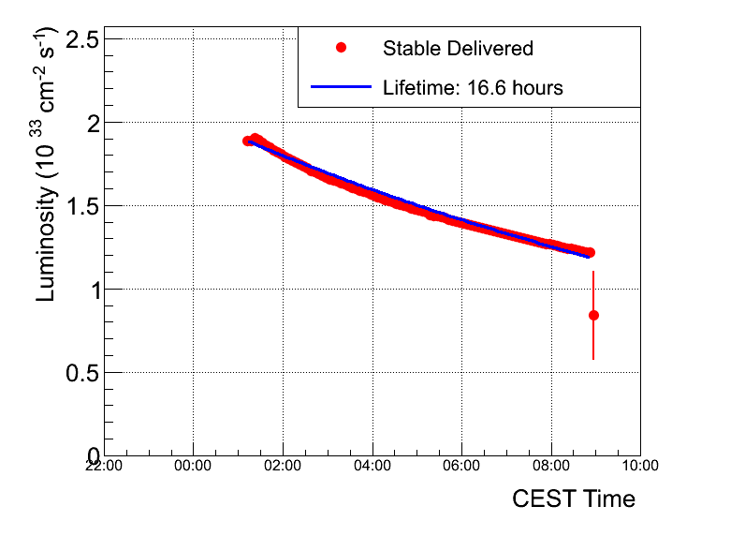
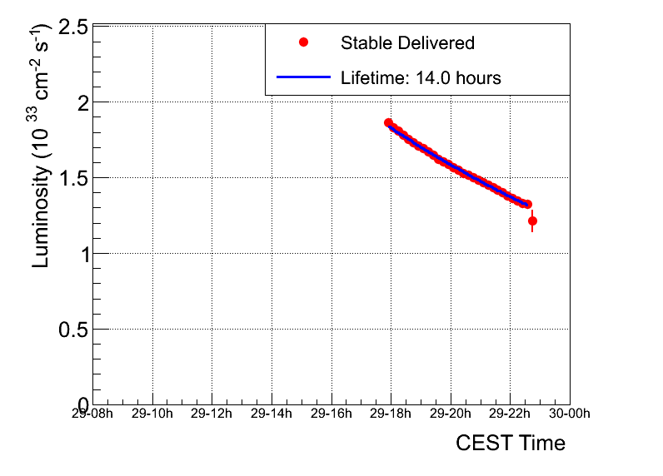
Fill 1991 vs. 1990
Fill 1990:
Emittance in collision from luminosity ~1.9 μm
BB tune shift ~ -0.007/IP
Lumi lifetime ~17 h (over 7.5 h)
Fill 1991:
Emittance in collision from luminosity ~2.0 μm
BB tune shift ~ -0.0065/IP
Lumi lifetime ~14 h (over 5 h). Slightly larger emittance from injection.

Slide 4
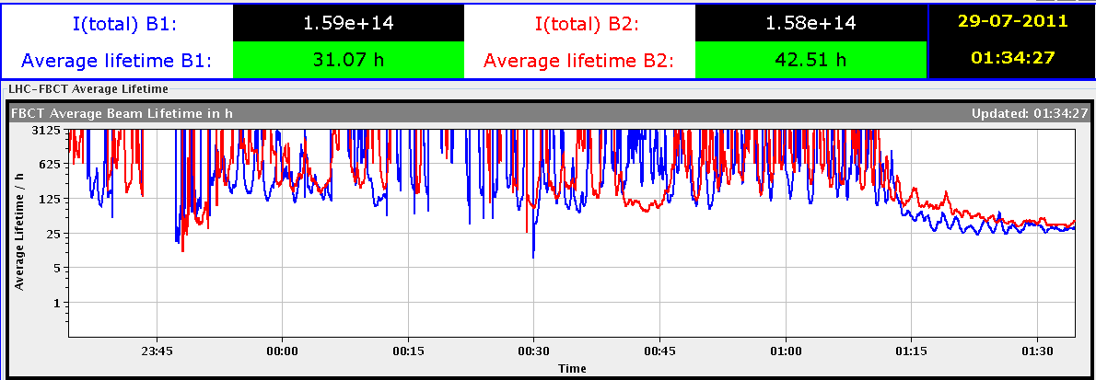
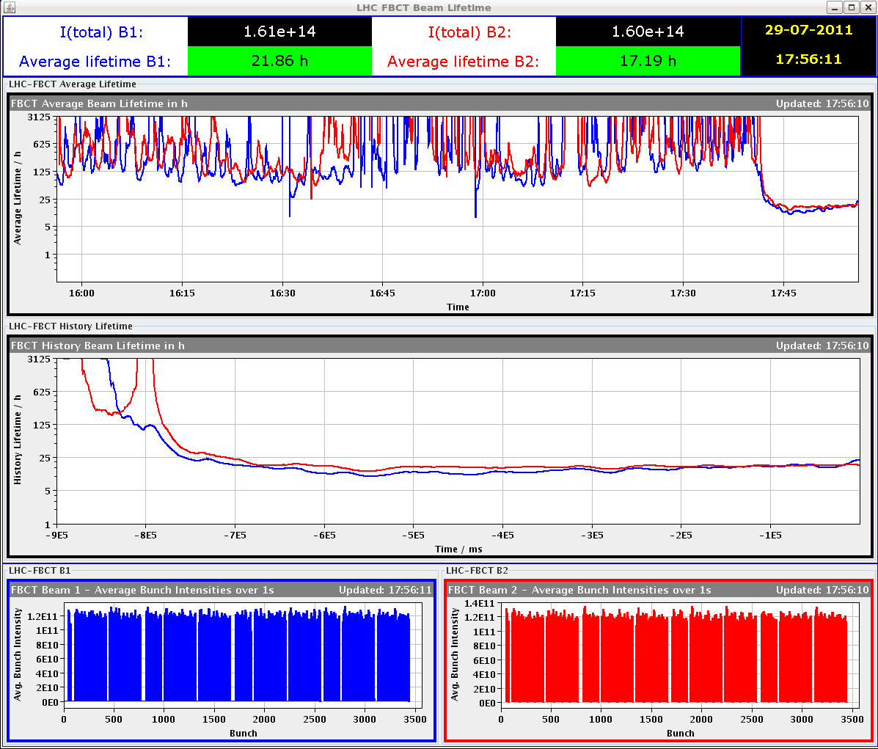
Fill 1991 vs. 1990
Fill 1990
Fill 1991

Slide 5
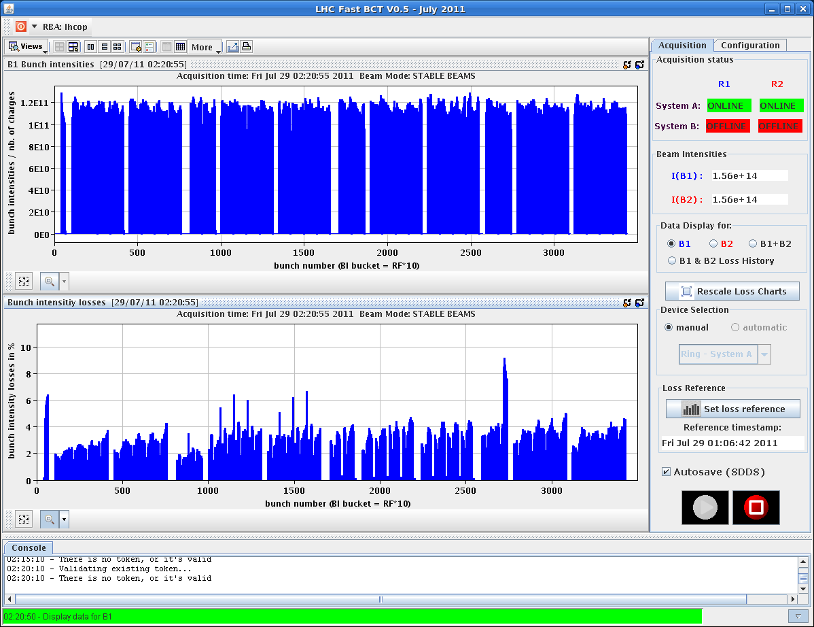
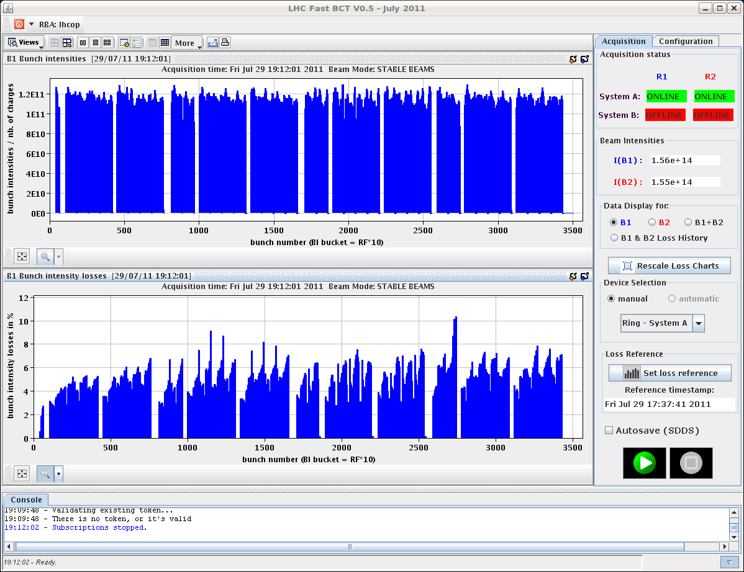
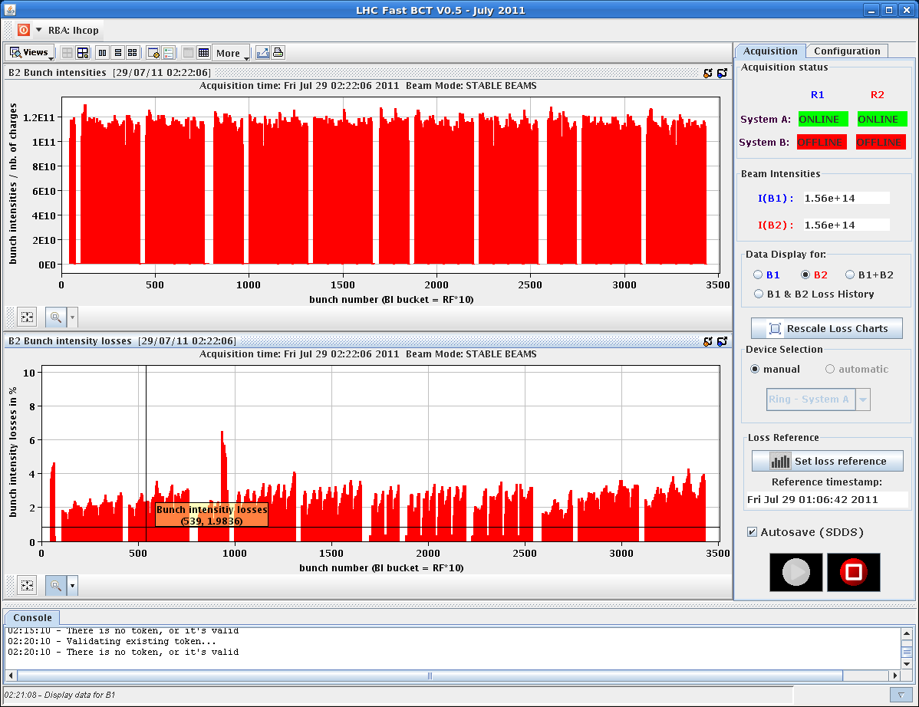
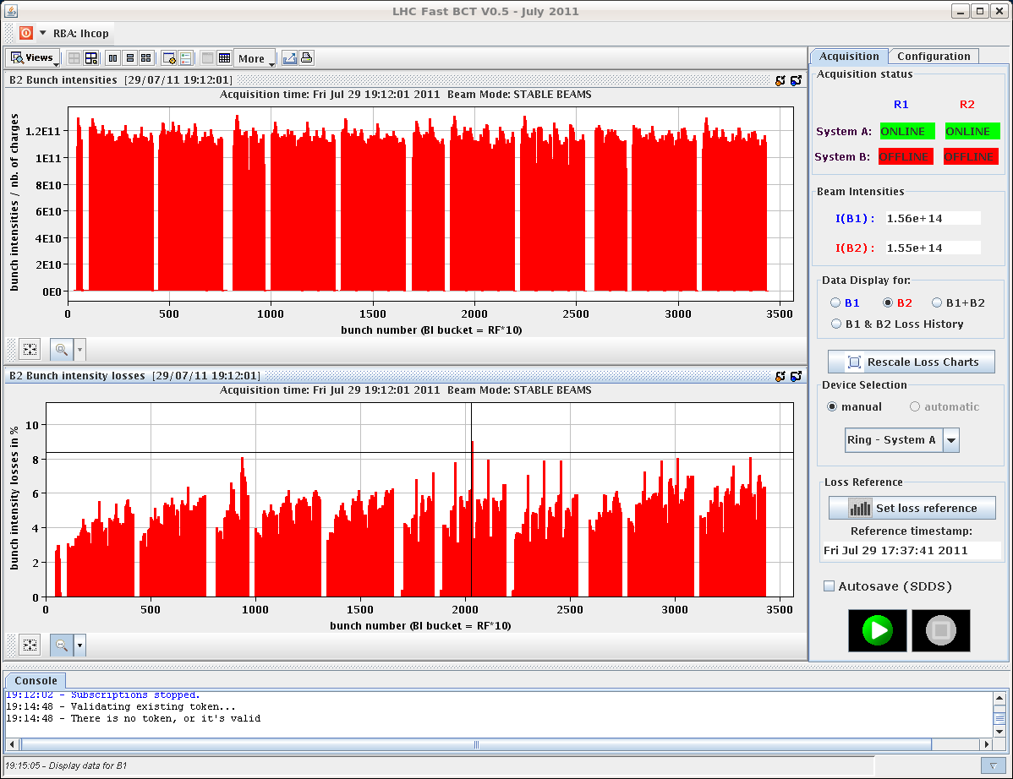
Fill 1991 vs. 1990
Fill 1990 after ~1h
Fill 1991 after ~1.2h
1-2-5-8
1-2-5-8
1-2-5-8
1-2-5-8

Slide 6
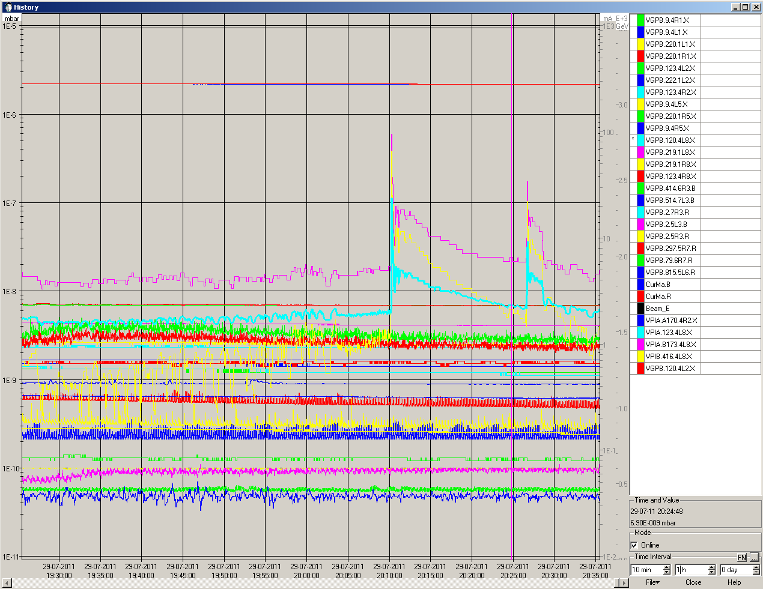
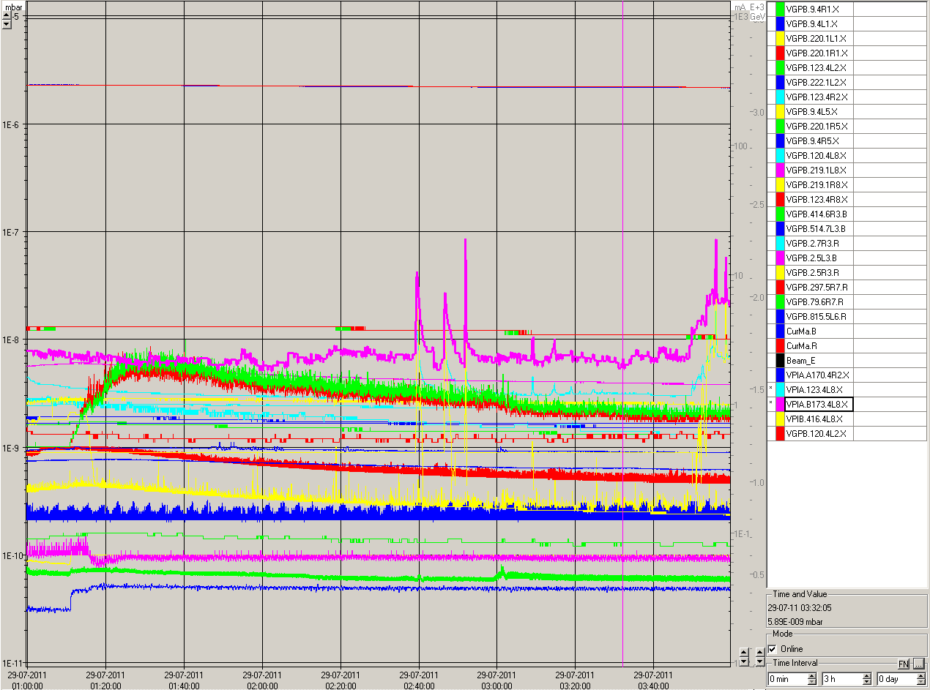
Fill 1991 vs. 1990
Some spikes just after levelling in IP8
Fill 1990
Fill 1991

Slide 7
Injection kicker status (M. Barnes)
Erratic trigger on main switch during the soft-start process
The erratic occurred at voltage higher than nominal (could be some de-conditioning of the thyratrons after 1 month)
The erratic detection system worked correctly and the main and dump switches were re-triggered correctly
No additional erratic seen in the other following soft-start
Inject and dump verification ongoing (~2 number of typical injections)

Slide 8
Plan
Go for another physics fill with different working point (0.312, 0.322)

Slide 9
Fill list
Fill | Termination | Peak L [10³³ cm⁻²s⁻¹] | Length [h] | Int. L (pb⁻¹) | ε _{coll.} [μm] | Dump cause
1975 | STABLE | 1.6 | 2.5 | 13 |  | Cryo valve PROFIBUS (UJ76) (SEU?)
1976 | ADJUST | 1.6E33 | - | - |  | BLM TCSG.L7
1977 | SQUEEZE | - | - | - |  | RF Module trip
1979 | STABLE | 1.3E33 | 6 | 23 |  | QPS RCO
1980 | RAMP | - | - | - |  | QPS RQTL7
1982 | STABLE | 1.7E33 | 2.5 | 13 |  | EL. perturbation
1984 | SQUEEZE | - | - | - |  | Vacuum R2
1985 | STABLE | 1.75E33 | 11 | 50 |  | El. perturbation
1986 | STABLE | 1.85E33 | 2.5 | 14 | 2 | RF klystron vac
1990 | STABLE | 1.92E33 | 7.5 | 41 | 1.9 | QPS trigger RCBXV3.R1 (SEU?)
1991 | STABLE | 1.88E33 | 5 | 27 | 2 | Cryo valve PROFIBUS (UJ16) (SEU?)

