Slide 1
Wed 27/7 – Thu 28/7
09:00 LHC Controls problems
11:00 Injection: vacuum rise in point 2 leading to beam dump. Possible outgassing at the ion pump switch on
Re-steering and re-inject ==> Beam dump due to vacuum raise close to D1.R2 during the squeeze ==> Increased threshold for the corresponding vacuum gauge to allow outgassing
17:20: STABLE BEAMS #1985. Initial luminosity 1.76x10³³ Initial luminosity
04:40: Electrical perturbation (argh!!!). Several FMCM trigger beam dump. End of fill #1985. ~50 pb⁻¹ in 11.7 h
05:30: problem with the BLM sanity check
08:00: Filling

Slide 2
Controls problems (A. Bland)
For many weeks the PS Operators complained that the PS Access video of the doors was "stuttering". This was traced to high network traffic on the IP57 network service of CS-CCR-TIMPS1 which receives the 19 MPEG2 video streams.
Last week the decision was made to create a new network service (IP1) and to put CS-CCR-TIMPS1 and the 2 PS Access consoles on it. This was announced on Tuesday 26th of July in the FOM. Interventions on Access systems are normally done in operation and not during Technical Stops.
The move of CS-CCR-TIMPS1 occurred at around 8:50am this morning. A few minutes later most network traffic in the CCC and the CCR was perturbed and the LHC Beam was lost around 9am.
This phenomenon had already occurred in the May 10th Technical Stop during a reboot of CS-CCR-VIDEO1 which also receives many video streams. The IT/CS Router expert was able to recreate that scenario in the lab and sent a bug report to HP, the manufacturer of the Router.
Today when I realized that the Router was overloaded I called the IT/CS Router expert who "blackholed" the CS-CCR-TIMPS1 IP address and the network recovered.

Slide 3
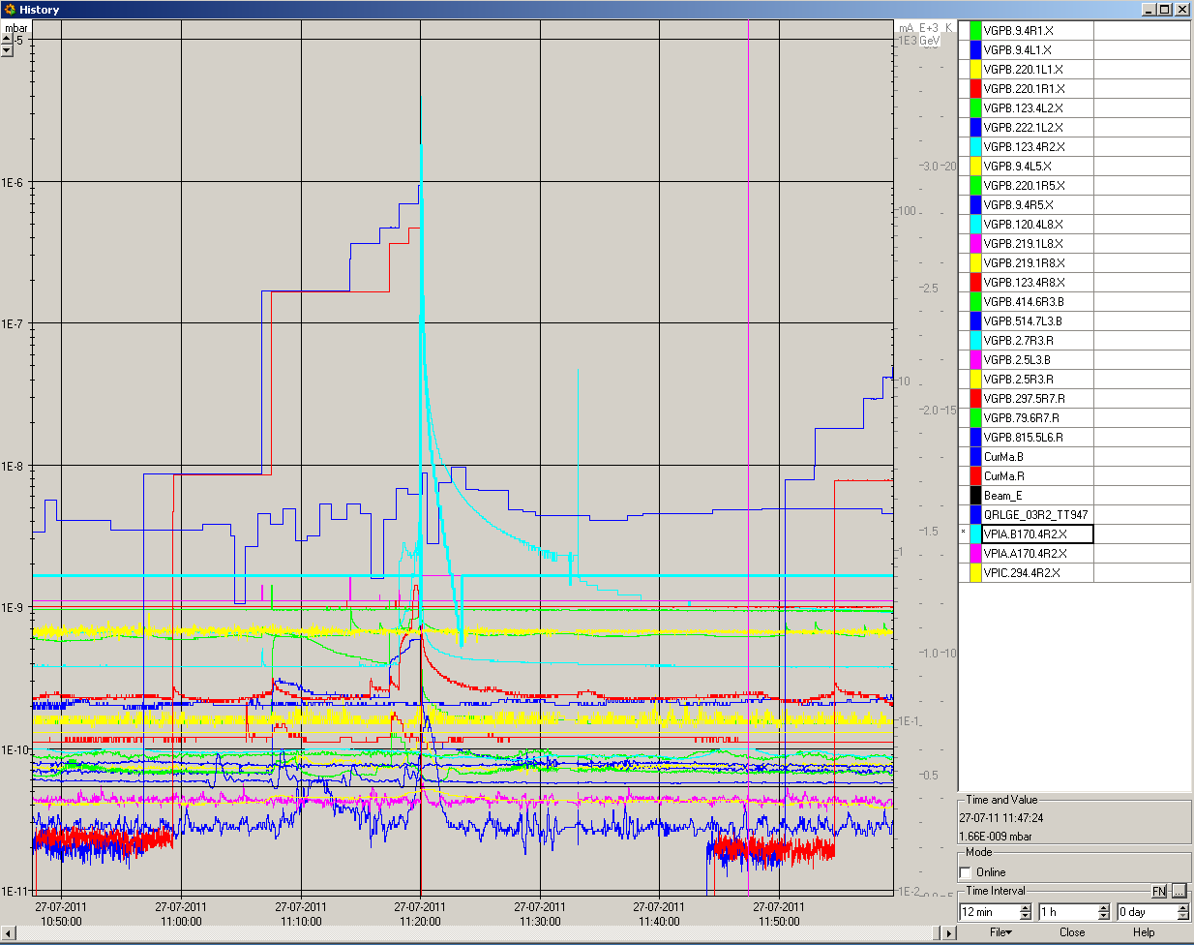
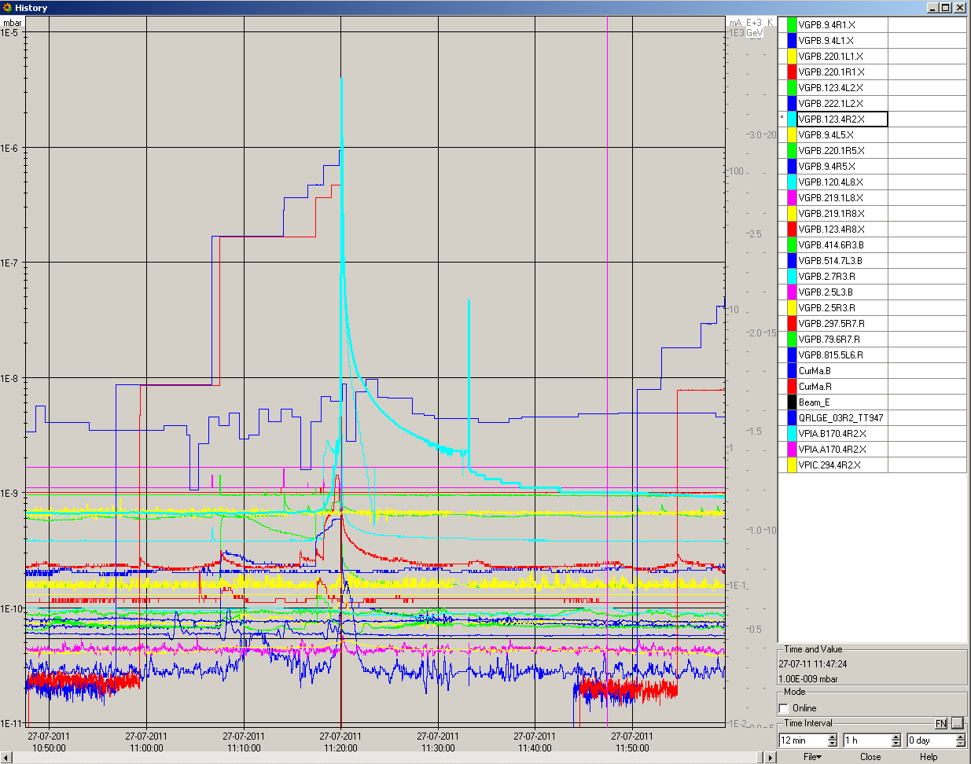
Vacuum spikes in R2
Possible explanation (V. Baglin) is the outgassing of an ion pump when the discharge is starting from time to time. Increase the interlock level on the nearby vacuum gauge temporarily to allow cleaning

Slide 4
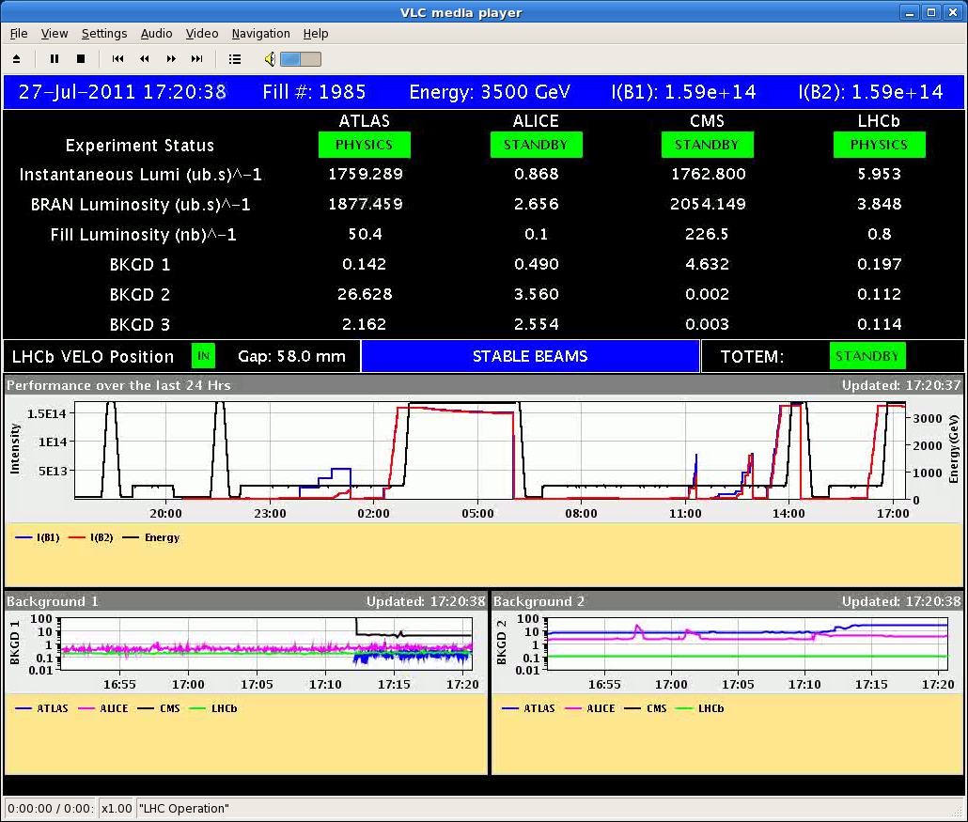
STABLE BEAMS#1985
Emittance in collision from luminosity ~2 μm
BB tune shift ~ -0.0065/IP

Slide 5
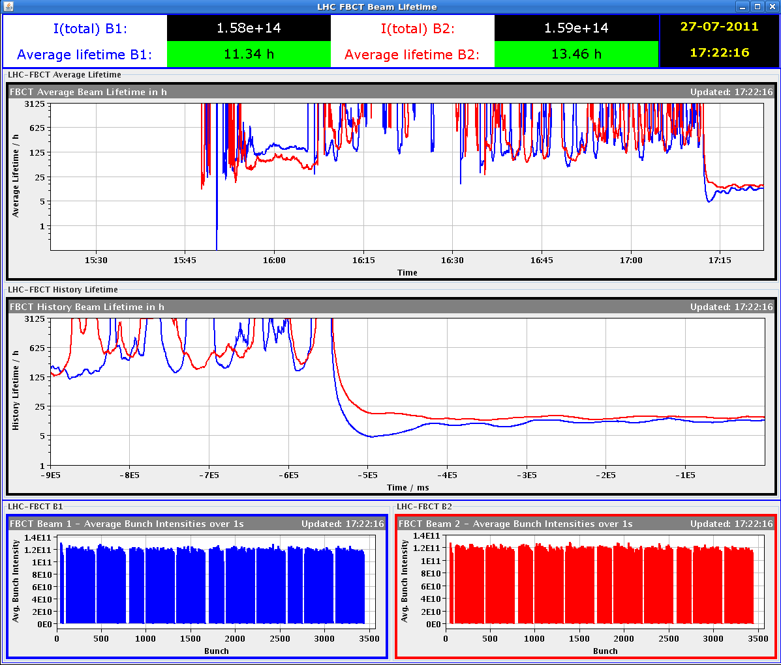
STABLE BEAMS#1985

Slide 6
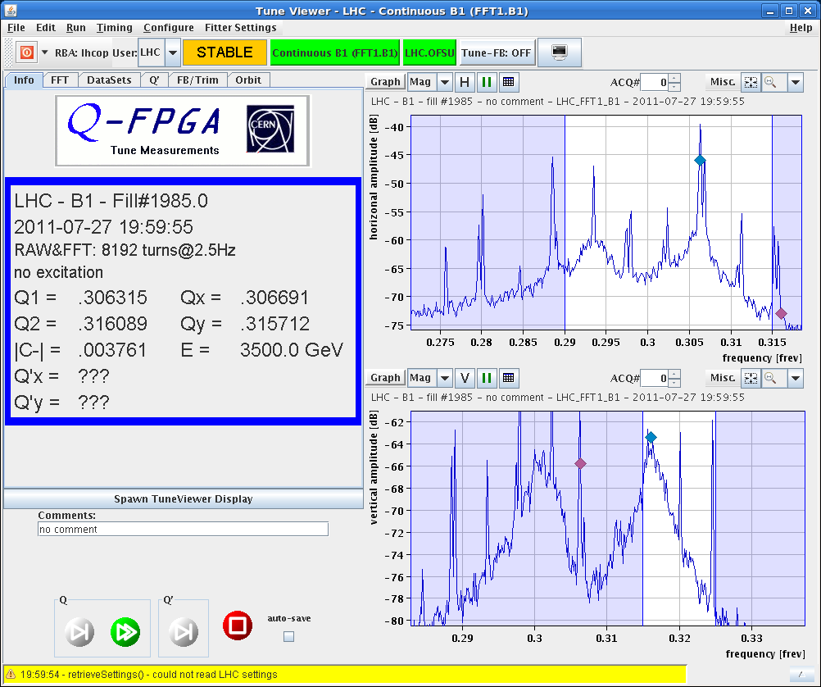
STABLE BEAMS#1985
0.014
0.015

Slide 7
Fill 1985
Cut a few minutes after going into collisions
Both beams have very similar losses
  IPs: 1 5 2 8 - 1 5 8 - 1 5 2 - 1 5 - 2 8 - 8 - 2

Slide 8
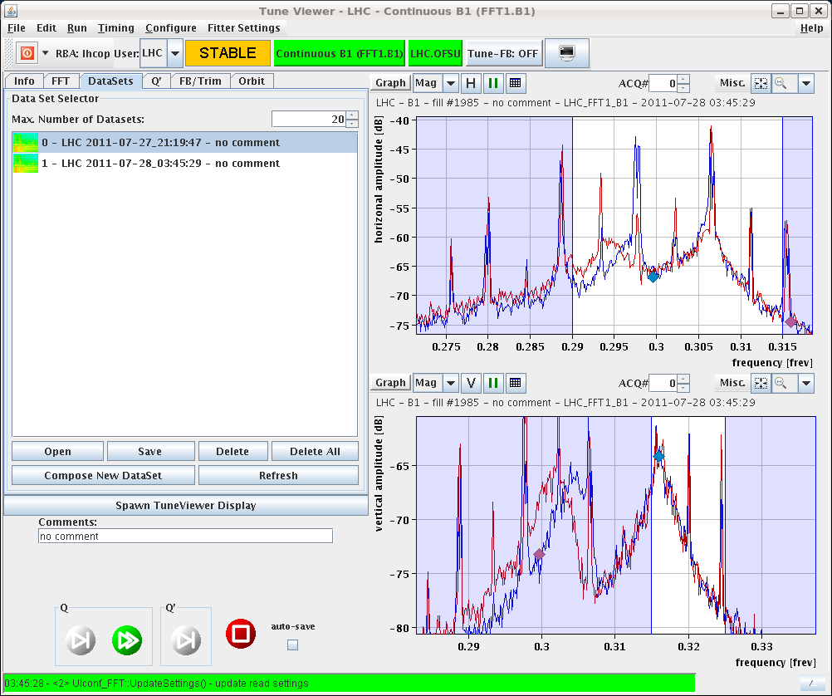
Tune shift

Slide 9
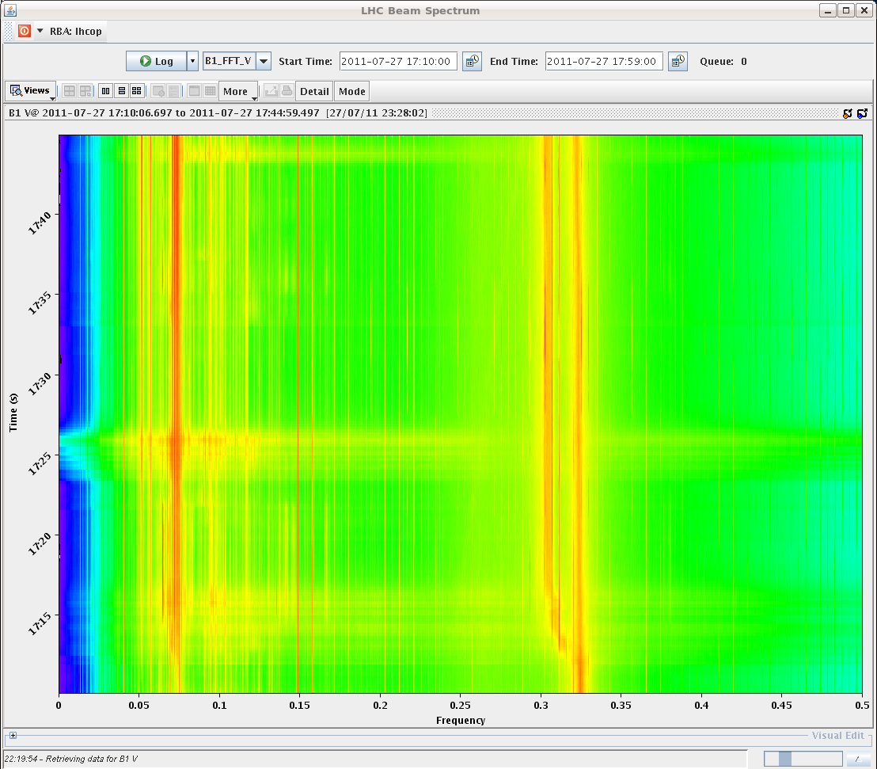

Slide 10
Plan
Go for another physics fill

Slide 12
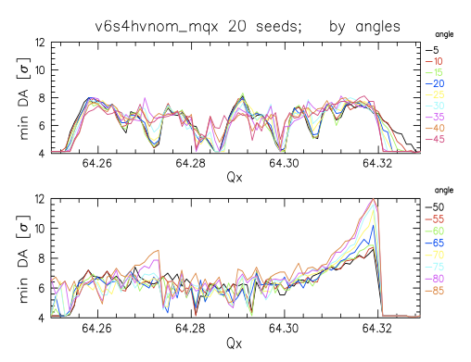
H-plane 0.31 (nominal)
DA from simulations:
Werner Herr &
Dobrin Kaltchev
4/14
2/7
3/10
4/13
1/3
ξ_{bb}/IP= -6.5 10⁻³
nominal tune
Chamonix, January 2011 Oliver Brüning BE-ABP
12

Slide 13
H-plane 0.308
DA from simulations:
Werner Herr &
Dobrin Kaltchev
4/14
2/7
3/10
4/13
1/3
ξ_{bb}/IP= -6.5 10⁻³
nominal tune
Chamonix, January 2011 Oliver Brüning BE-ABP
13

Slide 14
H-plane 0.318
DA from simulations:
Werner Herr &
Dobrin Kaltchev
4/14
2/7
3/10
4/13
1/3
ξ_{bb}/IP= -6.5 10⁻³
nominal tune
Chamonix, January 2011 Oliver Brüning BE-ABP
14

Slide 15
Fill overview
Fill | Termination | Peak L (cm⁻²s⁻¹) | Length (h) | Int. L (Average ATLAS/CMS) (pb⁻¹) | Dump cause
1975 | STABLE | 1.6E33 | 2.5 | 13 | Cryo valve PROFIBUS (SEU?)
1976 | ADJUST | 1.6E33 | - | - | BLM TCSG.L7
1977 | SQUEEZE | - | - | - | RF Module trip
1979 | STABLE | 1.3E33 | 6 | 23 | QPS RCO
1980 | RAMP | - | - | - | QPS RQTL7

