Slide 1
Tuesday
Access for RF & QPS (others in the shadow) until ~18:00.
Filters installed for crowbar control electronics on 3 out of 4 RF modules (one was already installed) to avoid spurious trips
S12 trip: power supply failure on old QPS system (MQ).
RCO/RCD/RCS in S56: replacement board in place.
RQTL7.R7.B1: 2 attempts with new boards failed. Went back to original board as it seems to be operational.
Increased gauge interlocks from 4e-7 mbar to 2 10-6 mbar behind the TCPs (V. Baglin).
We have been running within a factor 2 of the interlock limit in the past few days (start of stable beams).
When attempting to refill at 18:00, discovered problem on LBDS system – new access.
LBDS/Beam2 - Safety fault on generator MKD C (UA67) Siemens PLC board broken - changed successfully.

Slide 2
RCO/RCD/RCS in S56 problem
R. Denz and M. Zerlauth have understood the issue.
New sort of ‘X-talk’ among 600 A circuits.
Event sequence:
Trip of RCO (not beam interlocked by PIC)
→ triggers trip of RCD by EMC (not beam interlocked by PIC).
So far so good…
But after 6 minutes, automatic reset of the QPS controller (after trip) → triggers a trip of RCS (part of the same controller) which is beam interlocked by PIC → end of the beam.

Slide 3
Tuesday evening/night
Switch LHCb polarity (to ‘good’ one wrt machine) to increase separation at closest encounters around IP8.
A possible issue with the losses correlated to IP8 leveling could be the closest parasitic encounters.
1380 filling scheme has encounters (12b train) at +-3.7 m – not so good.
Steering needed on the injection lines (B2) – then clean filling.
Emittances at injection ~1.6-2 um, very uniform. Blow-up in the SPS essentially off now.
SPS emittances 1.6-1.7 um.

Slide 4
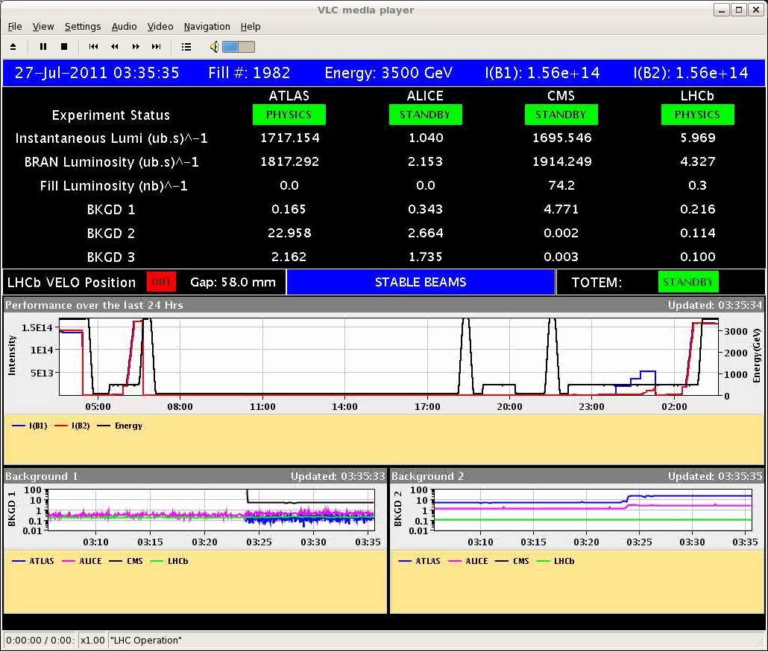
Finally…

Slide 5
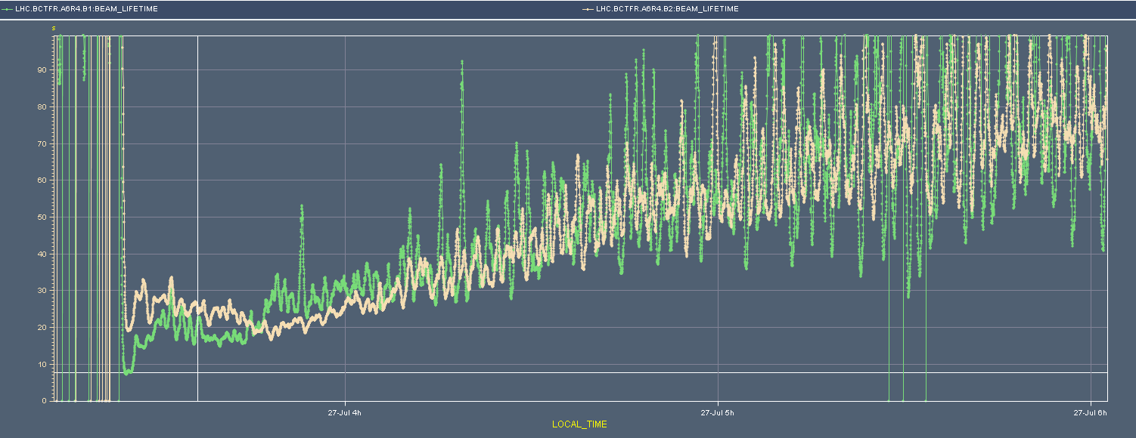
Lifetimes
B1 lifetime still lower than B2.
No dips during optimization / leveling.
Maybe slightly better than previous fills (factor ~2) – tbc.

Slide 6
Previous fills lifetime
Past few fills (So-Mo) all exhibit a second lifetime dip duration optimization.

Slide 7
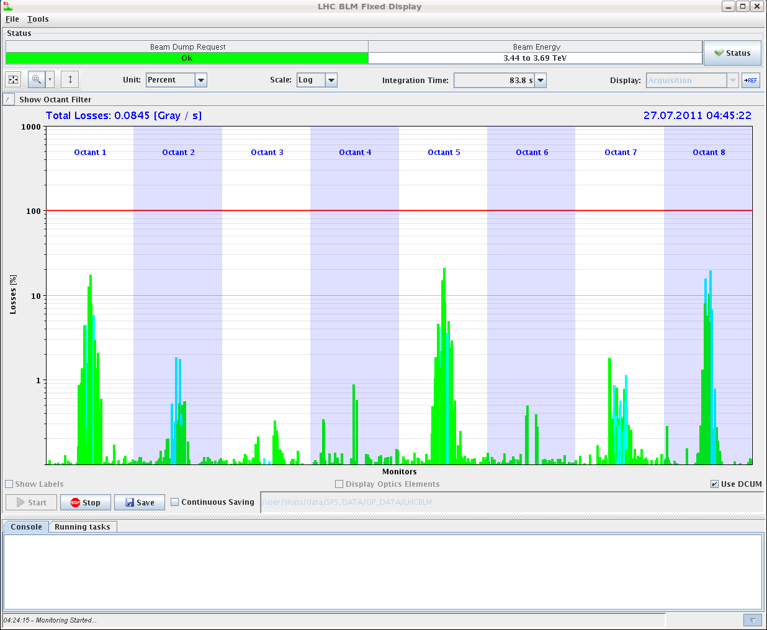
Vac. activity /losses in IP8 look better for this fill – to be confirmed.
Luminosity driven losses @ 20% of long RS thresholds

Slide 8
Fill lost on electrical glitch at 06:00. 13 pb-1.
Same thing again…but at the moment vacuum problem on the SPS injection kicker.

Slide 9
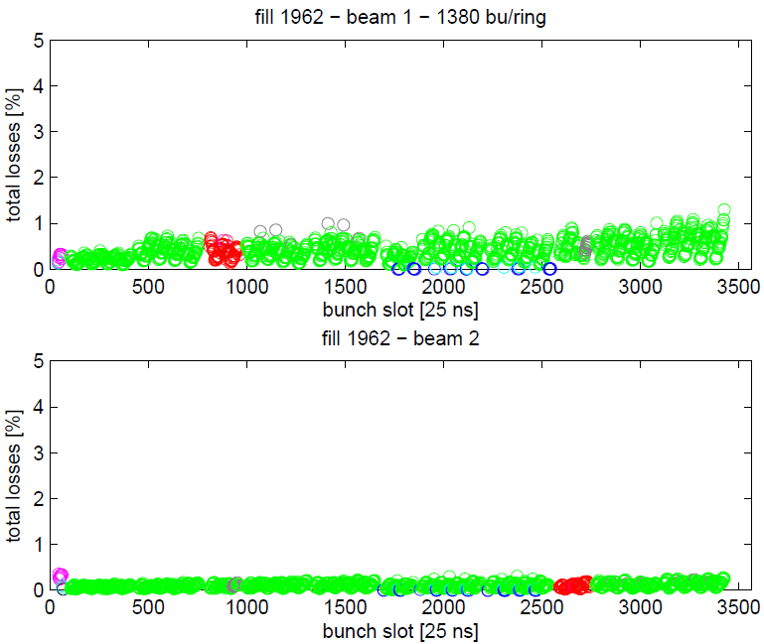
Losses vs bunch id – few minutes after collisions
G. Papotti
IP 1 5 8 IP 1 5 IP 8 only IP 1 5 2 IP 1 2 5 8

Slide 10
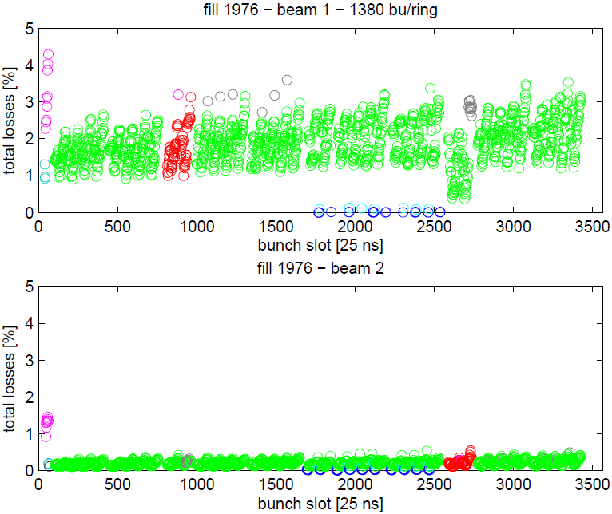
Losses vs bunch id (Mo, lost before SB)
IP 1 5 8 IP 1 5 IP 8 only IP 1 5 2 IP 1 2 5 8

Slide 11
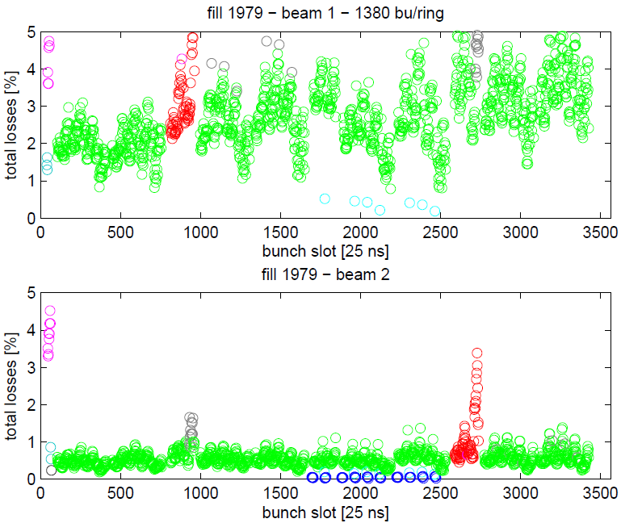
Losses vs bunch id (Mo night)
IP 1 5 8 IP 1 5 IP 8 only IP 1 5 2 IP 1 2 5 8

