Slide 1
Saturday 23.7.2011
Luminosity production 1380 bunches
Alice: main bunch – main bunch collisions

Slide 2
Fill 1967 in stable beams since 2:01
Previous night:
22.7. 23:00 BLM high voltage software interlock SIS: changed the delay time before beam dump from 10s to 1 minute for two crates: IP3 and IP7 central crate → no more disabling when going into collision
12:21 Orbit corrected (re-centered with 2 Hz) + lumi scan
13:24 Dump: Loss of cryo maintain in ITR1
QPS circuits tripped due to bad manipulation with sequencer
14:18 cryo conditions back
15:38 QPS recovered

Slide 3
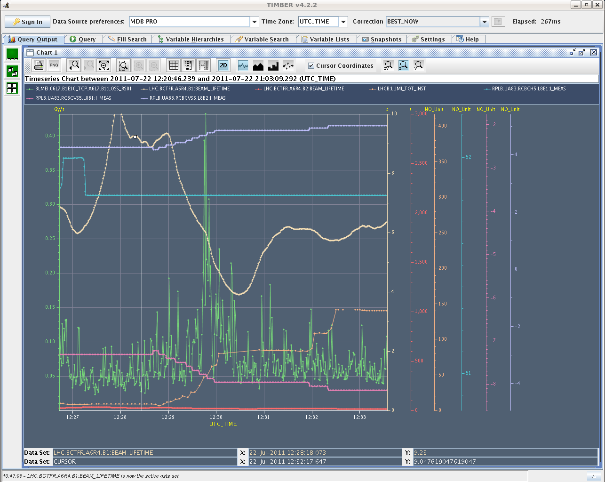
losses in IP7 when bringing LHCb into collisions

Slide 4
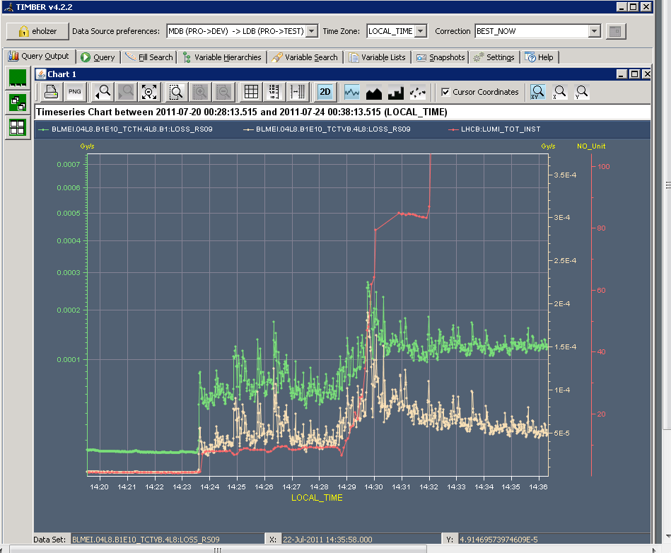
Fill 1966 for comparison

Slide 5
Fill #1968
18:25 stable beams fill #1968:
Bunch intensity 1.2E11
beam intensity 1.64e14
93 MJ/beam
Atlas/CMS luminosity: 1.67/1.65 Hz/nb
Emittance ~2.4 um into collisions
19:07 Dump: Glitch on the electrical network (EDF) seen by the FMCM on many warm magnets. RQ10.R4B1 and RQ10.R4B2 tripped as well.

Slide 6
Fill #1968

Slide 7
Fill # 1969
20:23 injection pilots
Bunch intensity B1: ~1.25E11 B2:~1.2E11
beam intensity B1: 1.72E14 B2:1.70E14
B1: 96.7 B2: 95.5 MJ
Atlas/CMS luminosity: 1.80 Hz/nb
Emittance in collision: ~2.4 um
22:14 Dump: BLM TCTVB.4L8 integration time 1.3 sec (due to vacuum activity).
Jorg noticed that a bump of around 1 mm had appeared at point 7, at the position of the collimators (the origin is not clear).

Slide 8
Vacuum spike 4L8 during BLM beam dump

Slide 9
Fill 1970
23:16 injecting probe beam
During injection (40%) and during ramp (60%): BLM TCTVB.4L8 of threshold and vacuum spikes L8 up to 1E-6 mbar
Bunch intensity: 1.2E11
Atlas/CMS luminosity: 1.76/1.74 Hz/nb
Try to bring up LHCB lumi with the leveling program
At first it does not work due to the vacuum spikes
When the spikes calmed down, LHCb lumi brought up
Now also BLMs of TCTH.4L1 and TCTH.4L8 in warning and 93% on TCTVB
2:19 → stay at 270 for LHCb
Beam life time ≥25 hours
2:50 LHCb brought up to target luminosity of 301 Hz/ub
3:12 Dump: BLM TCTVB.4L8 1.3 s RS (spike in vacuum/losses after a period of calm)

Slide 10
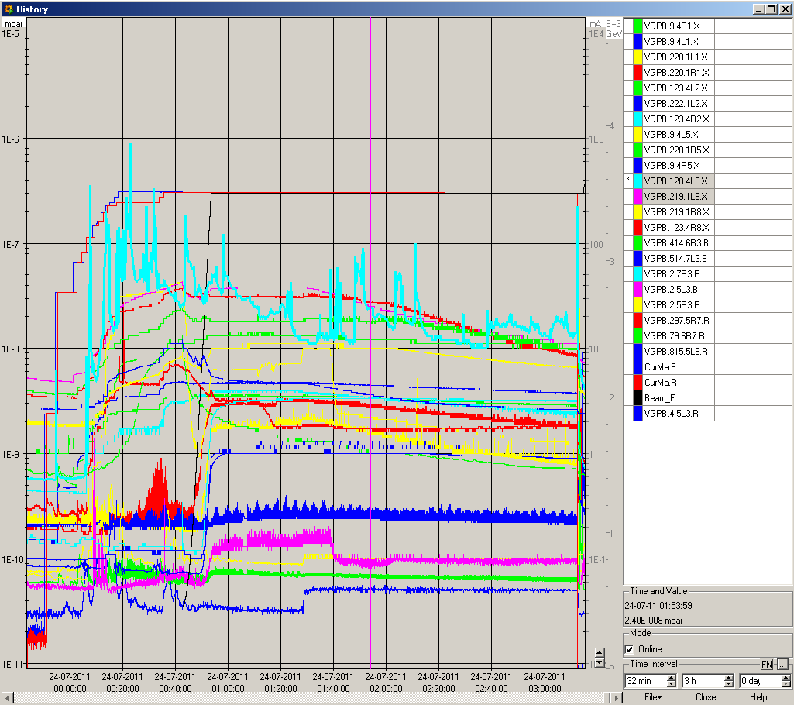
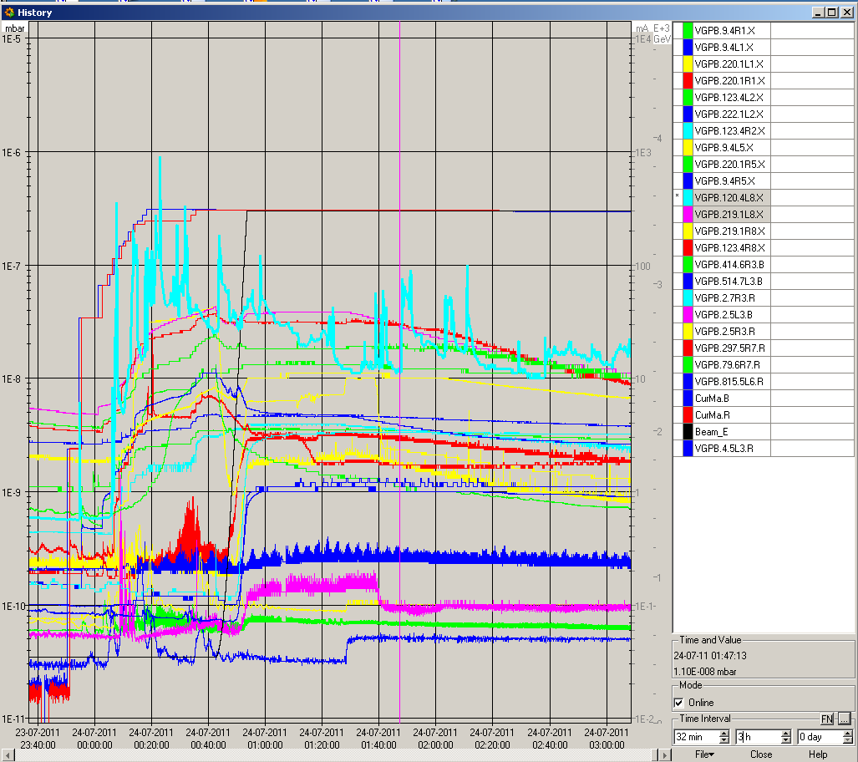
Fill 1970

Slide 11
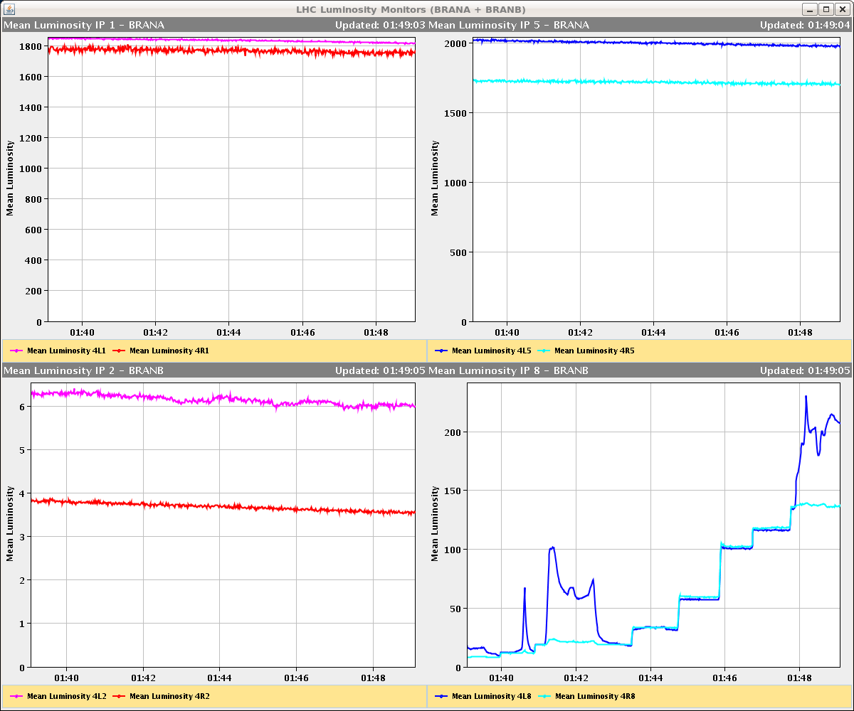
Fill 1970

Slide 12
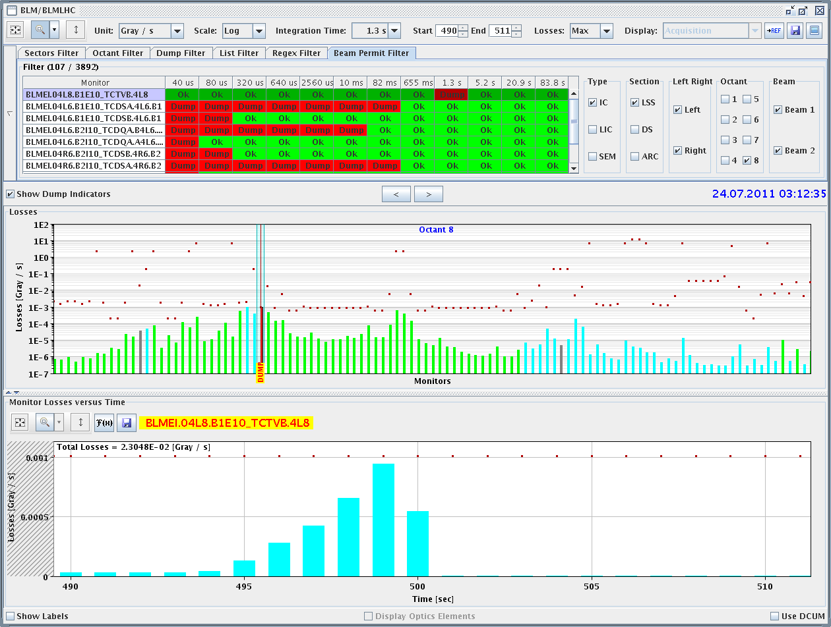
Fill 1970 BLM Post Mortem

Slide 13
Fill 1971
04:01 injecting probe beam
5:41 stable beams (turn around 2h 29’)
Bunch intensity: 1.2E11
Atlas/CMS luminosity: 1.63/1.62 Hz/nb
Slowly going up with lumi in LHCb
Life time ≤ 25h
Vacuum in L8 much better than previous fill, still a few big spikes in collision; no warnings on BLMs
6:49 Dump Cryo S56 ITR5 lost

