Slide 1
Thursday 20th July - morning
07:40 Sector access conditions cleared for 12 and 81 following intervention on RCBXH.R1
09:30 “Transparent” Cryo intervention
  DFB Helium level measurement glitch following adjustment on refrigeration uinit
  CM lost in sector 23
Intervention PS/LEIR
  Access in shadow
  RQ4.L2 quench heater power supply
  temperature calibration for the BPM
  some delay coming back – Booster MPS problem

Slide 2
Friday 22 July - afternoon
11:00 Precycle etc.
12:30 injection
14:30 Stable beams #1966 (the year England won the world cup)
  2 microns from SPS
  2.3 – 2.4 microns into collisions
  1.57e14 total per beam
  1.14e11 per bunch
  ~ 1.55e33 cm-2s-1
  tune-shift ~0.019

Slide 3
Friday to Saturday
23:01 #1966 dumped by CMS BCM2
Cryogenics reset from surface
  has lost cryo start in S12 during last fill
RF module 2B2 tripped on HOM temperature interlock without beam
had to mask the ventilation doors injection permit has the TIM signal were not available

Slide 5
Fill 1962
15 hours of stable beams
  IPs: 1 5 2 8 - 1 5 8 - 1 5 2 - 1 5 - 2 8 - 8 - 2

Slide 6
Fill 1962
Zoom in
  IPs: 1 5 2 8 - 1 5 8 - 1 5 2 - 1 5 - 2 8 - 8 - 2

Slide 7
Fill 1962
Cut after 2 hours from collisions
  IPs: 1 5 2 8 - 1 5 8 - 1 5 2 - 1 5 - 2 8 - 8 - 2

Slide 8
Fill 1962
cut after 120 min, zoom around 144 bunches
  (somewhat extreme cases)
  can see injector’s structure!

Slide 9
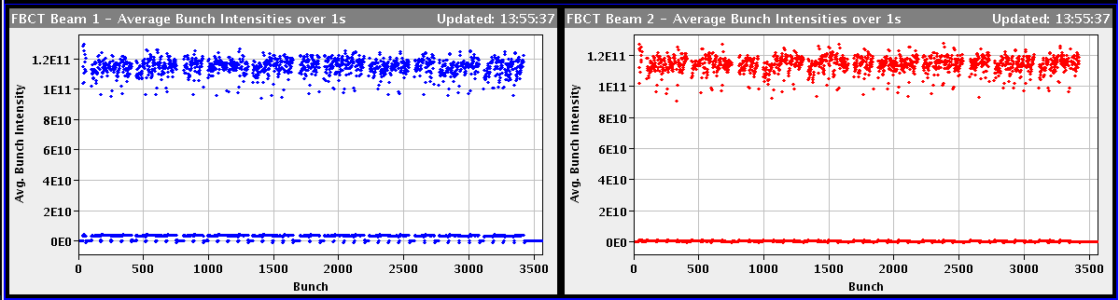
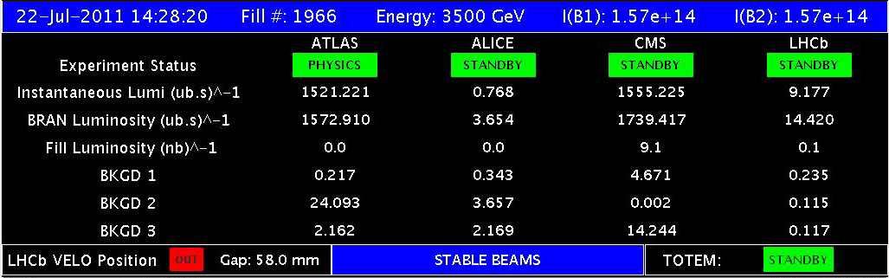
1966

Slide 10
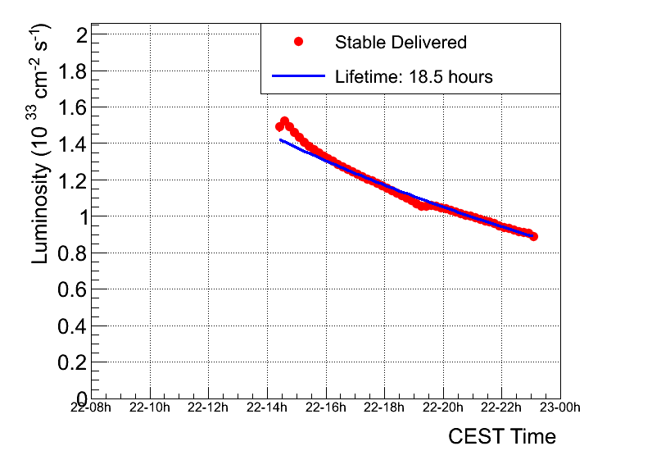
Luminosity lifetime

Slide 11
Saturday morning
01:23 start ramp
tune feedback beam 2 V stopped, managed to restart.
into collisions without reaching warning level on long running sums.
02:00 Stable beams #1967
  slightly lower bunch currents ~1.11e11
  Initial luminosity ~1.45e33

