Slide 1
Tuesday July 19th
Up to 21:00 Cryo recovery.
Replacement of PLC for cryo controls in IR4.
Access to PM25 (RP & QPS experts) + 2 EPC experts (PC consignation).
Access for MKD in UA63.
Access to P4 for inspection.
Access to US15 for ATLAS expert to inspect the 2 doors separating UX15 and US15.
Access to CMS.
Splice measurement in sector 23.
Continued on next page…
Alarm level 3 in SD8. Firemen access in PM85 → nothing found.
A vacuum crate in S81 has crashed and lead to the closure of the arc vacuum valves. An access to PM85 and PM76 (after fire alarm).

Slide 2
Tuesday July 19th
Up to 21:00 Cryo recovery: (continued)
Vacuum controls access PM76 to switch on the devices which have dropped out after a problem with the 220V distribution (same problem as in P8).
Access of EPC to PM85/UJ83 to intervene on 60A converters.
MKI kick lengths increased by 75 ns (M. Barnes). IQC adjusted.
Few circuits had to be re-qualified after intervention.
21:00 Cryo back. Cycling…
21:56 Injection.
22:49 Beams dumped (1380b) by vacuum interlock in IP8:
a few minutes after the end of the injections
Ch 6-Vacuum b1b2: B T -> F on CIB.UA83.L8.B2

Slide 3
Wednesday July 20th
23:30 Restart injection probes then physics beam
After opening valves in A4L8.
00:12 Injection of physics beam:
2/3 full: stopped due to vacuum activity in IR8L
01:00 Continuing injection
01:15 Machine full.
Waiting…
02:01 Start ramp.
02:19 Flat top. Waiting at flat top…
Checked with vacuum piquet before continuing
04:42 Stable beams. Waiting…
Vacuum improving, some UFO’s cleaned
05:51 Beam dump due to cryo problem in 81
UJ14, loss of communication in cryo controls

Slide 4
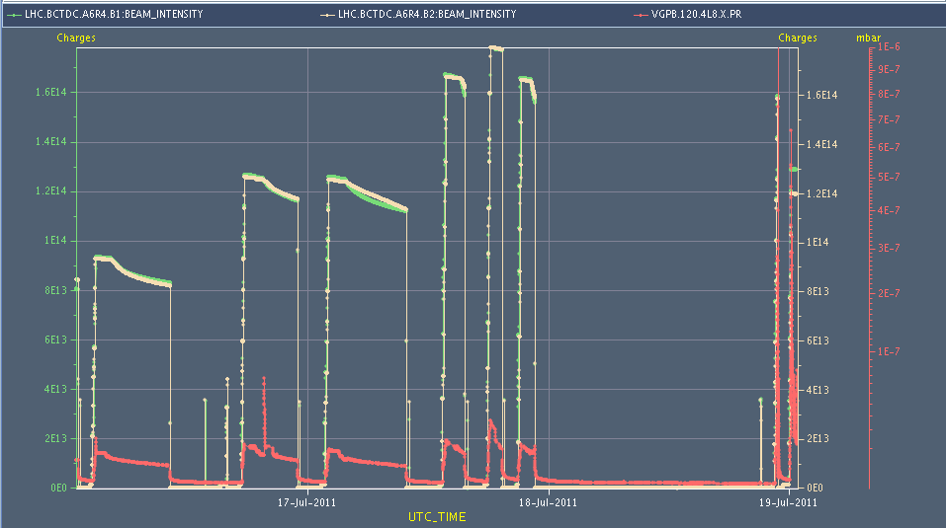
Beam intensity and vacuum (4L8)
➔ New issue

Slide 5
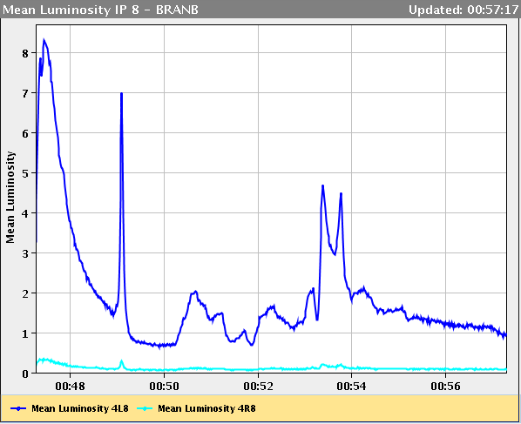
Seen in IR8 BRAN (luminosity)

Slide 6
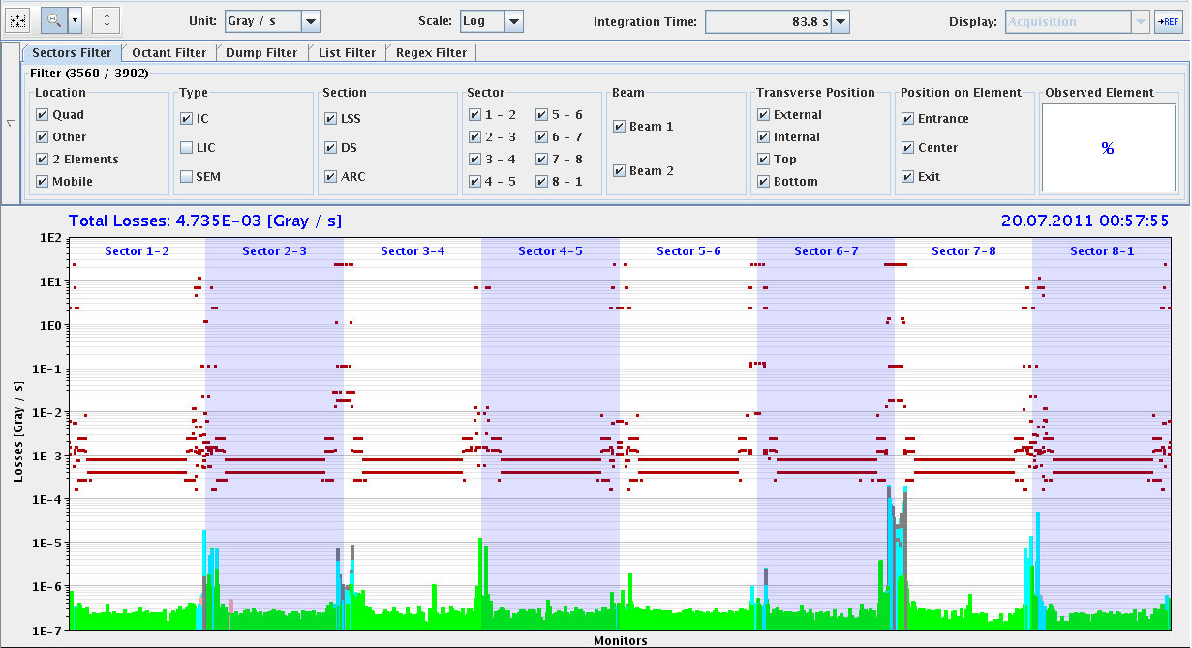
Loss pattern

Slide 7
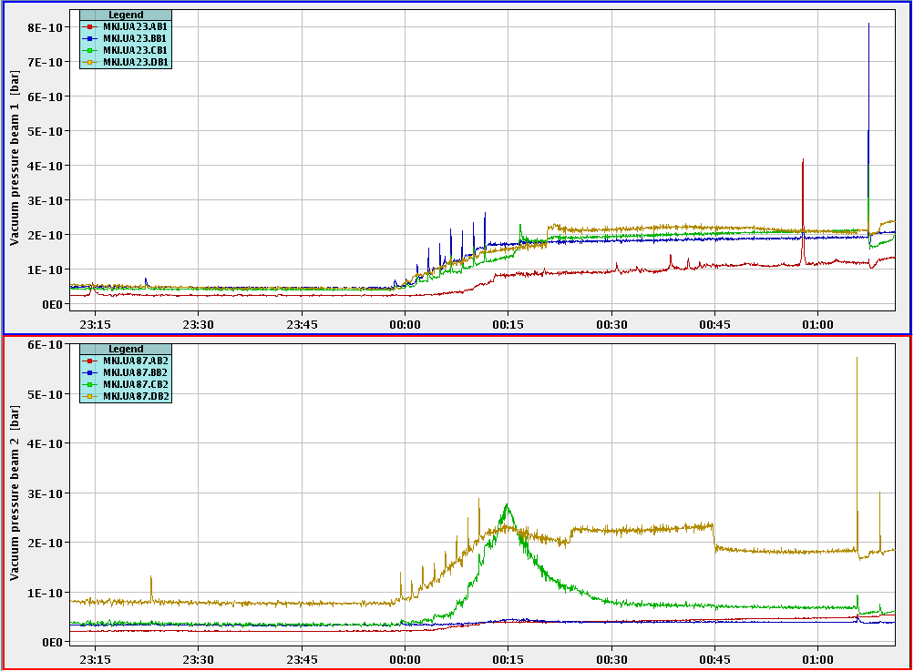
Pressure Spikes at MKI‘s

Slide 8
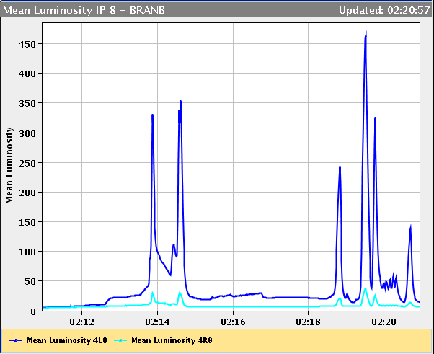
Mores spikes in ramp...

Slide 9
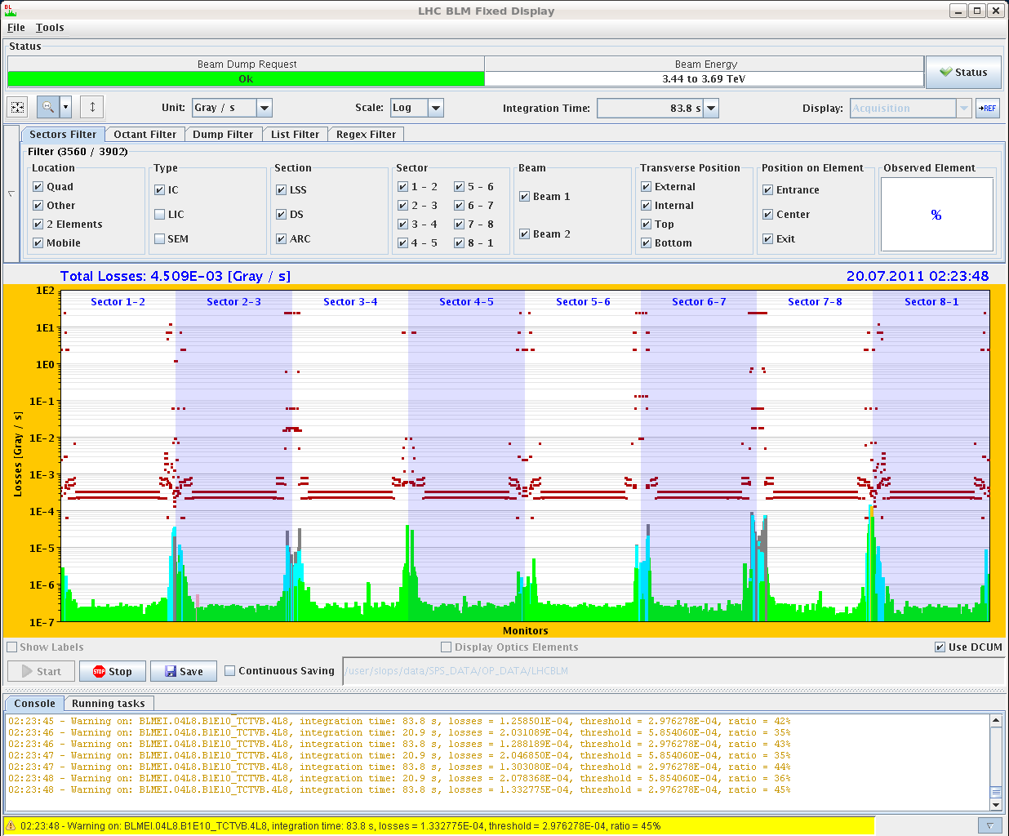
High losses in IR8L (flat top)

Slide 10
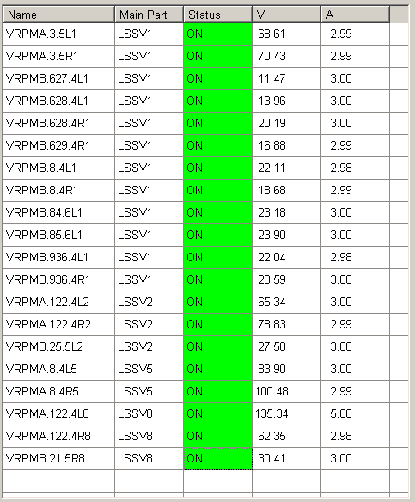
Checked e-cloud solenoids → all ON

Slide 11
Stable beams

Slide 12
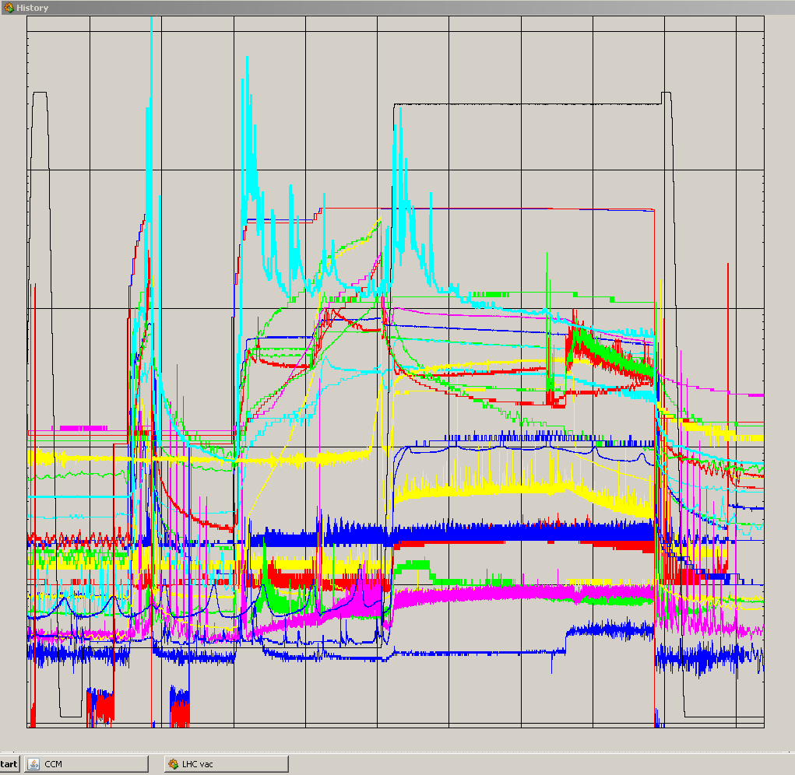
Summary vacuum during the night
Dump at 450 GeV

Slide 13
Ahead
Recover cryo by 8:30.
Beam back at 10:00.
Understand IR8L vacuum problem.
If problems with R2E to are confirmed then review strategy for bunch intensity increase:
Limit on losses to respect?
Does vacuum de-condition during technical stop?
Do we need to scrub for higher bunch intensity to decrease e-cloud and losses around ring?

