Slide 1
LHC Operations overview Week 28 – Getting back
Coordinators: Mike Lamont, Jan Uythoven

Slide 2
Int. & lumi’s Friday – Sunday Evening
Emit too small
264 bunches
1092 bunches Nominal emittance
Again 820 bunches but: - reduced bunch intensity - Larger emittances - Wait 1 hour at injection
820 bunches Slightly smaller emittance

Slide 3
Monday – Cryo Recovery & Problems
Cryo recovery following Power Cuts On Sunday around 11 h
Plenty of access all over the machine
19:22 Cryo back – sort out faults on the main circuits & BLMs
QPS problems on the quench loops S23 and S56 but found ‘magical button’ on Tuesday morning
Collimation busy finding back the collimator calibration

Slide 4
Tuesday – Beam Back, but not operational
Access for EPC (supported by QPS) to investigate a possible loose contact on the circuit RSF2.A81B
no loose connection was found and EPC changed the power module
15:15 Beam (52 hours after initial lightening strike)
Probe beams injected, preparing for TCDQ - TCSG relative position measurement
postponed
BLM problems
Trip of the Q6.L8B1 due to the water flow problems again. Reset but it tripped again - access from the CV team.
Tick of list of smaller outstanding items Tue – Wed night
Through full machine cycle with probes: OK

Slide 5
Wednesday – First ramp; sort out TCDQ; checks
9:30 Stable Beams… with 1 pilot and 2 nominals
11:10 Loss maps at 3.5 TeV
12:45 Check relative position TCDQ – TCSG B2
14:45 Collimator position checks at injection
18:15 In parallel scraping of full beam TCDQ – TCSG
21:00 RF phasing check ->access for one bad cavity
22:00 BLM 2.5 V problem
With new TCDQ functions:
23:00 Asynch dump injection
24:00 Asynch dump at 3.5 TeV
04:00 Loss maps at injection
07:00 Check injection of trains, 12 & 36 bunches
09:00 Access – 2 hours

Slide 6
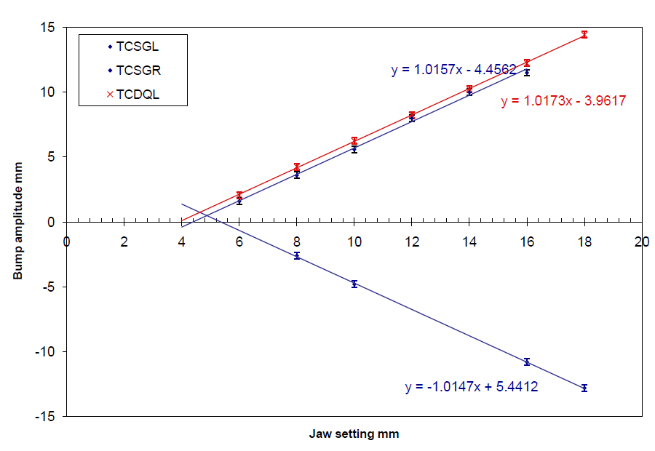
TCDQ – beam2
Was touched during the technical stop
Wanted to be sure that for same setting still the same position
Which was most likely not the case
Measurement from 10-March-11 shows an average offset between TCDQ and TCSG of +250 um while measurement from ‘today” shows -600 um
Crosscheck of TCDQ settings with scraping full beam with TCDQ and TCSG

Slide 7
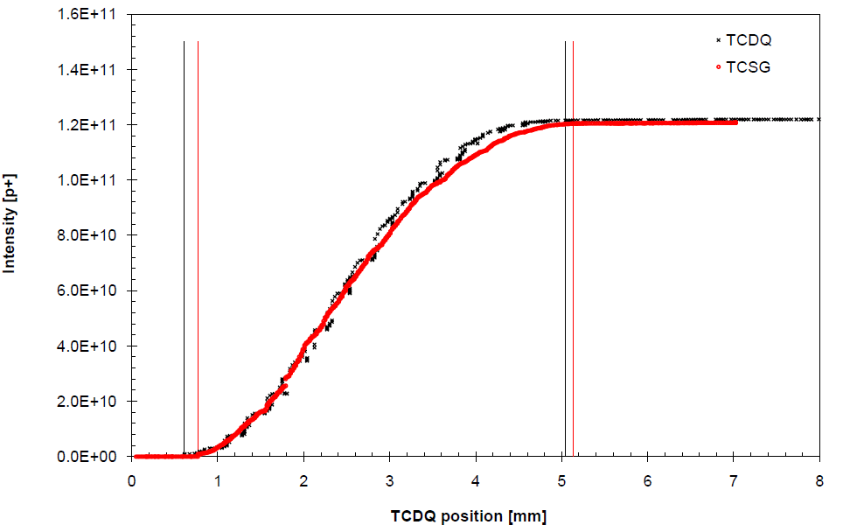
TCDQ – full beam scraping
Full beam scraping with TCSG left jaw and TCDQ
Find consistent results with measurement performed earlier today
offset corrected from 600 um to 500 um (TCDQ jaw too far out)
new TCDQ.B2 settings: 450 GeV 15.54 mm 3.5 TeV 6.29 mm
put in TCDQ jaw closer in to the beam --> safer for MP
TCSG settings remain where they are
Generate new TCDQ function
W.Bartmann, C.Bracco, B.Goddard & collimation team

Slide 8
Thursday
Access water cooled cables point 8
Plus many accesses in the shadow
48 bunches: OK
264 bunches: OK
840 bunches: lost due to software interlock on BLMs
Already see increased vacuum activity
Lost cavity 2B1 – reconfiguration of interlocks
Access the following morning together with ATLAS

Slide 9
Mini-Chamonix Friday & Saturday morning
Access in the morning for ATLAS and RF
Faulty temperature sensor on RQTL9.R7B2
Access again
Beam only in the evening – continue 840 bunches
Beams dumped in squeeze – trip of RQTF.A23B2
00:55 Colliding
Beams dumped by UFO on the MKI.D5L2.B1
05:49 Colliding again
beams dumped by an UFO again during optimization
The instantaneous luminosity for the previous fill went up to 1.11e33 Hz/ub The intensity per bunch was adjusted in the SPS to the nominal and the emittance was around 2.3-2.6, as measured in the SPS on the 36b.

Slide 10
Vacuum – Friday evening
Next time we wait 30 minutes at 450 GeV after finishing injection

Slide 11
Saturday, 16/7
08:45 trip of sector 81 - QPS glitch; checking QPS; pre-cycle
13:00 Filled – wait 30 minutes before ramp
14:09 At flat top: dumped - UFO #3 IP2 (assigned to MKI-D)
16:15 Injecting for physics – SPS some problems setting up; some injection losses in the LHC
Injecting 840b, but lower intensity and emittances up to 3.0 um @ inj.
19:15 Stable beam fill #1952
01:05 Dump fill by operator !
04:36 Stable beams fill #1953

Slide 12
The three UFOs which dumped the beam

Slide 13
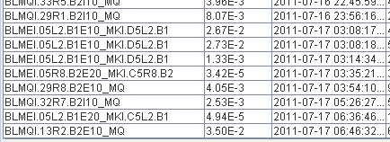
UFOs for the fill #1952 and #1953
#1952
#1953

Slide 14
Conclusions: UFOs 16/7/2011 from Ruediger
Three fills dumped by UFOs were analysed
In all cases the UFO came from the same area, for B1 close to the MKI in IR2
The loss patterns are nearly identical for all three events
The losses UFO for fill dumped at 0552 were very high, and even in point 5 at the TCT the threshold of BLMs was exceeded. The UFO at 0100 was much slower, and had the maximum before the dump (dump on longer running sums).
For both other UFOs an increase of the threshold by a factor of 2 might have prevented a beam dump.
In case of further UFOs dumping the beam, it is proposed to increase the threshold by a factor of 2 for the monitors indicated in YELLOW in the EXCEL table.
However, the storm now seems to be over, conditioned away

Slide 15
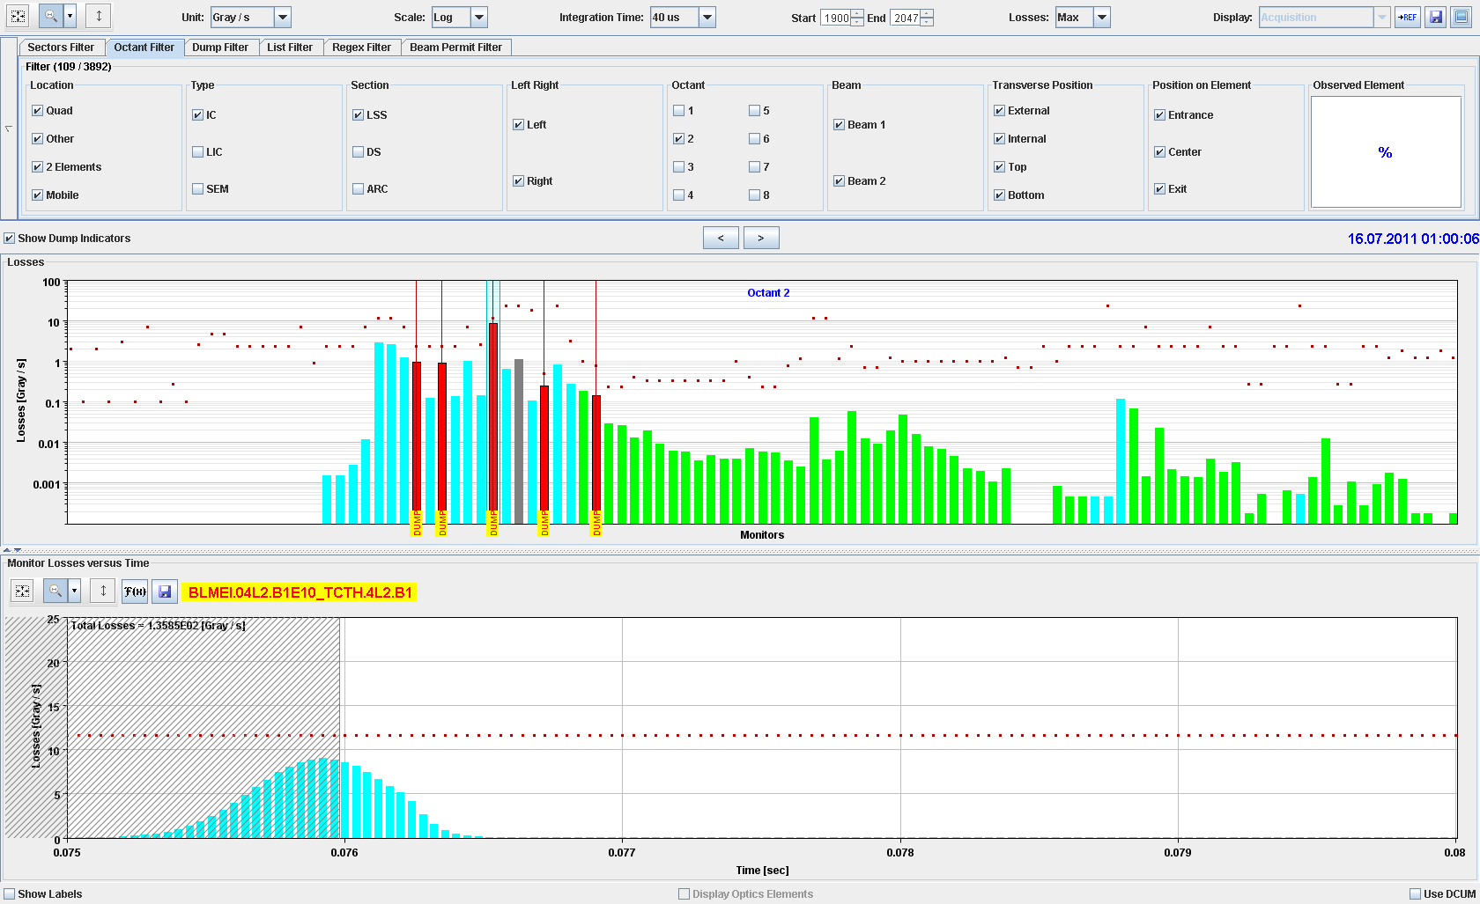

Slide 16
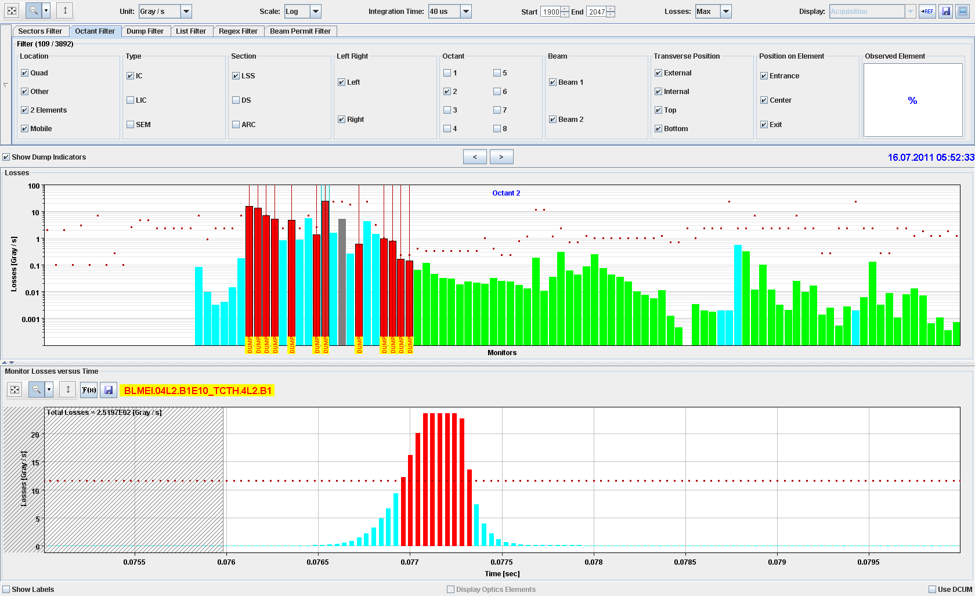
Saturated at the TCT !

Slide 17
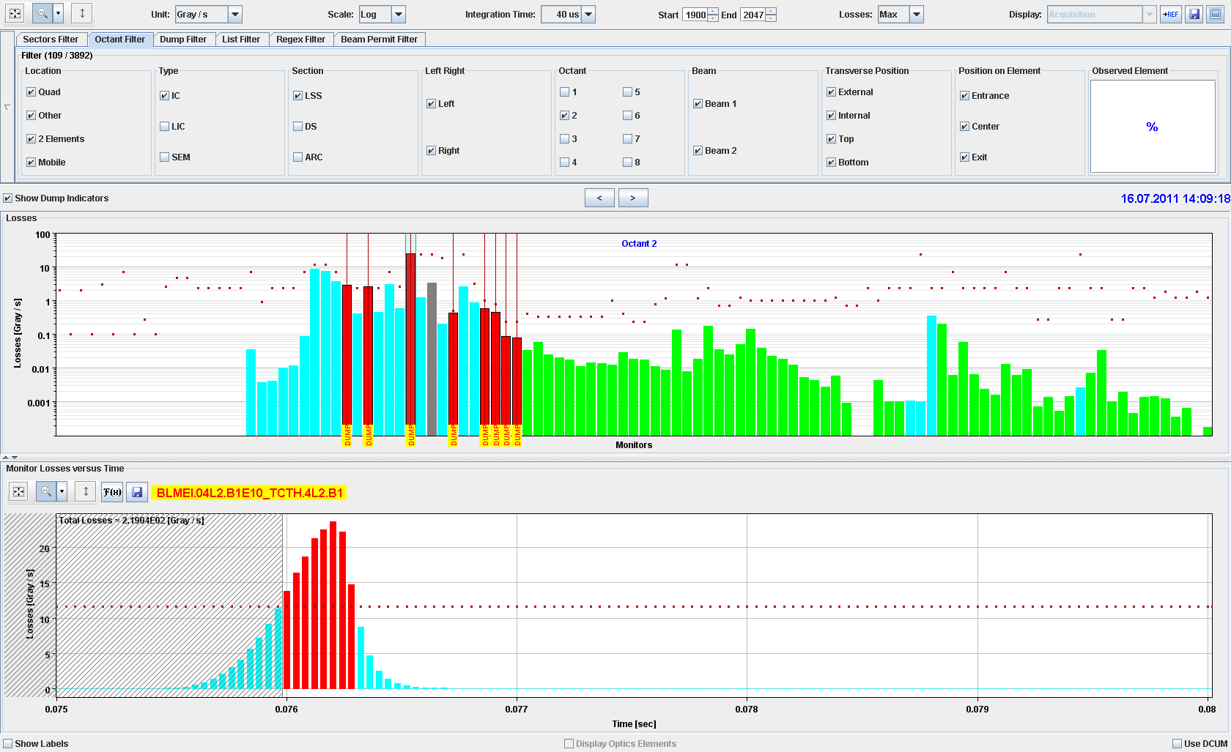

Slide 18
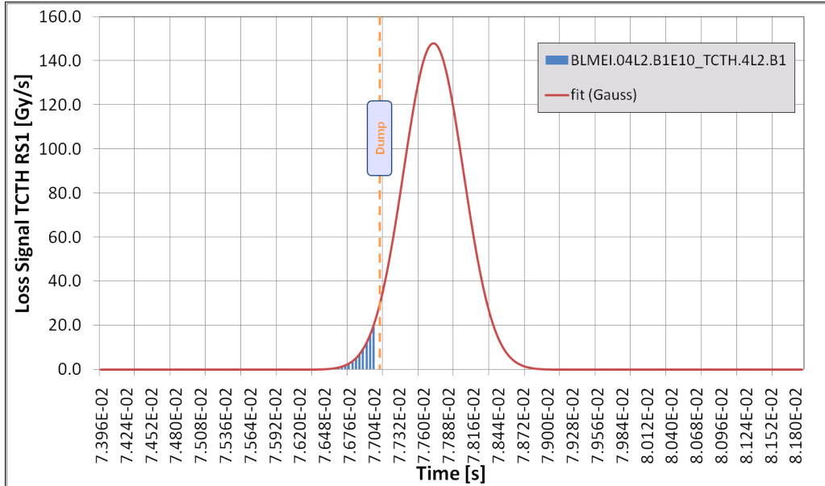
UFO record
The UFO dump today at 05:52:34 was the largest UFO ever seen.
With a saturated signal at the TCT and an extrapolated amplitude of up to 148 Gy/s at the TCT
The temporal width was 338us.
Tobias Baer

Slide 19
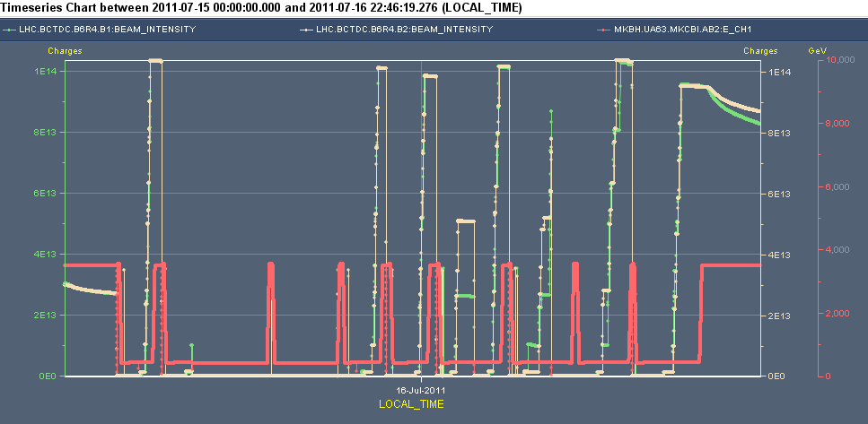
Next 840 fill was better
Emittances up to 3 um at inj., 3.7 um at collisions
Lower bunch intensities – 1.15e11
Wait one hour before ramping

Slide 20
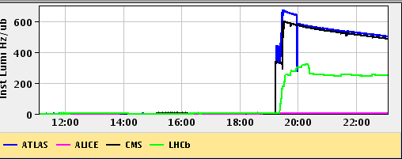
..but lower lumi
Lumi of 600e30 cm-2s-1 with 807 colliding bunches corresponds to a normalised emittance of 3.7 um!
ALICE is also optimized. They are at about 0.07 Hz/ub - while the published target is 0.3 Hz/ub.
What we optimized to is in good agreement with the luminosities we have for ATLAS/CMS, scaled by number of bunches, beta star and assuming a population for the satellites of about 0.1% (the scaling gives 0.09).

Slide 21
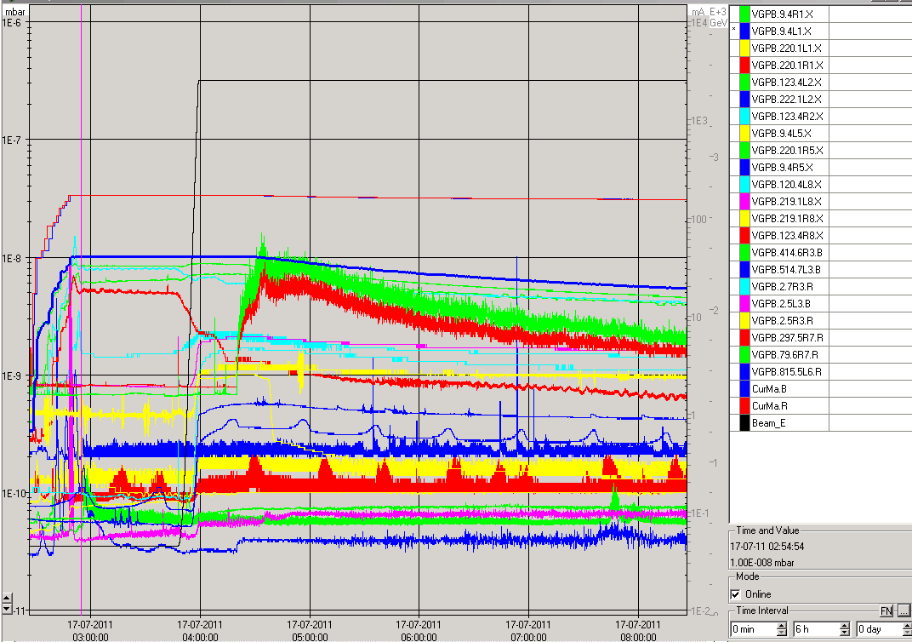
Vacuum fill #1952 #1953
#1952
#1953

Slide 22
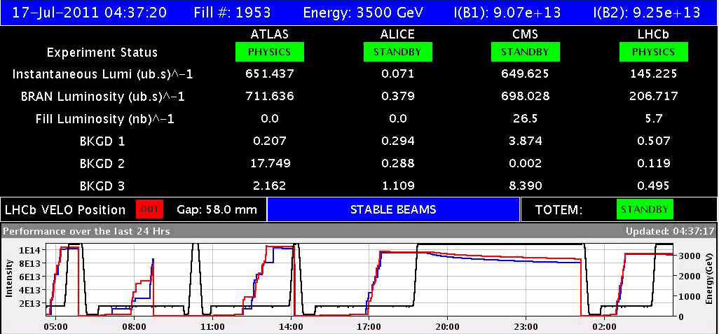
Fill # 1953
Waited one hour at injection, but not many UFOs
Normalised emittance when going into physics 3.2 urad
Compared to 3.7 urad for previous fill

Slide 23
Sunday
10:15 Dump fill #1953 - access system fault
Found indeed an ‘internal door’ half open – YCP03=US450
Same kind of problem in same zone happened before
14:30 Injecting probe beams
16:00 Dumped beam at inj., RQTL9.L3B2 QPS trip - OK to continue
17:41 Finished injecting and wait one hour before ramping
19:34 Stable beams fill #1954 - 1092 bunches -lumi's 1.16e33: back in production!
22:58 Beam dump due to RF HOM temperature
… most likely a glitch
XPOC error on BLM at TCDQs, both beams: just above threshold
Refill 1092 bunches, fill #1955
03:42 Stable beamsLower lumi’s, due to larger bunches, presently in

Slide 24
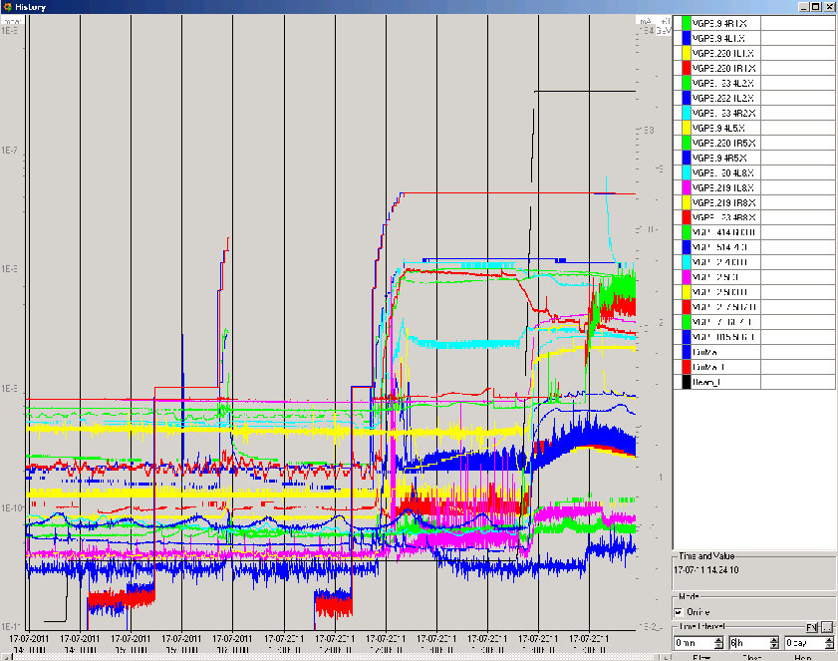
Vacuum second 840b and 1092 bunches
#1954 1092b
#1953 840b
Vacuum not any worse: conditioned

Slide 25
UFOs 1092b fill
Some larger UFOs at injection, Not only at the MKI Burned off 3x MKI at injection
ramp

Slide 26
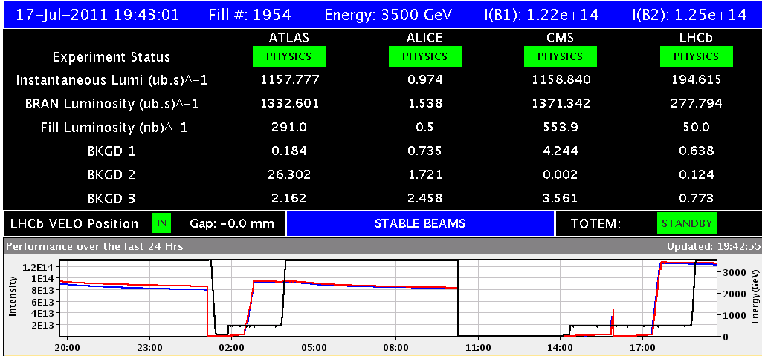
Fill #1954
1092 bunches, 1042b in collisions, only 1.12e11 p+/b
need normalised emittance of 2.4 urad to get to the instant. lumi!
Back in business!

Slide 27
Present fill #1955
Some smaller lumi’s, bunches a bit larger

Slide 28
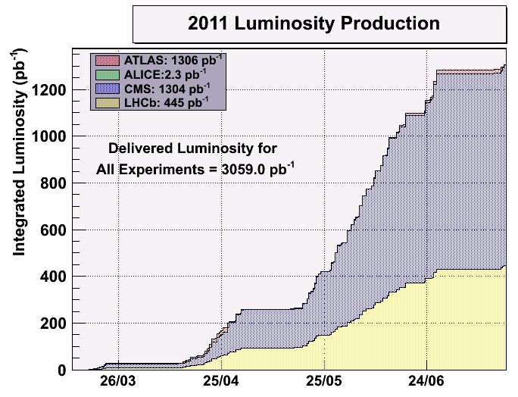
Conclusions
It was tough getting back after the TS and Power Cut on Sunday one week ago
Many accesses
Spent quite some time on verifying systems touched by either the TS or the Power Cut
Once the system was back the ramp in the number of bunches got stopped by UFOs at 840 bunches
Got around this by conditioning with two fills with 840 bunches:
Larger emittances, around 3.0 um at injection, 3.2 - 3.7 at collision
Smaller bunch intensities of around 1.15e11
Wait for the UFO storms at injection for about one hour
Next fill with with 1092 bunches producing 1.2e33 lumi
Still small bunch intensities of 1.15e11
But emittance at collision of only 2.4 urad
Vacuum also recovered – ‘together’ with the UFOs
Back at production
Integrated lumi inching up again

Slide 29
Plan
Keep: 50ns_1092b+1small_1042_35_1008_108bpi
Back to bunch – bunch collisions in Alice
Again 1.15e11 per bunch
Back to nominal emittances (fill #1954)
Dump this fill during the afternoon
Next fill: 50ns_1380b_1331_0_1320_144bpi12inj.txt (luminosity production)
Check MKI kick length
Following Mini-Chamonix and UFO experience
Stepwise decrease of emittance and increase of bunch intensity
Next coordinators: Barbara and Mike (again)

