Slide 1
Saturday, 16/7
Three fills lost overnight Friday to Saturday (840b):
first, QTF trip QP/tune feedback during squeeze;
next two to MKI UFOs while optimizing collisions.
08:45 trip of sector 81 - QPS glitch; checking QPS; pre-cycle
11:00 Injecting probes – problems in injector chain
13:00 Filled – wait 30 minutes before ramp
14:09 At flat top: dumped - UFO IP2 (assigned to MKI-D)
16:15 Injecting for physics – SPS some problems setting up; some injection losses in the LHC
Injecting 840b, but lower intensity and emittances up to 3.0 um @ inj.
19:15 Stable beam fill #1952
01:05 Dump fill by operator !
04:36 Stable beams fill #1953

Slide 2
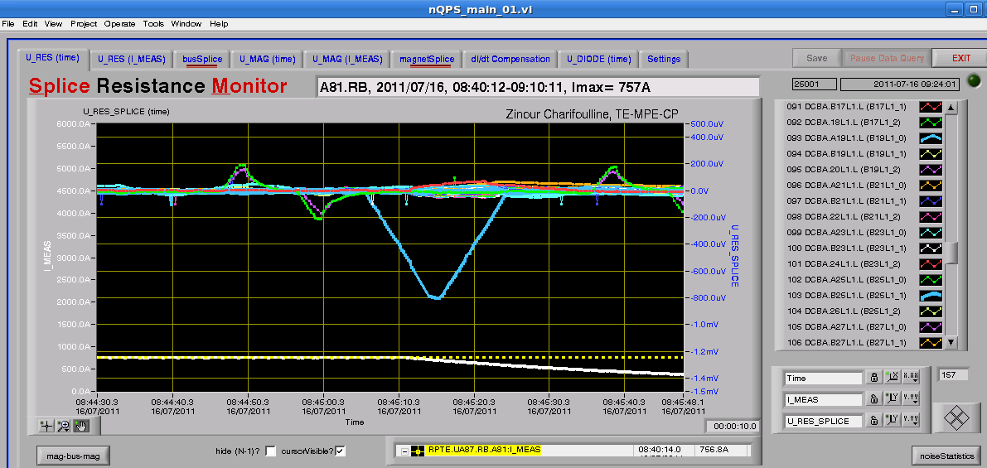
Quench loop of RB.A81 was opened
Splice signals of RB.A81. Only a spike close to 500 microVolt roughly in correspondance with the PC stop event
The shape of the signal corresponds to a negative square wave (say - 1mV for 8 s) after averaging with a 10 s moving window. The origin of this is not clear.

Slide 3
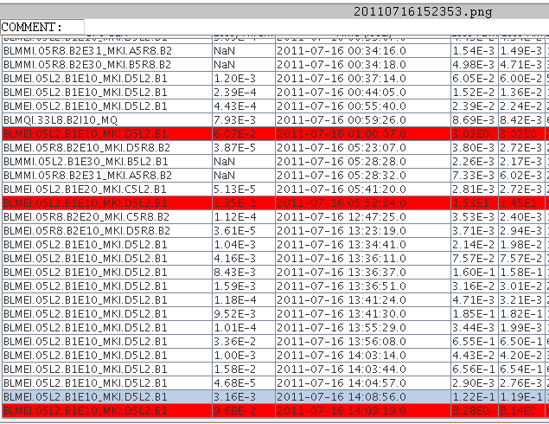
The three UFOs which dumped the beam

Slide 4
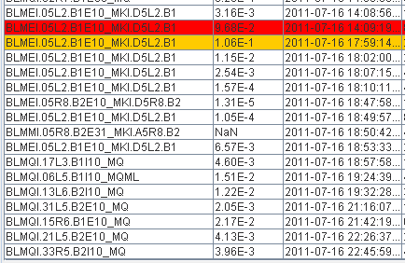
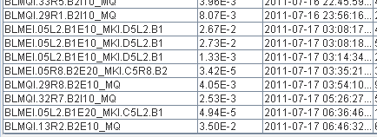
UFOs for the fill #1952 and #1953
#1952
#1953

Slide 5
UFOs on 16 July 2011
Some slides from Ruediger
R.Schmidt 16/7/2011

Slide 6
Conclusions: UFOs 16/7/2011
Three fills dumped by UFOs were analysed
In all cases the UFO came from the same area, for B1 close to the MKI in IR2
The loss patterns are nearly identical for all three events
The losses UFO for fill dumped at 0552 were very high, and even in point 5 at the TCT the threshold of BLMs was exceeded. The UFO at 0100 was much slower, and had the maximum before the dump (dump on longer running sums).
For both other UFOs an increase of the threshold by a factor of 2 might have prevented a beam dump.
In case of further UFOs dumping the beam, it is proposed to increase the threshold by a factor of 2 for the monitors indicated in YELLOW in the EXCEL table.

Slide 7
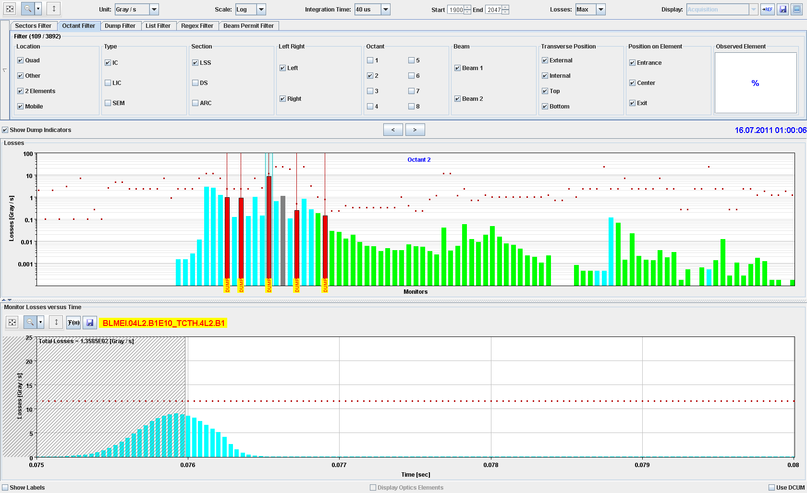

Slide 8
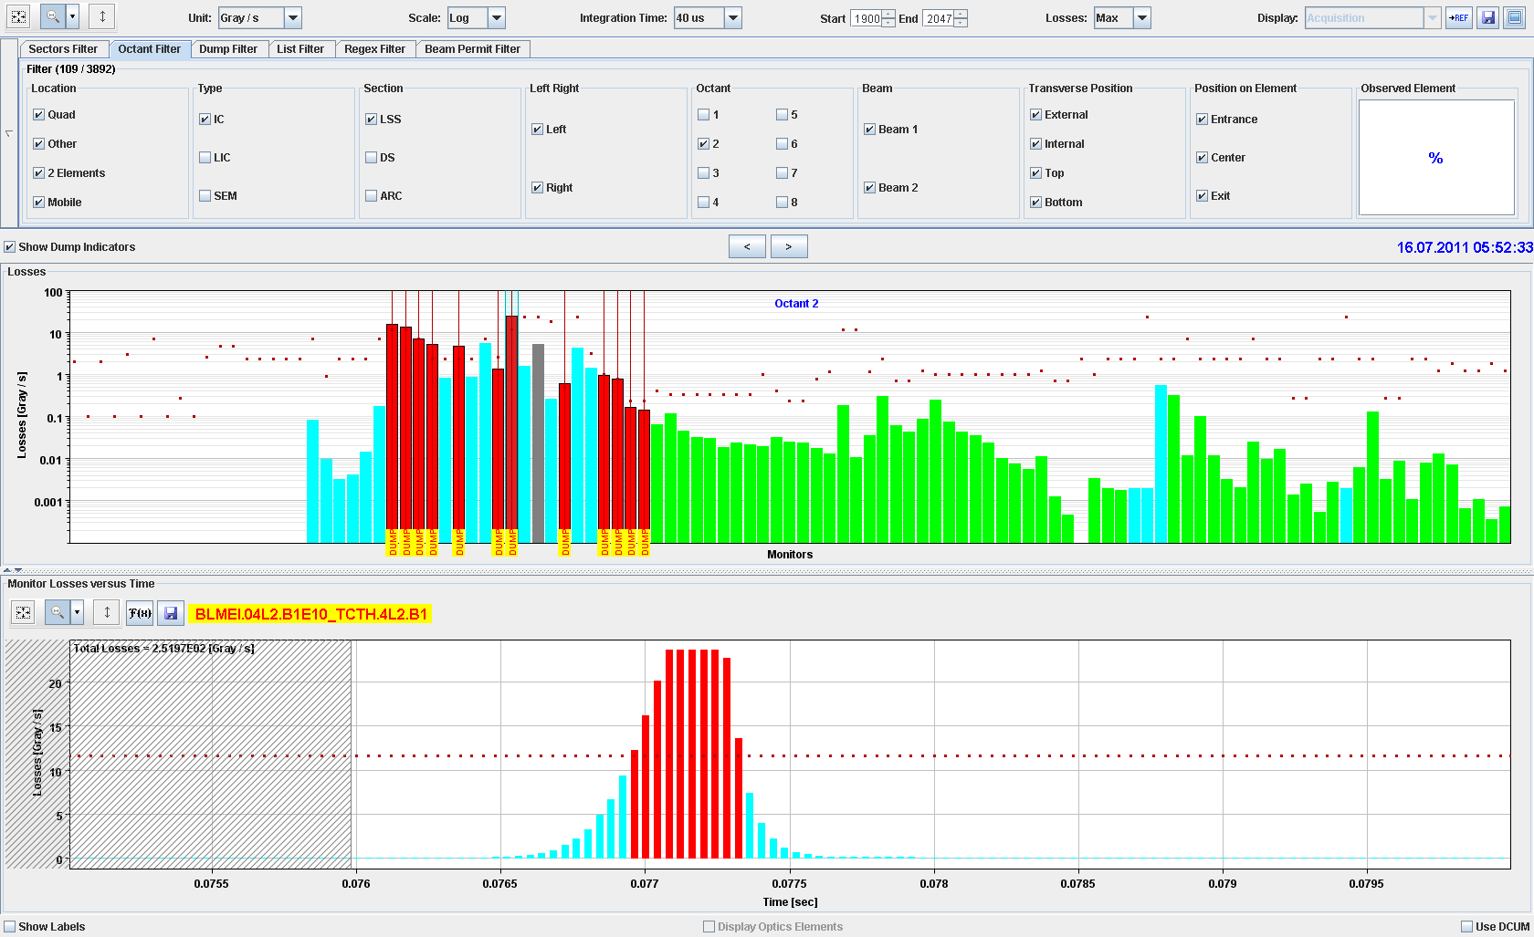
Saturated at the TCT !

Slide 9
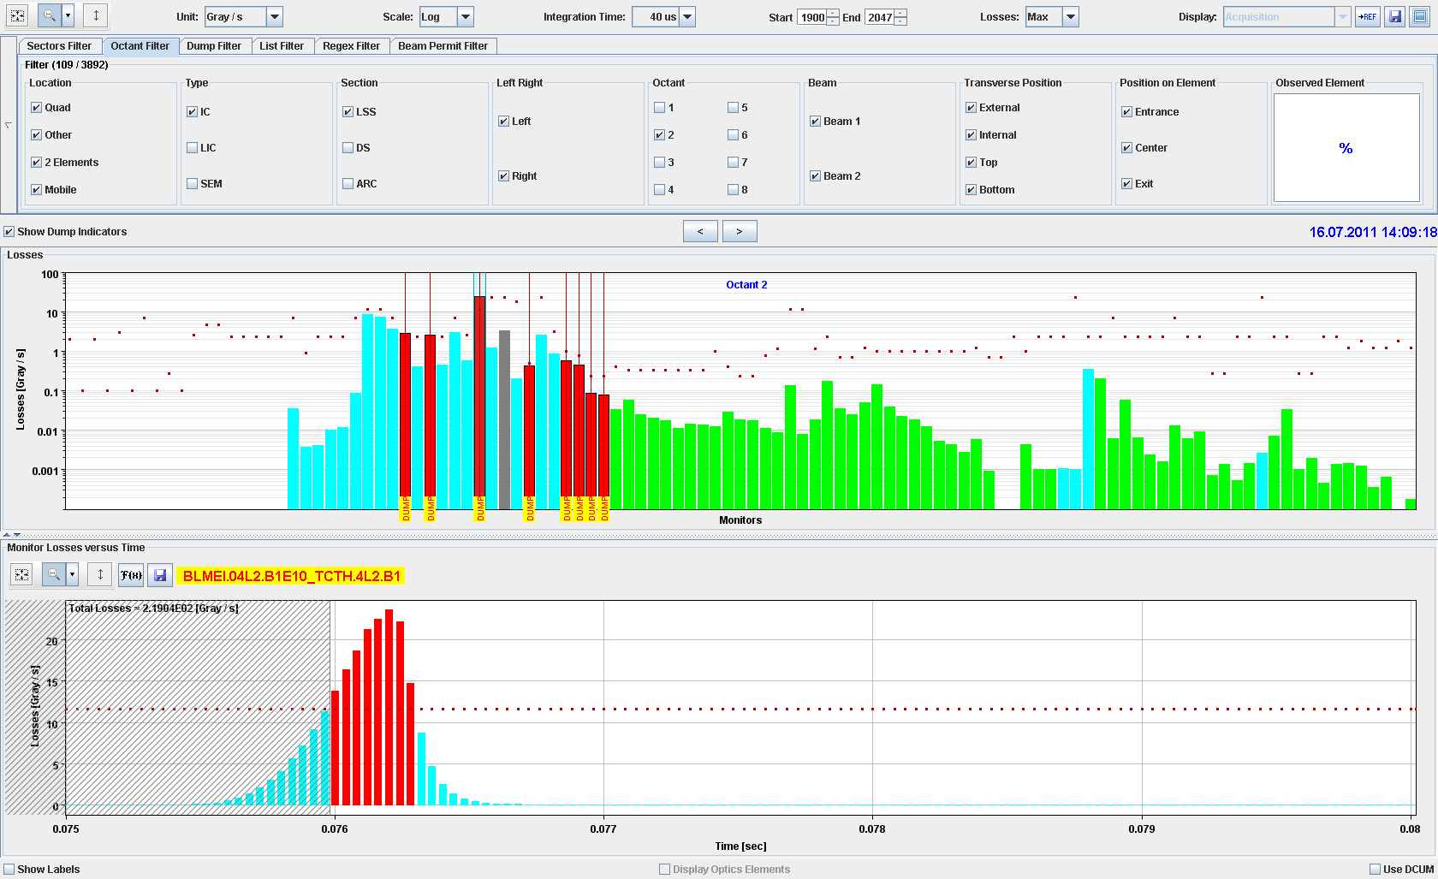

Slide 11
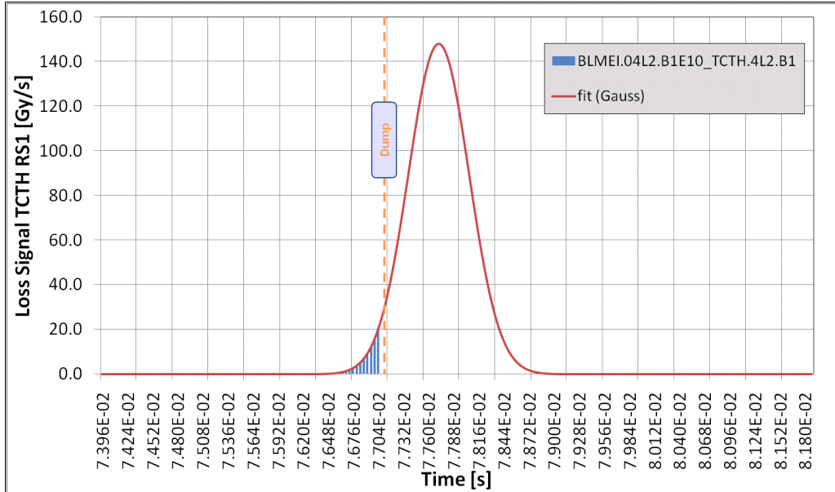
UFO record
The UFO dump today at 05:52:34 was the largest UFO ever seen.
With a saturated signal at the TCT and an extrapolated amplitude of up to 148 Gy/s at the TCT
The temporal width was 338us.
Tobias Baer

Slide 12
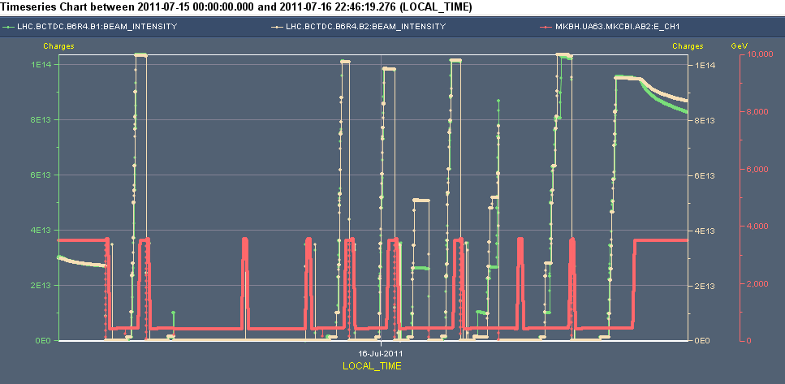
Next 840 fill was better
Emittances up to 3 um at inj., 3.7 um at collisions
Lower bunch intensities – 1.15e11
Wait one hour before ramping

Slide 13
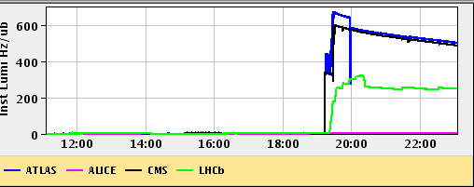
..but lower lumi
Lumi of 600e30 cm-2s-1 with 807 colliding bunches corresponds to a normalised emittance of 3.7 um!
ALICE is also optimized. They are at about 0.07 Hz/ub - while the published target is 0.3 Hz/ub.
What we optimized to is in good agreement with the luminosities we have for ATLAS/CMS, scaled by number of bunches, beta star and assuming a population for the satellites of about 0.1% (the scaling gives 0.09).

Slide 14
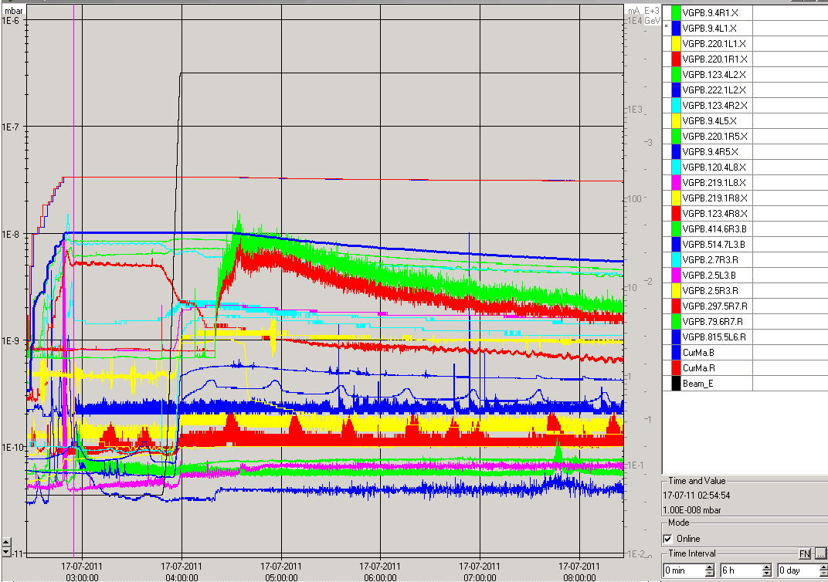
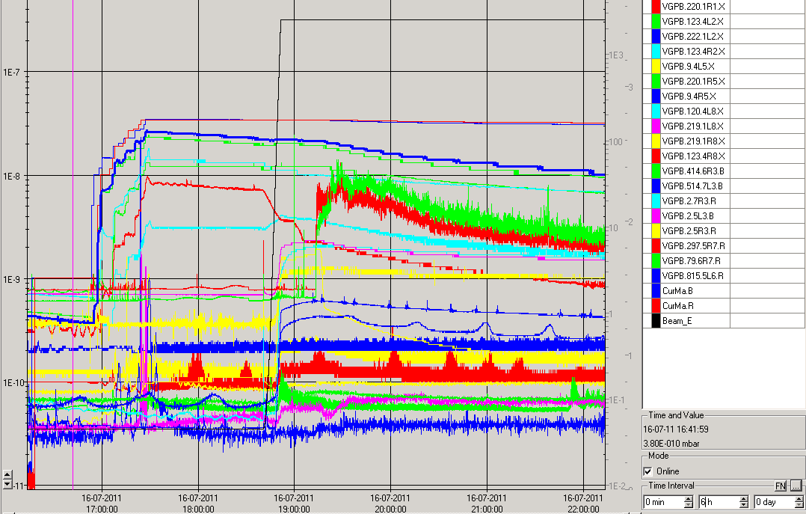
Vacuum fill #1952 #1953
#1952
#1953

Slide 15
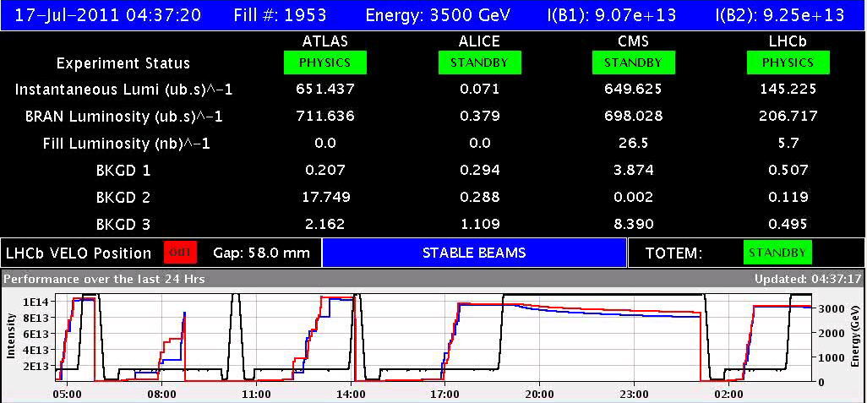
Fill # 1953
Waited one hour at injection, but not many UFOs
Normalised emittance when going into physics 3.2 urad
Compared to 3.7 urad for previous fill

Slide 16
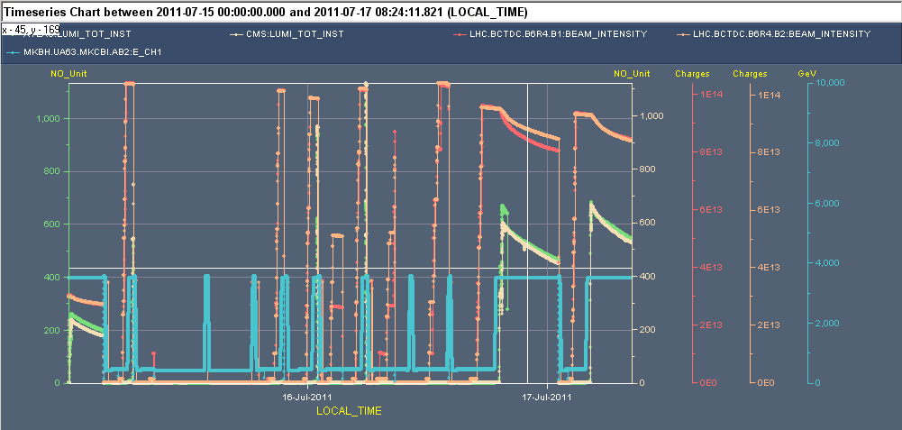
With the last fill

Slide 17
Plan
50ns_840b_807_0_816_108bpi12inj (1 fill) : keep again for 6 hours sb = until 10:30
1092b fill
Back to bunch – bunch collisions in Alice
Again 1.15e11 per bunch
Emittance slightly down (aim for 2.5 um at inj, expect 3.0 phys., expect ins. lumi of 900)
If lumi OK – keep this fill
50ns_1380b_1331_0_1320_144bpi12inj.txt (luminosity production)
Check MKI kick length

