Slide 1
Thursday 14/7
04:00 Loss maps at injection
07:00 Check injection of trains, 12 & 36 bunches
09:00 Access – 2 hours
11:45 Start pre-cycle
12:50 Injecting
13:20 ADT check
14:50 Injecting for physics
16:45 Stable beams fill #1944, 48 bunches
19:20 Dumped, RF Power interlock
22:15 Injecting again
00:30 Stable beams
03:30 Dumped, fill #1945, 264 bunches
04:30 Injecting probes, filling for fill with 840 bunches
06:34 Lost beam during adjust, Software interlock triggered on Voltage interlock of point 7 BLMs.
09:00 Access for Atlas and RF

Slide 2
Accesses
Water Point 8
Replaced two flow meters
Adjusted warning levels
Quite a few accesses in the shadow: - LHCb, - CMS, - Pt 6 cryo PLC communication to be reestablished (15'). - Pt 4 and 8 cryo valves to be opened (15'). - Pt 4 RF and CV. - ATLAS, cavern and PM15. - Pt 6 BLM (tunnel).

Slide 3
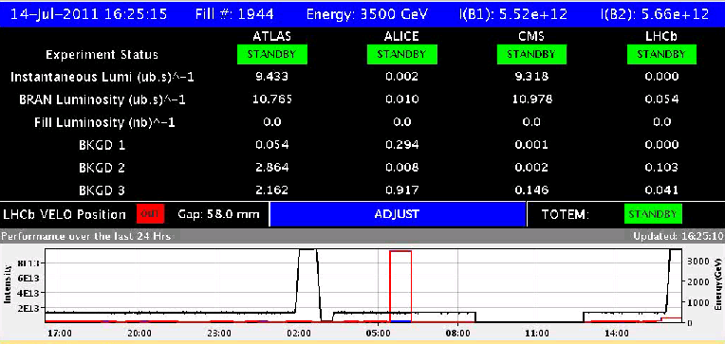
48 bunches
We had to fight a bit to find the collisions in ALICE and LHCb and ended up with an almost zero separation in ALICE and a lumi of 0.008 Hz/ub ('requested' was 0.009 Hz/ub). LHCb had as well some problems of transmission of the target lumi through DIP: to be looked at by experts.

Slide 4
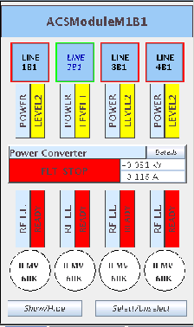
19:20 RF Power interlock
ACSLine2B1 :: Klystron filament current too low
DCCT measurement system fault or a klystron filament problem. Access required -> later
Re-configured to continue without cavity 2B1

Slide 5
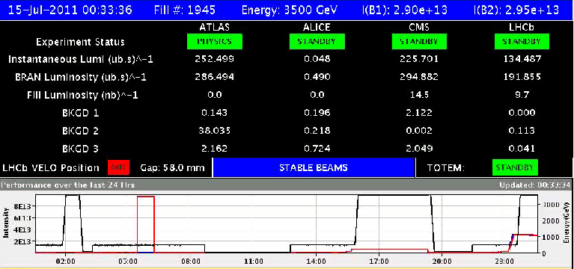
264 Bunches

Slide 6
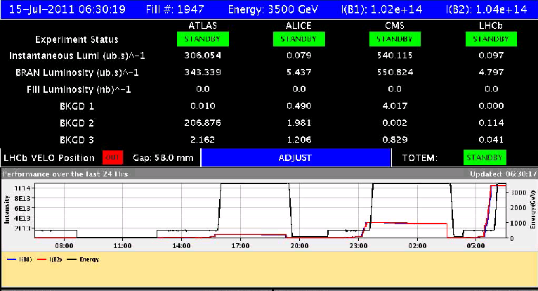
840 Bunches – lost during adjust
Increased vacuum activity with this fill. ATLAS was complaining about high background

Slide 7
Plan
Access
Atlas
RF cavity, 2B1 off for the moment
To be checked
BLMs Voltage interlock of point 7 BLMs (and other points)
Stable beams
48 bunches per beam: Done
Default is to continue with the satellite collision scheme (unless requested otherwise by ALICE):
50ns_264b_249_0_240_36bpi8inj (1 fill) : Done
50ns_840b_807_0_816_108bpi12inj (1 fill) : Again, 6 hours sb
50ns_1380b_1331_0_1320_144bpi12inj.txt (luminosity production)
Do an 1092b or 1236b fill to check vac and UFO if required
Alice OK if back to bunch – bunch collisions for one fill?

