Slide 1
Wednesday 13th
9:30 Stable Beams… with 1 pilot and 2 nominals
11:10 Loss maps at 3.5 TeV: Ralph says OK
12:45 Check relative position TCDQ – TCSG B2
14:45 Collimator position checks at injection
18:15 In parallel scraping of full beam TCDQ – TCSG
21:00 RF phasing
22:00 BLM 2.5 V problem -> replace this morning
23:00 Asynch dump injection
24:00 Asynch dump at 3.5 TeV
04:00 Loss maps at injection
07:00 Check injection of trains, 12 & 36 bunches
09:00 Access – 2 hours

Slide 2
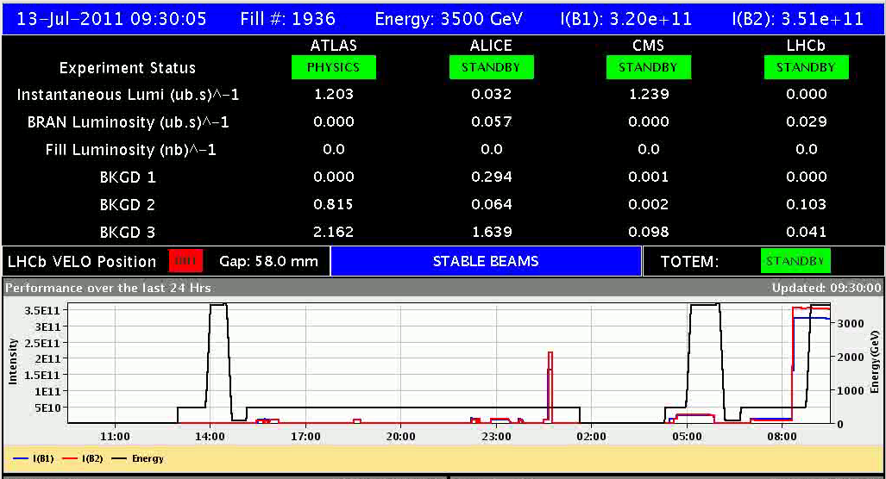
Lumi’s ok for 2 bunches

Slide 3
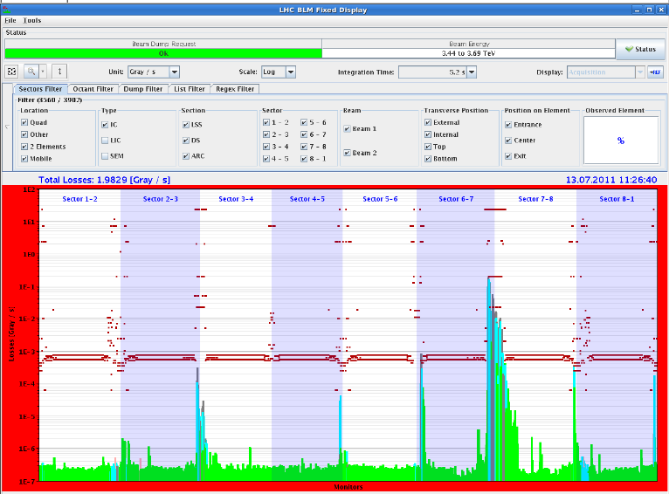
Loss maps 3.5 TeV look ok – H B1

Slide 4
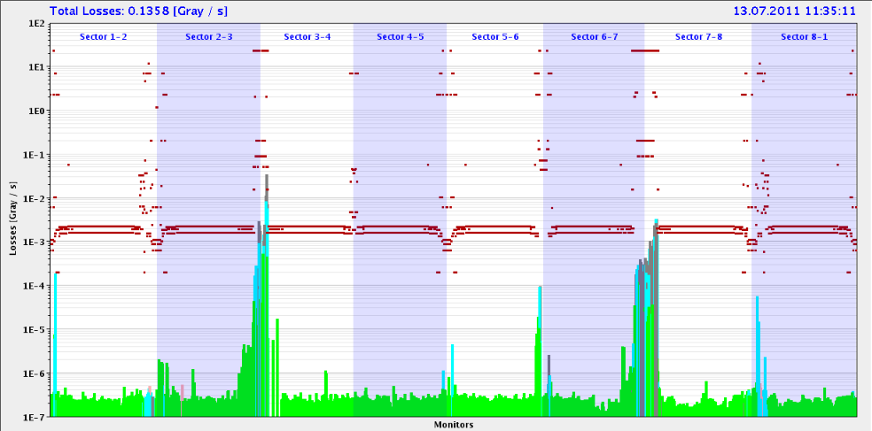
Frequency trim up

Slide 5
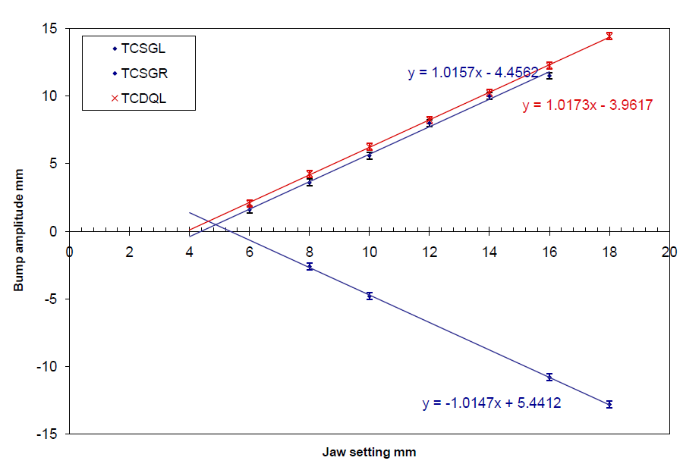
Check relative position TCDQ - TCSG
measure an average offset between TCDQ and TCSG setting of 0.6 mm +/-200um
for the same absolute setting in mm we measure with the bump height that the TCDQ is further out than the TCSG whereas in 10-March-11 the TCDQ was further IN (!) than the TCSG --> so now the TCDQ should be set further in by this offset
measurement from 10-March-11 shows an average offset of +250 um while measurement from today shows -600 um
Crosscheck of TCDQ settings with scraping full beam with TCDQ and TCSG

Slide 6
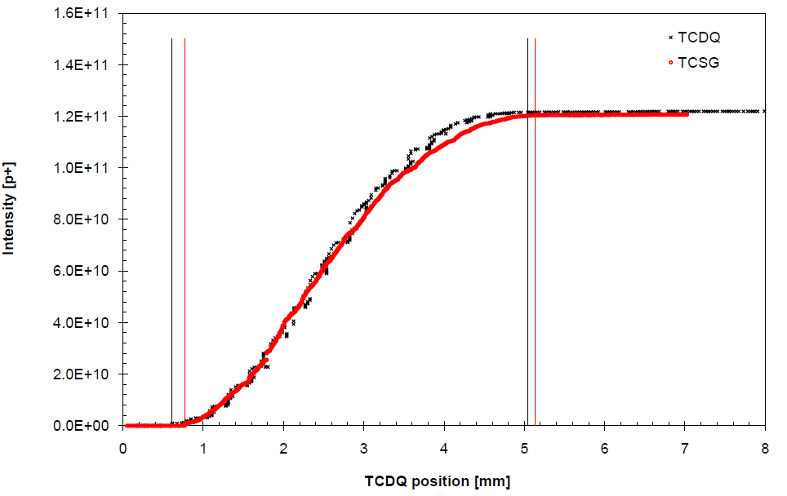
TCDQ – full beam scraping
Full beam scraping with TCSG left jaw and TCDQ
Find consistent results with measurement performed earlier today
offset corrected from 600 um to 500 um (TCDQ jaw too far out)
new TCDQ.B2 settings: 450 GeV 15.54 mm 3.5 TeV 6.29 mm
put in TCDQ jaw closer in to the beam --> safer for MP
TCSG settings remain where they are
Generate new TCDQ function
W.Bartmann, C.Bracco, B.Goddard & collimation team

Slide 7
Check of collimator position checks
Check of list of “suspect” collimators: TCSG.A4R7.B1 TCLA.D6R7.B1 TCL.5R1.B1 TCLA.7R3.B1
When compared to the centres found during the Feb/March 2011 setup, variations were recorded up to 200um. In measured beam sigma, the differences are about 0.3 throughout.
Worries about not having scraped with TCP for the measurement
Cross-checks B1: little effect found
Concluded: collimators OK
The parallel setup function was tested, which automates the recognition of the spike origin, and it worked very well
TCSG.4L3.B2 TCLA.7L3.B2 TCP.C6R7.B2 TCLA.A7L7.B2 TCTH.4R5.B2
Adriana Rossi, Gianluca Valentino

Slide 8
RF cavity phasing
The problematic cavity 2B2 is back with original settings (both tuner and polar loop). The cavity loop was actually unstable with the new setting (60 deg/6dB problem after the Sunday's power cut). We still need to check the Icfwd signal path in UX45 (there is an access tomorrow morning).
Apart of that the cavity phasing was good for Beam 2 (+/-1 degree). We needed to adjust C3B1 by 9.5 degrees and C4B1 by -4.5 degrees. Now all Beam 1 cavities are in phase within 0.25 degree. Daniel Valuch, John Molendijk

Slide 9
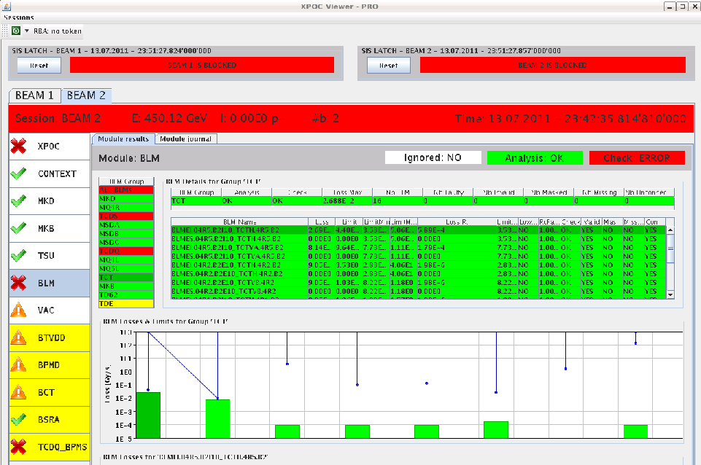
Check of new TCDQ functions
Asynch dump at injection
Ratios: Losses TCT-TCDQ beam 1: max 4.71e-6 Losses TCT-TCDQ beam 2: max 5.89e-4 (at the triplet in point 5, others around 1e-6)
Loss ratio should be max some 1e-3.
Asynch dump at collision, 3.5 TeV
Ratio TCT-TCDQ beam1 2.4e-4 beam2 5.7e-4 Should be in the order of some 1e-4: OK

Slide 10
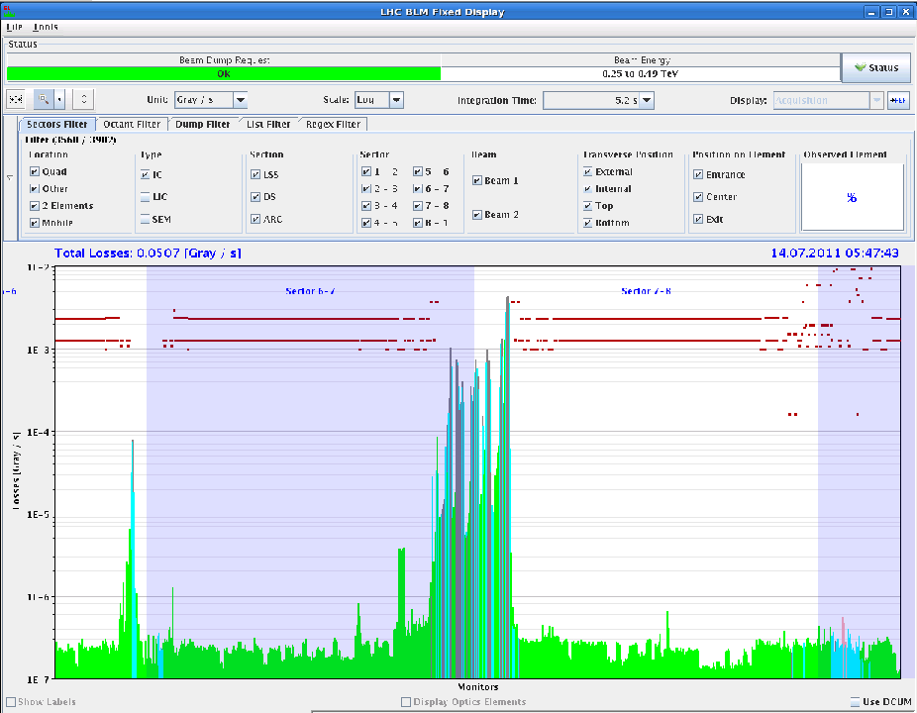
Loss maps at injection
With and without injection protection, all transverse and all off momentum.
They still need analysing by the experts.
Nothing obviously wrong

Slide 11
Plan
09:00 Access for 2 hours,
Driven by water cooled cables point 8
Go for stable beams and ramp up number of bunches
48 bunches per beam
New fill pattern for satellite on main collisions in ALICE: pilot NOT over-injected, 250ns SPS gaps
MKI pulse length might need increasing
Keep in stable beams for 3 hours
Default is to continue with the satellite collision scheme (unless requested otherwise by ALICE):
50ns_264b_249_0_240_36bpi8inj (1 fill)
50ns_840b_807_0_816_108bpi12inj (1 fill)
50ns_1380b_1331_0_1320_144bpi12inj.txt (luminosity production)

