Slide 1
Monday 11/07: Recovery
Plenty of accesses.
Due to the recovery of the communication of the access PLCs at point 3, the veto was applied to the whole ring. The problem was fixed only at midday.
12:00 Patrols and RP surveys start.
List of interventions carried out: - cryogenics accessed in several points for inspections and fault acknowledge; - vacuum accessed as well in several points to restart the turbo pumps that stopped with the power cut; - QPS fixed problems at point 1 and 5; - RF accessed point 4 - EPC did several checks and intervene in a couple of points; - CV check the water faults in RR13 and they are going to check as well point 8 and point 6 - Check of TCDQ alignment - Reload of MKD settings table - BI and BLMs

Slide 2
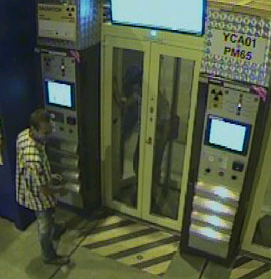
Access system requiring a lot of attention
10:00 The access system went into safe mode and has put a veto everywhere. No access possible anywhere. The siren set off and people left the machine.
…..the PLC's lost their configuration data and lost communication. The PLC's had to be configured again.
Many patrols, all over the machine.
16:45 Person blocked in PAD PM65 (out by now)

Slide 3
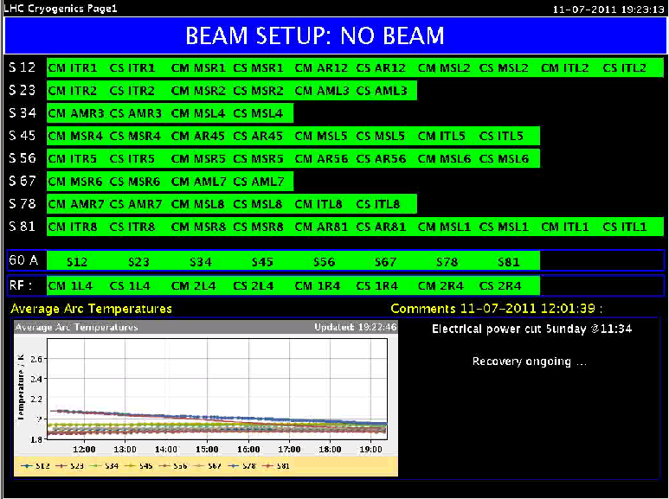
Cryo back… but not finished yet.
19:22
20:55 Everybody out of the machine.
21:10 Called piquet to have a look at main circuits S23 and S56. Cannot establish QPS OK for these
21:15 BLM expert had to go back into the tunnel, point 8.
22:00 All vacuum valves out
22:30 MKI Soft Starting but tripping – M.Barnes, E.Carlier coming in

Slide 4
22:00 BLMs releasing beam permit loop
Hard work from Christos, Ewald and Stephen

Slide 5
Night
QPS problems on the quench loops of the mains in S23 and S56 prevent powering in these sectors.
Important interventions to identify the location where the loops are broken: to be done during the day
MKI problem on B2 was solved by changing a power supply.
This was done with an access that lasted until 3h00
Pre-cycle of the available circuits and a dry machine cycle
trip of the RSF circuits in 81 and of a warm correctors
The work of the collimator piquet continued until ~2h00 before the system could be released for OP
Dry-run except for the TCT collimators in the sectors that are off, for which the betastar information is not distributed correctly.
Faulty TCP.D6L7.B1 collimator that gives spurious interlocks was found

Slide 6
Plan for today - Recovery
Sort out problems on the quench loops of the mains in S23 and S56, identify the location where the loops are broken
Sort out remaining collimation problems
Minor issues in the shadow
Machine through full cycle without beam
Machine through full cycle with pilots

Slide 7
Plan after recovery
Verification tests:
TCDQ and TCSG relative position --> re-measurement required.
Beam presence flag intensity limit
Beam Dump (inject and dump mode)
Asynchronous dump 450 GeV B2 (pilot or 1-2 nominal bunches)
Pilot + 2 nominal bunches (ATLAS needs the pilot on pilot collisions --> no overinjection)
loss maps at injection
1 hour in stable beams
loss maps at 3.5 TeV
48 bunches per beam
new fill pattern for satellite on main collisions in ALICE: pilot over-injected, 250ns SPS gaps
MKI pulse length might need increasing
keep in stable beams for 3-4 hours (check with experiments)

Slide 8
Ramp up number of bunches
Default is to continue with the satellite collision scheme (unless requested otherwise by ALICE):
50ns_264b_249_0_240_36bpi8inj (1 fill)
50ns_840b_807_0_816_108bpi12inj (1 fill)
50ns_1380b_1331_0_1320_144bpi12inj.txt (luminosity production)

