Slide 1
Saturday 9.7.2011
Coordinators weekend: Mike Lamont, Eva Barbara Holzer
7:00 – 9:13 Access Point 8 for QPS RQD A78
7:24 MKB (dilution kickers) in fault B1 & B2 → reset by piquet
SIS positioning wire on IR8 triplet out of tolerance (why?) → changed WPS limits
8:05 cryo is back
MCS check on MKD settings failed, called piquet → hardware setting off (not by much) → changed LSA values to be able to continue; need access to change hardware setting.

Slide 2
Saturday cont.
12:22 MKI B1 tripped during soft-start (MKISS)
Access to replace a switch, but in the end not needed for MKI. It was reconditioned by several soft-starts at 14:22 (M. Barnes: probably insufficient conditioning of a new switch)
A modified soft-start procedure would have been desirable (more gradual change), but not possible due to absence of experts (RBAC role holders)
Access used by Alice and CMS
16:10 Access finished
16:52 update of LBDS energy tracking tables
Notes:
Shift summary: *) Cryo conditions were recovered at 8:05am. *) In the meantime we were in access in S78 for an energy extraction problem on RQD/F S78. The remaining HWC tests on the 60 A circuits in 78 could only be done after the intervention due to the global protection mechanism. Access was finished at about 9:10. Otherwise: *)Survey wires at triplet R8 were out of tolerance. Updated the interlock threshold. Did not investigate whether they triplet had been really moved. *) The hardware settings for two MKD generators of beam 2 are not correct. Can run like this for the time being. Needs to be modified at some point however. Access of 2-3h. *) The switch change at the MKI B1 caused the kickers to trip during the softstart. After a couple of trials it was decided with the piquet to access and change the new switch again. Access was prepared. It turned out however later on that the switch probably just needed more conditioning via more softstarts or an extended softstart. It seems to be OK now. *) CMS and ALICE profited from the access. *) Precycle started.

Slide 3
Evening
17:30 pilot injection:
Optimization at 450 GeV (orbit, tune, chromaticity, RF phasing)
Instrumentation: BPM calibration (phasing-in); Set-up of BSRT and abort gap (injection energy) F. Roncarolo
Temporary injection line steering (SPS orbit to be corrected)
19:40 Trip of RQ10.L1B2
Dry ramp for testing before access → which verified that the new LBDS energy tracking tables are OK
access afterwards: 22:21 water flow increased RQ10, reset OK
Water flow generally too low for quadrupoles?
MKI thresholds for IQC updated (first iteration) Etienne Carlier
21:36 RQ6.L8B1 and RQ6.L8B2 (same fault as the RQ10: “EXTERNAL DC CABLE WATER FLOW”) → reset ok
22:42 UJ14 patrol lost: problem with access doors

Slide 4
Night
1:00 machine closed
1:37 pilot injection
Optimizatrion of orbit, tune chromaticity, RF phasing
Ramp
2:24 Beams dumped at top energy, RQ4.R6B2 tripped: again the “external DC cable water flow”
Injection test for MKI - IQC limits (inject and dump 10 times)
Ramp – squeeze
Problem with IR steering to find collisions in Alice
→ in the end used LUCID_EVENTOP_False detector as it is the most sensitive for ATLAS
Used BSC_MBALL_false for CMS
Alice and LHCb could not be optimized for collisions
Operator dump and reinjection for 450 GeV studdies

Slide 5
To be checked
Actual trim program and lumi scan application not working → already fixed this morning by Pablo Pera Mira
Injection oscillations and SPS orbit
Water flow for quadrupoles
Loading of the ADT settings
BPM crate: cfv-sr1-bpmb2la

Slide 6
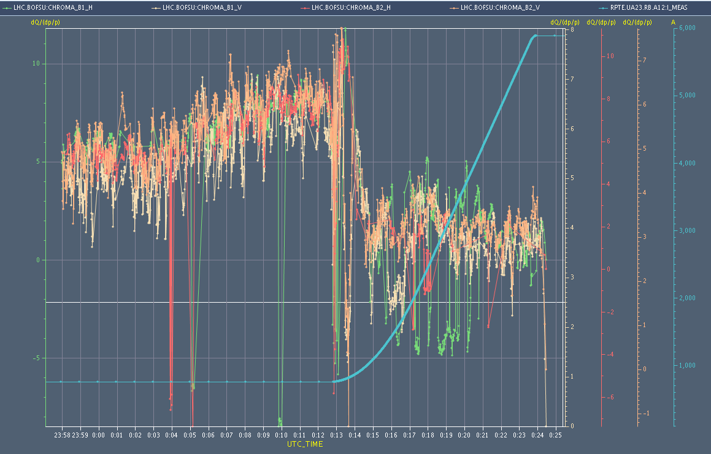
Chromaticity during injection and first ramp

Slide 7
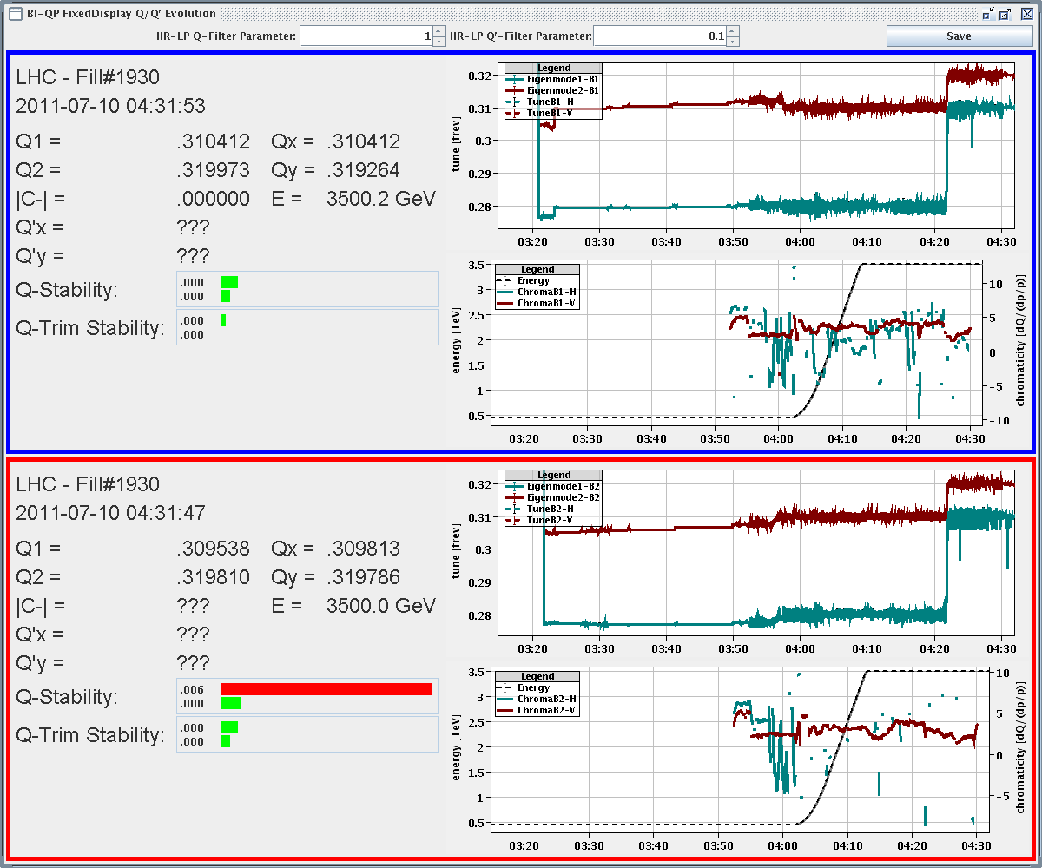
Tune and Chromaticity during second ramp

Slide 8
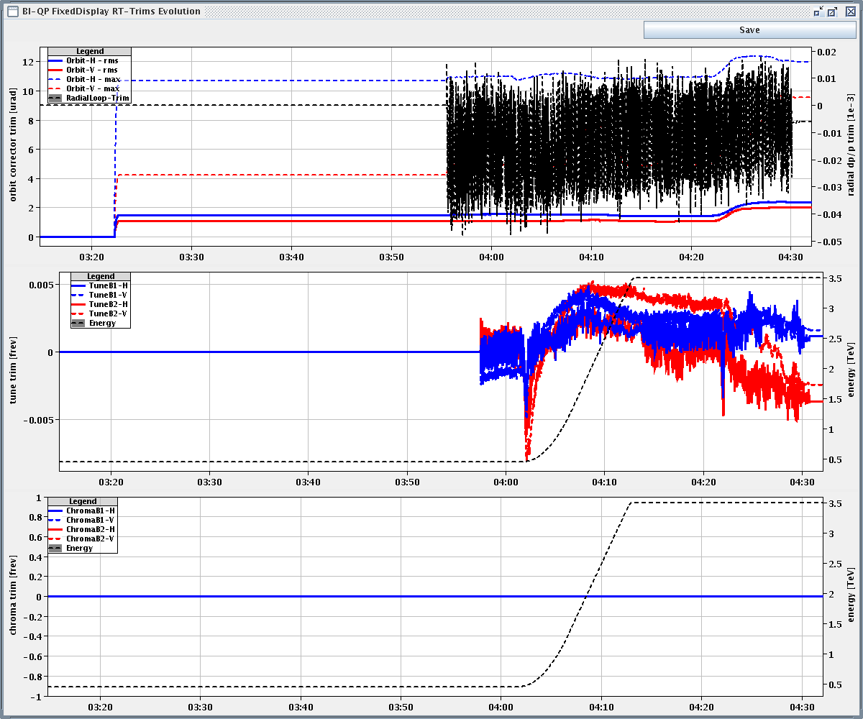
Second ramp: tune and orbit feedback trims

Slide 9
Collision orbit wrt reference

Slide 10
Planning
Ramp 2 pilots (collapse separation bump to zero in Alice and check if interlocks are too tight)
Verification tests:
TCDQ and TCSG relative position
Beam presence flag intensity limit
Beam Dump (inject and dump mode)
Asynchronous dump 450 GeV B2 (pilot or 1-2 nominal bunches)
Pilot + 2 nominal bunches
1 hour in stable beams (ideally)
Followed by loss maps at 3.5 TeV: H, V and longitudinal -500 Hz
loss maps at injection
48 bunches per beam; new fill pattern for “satellite collisions in ALICE” (MKI pulse length might need increasing); keep in stable beams for 3-4 hours
OR
OR

