Slide 1
MD#2 Summary (R. Assmann, F. Zimmermann, G. Papotti)
Very satisfied with second MD:
Some ground-breaking results → path to very high LHC luminosity.
Good balance: MD’s pushing the boundary and detailed studies.
Almost all MD teams had the opportunity to obtain good results.
Good availability, though not as good as first MD.
We managed to hold reasonably to schedule, thanks to the excellent preparation and discipline of many colleagues involved.
Some issues:
TED issues, BETS problems, PC for LHC damper + minor issues…
Had to accommodate two stops for access → some minor rescheduling. Thanks to the colleagues who took the hit in time!
Some MD’s lost 20-60% of time…
Thanks to the many colleagues who made the successful second MD possible!
Thanks to the injectors that provided the planned beam!

Slide 2
MD Time Statistics (not counting loss of beam, ramps, squeeze, …)
MD (in order of execution) | Time scheduled | Time used | Balance
ATS I | 02 h | 02h46 | + 0h46
Injection 25 ns | 06 h | 05h40 | - 0h20
RF setup high bunch int. | 06 h | 05h07 | - 0h53
Beam instr. (stopped late), followed by access | 08 h | 09h00 | + 1h00
Head-on beam-beam limit | 08 h | 03h17 | - 4h43
Inj. nom. emittances, UFO’s | 09 h | 09h50 | + 0h50
RF longitudinal stability, followed by access | 13 h | 10h21 | - 2h39
Long-range beam-beam limit | 08 h | 05h17 | - 2h43
Non-linear dynamics (started early, stopped late, 1b only) | 08 h | 10h31 | + 2h31
Collimation | 08 h | 04h28 | -3h32
ATS II (started early, stopped late) | 08 h | 10h51 | + 2h51
Beam distribution | 04 h | 01h45 | -2h15
Quench margin at injection | 08 h | 08h15 | +0h15
R2E | 08 h | 05h38 | -2h22

Slide 3
Efficiency and Scheduling
Available MD hours: 120.0 h
Scheduled for MD: 104.0 h (87% of total time)
Availability for MD: 92.7 h (89% of scheduled time) (77% of total time)
→ Scheduling worked: Explicit scheduling of recovery time which was indeed always needed.
Biggest loss: 4h43 (60% of scheduled time of MD)
Biggest addition: 3h37 (34% of scheduled time of MD)
As somebody put it: “The good, the bad and the ugly”…
Overall, excellent availability. We could get data for all MD’s, even though for some in very limited time!
Thanks to the HW groups: Cryo, vacuum, PC, magnets, QPS, collimators, BI, kickers, infrastructure, …

Slide 4
The Achievements MD#2
First injection of 25 ns bunch trains with up to 216 bunches.
Collision of bunches with twice nominal intensity and half emittance, demonstrating 8 times nominal bunch luminosity.
Injection and storage of even higher bunch intensities with nominal emittance.
Collision of 50 ns bunch trains with 4-5 sigma separation, demonstrating margin in long-range beam-beam effects.
First squeeze to below 1.5 m, demonstrating β* = 0.3 m with pilot beam, flat machine, no collisions and ATS optics.
Many, many detailed studies that allow to achieve the above and will make it usable (RF, injection, collimation, quench margins, R2E, optics, …). The devil is in the details!

Slide 5
Achievements MD#2 in numbers
High bunch intensity in LHC: N_{p} = 2.7×10¹¹ p/bunch excellent beam lifetime γε ≈ 3.3 μm
Colliding beam @ 450 GeV: N_{p} = 2.3×10¹¹ p/bunch twice nominal intensity, half nominal γε ≈ 1.7 μm emittance, head-on & parallel separation OK
Long-range beam-beam for 50ns: α_{c}/2 = 48 μrad for τ ≈ 15 h crossing angle can be more than halved
Short bunch spacing → 25ns: N_{bunch} = 216 24b trains, vacuum ~OK, heat load ~OK, N_{p} = 1.2×10¹¹ p/bunch instabilities, better than 50ns at same stage γε ≈ 2.7 μm first batches
Injection: γε ≈ 3.5 μm OK for injection
Tune working point: Q_{x}/Q_{y} = 0.47/0.47 more space in tune diagram for BB footprint
ATS optics: β* = 0.3 m

Slide 6
MD#2: What could it mean?
50 ns operation with double bunch intensity, half emittance:
OK for head-on beam-beam, OK for long-range beam-beam.
Can we get 50 ns bunch trains with these parameters (→ single bunch MD). OK for machine protection? OK for pile up?
Luminosity reach is factor ~ 5–7 beyond present at 3.5 TeV.
Luminosity reach is factor 4 beyond nominal at 7 TeV.
25 ns operation with 10% higher bunch charge, 25% lower emittance:
Can gain factor 2 in number of bunches. Some scrubbing required?
Can gain factor ~1.4 in brightness beyond nominal.
Luminosity reach is factor ~2 beyond present at 3.5 TeV.
Luminosity reach is factor ~1.4 beyond nominal at 7 TeV.
Low β* operation:
Can gain factor ~1.5 (previous MD). Details being worked out.
Could gain more by reducing crossing angle (then limits bunch charge?).
ATS demonstrates path to very low β*, keeping perturbations under control.
Multiple paths to performance improvements are possible. Mini-Chamonix on July 15th: Discuss detailed limits and optimal strategy…

Slide 7
Highlight slides from MD’s…

Slide 8
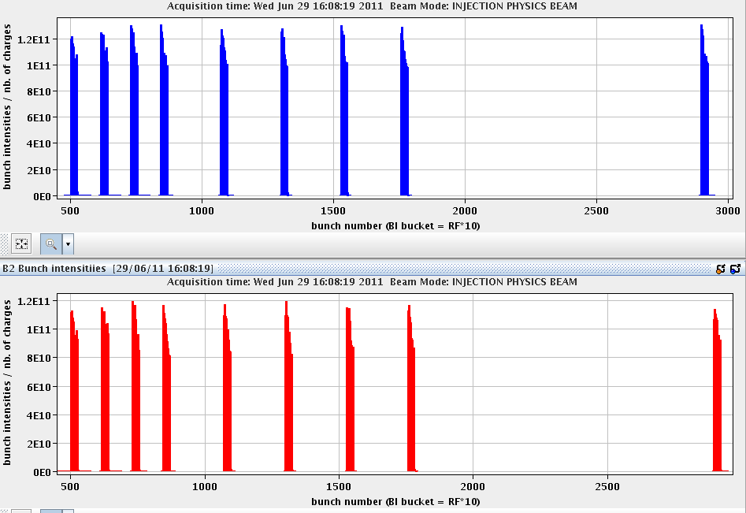
First 25 ns Injection Test (B. Goddard et al)

Slide 9
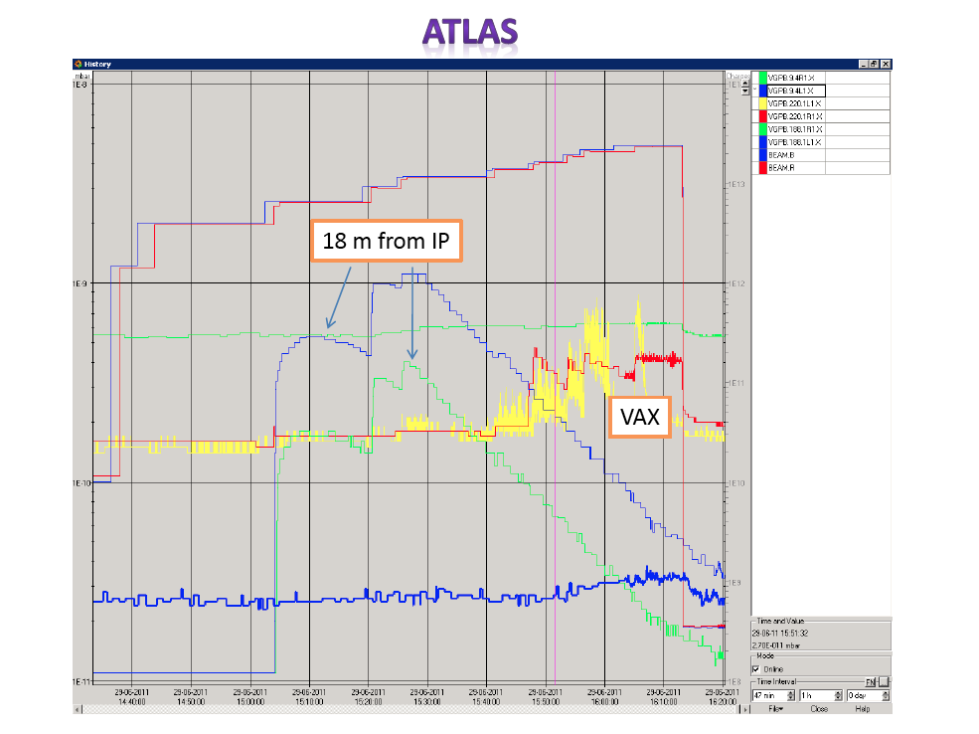
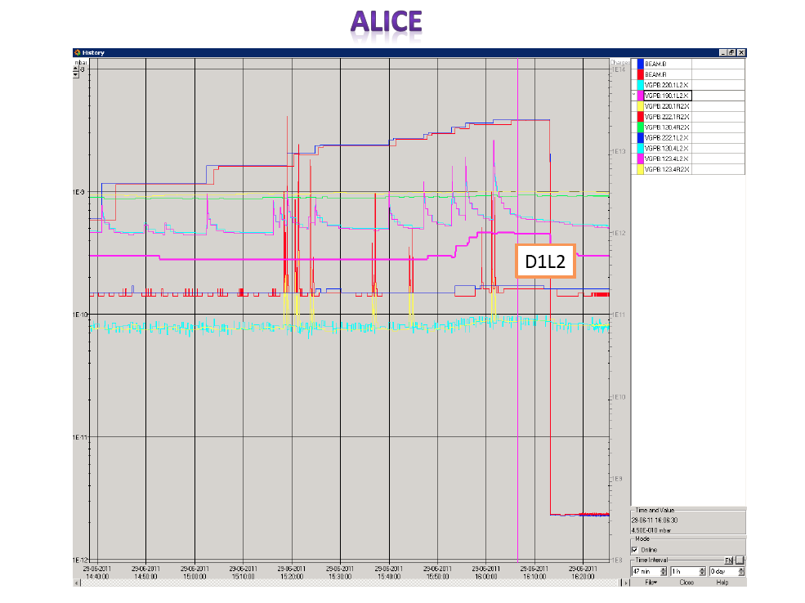
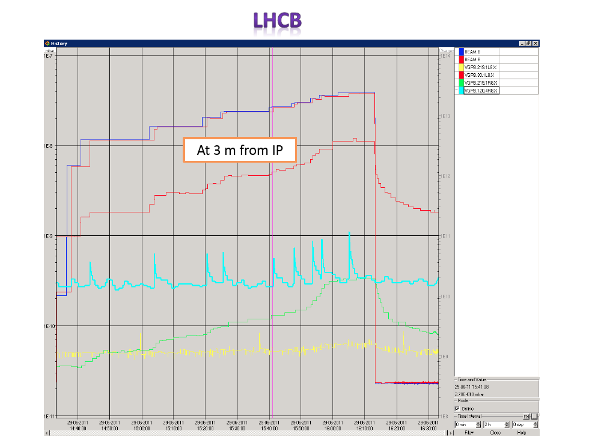
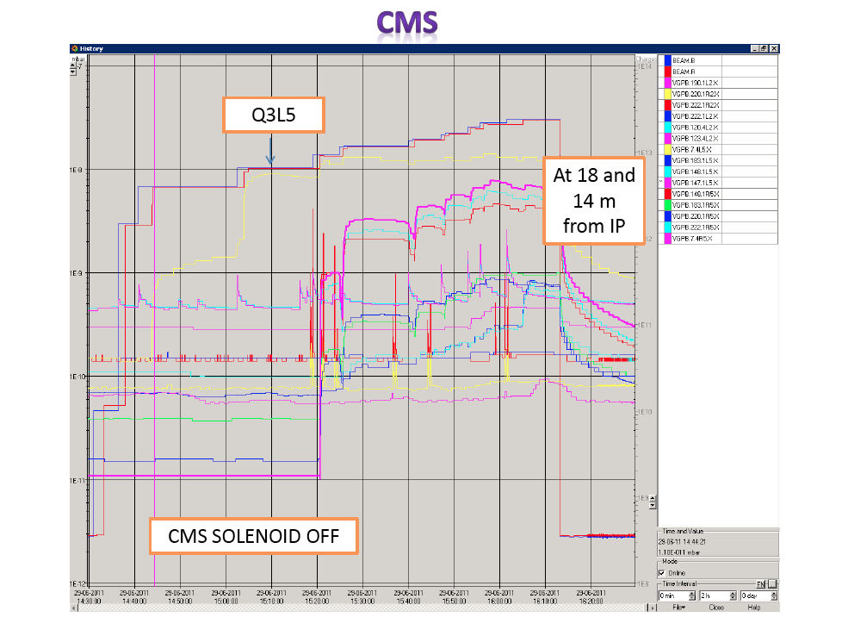
IR vacuum not too bad!
All e-cloud solenoids off!
G. Lanza,
G. Bregliozzi

Slide 10
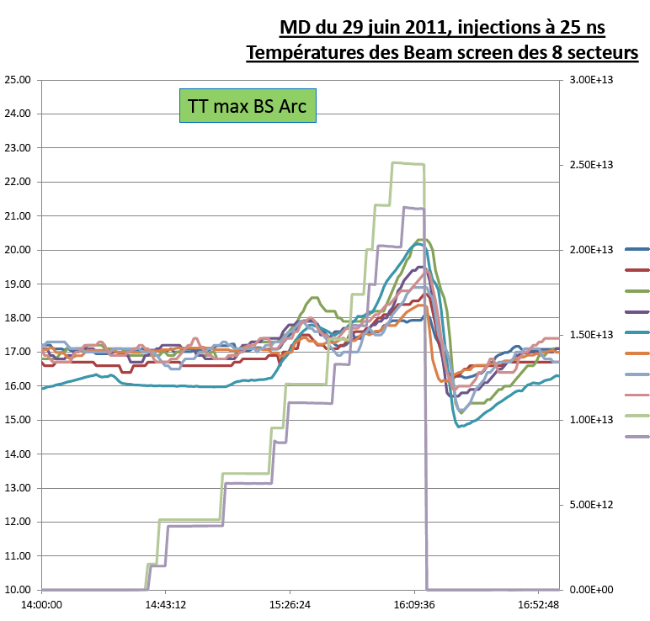
Injection 25ns – Heat Load
Beam screen temperatures (S. Claudet):
"From operations point of view nothing dramatic has been observed.
T_{max} arcs only at about 20K, so nothing serious
For triplets very smooth tempe- rature bump, maxi L1 probably due to ATLAS field down.”

Slide 11
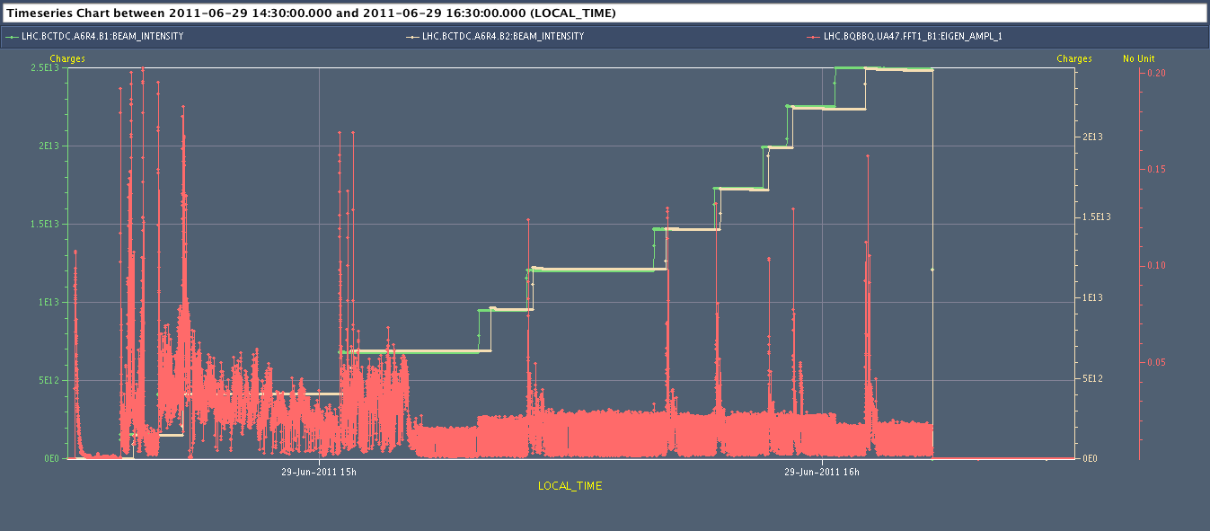
25 ns – Emittance Blowup
Fine…
Later batches with blow-up of trailing bunches!
Origin not clear: damper switched on after 2-3 batches.
Follow-up for scrubbing need…

Slide 12
Setup High Bunch Charge RF/BI/OP/Injector Teams
Excellent beam lifetimes: no losses at colli-mators
2.45e11 p / bunch
2.6e11 p / bunch

Slide 13
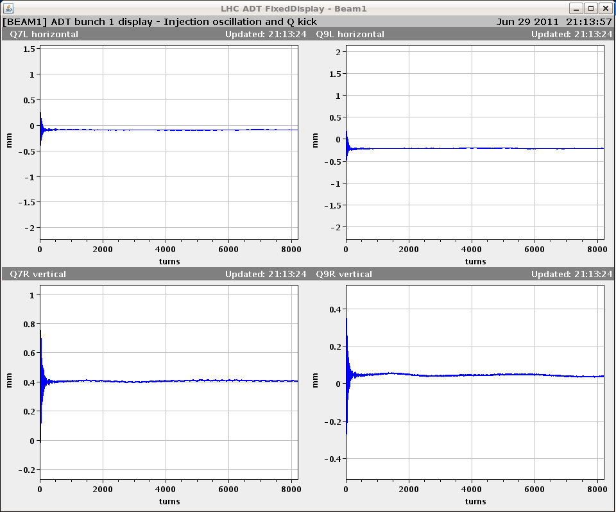
Setup High Bunch Charge RF/BI/OP/Injector Teams
Emittance in the LHC for 2.6e11 p/bunch:
B1H: 3.3, 3.5 μm
B1V: 3.1, 3.2 μm
B2H: 3.7 μm
B2V: 3.9 μm
Injection oscillations:
Damper fine…

Slide 14
Head-on beam-beam limit (Werner Herr et al)
Twice nominal bunch intensity, half nominal emittance! Tune-shift and luminosity as expected (~ 0.015/IP).
Fill 1:
B1 B2
Intensity per bunch 2.3e11 p 2.2e11 p
Emittance H: 1.6 um 1.7 um
Emittance V: 1.6 um 1.9 um
Fill 2:
B1 B2
Intensity per bunch 2.2e11 p 2.3e11 p
Emittance H: 1.9 um 1.9 um
Emittance V: 1.7 um 2.1 um
Highest bunch intensities as achieved the day before in LHC (2.7e11) still to be tested
Will have somewhat higher emittance

Slide 15
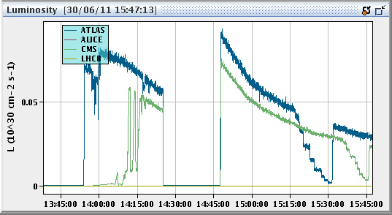
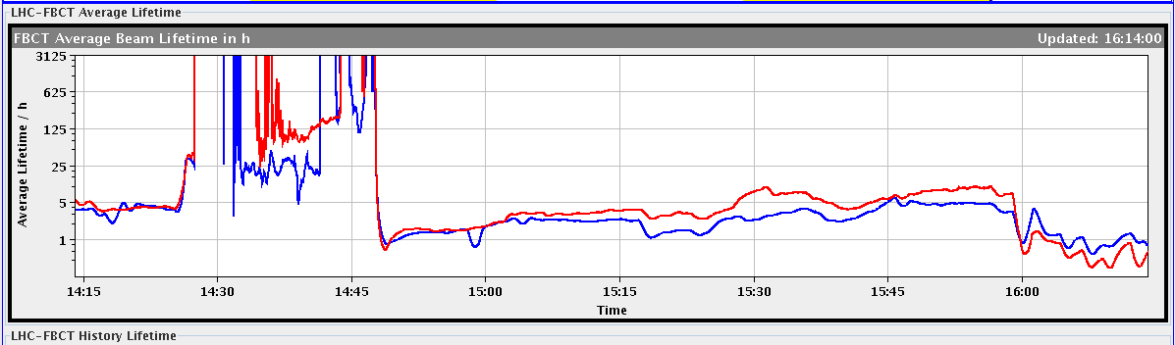
Luminosity and Lifetime
Start collision, fill #2
Luminosity
Separation scans
Twice nominal bunch intensity, half nominal emittance!
No effect on beam lifetime
Start collision, fill #2
Tune scan
Lifetime

Slide 16
Beam Instrumentation F. Roncarollo et al, BI Team
RF OFF: Debunching of beam – seen with FBCT

Slide 17
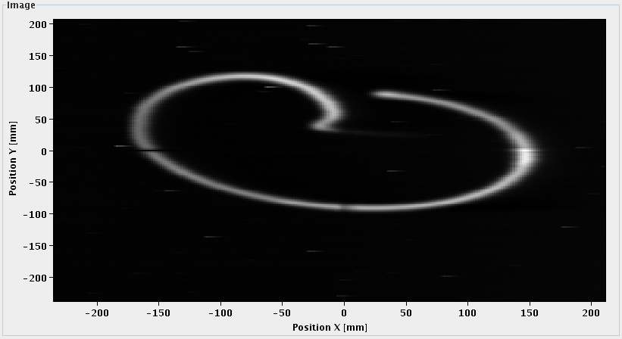
Beam Instrumentation F. Roncarollo et al, BI Team

Slide 18
BI: Comparison Fast BCT and DC BCT
Disagreement below 1%...

Slide 19
Injecting nominal emittances V. Kain et al
Longitudinal OK:
no significant degradation of injection quality (12 or 36 bunch injections).
Transverse checks OK:
Inj. emittances of ~ 3.5 um with comparable losses to 2.5 um on TCDIs and nom. scraping (int. loss in SPS due to scraping 10 %).
Injected emittances up to 7.5 um and varying scraping with expected unacceptable losses for physics filling.
The TCDIs were kept at nominal settings throughout the test.
MKI & UFO’s J. Uythoven et al
Data taken for selective pulsing of injection kickers.
Some initial correlation with UFO’s that later disappeared.
To be followed…

Slide 20
RF MD Results (Philippe, Elena et al)
Goal: compare thresholds for single and multi-bunch stability.
Only time to do single bunch studies:
Single bunches injected to LHC with nominal (0.5 eVs) and smaller longitudinal emittances extracted from the SPS (down to 0.35 eVs).
Intensities were about 1.2-1.4e11 ppb, SPS transverse scraping was disabled for the second part of the MD.
Injection phase errors were damped for nominal emittances, but remained undamped for smaller emittances (even slightly growing).
The capture voltage changed to 8 MV and 3.5 MV (operational: 6 MV), for different fills (3.5 MV is matched to SPS extraction voltage).
The bunches injected in the 3.5 MV were observed to have a longer damping time of the dipole oscillations.
One ramp was performed with 8 bunches per ring: observed different energy onset of instabilities for bunches with slightly different long. emittances. Data acquired and will be analysed in detail.

Slide 21
Long-range beam-beam (W. Herr, BB team, coll team)
One ramp with 12+36 bunches per beam to 3.5 TeV, beta*1.5m in IP 1/5.
Reduced crossing angle in steps from 120 μrad to 36 μrad and recorded losses.
Tertiary collimators following the changed orbit.
First losses observed at separation of 4-5 sigma, reduced lifetime.
Strong correlation of losses with number of long range interactions (PACMAN effects).
Detailed analysis will be done.

Slide 22
Reduction crossing angle IR1 (V) and IR5 (H)
12+36 b per beam
3.5 TeV
beta*1.5m in IR1/5
Reduce IR1 angle
Reduce IR5 angle
40%
35%
50%
40%
35%
30%
40%
30%
50 h
2 h
Crossing angles in IR1 and IR5 reduced in steps of 5 – 10 %.
TCT’s following changed orbit.
100% = 120 μrad = 12 σ beam-beam separation for ε~2.5μm!
50% fine (no reduction in lifetime), 40% (5 σ b-b) still OK, 30% too low!

Slide 23
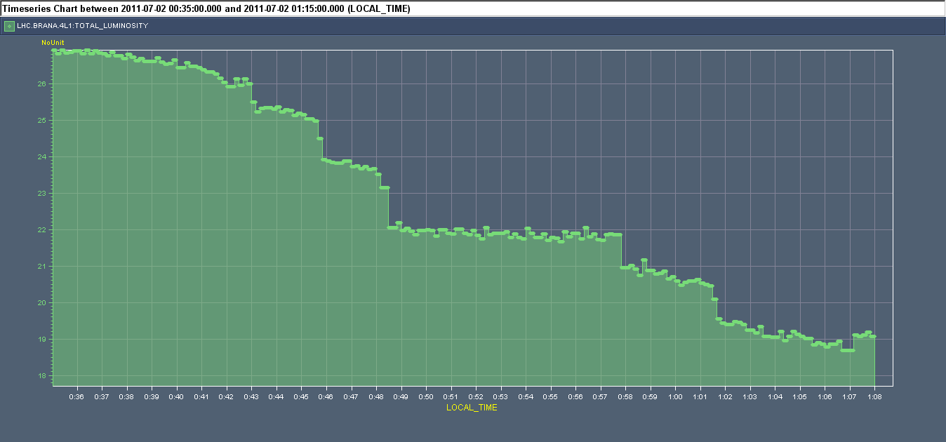
IR1 Luminosity During IR5 Adjustments
IR1 cross. angle at 48 μrad (~5σ sep) constant. IR5 cross. angle being reduced.
72 μrad
60 μrad
Luminosity
48 μrad
42 μrad
36 μrad
Time
Equal crossing angle amplitude in IR1/5 best for diffusion!
Compensation of LR beam-beam effects in IR1 and IR5…

Slide 24
IR1 Luminosity During IR5 Adjustments
IR1 cross. angle at 48 μrad (~5σ sep) constant. IR5 cross. angle being reduced.
72 μrad
60 μrad
Luminosity
48 μrad
42 μrad
36 μrad
Maybe even smaller beam-beam separation is acceptable with equal amplitudes of IR1 and IR5 crossing angles!?
Time
Equal crossing angle amplitude in IR1/5 best for diffusion!
Compensation of LR beam-beam effects in IR1 and IR5…

Slide 25
Losses at Collimator: Dynamic Aperture and Core Diffusion
Two processes seen after change of crossing angle → beautiful acc. physics
1 → Reduced dynamic aperture: sweep out beam tails
change of crossing angle
1
2 → Increased diffusion rate for beam core
Measured Loss at Prim. Collimator
2
42 μrad
36 μrad
Time

Slide 26
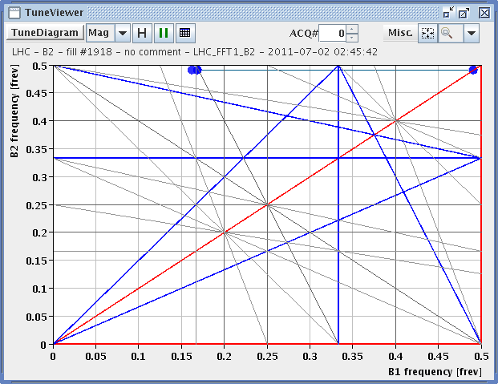
Tune WP Close to Half Integer (B1 shown)

Slide 27
Non-Linear MD: DA measurement
M. Giovannozzi,
F. Schmidt
et al
DA estimate could be obtained by off-line analysis of intensity decay: analysis in progress.
The aperture kicker is used to blow up the emittance: losses are due to non-linear effects
Different loss rates as a function of MCO strength
Standard beam
MCO strength: nominal case
MCO strength: scan
No more Beam 1 as from 10 am due to BTEs problem at the SPS: MCD scan dropped (problem solved after end of MD). Additional time will be requested.

Slide 28
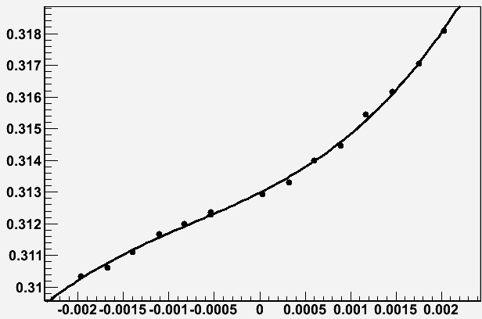
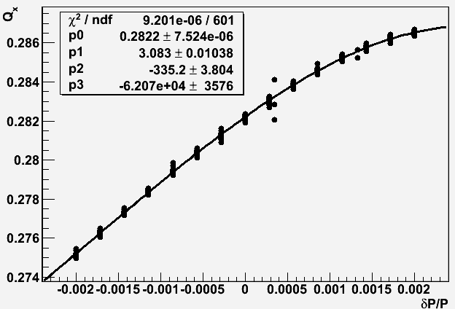
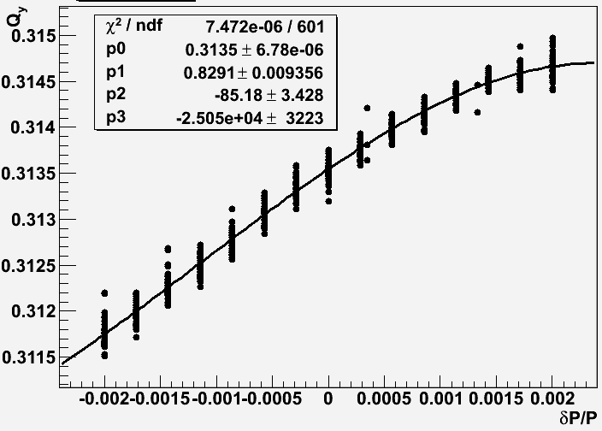
Non-linear MD: Chromaticity before and after Correction
M. Giovannozzi,
F. Schmidt
et al
Beam 2: Horizontal (left) and vertical (right) non-linear chromaticities
Beam 2: Horizontal (left) and vertical (right) non-linear chromaticities after correction

Slide 29
Collimation MD G. Valentino et al
New alignment of collimators in IR3 for b1 and b2.
Centers of collimators within 100 μm from previous values, but for TCSG.5L3.B1 (230 μm difference) ➔ Excellent news!
In parallel, tested new automatic collimation setup.
Setup combined H betatron cleaning in IR3 for B2:
IR3 collimators moved to 5.7 (TCP),6.7 (TCSG),10 sigma (TCLA).
IR7 H and skew opened. IR7 V collimators left at relaxed settings.
Test of system with B2 horizontal loss map
Note that also TCTV in IR1 and IR8 were above dump thresholds (cleaning inefficiency ~ 1to 2%).
Cleaning inefficiency downstream IR3 (cold regions) 5e-4
To be compared with simulations.

Slide 30
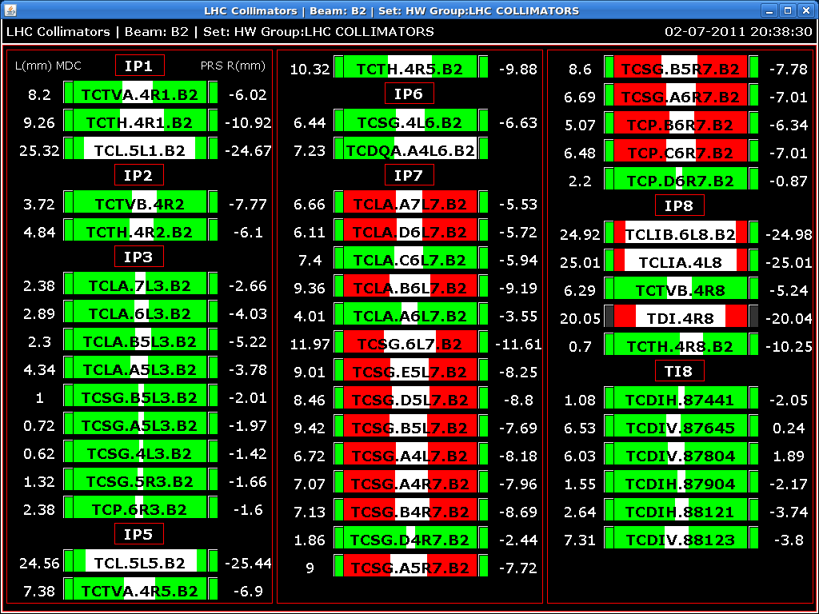
Collimator Settings B2: H Cleaning in IR3

Slide 31
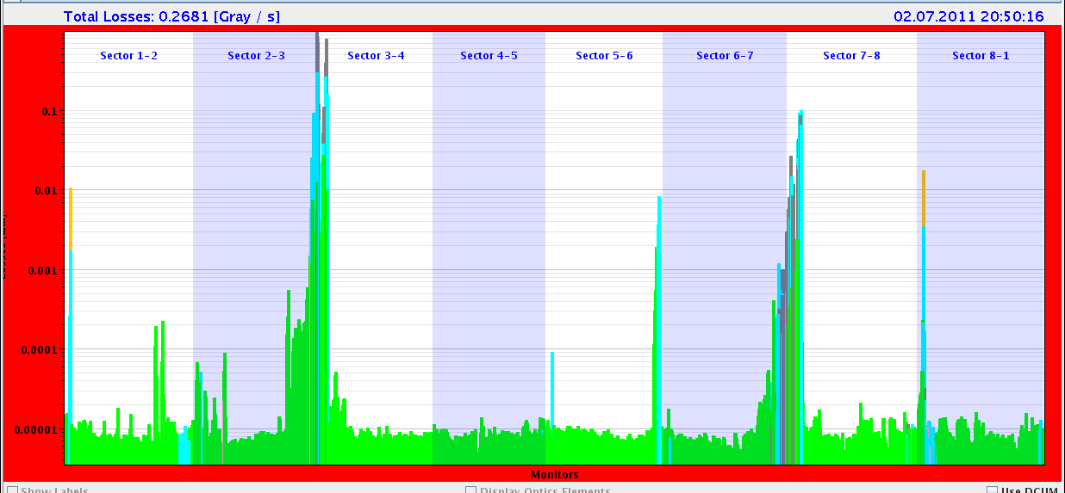
Loss Map Combined H Betatron Cleaning
99.9 %

Slide 32
ATS MD (S. Fartoukh et al)
Two unsuccessful ramps (for various reasons), third fine.
Second ATS MD successfully demonstrated the principle:
beta*: 30 cm was reached at IP1 while
beta* IP5 remained to "pre-squeeze beta* of 1.2 m (already below existing collision beta* of 1.5 m).
Chromatic aberrations were well under control during the squeeze (non-linear chroma, off-momentum beta-beating).
The on-momentum beta-beating was recorded at beta*=4.4 m, 1.2 m, 54 cm and 30 cm.
At 30 cm: peak beta-beating error 15% - 40%, depending on plane and beam, with correction from empirical trims on Q2.R1, Q2.L5 and Q2.R5 (about 10-13 units), as derived for the nominal squeezed optics.
This beta-beating error has to be compared to the 400% design beta-beat induced on purpose in sectors 81 and 12 to squeeze beta* by a factor of 4 w.r.t. the pre-squeezed beta* of 1.2 m.
Note: Pilot intensity → Setup presently not usable for high intensity (collimation & MP issues).

Slide 33
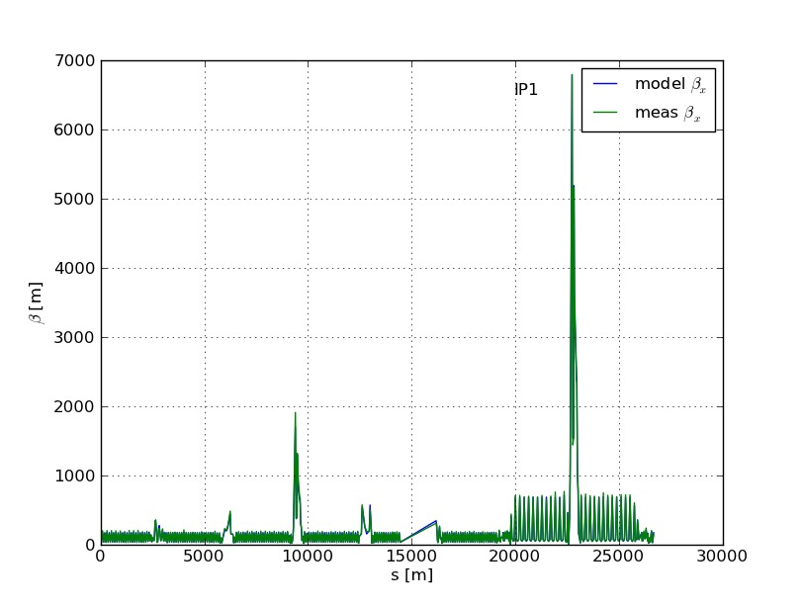
ATS: 30 cm β* in IP1: Measured β_{x}
First time ever proof of principle for this optics solution

Slide 34
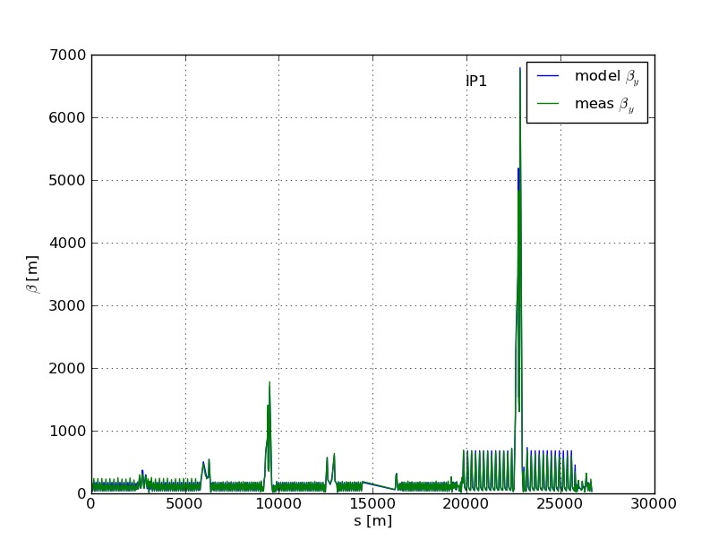
ATS: 30 cm β* in IP1: Measured β_{y}
First time ever proof of principle for this optics solution

Slide 35
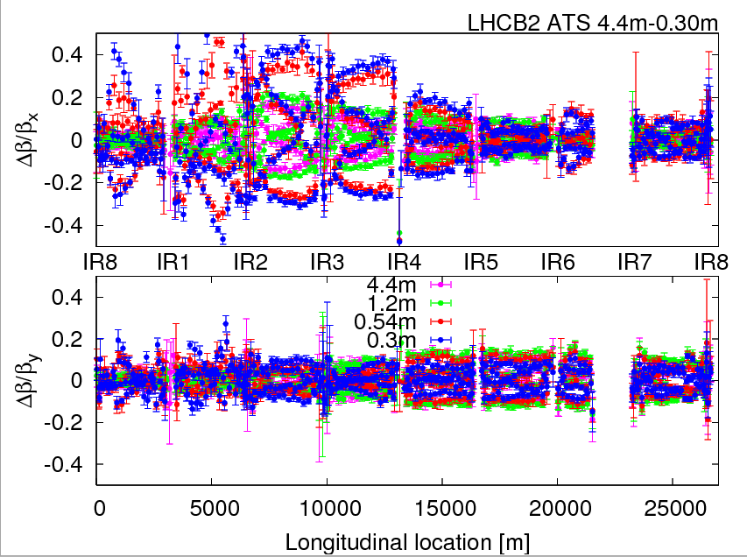
ATS: Meas. Beta Beat Err (here B2; B1 better)

Slide 36
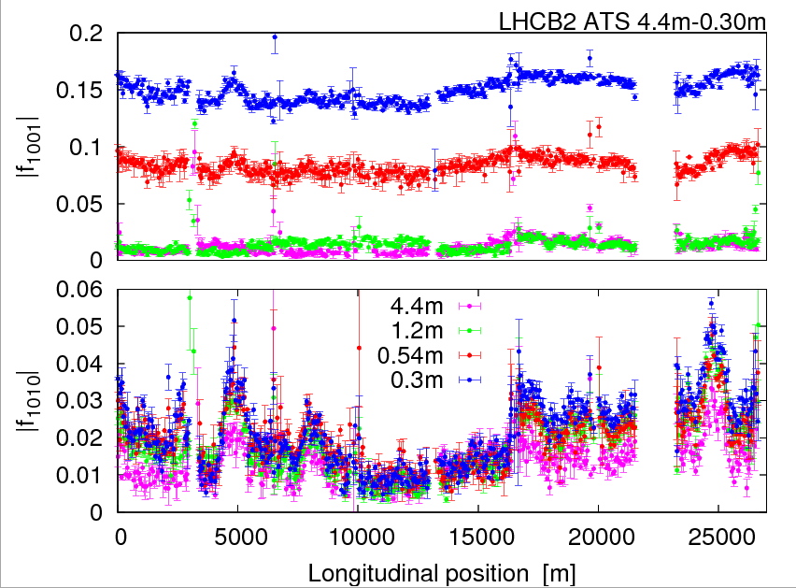
ATS: Meas Coupling Error (here B2; B1 better)

Slide 37
Transverse Beam Distribution F. Burkart et al
450 GeV: H, V, skew scraping to determine 2D bunch distribution
Beam loss [p]
Jaw
4e9
3e9
2e9
1e9
0.5 mm
1.0 mm
1.5 mm
2.0 mm
Jaw position

Slide 38
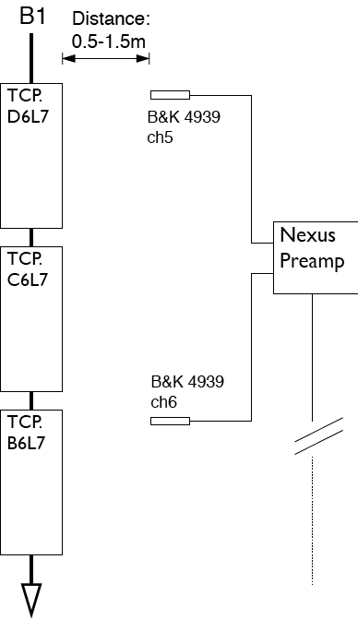
Scraping: Sound at Microphone D. Deboy et al
Hearing the LHC revolution frequency…

Slide 39
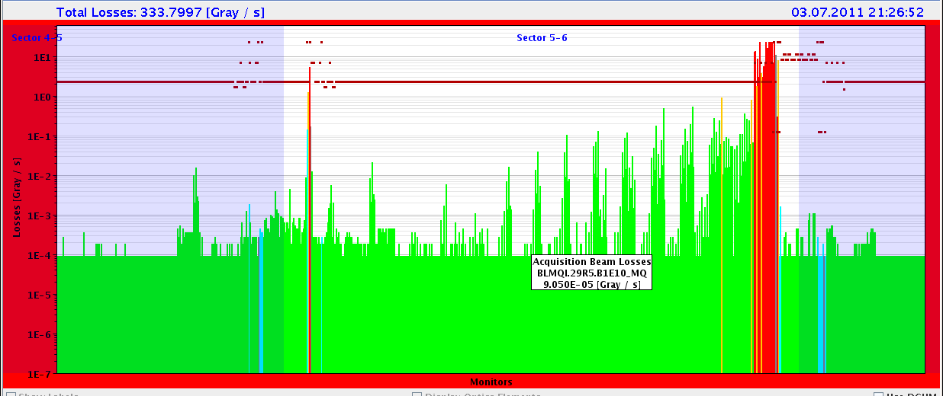
Quench Margin at Injection C. Bracco et al
No quench, even with 2e10 p per bunch
10 times above BLM threshold
To be analyzed

Slide 40
R2E M. Brugger et al
Data collected for better predictions of radiation to electronics effects.

Slide 41
Ahead
Writing up the MD notes: please remember 1 week deadline!
Mini-Chamonix
Preparing the 3rd MD

Slide 42
Other Slides

Slide 43
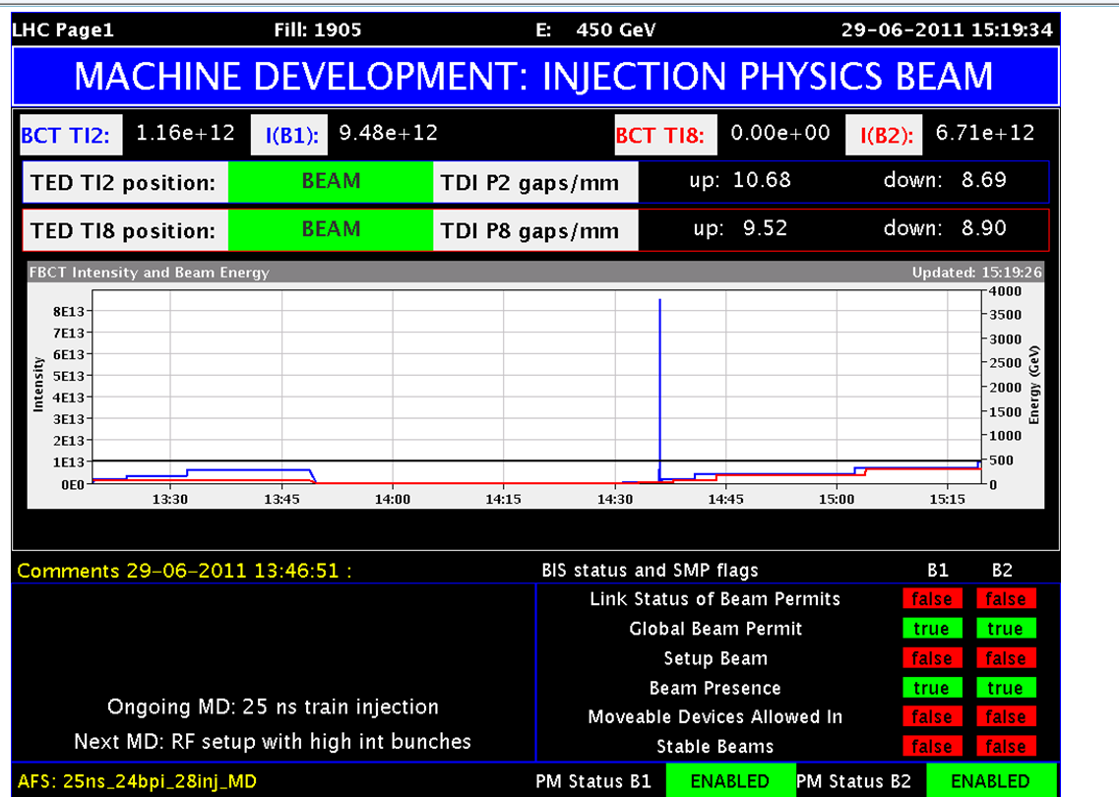
Filling Scheme with distance between each trains
G. Lanza, G. Bregliozzi
Total bunches = 228
Bunch spacing = 25 ns
Bunch intensity about 1E11 p/b
All e-cloud solenoids off!
10.85 us
2.28 us
2.28 us
2.28 us
5.13 us
5.13 us
5.13 us
5.13 us
27.93 us
12b
24b
24b
24b
24b
24b
24b
24b
24b
24b

Slide 44
Setup High Bunch Charge RF/BI/OP/Injector Teams
Very high beam lifetime:
FBCT in saturation → no reasonable values
However, no losses at collimators…

Slide 45
BI: No Emittance Growth for Large Chroma
R. Steinhagen

Slide 46
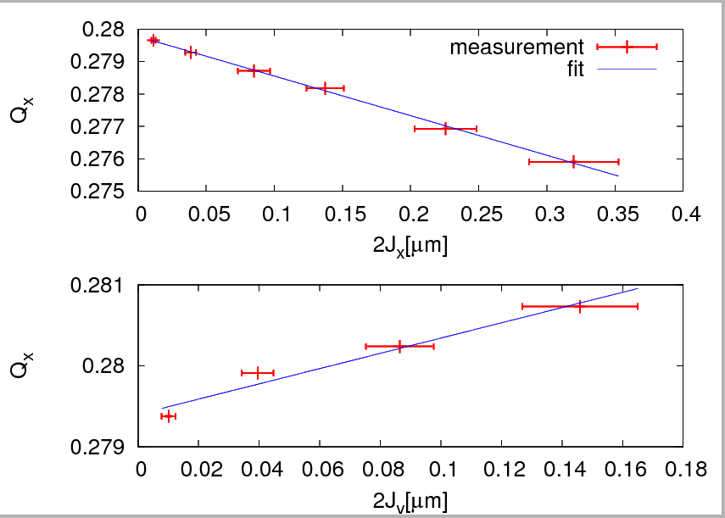
Non-linear MD: Detuning with amplitude including crossterm
M. Giovannozzi,
F. Schmidt
et al
Q_{x}(e_{x}, e_{y}) = Q_{x} + a * e_{x} + b * e_{y}
Beam 2: Horizontal (left) and vertical (right) non-linear chromaticities after correction

Slide 47
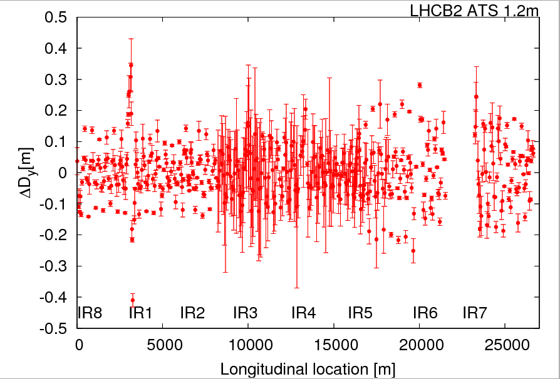
ATS: Measured Dispersion Error (here B2)

Slide 48
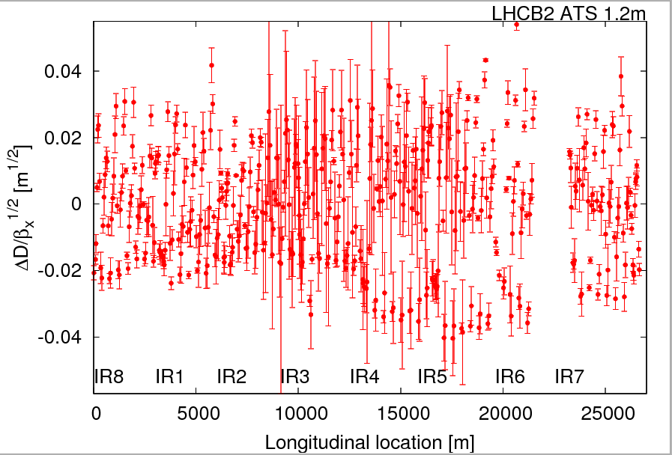
ATS: Off-Momentum Beta Beat Error (B2 H)

