Slide 1
MD Planning Fri – Sat (1. – 2.7.)
Day | Time | MD | MP
Fri | 18:00 | 450 GeV → 3.5 TeV: Long-range beam-beam limit – lifetime, emittance versus beam-beam separation. Collimation with changing crossing angle. | C
Sat | 02:00 | Ramp down, cycle.
 | 04:00 | 450 GeV: Non-linear dynamics – Dynamic aperture, non-linear chromaticity and frequency map. | A
 | 12:00 | If needed: Precycle.
 | 14:00 | 3.5 TeV: Collimation – combined cleaning, faster setup. | A
 | 22:00 | Ramp down, cycle.
Sun | 00:00 | 3.5 TeV: ATS – correction & pre-squeeze. | A
 | 08:00 | Ramp down, cycle.

Slide 2
Long-range beam-beam MD
Some additional result: IR1 → IR5 compensation…
Test of tune working point close to half integer: 0.47

Slide 3
Reduction crossing angle IR1 (V) and IR5 (H)
12+36 b per beam
3.5 TeV
beta*1.5m in IR1/5
Reduce IR1 angle
Reduce IR5 angle
40%
35%
50%
40%
35%
30%
40%
30%
50 h
2 h
Crossing angles in IR1 and IR5 reduced in steps of 5 – 10 %.
TCT’s following changed orbit.
100% = 120 μrad = 12 σ beam-beam separation for ε~2.5μm!
50% fine (no reduction in lifetime), 40% (5 σ b-b) still OK, 30% too low!

Slide 4
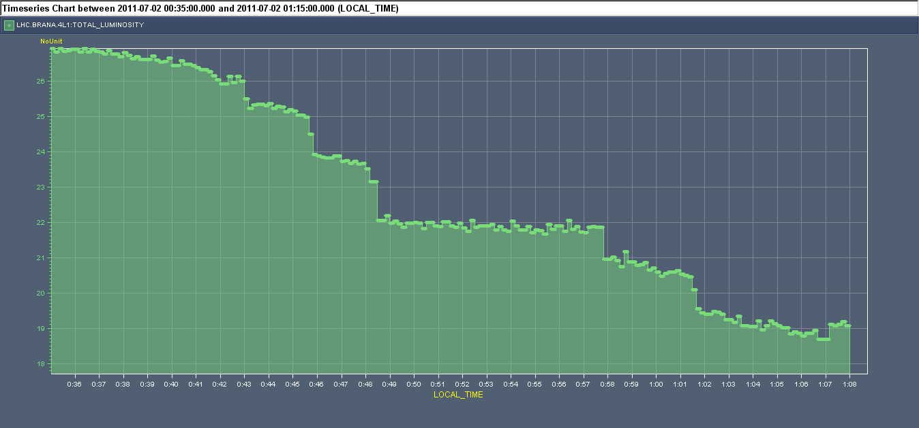
IR1 Luminosity During IR5 Adjustments
IR1 cross. angle at 48 μrad (~5σ sep) constant. IR5 cross. angle being reduced.
72 μrad
60 μrad
Luminosity
48 μrad
42 μrad
36 μrad
Time
Equal crossing angle amplitude in IR1/5 best for diffusion!
Compensation of LR beam-beam effects in IR1 and IR5…

Slide 5
IR1 Luminosity During IR5 Adjustments
IR1 cross. angle at 48 μrad (~5σ sep) constant. IR5 cross. angle being reduced.
72 μrad
60 μrad
Luminosity
48 μrad
42 μrad
36 μrad
Maybe even smaller beam-beam separation is acceptable with equal amplitudes of IR1 and IR5 crossing angles!?
Time
Equal crossing angle amplitude in IR1/5 best for diffusion!
Compensation of LR beam-beam effects in IR1 and IR5…

Slide 6
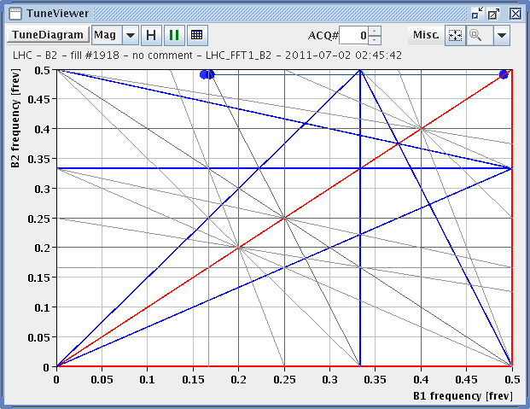
Tune WP Close to Half Integer (B1 shown)

Slide 7
Non-linear Dynamics MD (Dynamic Aperture)
M. Giovannozzi et al
DA measurement part of the non-linear MD:
Correcting/checking tunes, coupling and chromaticity.
Aperture kicker was used to heat the beam and induce losses related to non-linear dynamics.
Intensity vs. time was recorded for:
nominal conditions (but with MOs set to zero)
scan on the MCOs strength
Originally it was also planned to scan over the MCDs strenght, but in the end it was not possible due to lack of time (mainly BETs issue at the SPS, which prevented to inject Beam 1 for a long time).
The data collected will need to be analysed off-line.

Slide 8
Non-linear Dynamics MD II
F. Schmidt et al
NL chromaticity measurement and correction of Q" and Q"' with newly defined MCO & MCD spool piece:
In System/BETA-BEATING:
LHCBEAM/non_lin_chroma_dqq_b2 (b4) 1200.0
LHCBEAM/non_lin_chroma_dqqq_b2 (b5) 160.0
NL chromaticity B2 before correction:
Q" = -1800 570 (H/V)
Q"' = -1.900E6 0.78E6 (H/V)
NL chromaticity B2 after correction:
Q" = -670 -170
Q"' = -0.37E6 -0.15E6
Comments:
Collimation settings in IP6 limited the maximum kick strengths of both kicker types. Therefore no true DA measurement possible with kickers.
Spool piece correction very effective also to reduce detuning. with amplitude.

Slide 9
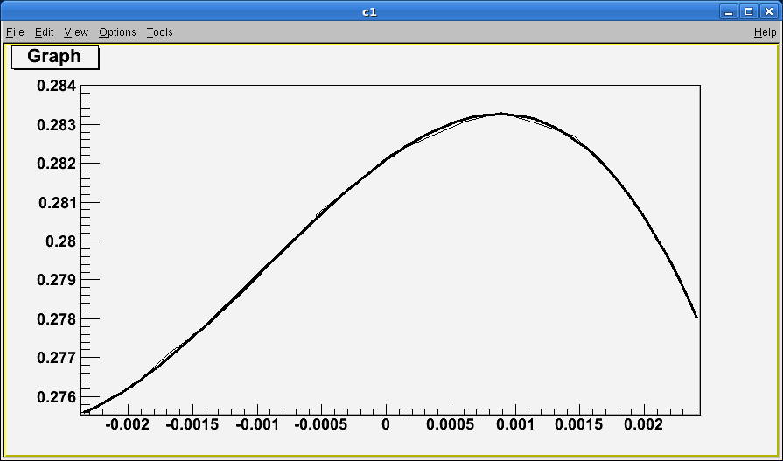
Non-linear Dynamics MD: Non-linear chromaticity (not corrected)

Slide 10
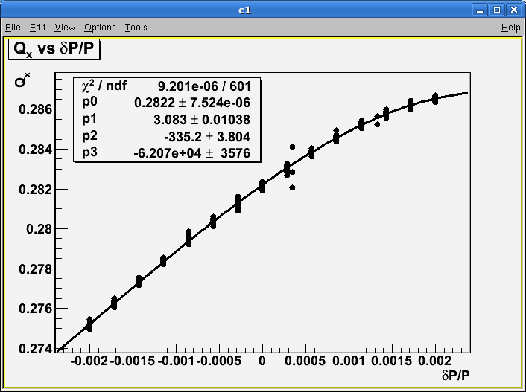
Non-linear Dynamics MD: Non-linear chromaticity (corrected)

Slide 11
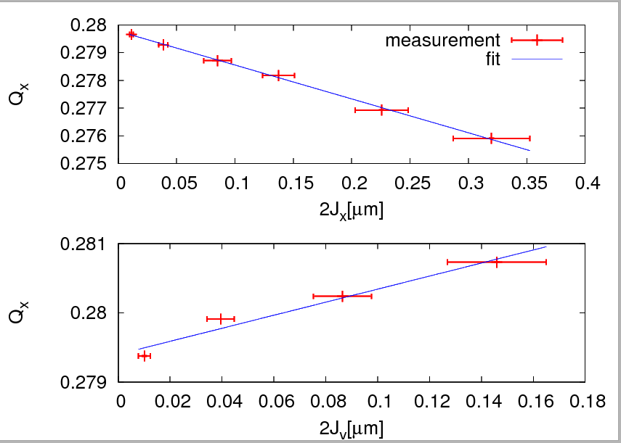
Tune versus Action

Slide 12
Collimation MD
MD started at 17.00 (3 hours late) - due to delayed recovery from previous MD.
New alignment of collimators in IR3 for b1 and b2.
Centers of collimators within 100um from previous values, but for TCSG.5L3.B1 (230um difference) ➔ Excellent news!
In parallel, tested new automatic features of collimation application on B1.
Automatic alignment (not satisfactorily functioning yet).
Automatic pattern recognition of loss spikes. Worked for 98% of cases. 2% other cases: delay in detecting loss spike (under investigation)?

Slide 13
Collimation MD
Setup combined H betatron cleaning in IR3 for B2:
IR3 collimators moved to 5.7 (TCP),6.7 (TCSG),10 sigma (TCLA).
IR7 H and skew opened. IR7 V collimators left at relaxed settings.
Orbit correction on B2 before loss maps.
Test of system with B2 horizontal loss map
V and H tunes swapped.
Loss maps on B2 H betatron caused beam dump on both beams (TCLA.A5L3.B2).
Note that also TCTV in IR1 and IR8 were above dump thresholds (cleaning inefficiency ~ 1to 2%).
Cleaning inefficiency downstream IR3 (cold regions) 5e-4
To be compared with simulations.

Slide 14
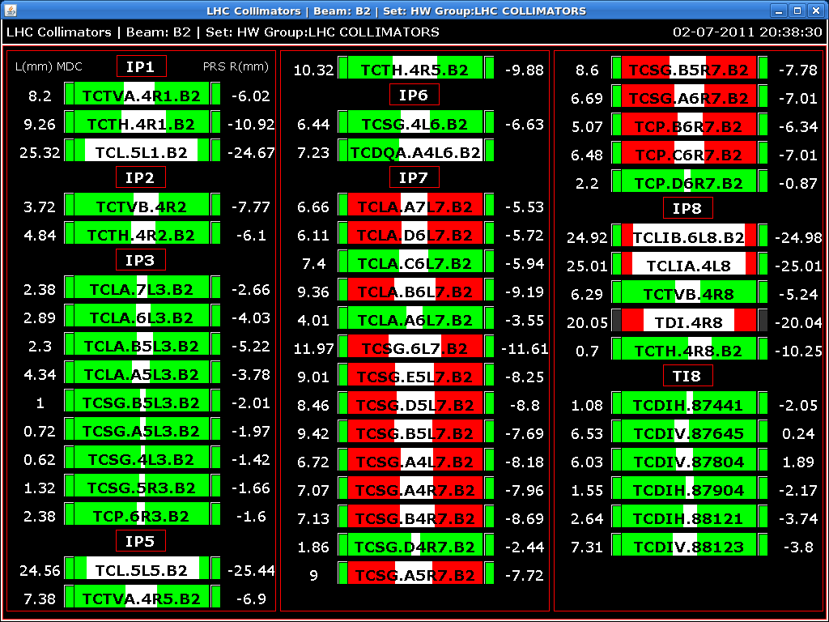
Collimator Settings B2

Slide 15
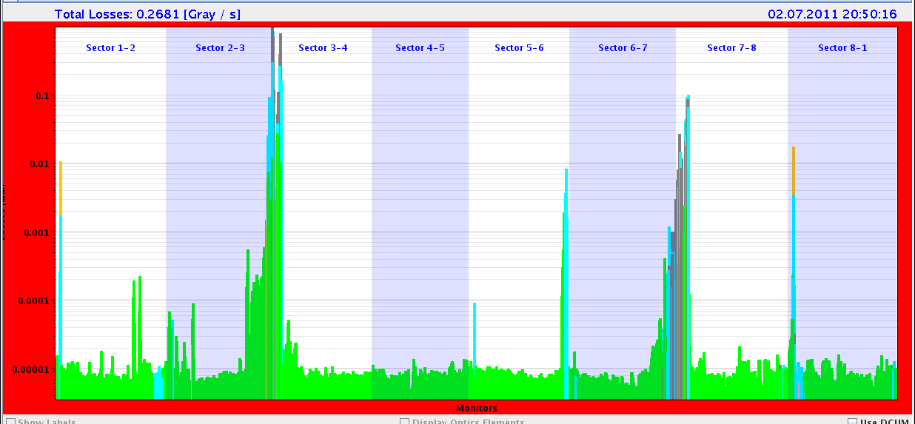
Loss Map Combined H Betatron Cleaning
99.9 %

Slide 16
ATS MD (S. Fartoukh et al)
Two unsuccessful ramps (for various reasons), third fine.
Second ATS MD successfully demonstrated the principle:
beta*: 30 cm was reached at IP1 while
beta* IP5 remained to "pre-squeeze beta* of 1.2 m (already below existing collision beta* of 1.5 m).
Chromatic aberrations were well under control during the squeeze (non-linear chroma, off-momentum beta-beating).
The on-momentum beta-beating was recorded at beta*=4.4 m, 1.2 m, 54 cm and 30 cm.
At 30 cm: peak beta-beating error 15% - 40%, depending on plane and beam, with correction from empirical trims on Q2.R1, Q2.L5 and Q2.R5 (about 10-13 units), as derived for the nominal squeezed optics.
This beta-beating error has to be compared to the 400% design beta-beat induced on purpose in sectors 81 and 12 to squeeze beta* by a factor of 4 w.r.t. the pre-squeezed beta* of 1.2 m.
Note: Pilot intensity → Setup presently not usable for high intensity (collimation & MP issues).

Slide 17
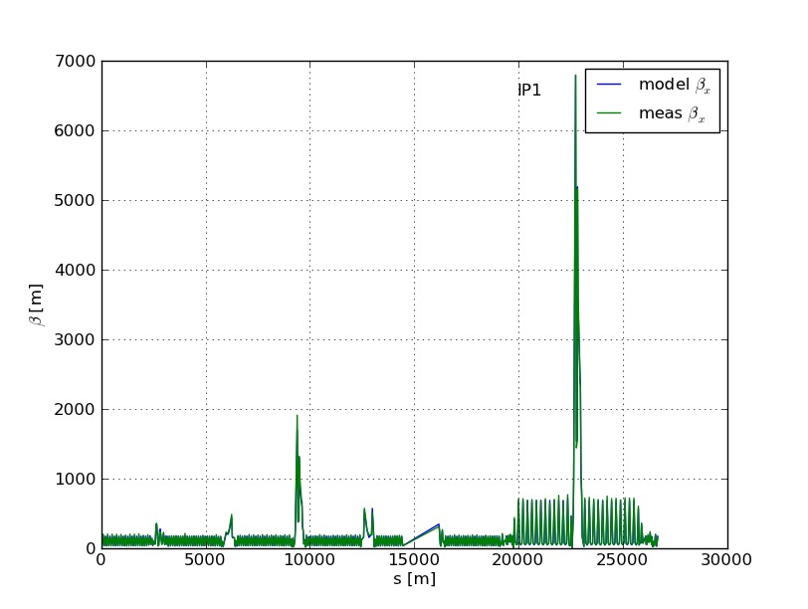
ATS: 30 cm β* in IP1: Measured β_{x}
First time ever proof of principle for this optics solution

Slide 18
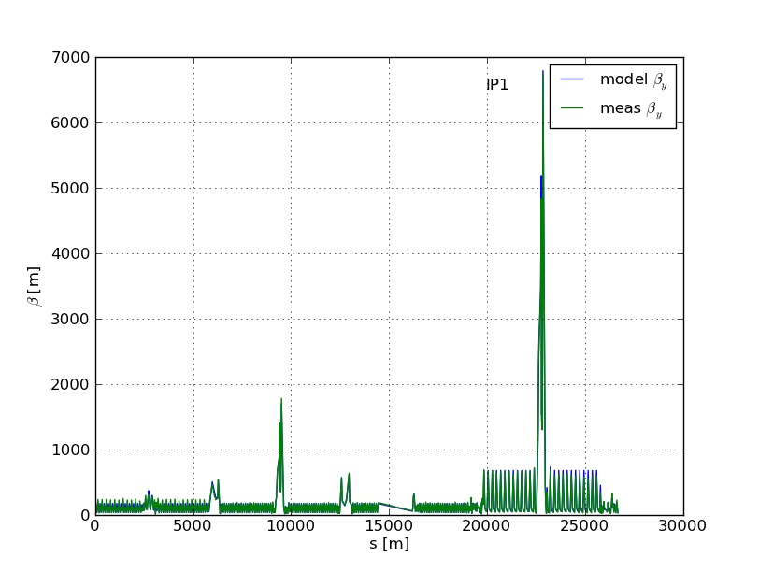
ATS: 30 cm β* in IP1: Measured β_{y}
First time ever proof of principle for this optics solution

Slide 19
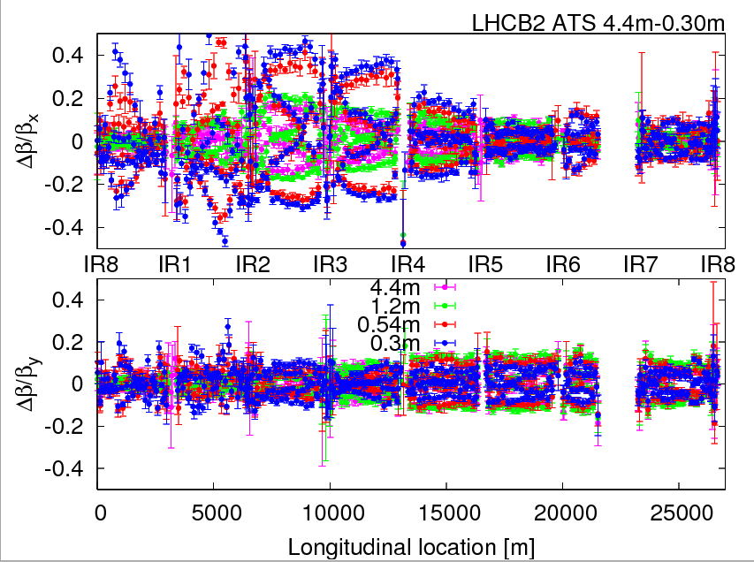
ATS: Meas. Beta Beat Err (here B2; B1 better)

Slide 20
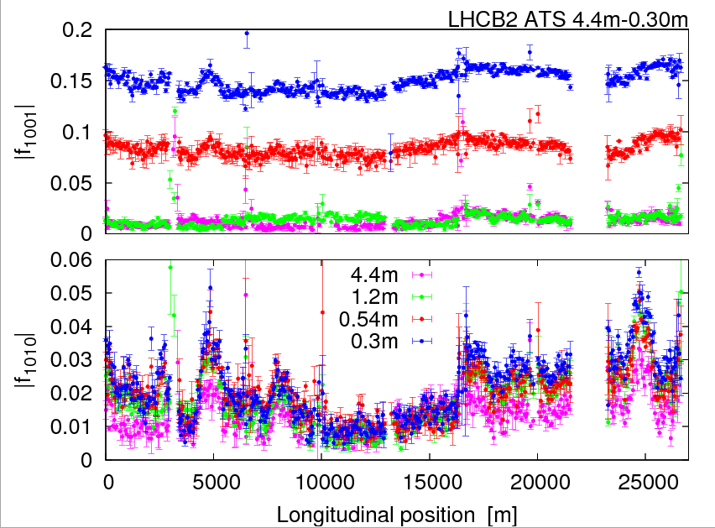
ATS: Meas Coupling Error (here B2; B1 better)

Slide 21
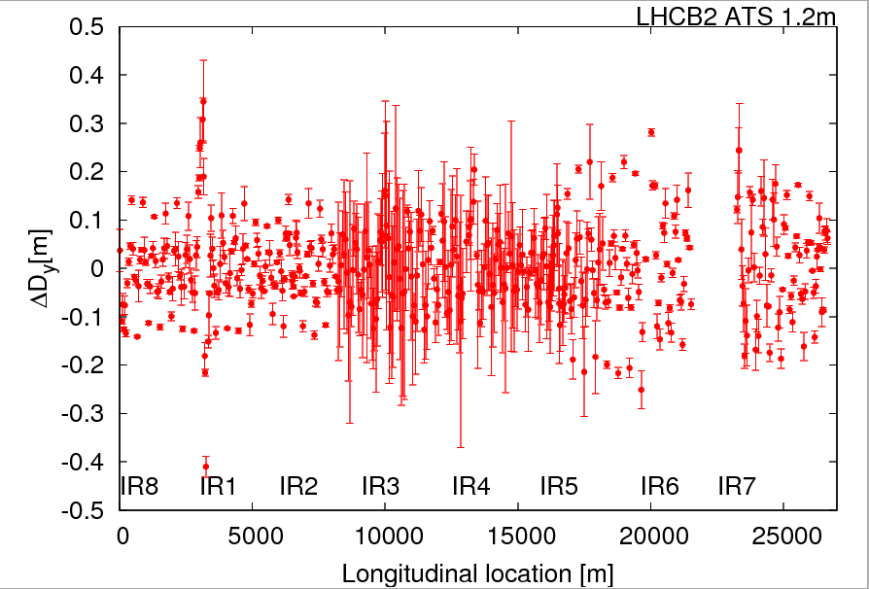
ATS: Measured Dispersion Error (here B2)

Slide 22
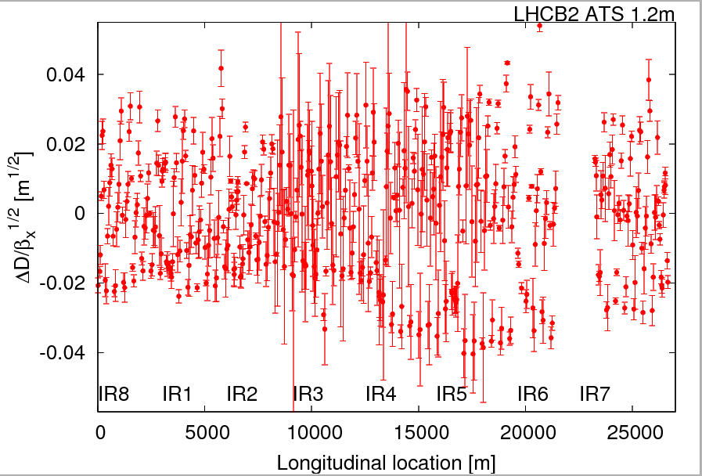
ATS: Off-Momentum Beta Beat Error (B2 H)

Slide 23
MD Planning Sun – Mon (3. – 4.7.)
Day | Time | MD | MP
Sun | 00:00 | 3.5 TeV: ATS – correction & pre-squeeze. | A
 | 08:00 | Ramp down, cycle.
 | 10:00 | 450 GeV: Beam distribution in LHC – scraping, halo, tails, BLM limits, … (high intensity) | B
 | 14:00 | 450 GeV: Quench margin at injection – observation with special QPS instrumentation, losses from TCLIB collimator, TCDQ checks in parallel | C
 | 22:00 | 450 GeV: R2E – slow controlled losses (1e13p on Q14.R2.B1). | A
Mon | 06:00 | Technical Stop
Needs from experiments:
30.6., 08:00 to 16:00 – Luminometers on in ATLAS and CMS
01.7., 18:00 to 02:00 – Luminometers on in ATLAS and CMS

