Slide 1
Friday June 24th
Small adjustments of the line steering for losses.
09:34 Filling for 1236b.
11:04 Stable beam fill #1889 with 1236b
Initial luminosity 1.26E33 cm-2s-1.
Integrated luminosity: ~ 11 ub^-1.
13:46 fill #1889 dumped by AUG (Arret Urgence General) in TI2. 11 pb-1 integrated luminosity.
Access:
IR2 & 4: AUG
S23: quench heater power supply
IR4: klystron for cavity in B1.

Slide 2
Friday June 24th
19:00 Beam back, injection:
RPLA.26R2.RCBH26.R2B1 -> I_MEAS NO_PC_PERMIT LIMITS. It tripped again, take it out of the SOC S23 and put into NOT_USED.
Changed QPS board for RQS.L7B2, RCD.A67B2, RCBXH3.L5 (which is anyway not used... masked the QPS_OK in SIS).
21:31 Flat top with 1236b
Problems to load squeeze:
Had forgotten to remove the RCBH26 from the ORBIT-H SOC so it does not load. Removed it from the SOC ORBIT_H then, but still it does not load - for the sequencer it is still in the SOC (not for EquipState for example).
We restarted the SEQ-LHC-PRO server - now none of the groups loads.
Loading with EquipState, also sent the event group with it (error returned from sequencer).
Vito called back. The second error we got (bad array length) is due to the fact that the information on the squeeze segment length got lost when we restartedthe sequencer server.
22:53 Stable beams. Fill 1890.

Slide 3
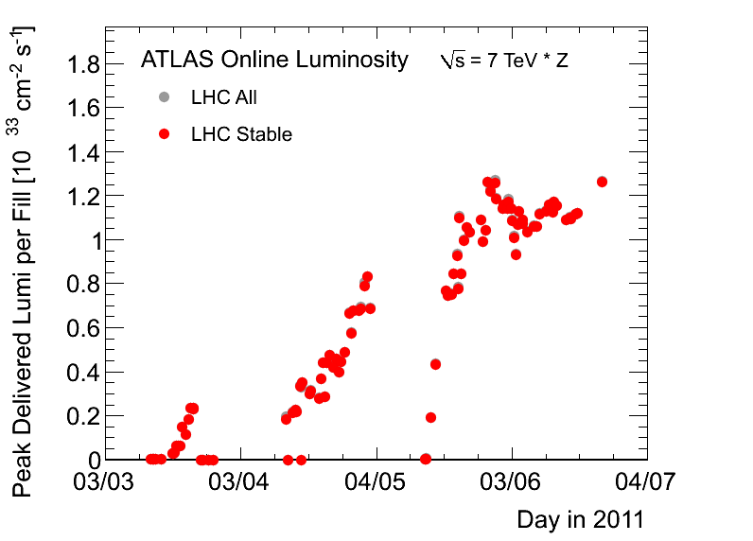
ATLAS Peak Luminosity

Slide 4
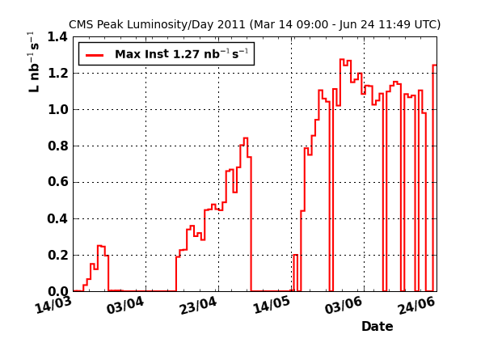
CMS Peak Luminosity

Slide 5
ATLAS Records Pages

Slide 6
Fill in the Machine

Slide 7
Saturday June 25th
Reyes & Fabio:
New features in leveling software (see logbook).
LHC Big Sister: New logical trees.
Stable beams ongoing…

Slide 8
ALICE Problem
The TPC is off due to high conductivity of the water to cool the resistor rods which prevents raising the HV of the field cage to nominal voltage.
To try to fix it ALICE needs a rather long access (~6h) in order to empty the cooling plant and fill it with unpolluted water.

Slide 9
Ahead
Physics with 1236b
When can we go up? Last step of 144b is +12%!

