Slide 1
Investigation into the I_MEAS fault trip of RTQX2.R5 at 13:30 June 3rd and RTQX2.R1 at 7:28 June 7th
Quentin King
Pierre Déjoué
June 6th 2011

Slide 2
RTQX2.R5 tripped on June 3rd and RTQX2.R1 tripped on June 7th
The FGC software tripped the converters following a bad acquisition on one measurement channel.
The software reported an I_MEAS fault even though I_MEAS was always good.
This was due to a bug in the software: the check on the difference between I_A and I_B was not suppressed following the recovery of the bad channel.
The current measurement difference is calculated at 1Hz from 1 second averages of I_A and I_B (which are acquired at 1kHz)
So at least 1 second of valid measurements are needed before the measurement difference can trusted

Slide 3
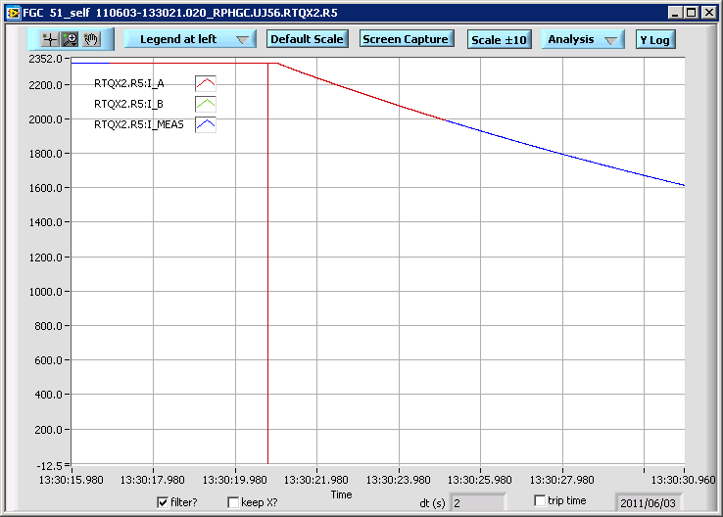
The bad acquisitions were on I_A

Slide 4
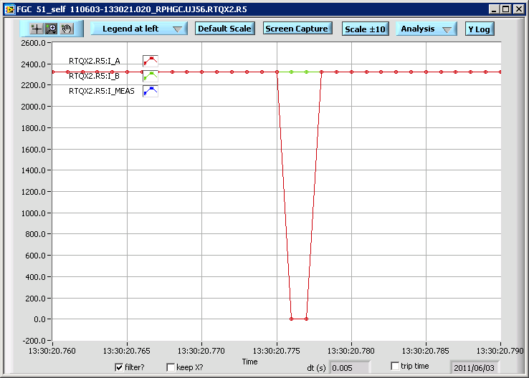
Two samples were bad

Slide 5
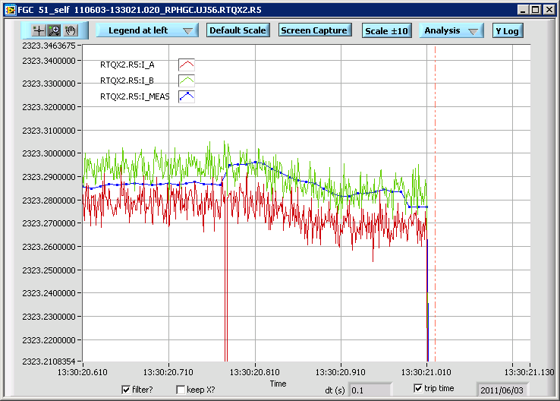
The software correctly switched from using the average of I_A and I_B to just I_B for 200ms and then switched back
I_B only

Slide 6
I_DIFF
So I_MEAS was always good and the handling of the bad acquisitions of I_A was correct
Unfortunately the I_DIFF limit was checked at the start of the next second because I_A and I_B were again valid, but the bad I_A samples were poisoning the 1s average used in the calculation of I_DIFF
The I_DIFF fault limit is 0.5A and the two bad samples resulted in a calculated difference of 4.6A.

Slide 7
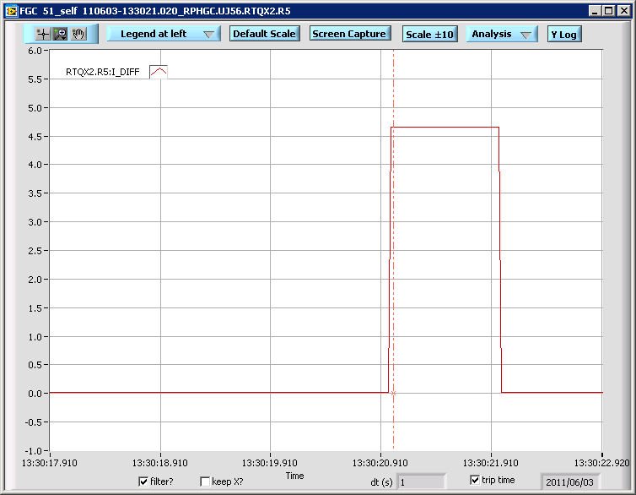
I_DIFF exceeded the 0.5A threshold

Slide 8
Why the bad acquisitions?
The ADCs are external to the FGC and send their data over fibres
There was a defect in the fibre termination tool so all the fibres used with these external ADCs have a problem with the quality of the light transmission
Bad acquisitions have been seen occasionally for some time and all 80 fibres concerned will be re-terminated in future technical stops with a new tool (~10 minutes per connector)
If it wasn’t for this bug, these occasional acquisition errors would not have been a problem due to the redundancy of having two channels

Slide 9
Software fix
A new version (V390) of the FGC software has been released which fixes this problem by suppressing the use of a channel until good acquisitions have been received for 1200ms.
This guarantees that 1s averages used for the I_DIFF calculation will always be valid.
This has been tested in the lab and the software no longer suffers from the vulnerability.
The new version was released to all non-operating FGCs in the LHC on Tuesday morning. All concerned systems (with external ADCs) were updated so this problem should be solved.

