Slide 1
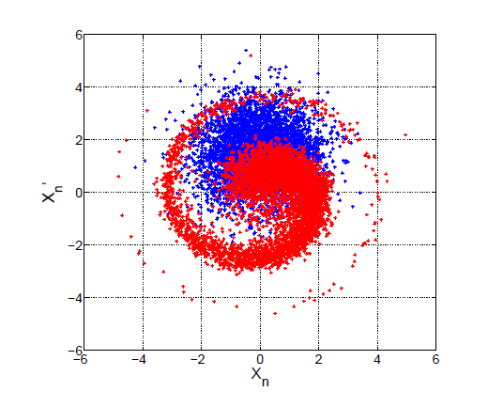
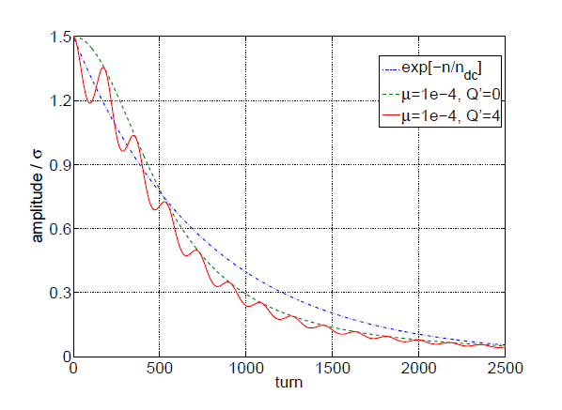
Check of filamentation time with octupoles on and damper off
motivation: desire to use octupoles @450 GeV to provide more Landau damping
in transverse planes
→ requires check of effectiveness of damper in presence of octupoles
without damper: “filamentation” of injection error (from simulation / theory)
μ=10⁻⁴, Q’=2, (Δp/p)_{rms}=0.44x10⁻³
G. Kotzian, W. Hofle, E. Vogel, EPAC 2008
G.M. Minty, SLAC-PUB-95-6815 (1995)
→ speed at which filamentation happens depends on amplitude de-tuning (octupoles)

Slide 2
Reminder: Emittance increase by filamentation
without damper a steering / kick error of Δx in position and Δx’ in angle will lead to a relative emittance increase of
Introducing the effective (overall) damping rate
simplified
(because not all processes follow exp. law)
also only valid for small injection errors
where
τ_{dec} de-coherence time in absence of instability and active damping
τ_{inst} instability rise-time
τ_{ad} active damping time as it would follow from damper gain without having any instability
and without de-coherence phenomena
and assuming τ_{dec} >> τ_{ιnst} > τ_{ad} the emittance increase becomes
blow-up
reduction factor
typically τ_{dec} > 10 x τ_{ad} hence emittance increase reduced by factor >100 !

Slide 3
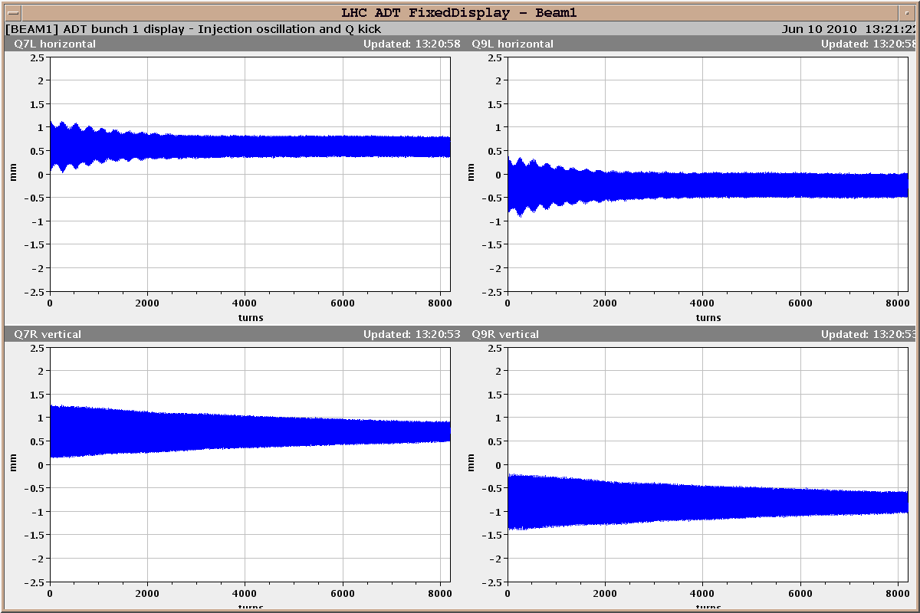
Example from 2010 with pilot
Damper off
Beam 1: Transverse injection transient, pilot, Thursday, 10.06.2010, 13:12
H Q7, no dispersion
H Q9, dispersion, 1.1 m
high chromaticity
high chromaticity
V Q7
V Q9
low chromaticity
low chromaticity

Slide 4
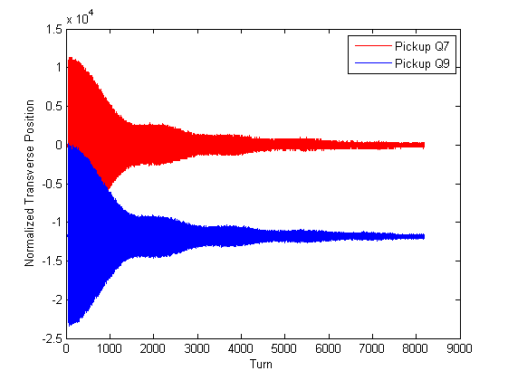
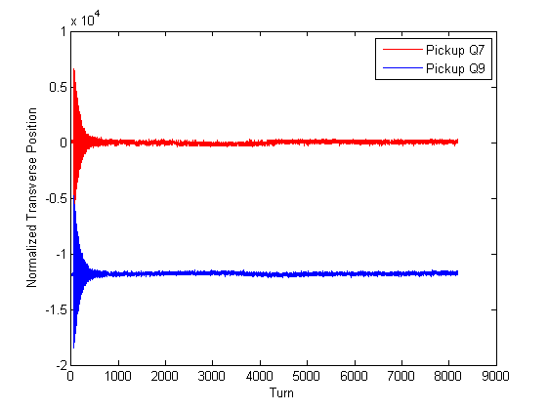
Test with ocupoles @450 GeV on 09.06.2011, Fill #1861
take INDIV beam at nominal intensity
emittances: ranged from 1.5 to 2.5 μm
check filamentation without damper, with octupoles on and off
method: disable damper for first 2000 turns
octupole polarities: positive for de-focusing, negative for focusing
additional de-coherence already seen 2010 with high bunch intensity
→ tune spread associated with space charge (image space charge)
damper off
damper on
22.04.2010

Slide 5
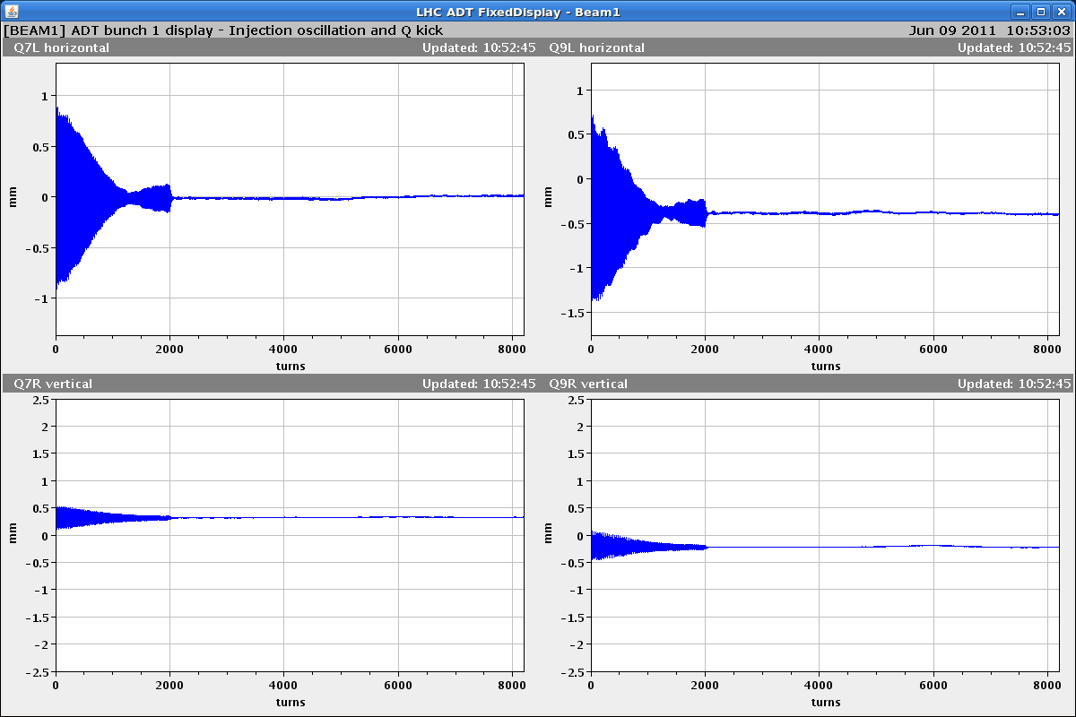
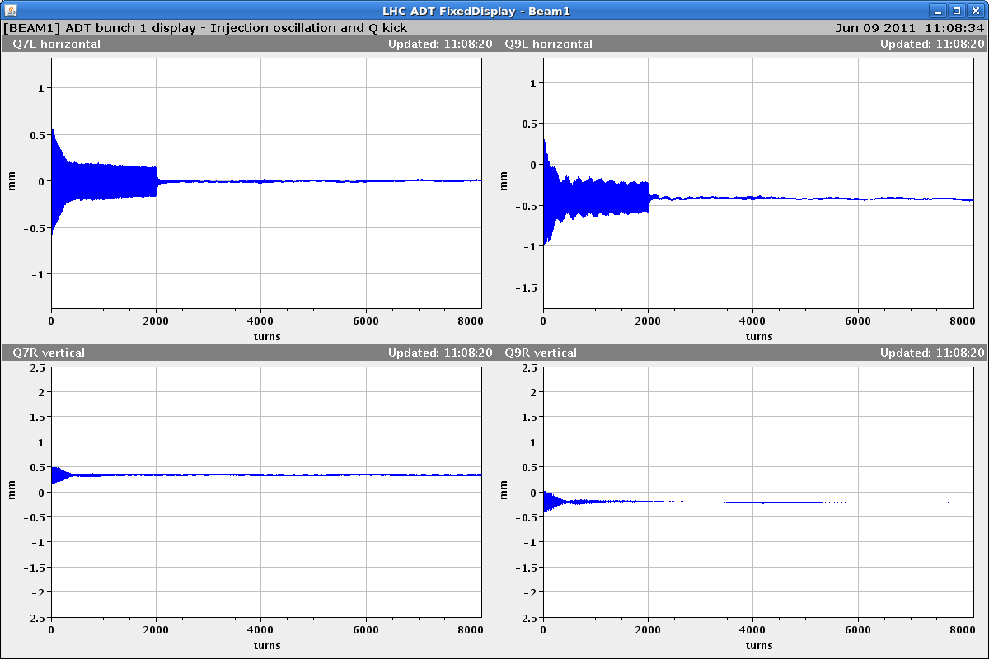
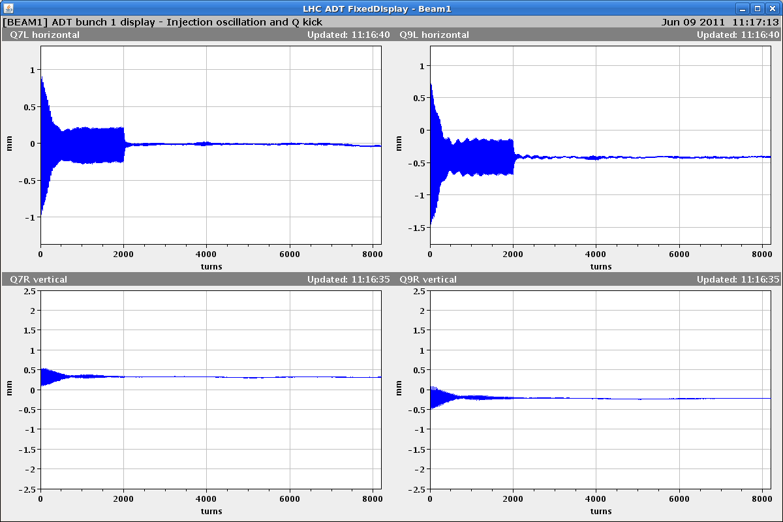
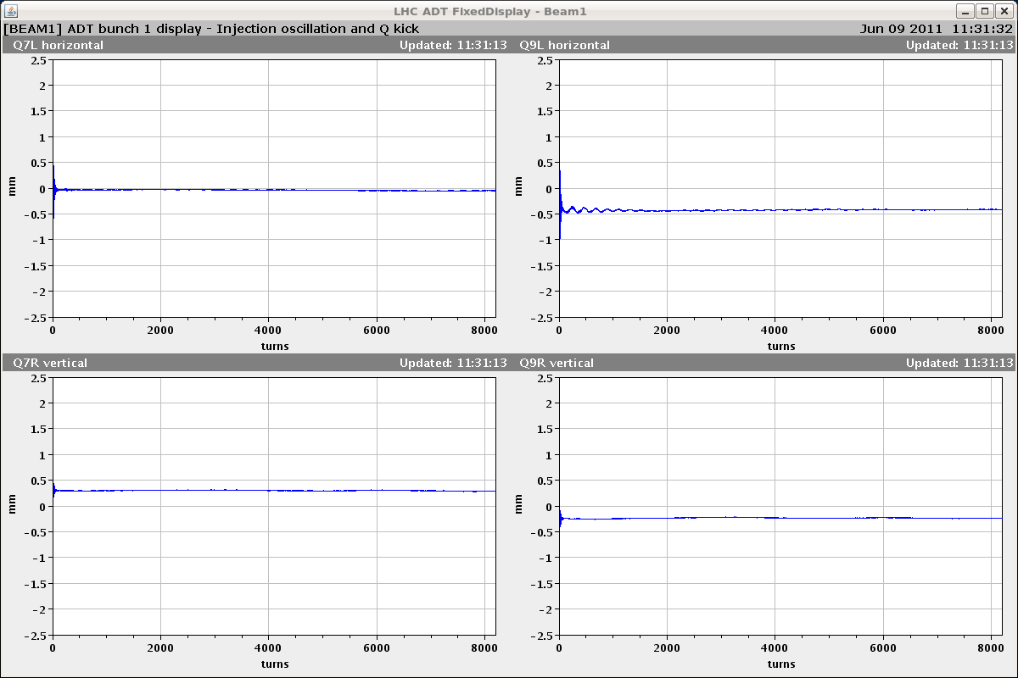
Beam 1: test of yesterday
0 A
13 A
6.5 A
6.5 A
damper ON
horizontal
vertical
damper always switched on at turn 2000

Slide 6
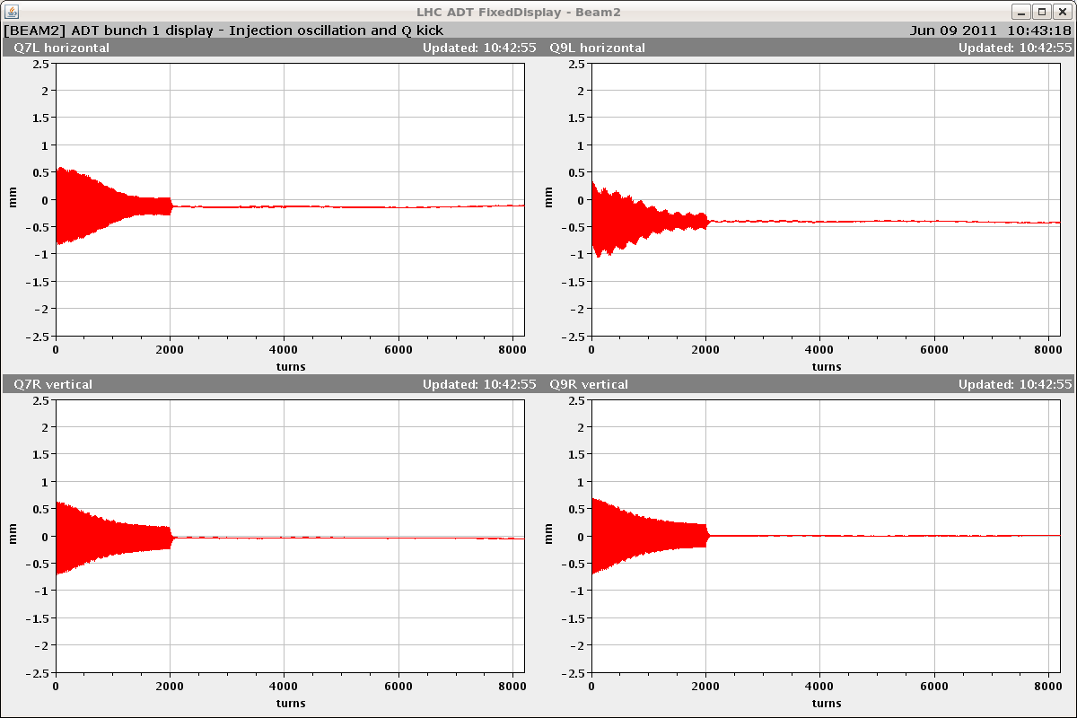
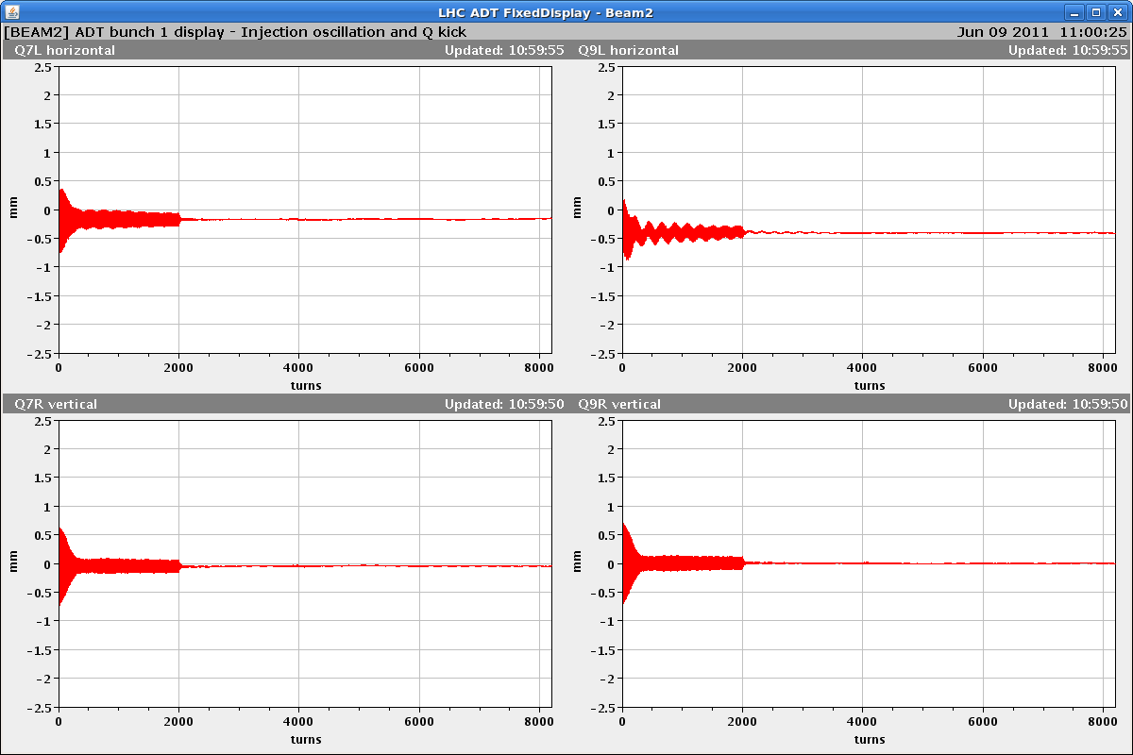
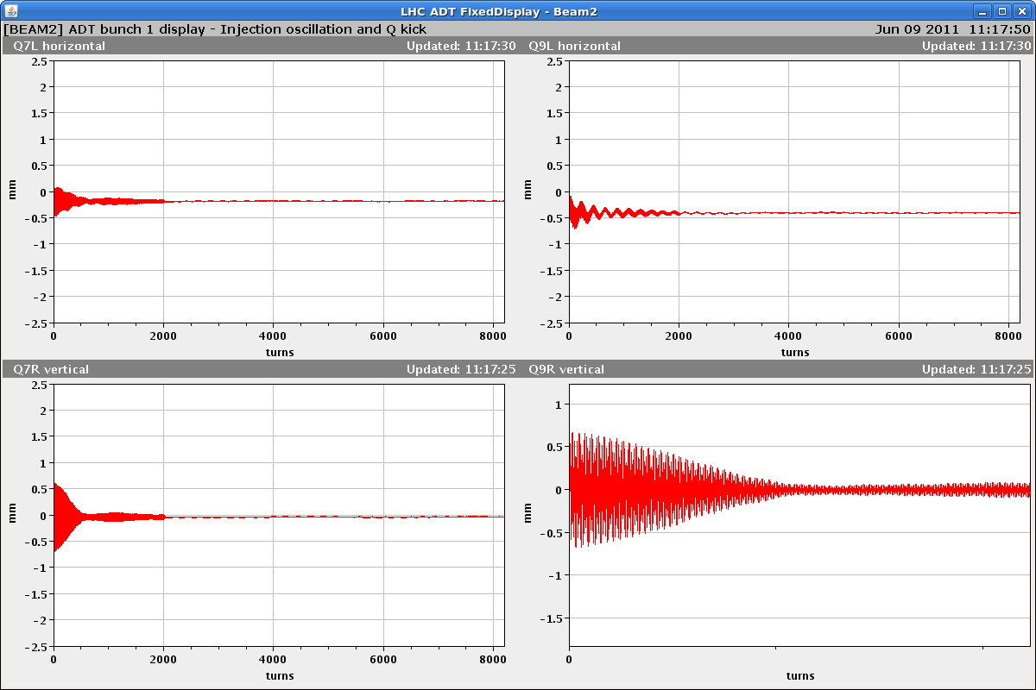
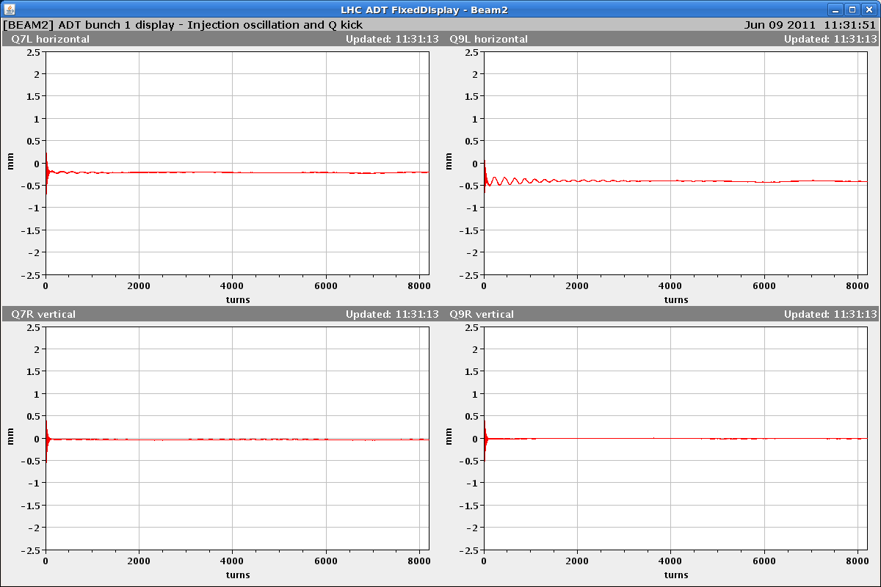
Beam 2: test of yesterday
0 A
13 A
6.5 A
6.5 A
damper ON
horizontal
vertical
damper always switched on at turn 2000

Slide 7
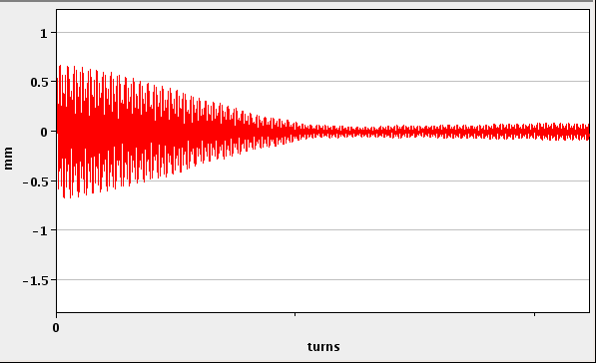
Luminosity cost estimate
6.5 A
back of the envelop:
B2V: de-coherence time change
0 A → 6.5 A: 1500 turns → 400 turns
typical damping by damper:
(@high gain) < 20 turns
500
blow-up reduction factor change:
1.84x10⁻⁴ →2.41x10⁻³
luminosity cost: 0.06% (0.75 σ injection error)
40 turns damping instead of 20 turns → cost: 0.25%
150 turns filamentation instead of 400 turns → cost: 0.4%
1.5 σ injection error instead of 0.75 σ ◊ cost: 0.25 %
150 turns filamentation, 40 turns active damping
1.5 σ injection error → lumi cost 5.5 % !
word of caution:
damping not
equally fast for all bunches
due to effect of
injection kicker ripple/rise-time
+ limited damper bandwidth
would need to scan all bunches
to quantify experimentally

