Slide 1
Monday 6th
07:39 Dump fill #1854, RQ6.L2 tripped, followed by access
Piquet EL has changed the three fuses on electrical distribution. Piquet EPC has not found any fault on their power supplies.
9 minutes of stable beams….
11:35 Injecting again, fill #1855, 1092 + 12 non colliding bunches
13:09 Prepare ramp
13:15 Beam lost before ramping, UFO near MKI Point 2
15:56 Stable beams, lumi’s around 1.1e33
Alice using automatic lumi levelling (same as LHCb)
22:30 Adjust for RF test, switching off one cavity per beam
23:41 Stable beams back
07:28 Beam dump due to bad current reading on RTQX2.R1
This is a known problem, FGC issue– already happened Friday morning inner triplet IP5
Try to fix this morning…
Fill did 42 pb-1 in 15h30min, minus one hour without stable beams
08:00 MKI magnet at 54 degrees (interlock @ 55) – SoftStart to check kick

Slide 2
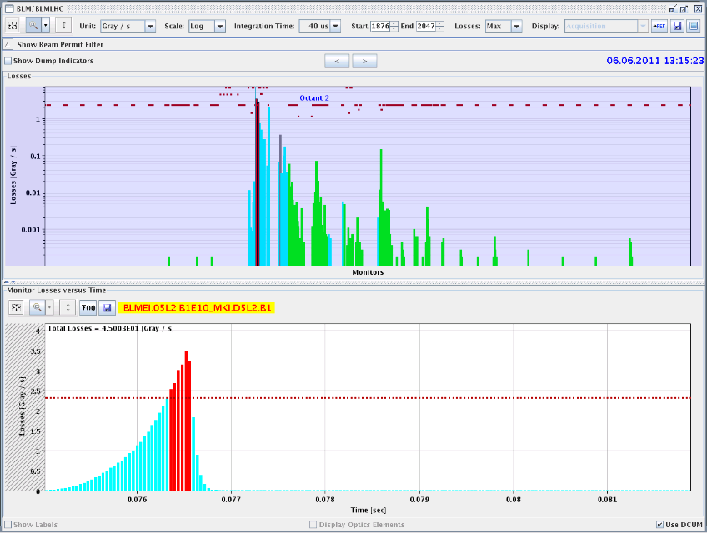
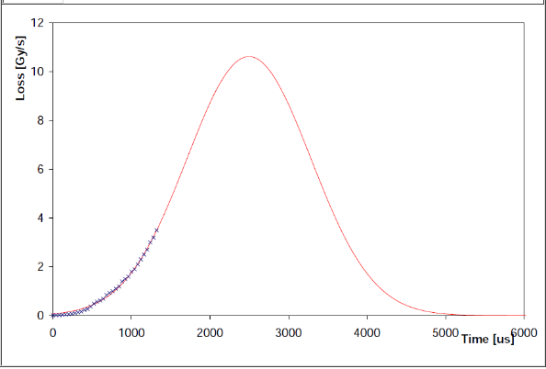
Point 2 UFO near MKI
BLMs on MKID and MKIC were the first to go above threshold - These thresholds are factor ~5 lower than adjacent elements. - Beams dumped while losses still rising. Fit to the data gives an expected peak of about 11 Gy/s, which is a factor 3 above the loss recorded. - Gaussian fit to the data gives an RMS of about 780 us. Beam size at MKID (assuming 2.2 um) is about 0.37 mm, which gives a speed of 0.47 m/s for a hypothetical transiting dust particle. - Losses seem to start at the MKID monitor - at the upstream Q5 there are losses but these are a factor 200 lower - Except for MKIs and TCTH, the losses everywhere were a factor 5 -10 below dump threshold
Brennan G.

Slide 3
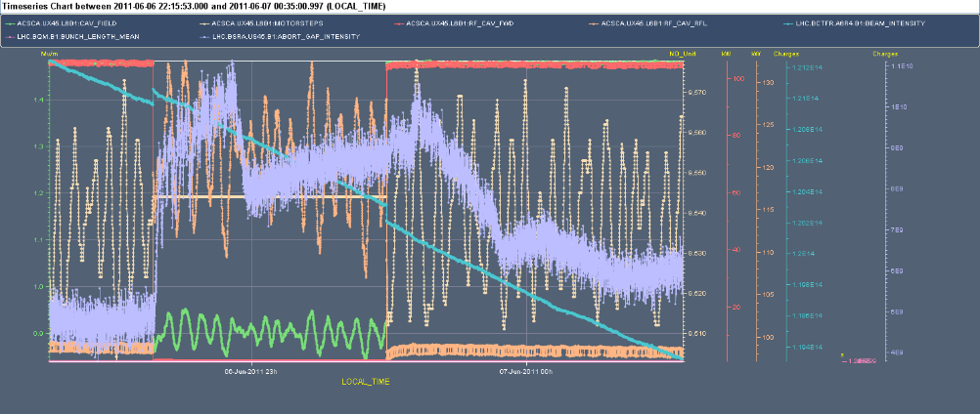
RF test: Switching off one cavity
Switching off cavity B1, followed by B2. Study reflected power and debunching
After ramp: B1 @ 1.2 ns, B2 @ 1.1 ns
For the RF transients, there is barely any difference compared to the measurement done with 912 bunches on May 28th at the beginning of the fill (0.9 MV and 115 kW). At the time we had almost the same total intensity (1.1E14).
The B1 abort gap increase was double that of B2, and this may be related to the lack of B2 longitudinal blow up during the ramp
Philippe B.

Slide 4
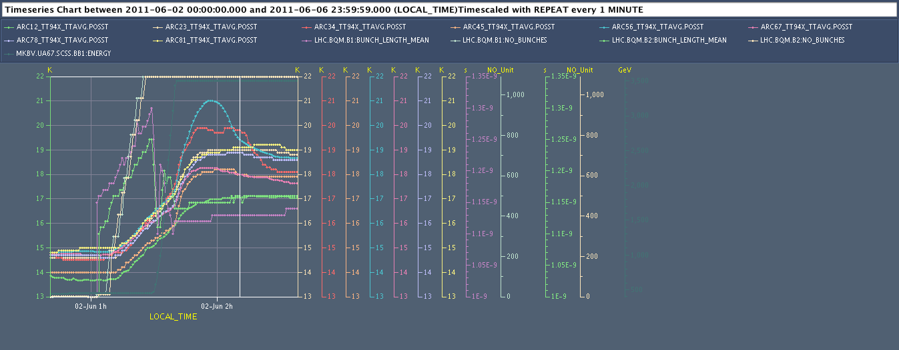
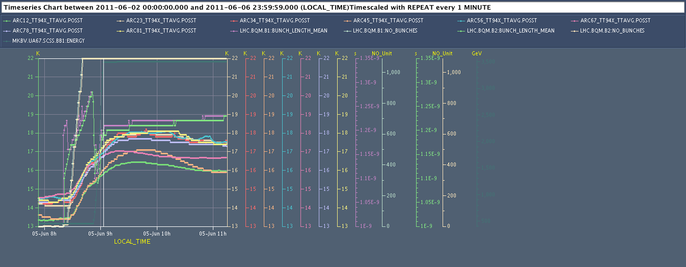
Too low bunch length => direct impact on image current heat loads!
Injection
Bunch L B1
1.1 ns
Ramp
ARCs 34 & 56 mostly penalised
Injection
Longer bunch length => lower heat loads
1.2 ns
Very homogeneous behaviour of all arcs
Ramp
Serge C.

Slide 5
Plan
Chromaticity measurements at injection after this long fill to get data for FIDEL (1.5 hours)
Also non-linear chromaticity for Wolfgang
Try to fix FGC in the same time
Physics 1092 x 1092 bunches
Some fills with additional 12 non-colliding bunches
Outstanding
End of fill: TCL adjustment
Test ramp with new RF blow-up control (12 bunches)

