Slide 1
Friday 03.06.
05h55 Stable beams. Fill #1841. Lumi ~1.2e33.
13h30 Beams dumped:
Loss of I_meas reading (only channel A of PC) for 4 ms. This tripped the PIC. Note that the after the loss of I_MEAS, the signal came back.
Delivered lumi: 27.5pb-1. Length of stable beams: 7h35.
18h24 Beam dump @3.5TeV:
UFO in IR8R during squeeze.
20h54 Stable beams. Fill #1844. Lumi ~1.1e33.
21h17 Beam dump:
Undulator IR4 tripped. Reset was needed (forgotten before).
Length of stable beams: 0h23.
23h30 Cryo back for ML4.
02h16 Stable beams. Fill #1845. Lumi ~1.1e33.
07h56 Beam dump: QPS FIP comm. lost. S12 tripped.

Slide 2
Ongoing injection problems
Consistent problems after long fills:
First filling attempts after long fills hit by strong emittance blow-up: ~100%.
Blow-up happens a few seconds after injection.
Seen as beam instability.
Not all batches affected. Some good, some bad.
Seeing drifts in chromaticity at flat bottom after long fills.
Not understood. Possible actions:
Update Fidel model to take into account better long powering history.
Full pre-cycle after long fill.
Check for the hump. Is it back?
Tails beneficial for Landau damping → less scraping in SPS? Last fill with larger emittances (less scraping) went without problem, but also benfited from earlier short fills.

Slide 3
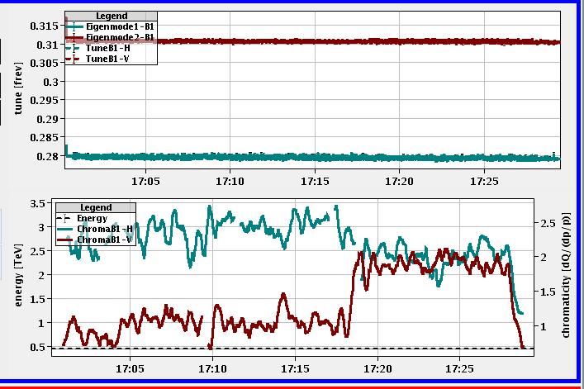
Chromaticity Drift

Slide 4
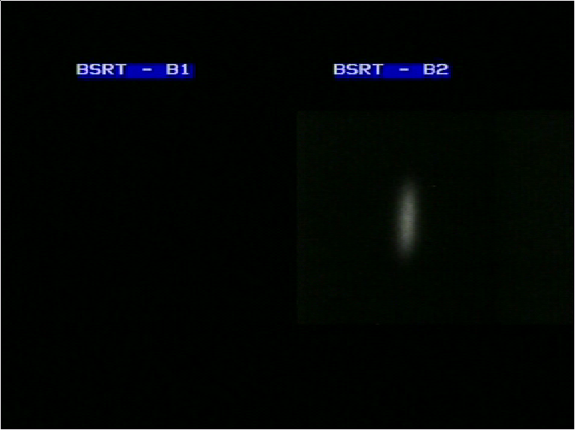
Vertical Blow-up B2

Slide 5
Length Stable Beams: 9 this week so far
Fill | Length
1816 | 09h00
1822 | 00h27
1823 | 01h13
1835 | 01h06
1836 | 14h55
1839 | 00h04
1841 | 07h35
1844 | 00h23
1845 | 05h40
 | 40h23
Average length stable beams: 4.5 h

Slide 6
Beam Dumps at > 450 GeV
Date | Time | State | Reason
30/05 | 11h08 | Stable beams | QPS trigger circuit detector of RCBXH2.L1. SEU?
 | 15h43 | Adjust | New RF interlock not masked
 | 20h20 | Adjust | FMCM. Electrical glitch
31/05 | 06h22 | Stable beams | UFO IR2L
 | 10h38 | Stable beams | Communication with DFBAJ. SEU?
 | 22h20 | Squeeze | UFO IR2L
01/06 | 02h10 | Squeeze | QPS trigger (Quench of Q9R5 ?)
 | 06h53 | Adjust | RF trip (radiation-induced arc detector signal?)
 | 09h17 | Ramp | Collimator temperature
 | 20h37 | Stable beams | Collimation crate IR5R failure (PRS)
02/06 | 16h58 | Beam dump | EIC
 | 21h50 | Stable beams | UFO IR8
03/06 | 00h28 | Squeeze | Trip of RQTF.A23B2
 | 13h30 | Stable beams | Loss of I_meas reading
 | 18h24 | Squeeze | UFO in IR8R
 | 21h17 | Stable beams | Trip undulator IR4.

Slide 7
UFO’s 2.6.
5 MKI R8
1 MKI L2

Slide 8
3 MKI L2
4 MKI R8

Slide 9
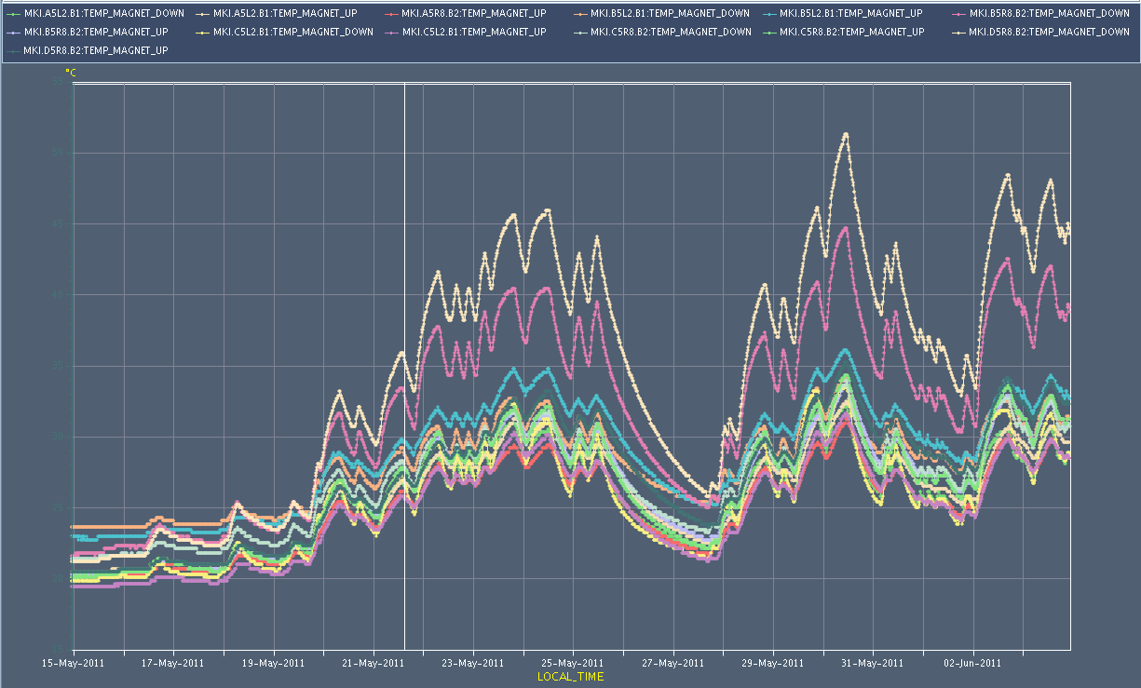
Injection Kicker Temperatures

Slide 10
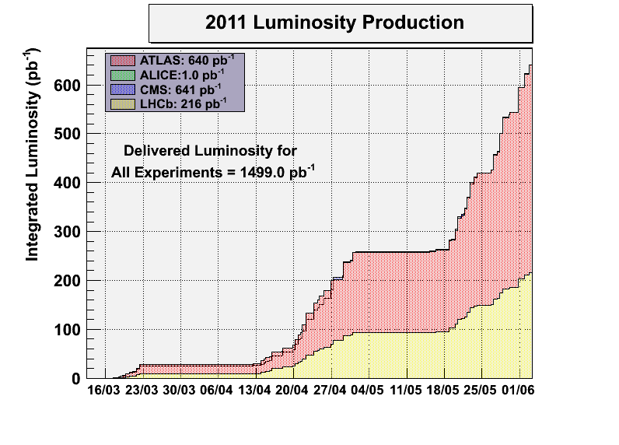
Luminosity Production

Slide 11
Ahead
Physics fills continued (1092 x 1092 bunches, 108b injections).
Average bunch intensity: ~ 1.2e11 p
End of fills (if any):
Try to reduce DS losses with TCL collimators (open now)
RF cavity switch off test

