Slide 1
Finally....
We had to wait a long time....
We had many problems....
We had to do many machine checks....
But there it was:

Slide 2

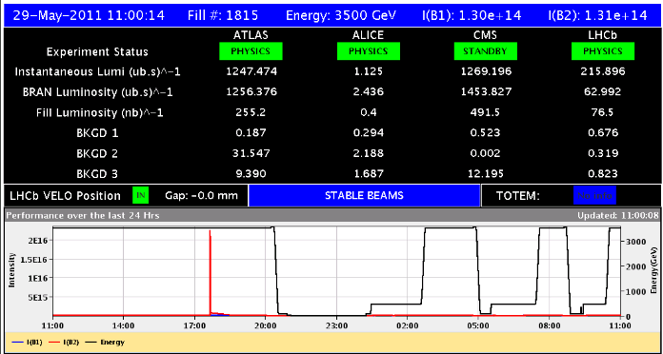
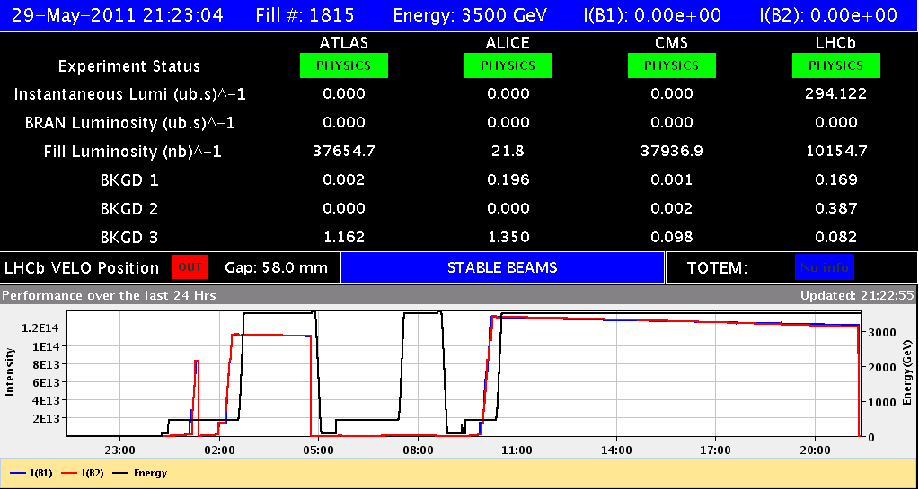
Fill #1815: 1092 x 1092 bunches
Which broke all records
2 x 73 MJ in the machine
Initial Lumi:
1.25 x 10³³ cm⁻²s⁻¹
And produced......
Integrated lumi 37.8 pb-1
after 10h30min
Dumped by QPS fault on RCBXH in S12
SEE? – UJ16

Slide 3
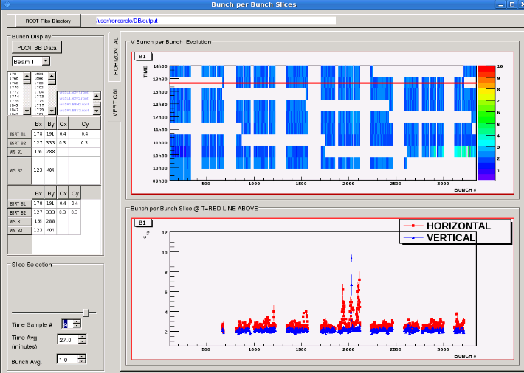
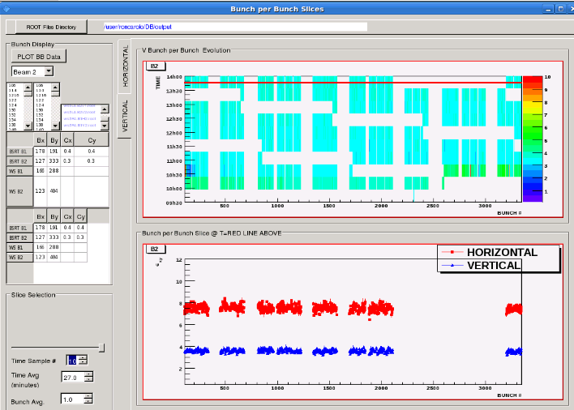
Fill #1815
Good at injection
  Injection losses < 10 % of ring BLM limits
  Injected emittances were good - around 2.5 microns - and were preserved for all trains, except for one B1 train (according to the BSRT)
    Emittance at physics from lumi 2.7 microns !
Rapid turnaround: did not wait long time at injection
  Stable beams 2h20 min after dump for the loss map at 3.5 TeV
  Including few minutes wait for vacuum at point 8, near injection kickers MKI, to come down
B1
B2

Slide 4
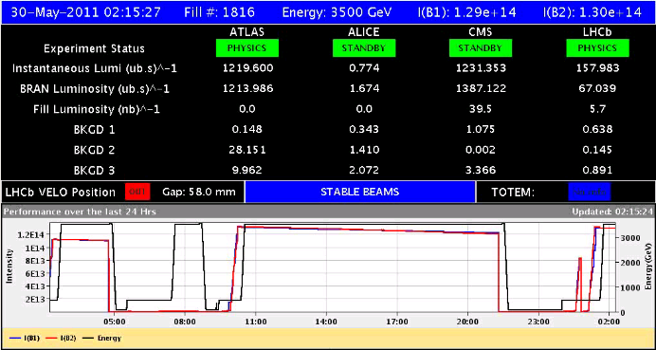
Followed by fill #1816 of last night / this morning
Again very nice lumi’s, even according to BSRT B2 is blown up horizontally. To check.
Presently this fill 22 pb-1
But blow-up at injection: dump and refill
Not understood, but watched...

Slide 5
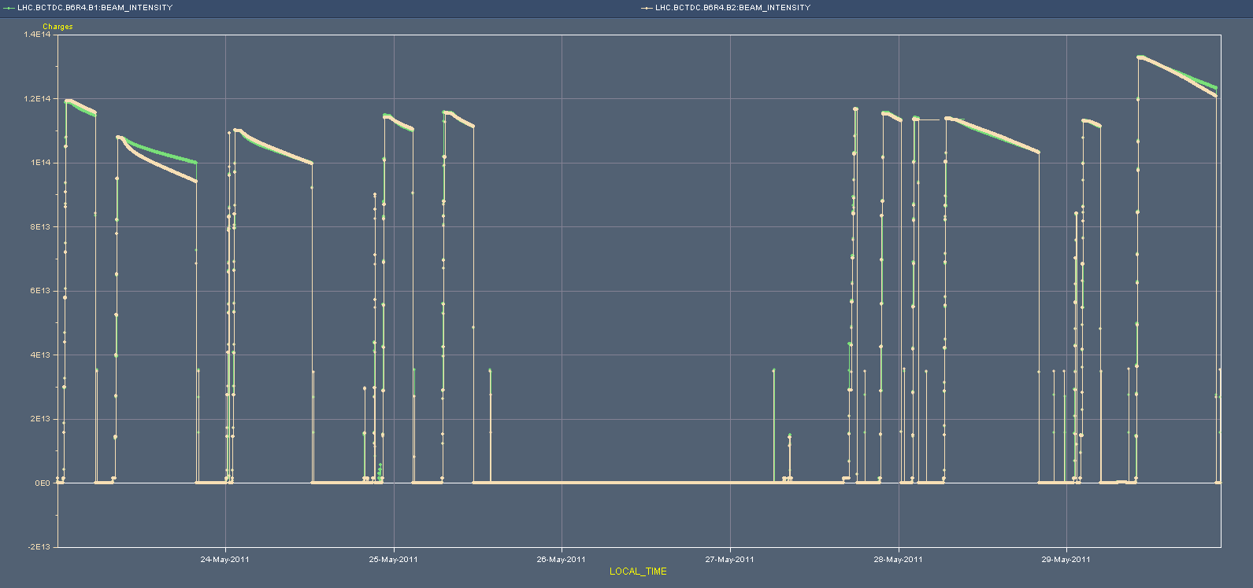
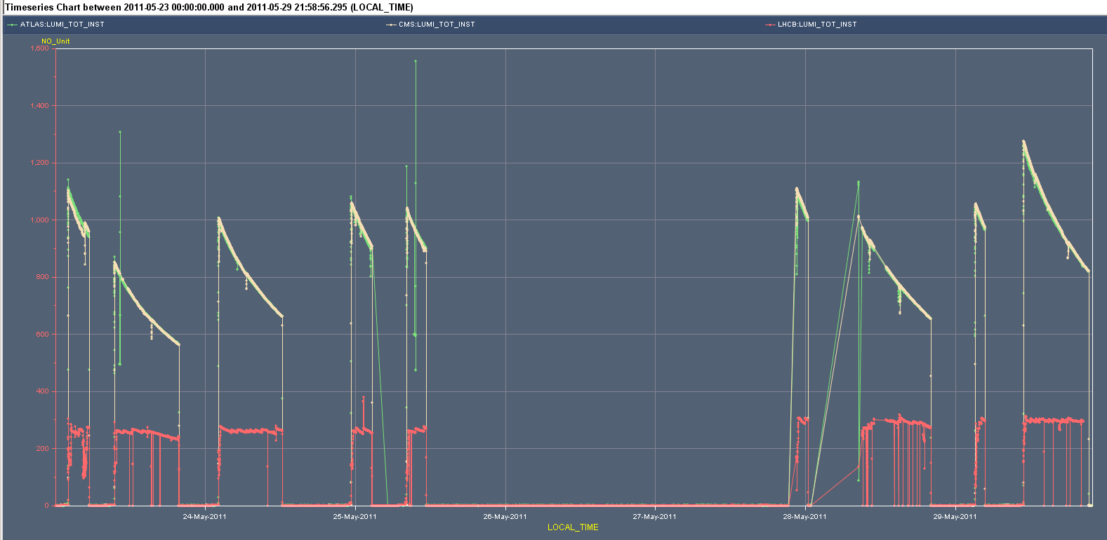
The Week
1.4e14
Ibeam
1.0e14
1.6e33
Lumi
1.0e33
Cryo Problem
0:00 Monday
Sunday Evening

Slide 6
The fills of the week
Fill # | #b | Lpeak | T-phys | L-int | Dump
1816 | 1092 | 1.20e30 | Still in
1815 | 1092 | 1.25E+30 | 10:30 | 37.8 | PC – QPS – SEE?
1813 | 912 | 1.05E+33 | 1:31 | 5.5 | UFO
1812 | 912 | 1.00E+33 | 10:40 | 31.7 | Operator
1809 | 912 | 1.09E+33 | 1:46 | 6.75 | FMCM - electr. pert.
1806 | 912 | 1.05E+33 | 2:58 | 10.4 | Cryogenics – SEE?
1805 | 912 | 1.05E+33 | 3:18 | 11.3 | RF frequency crate
1804 | 912 | 1.00E+33 | 10:09 | 29 | RF interlock - UFO
1803 | 912 | 8.50E+32 | 10:13 | 24 | Operator
4 Fills staying in more than10 hours
Only first fill initial lumi < 1e33
2 Fills dumped by operator
2 Fills dumped due to possible SEE related interlocks

Slide 7
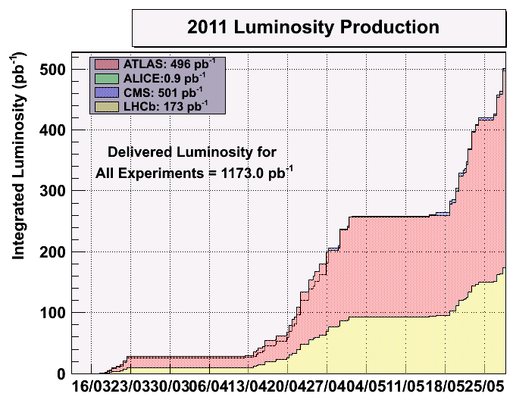
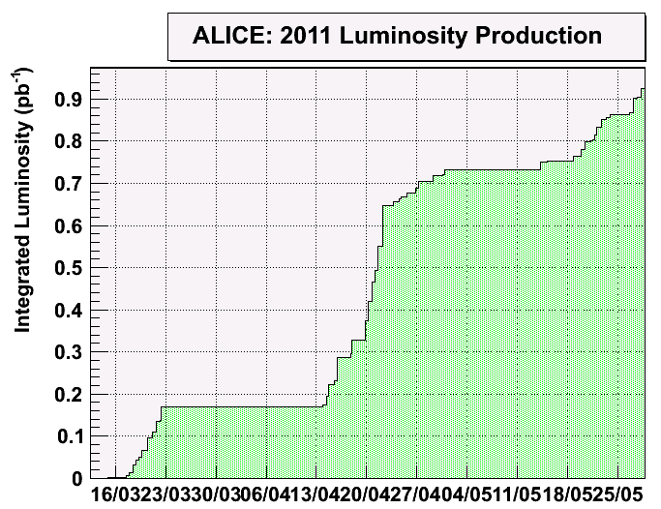
Reaching (almost) 0.5 fb⁻¹

Slide 8
The problems of the week
RF arc detector in waveguide
  Coupler arc detectors dumped 4 fills, of which 3 did not make it into stable beams
  Became quiet again over the last days
Various other problems
  Be-CO first line has arrived and started the intervention on the timing server A (CPU to be changed)
  UPS US85 is not working. Experts are in US85 and tried to switch it back, but it gives an electric arc.
    UPS US85 not redundant any more BUT ONLY SERVES CRYOGENICS (mp)
  QPS specialists in points 6 and 8
But the main problem of the week
  Cryogenics

Slide 9
Localization
QSCB PLC problem on 13.05.2011 – not replaced
Radiation problem NOT possible
QSCB PLC problem on 25.05.2011 – replaced
Radiation problem NOT possible
QURCB PLC problem on 19.04.2011 – replaced
Radiation problem possible
QURCB PLC problem on 25.05.2011 – replaced
Radiation problem possible
Equipment not in operation
– one cryo plant supplies two LHC sectors
Detailed explanation of the problems origin should be given by EN/ICE experts

Slide 10
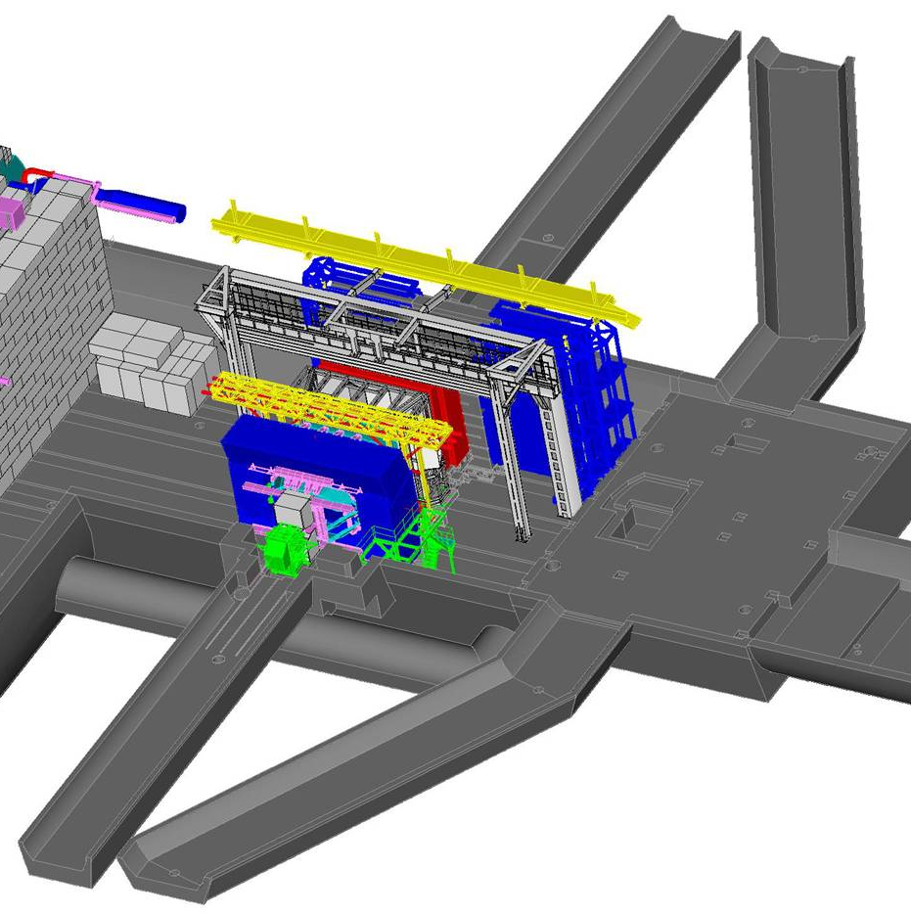
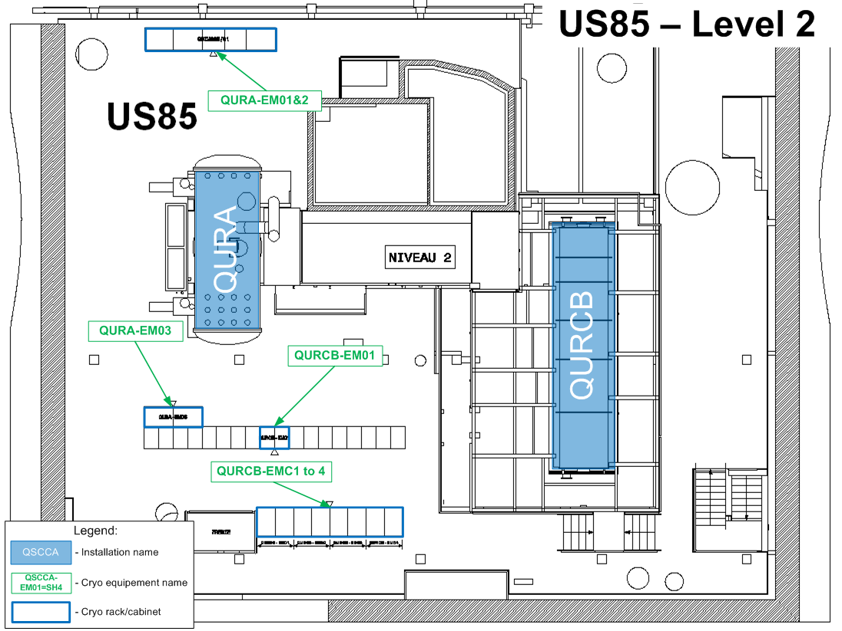
Localization
(C. Theis & co-workers, EDMS 735075)
US85
QURCB PLC localization

Slide 11
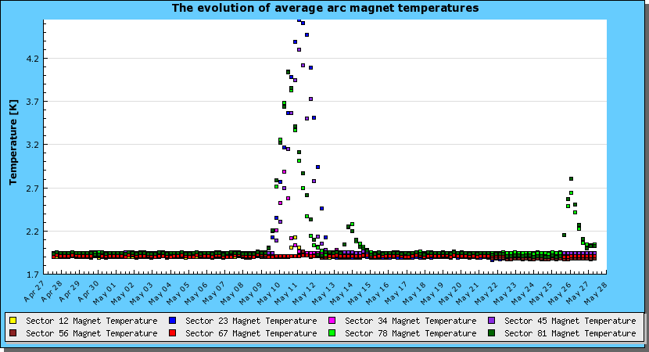
Recovery curves
Recovery and stabilisation took about 48 hours
TS May
Stop 25.05.2011
Stop 13.05.2011

Slide 12
The machine checks of the week
RF checks with one cavity off, checking debunched beam in the abort gap & reflected power
Loss maps at injection
Injection protection checks – TDI, TCLI, TCP
Off-energy loss map
Dynamic collimator position limits during the squeeze
RF-voltage interlock at 3.5 TeV
  Moved to software interlock after it spoiled a fill at the start of the ramp

Slide 13
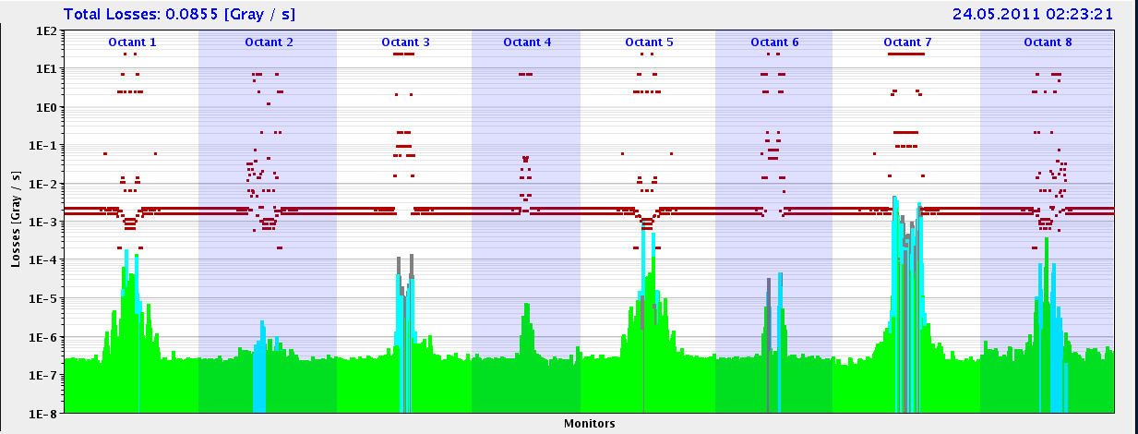
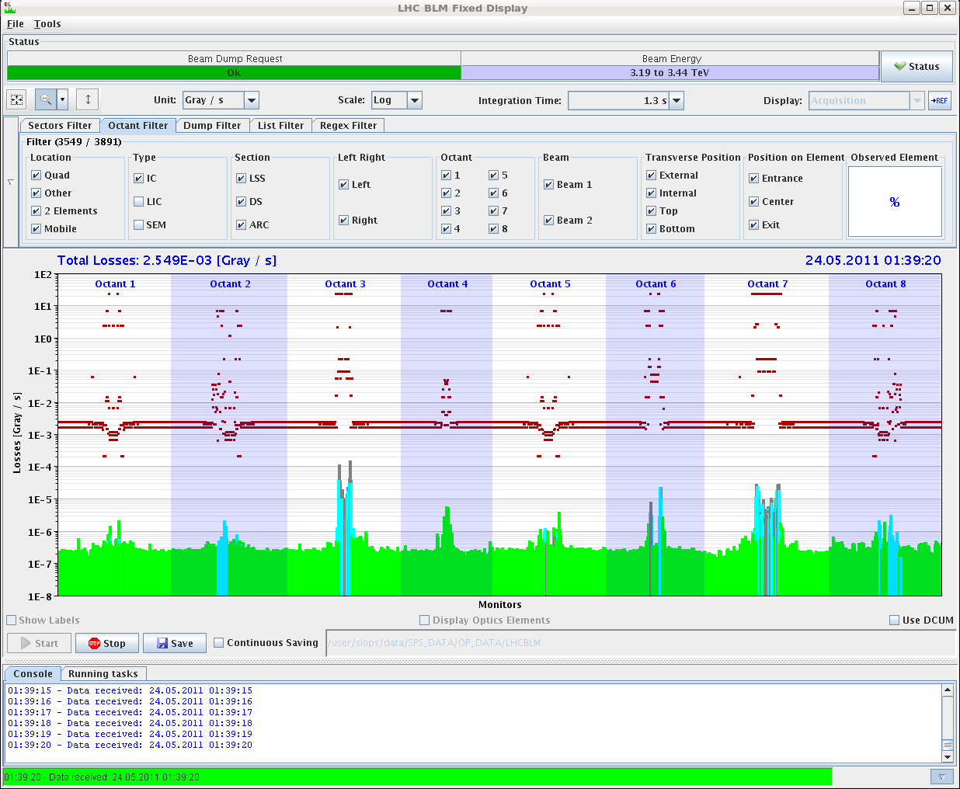
Monday
End of ramp : again high losses in IR6 (as compared to IR7)
  Disappears in collisions.
Collisions
Due to:
- Increased vac. Levels
- Synchrotron light ?
Ramp

Slide 14
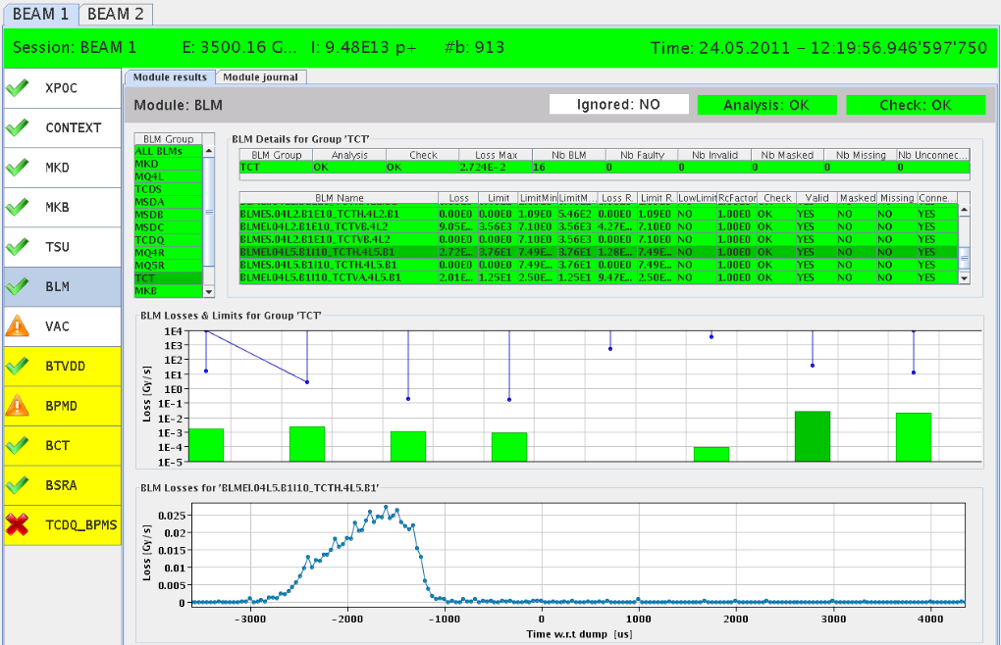
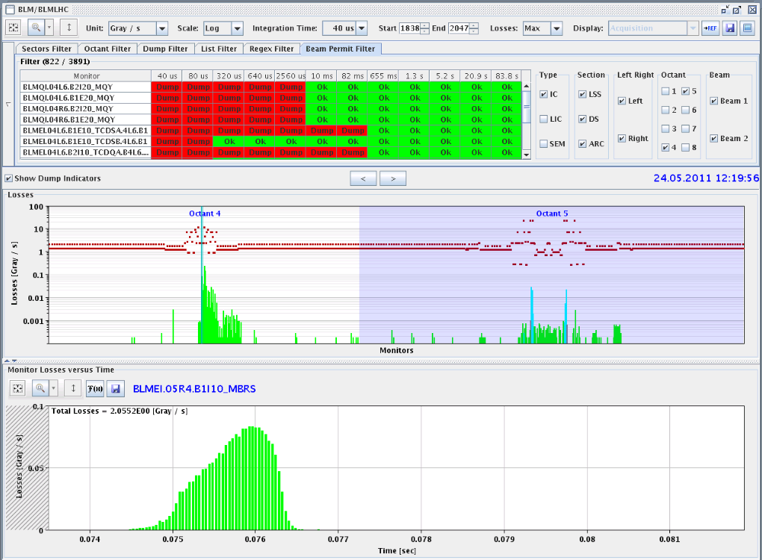
UFO point 4
Dumped by RF arc detection – following a UFO in point 4
XPOC TCT.4L5.B1
PM TCTV.4L5.B1

Slide 15
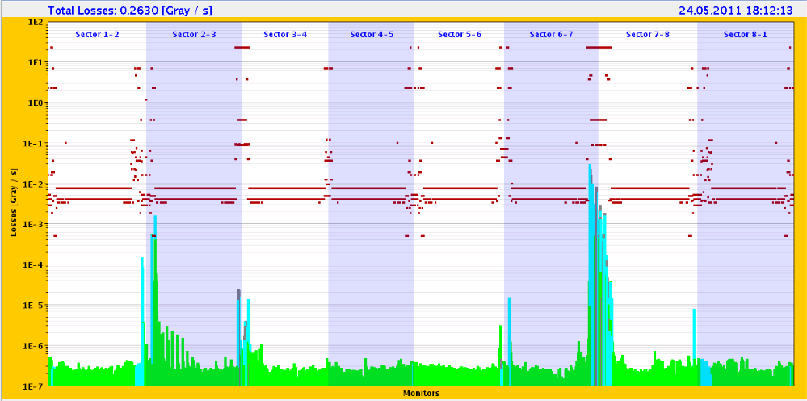
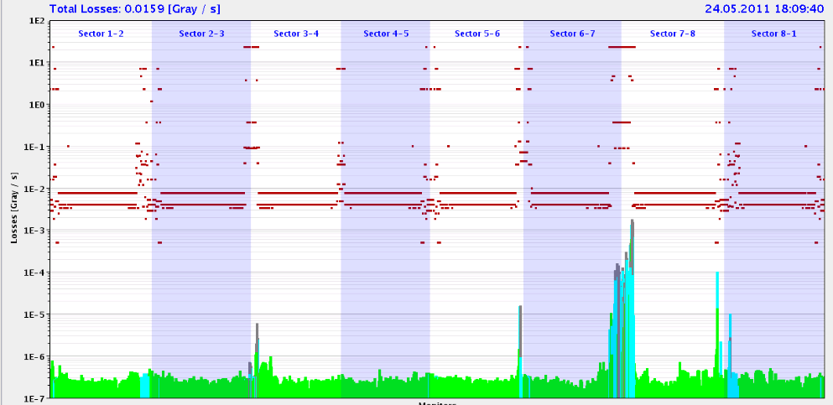
Loss Maps at injection
With injection protection in, check ratio TDI / TCP before TCLI changes
B1 – V:
TCP
TDI seems to be too close to beam
TDI
B2 – V:
TCP
Looks OK
TDI

Slide 16
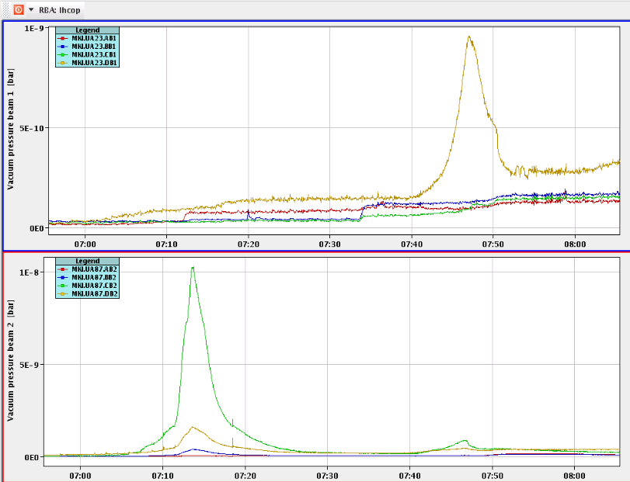
Injection kickers MKI Point 8 vacuum
Vacuum increase during end of filling stopping injection for a few minutes occurred a couple of times now.
  SIS interlock at 2E-9.
E-cloud in interconnects between the injection kickers? But then why does it decay so rapidly? -> Beam Screens ?
Vac reading MKI-C stopping injection

Slide 17
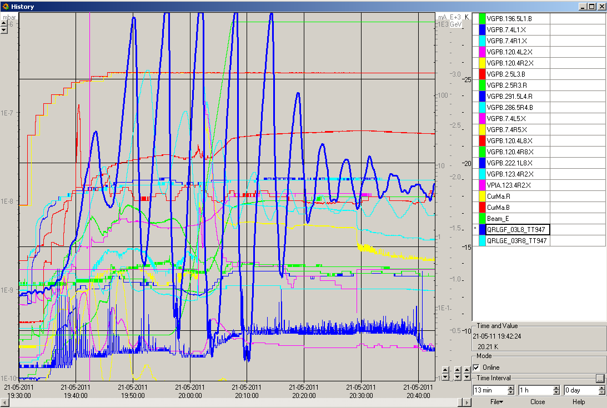
Vacuum and cryo evolution L8
Cryo team struggling to keep the temperature of the BS L8 under control
  Ad-hoc settings for injection & ramp improved the situation
Better now, but still point 8 worse than the rest
  Partly due to warm up

Slide 18
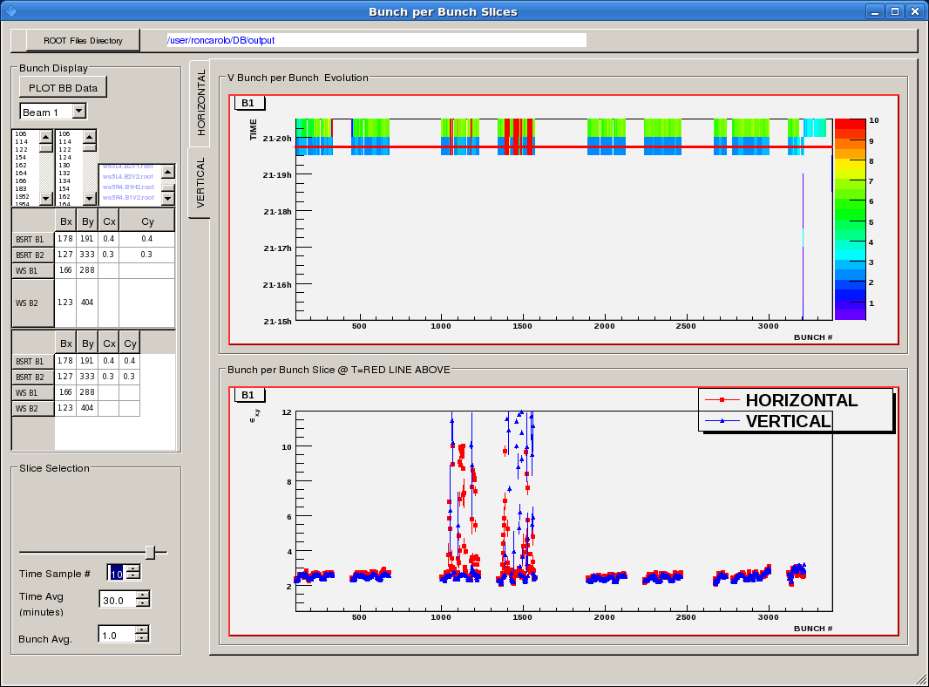
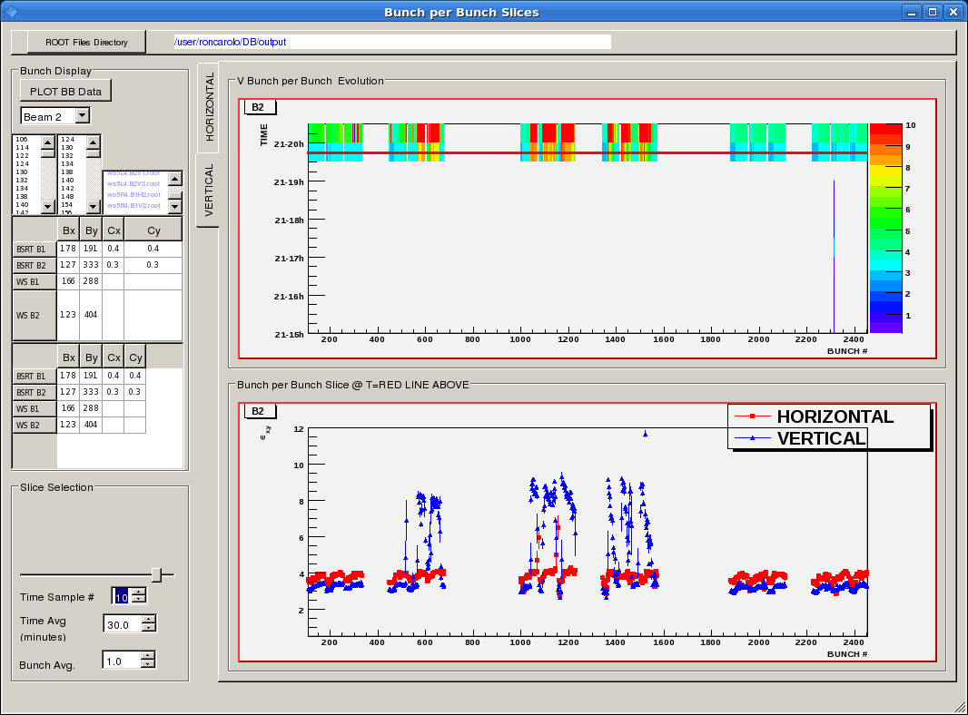
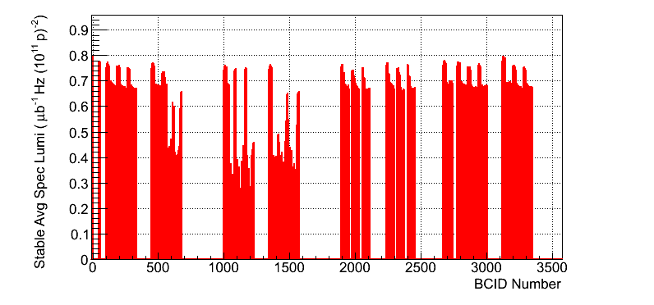
912 bunches – lower performance fill
In all fills with poorer performance, blow-up mostly in trains 2 to 4.
Happens typically at injection.

Slide 19
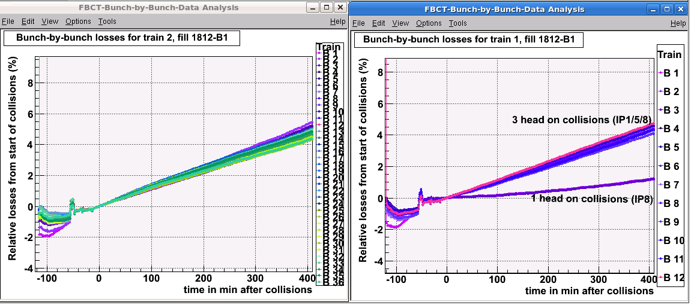
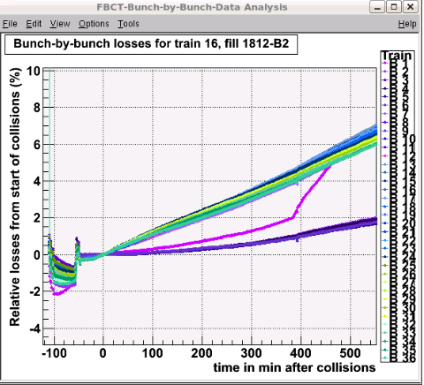
Fill #1812
Relative losses of bunch current after 3.5 hours
Clear effect of number of collisions
B2 increasing losses of one bunch when levelling IP2 and LHCb at the same time

Slide 20
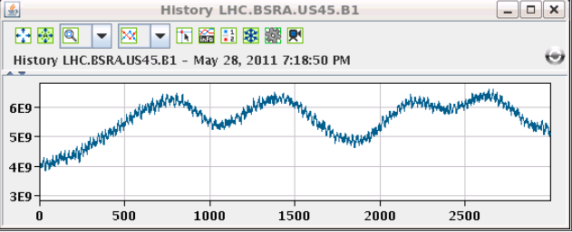
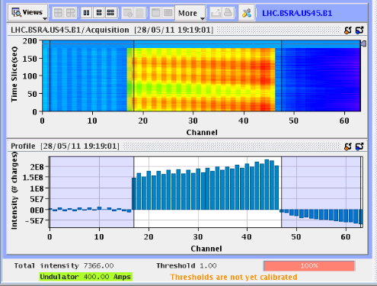
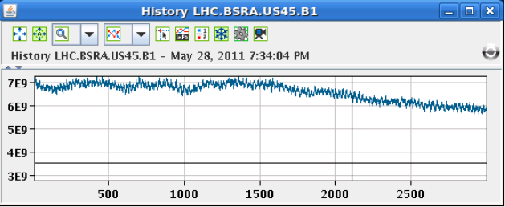
Switching off one RF cavity
After 5 minutes see the “bunches” passing the abort gap
After 20 minutes abort gap population starts to decrease

Slide 21
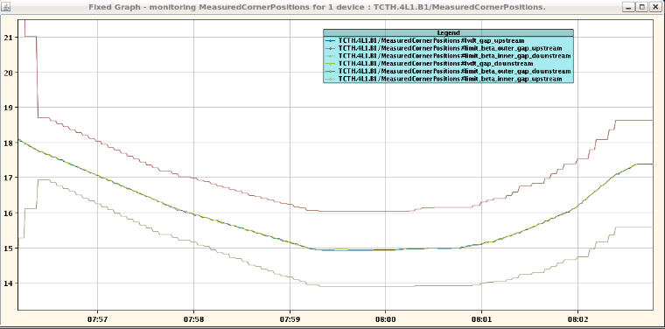
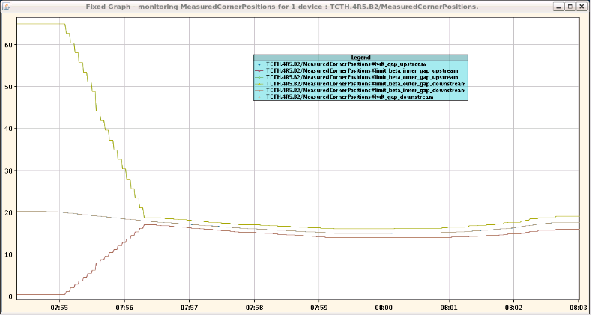
New betastar limits for collimator gaps worked as expected.

Slide 22
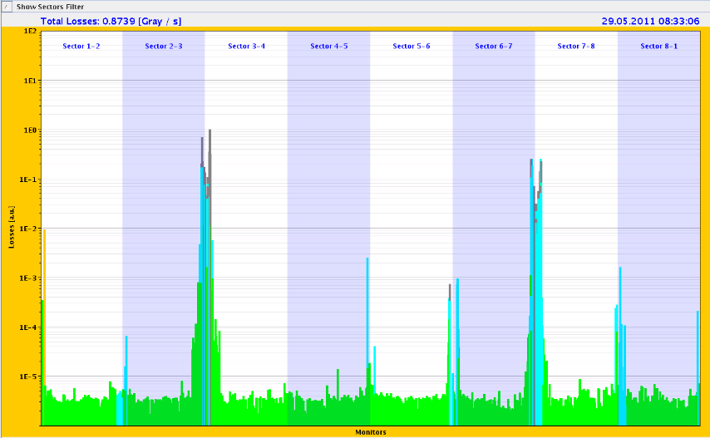
Off energy loss map (-500 Hz): SR says OK

Slide 23
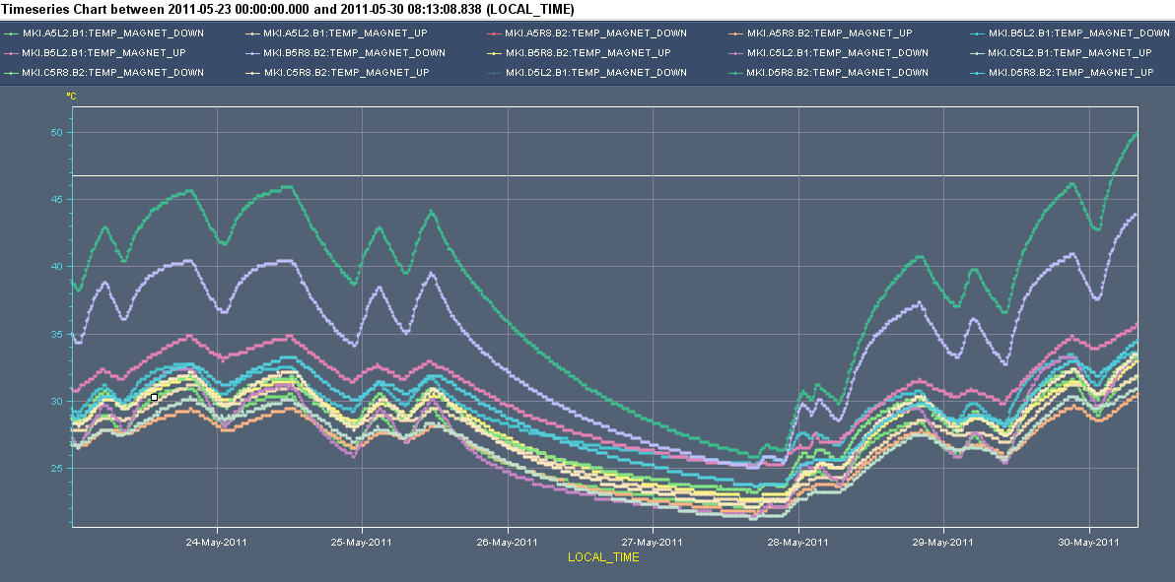
MKI temperatures
Reached 50 °C this morning
Software interlock for the moment at 55 °C
52 °C
20 °C
0:00 Monday
“now”

Slide 24
The coming week
Outstanding
  Asynch dump test @ 3.5 TeV for Roman Pots
    Measure chromaticity for FIDEL over the ramp
  End of fill: TCL adjustment
  TCLIB adjustment before going to 144 bunch injection
  Inch up the MKI temperature interlock
But mainly
  Continue 1092 x 1092 bunches physics
  1092 x 1092 and 144 bunch injection

