Slide 1
Friday AM
Some oscillations of the cryo conditions in MSR8 perturbed the setup for injection.
RF frequency interlock fixed – required a reset of RF controls in Pt4.
Injection protection:
Check of TDI and TCLI setup, confirmed with loss maps.
Summary:
TDIs are at the assumed settings and consistent with the TCPs - upper jaw of TDI. B1 needs moving IN by 0.4 sigma, all others are correct → done.
Protection is good with the current settings of TDI/TCLIb/TCLIa, but we still risk having large beam loss on a TCLIb. The TCLIb of at least point 8 will be opened up more (next week) to reduce the load on the Q6 in case of injection loss problems, and pending full FLUKA simulations.

Slide 2
Friday PM
16:00 Start filling 912x912
Vacuum OK – one large spike around Q5.L1 (S81) at the beginning of injection
18:15 Ramp - beautiful beams (intensity+emittance).
Dumped by the new RF interlock on total voltage at 563 GeV.
>> disabled again. RF will now first monitor the interlock.
21:00 Refill
22:40 Stable beams fill 1809 – almost 1.1E33 cm-2s-1.
DIP problem at start of fill…
00:30 Dumped by FMCM on RD1.LR5 – electrical perturbation.

Slide 3
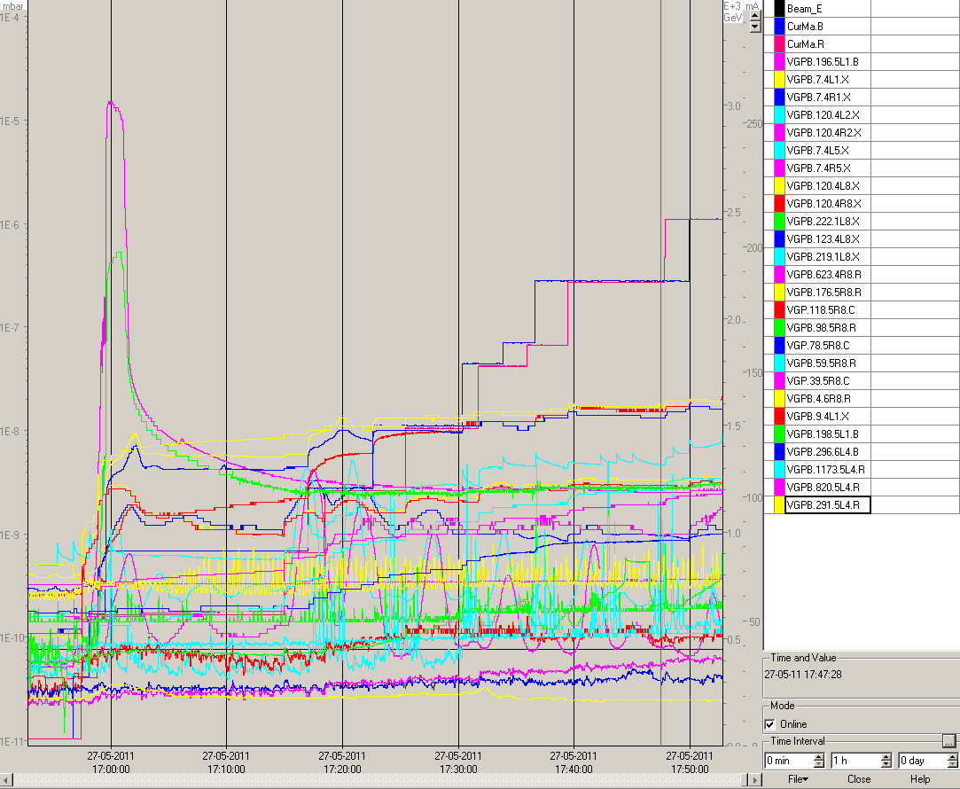
Vacuum spike during first HI injections

Slide 4
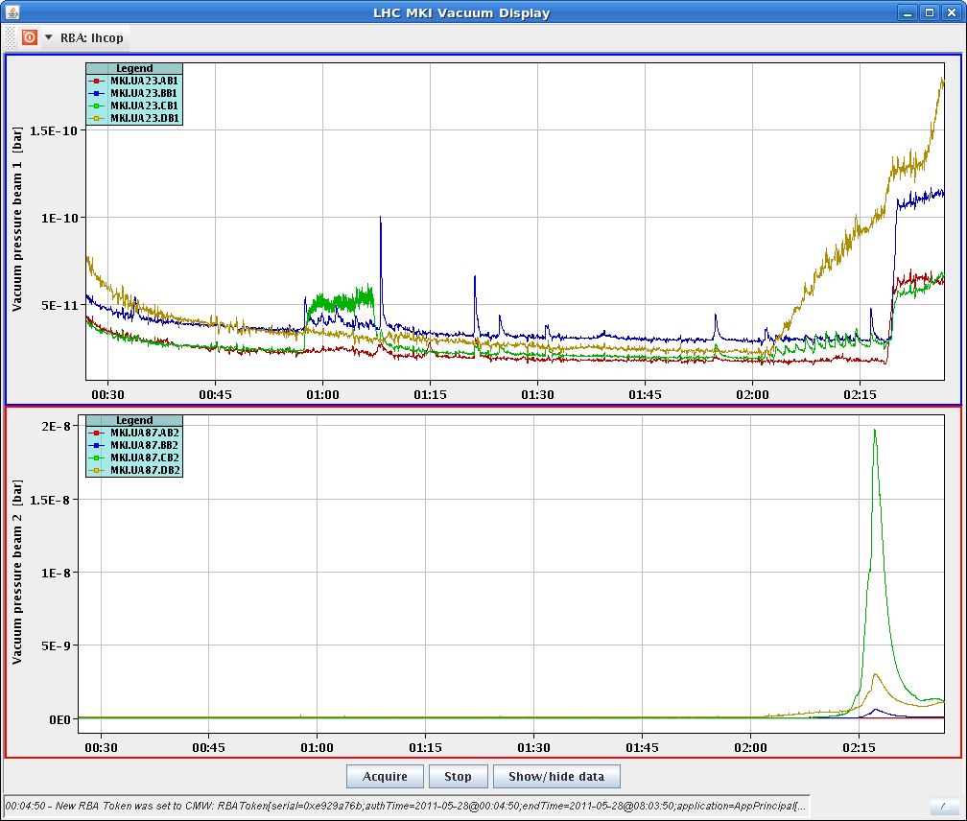
Friday Night
Refill…
Vacuum spike on MKI B2 again.
Problems with Q measurements – almost no signal…
Beam dumped on flat top – again RD1.LR5. Also problem on RB.23 – electrical perturbations

Slide 5
Friday Night / Saturday morning
Refill once more.
Vacuum interlock on MKI B2. Reset by expert needed.
Problem with the MTG – no timing event sent.
Reboot of timing system stops all 60A CODs and send out access events for 2 sectors…
At 07:00 the MTGA is found dead again. Switch the MTGB.
08:15 Stable beams fill 1812
Again DIP problem with luminosity.

Slide 6
Today
Keep this fill a while… end of RF off tests (ADJUST).
If fill is lost before RF test: special cycle – only to flat top – for the RF test (no squeeze, no collisions).
Off momentum loss map (required by coll team).
Increase number of bunches if time is reasonable (not in the night)

