Slide 1
LHC Status Tue Morning 17-Mai
Bernhard Holzer, Gianluigi Arduini et al
Tentative Planning
Mo morning | set up 228 bunch injection (36 bunch trains), ramp, squeeze, collisions 1... 2 h luminosity (depending on experiments) ATLAS length scale calibration
Mo late | Abort Gap keeper Checks Loss Maps at Injection
Mo night | 480 bunches: injection (72 bunch trains), ramp, squeeze, collisions, luminosity run until Tue morning, 7:00h
Tue morning | 8:00h TOTEM / ALFA alignment studies,special fill pattern, scheduled time: ... until 20:00h
... | tcdi adjustment (beam 1) set up 108 bunch transfer

Slide 2
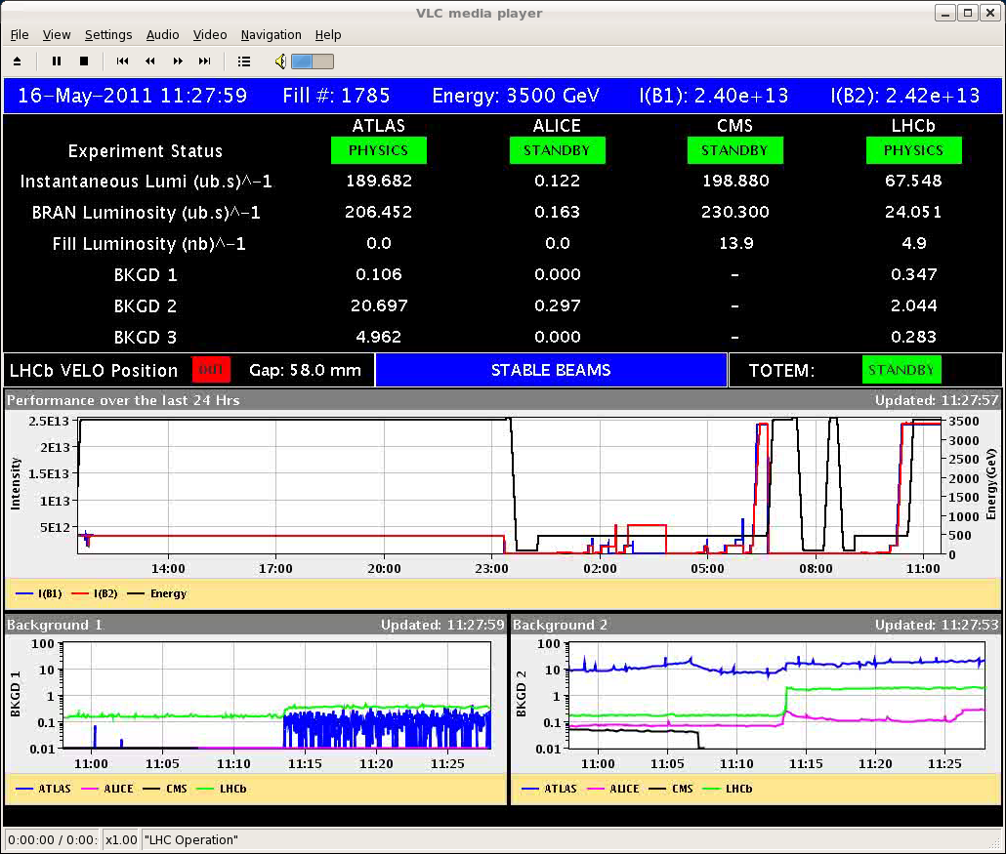
Mo morning
9:00h recovered from power glitch
228 x 228 bunches
no problems.

Slide 3
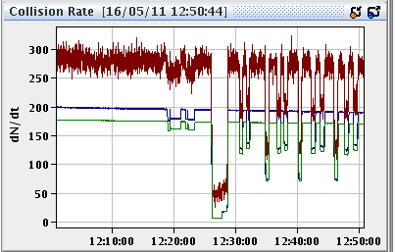
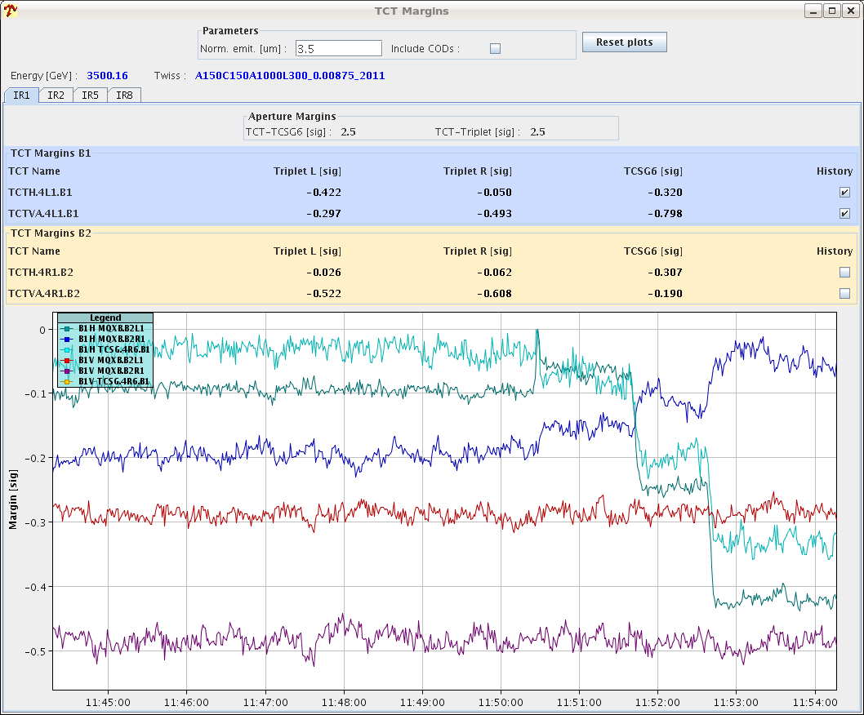
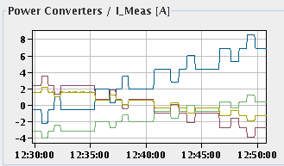
Mo morning
11:45h VdM scan bump calibration

Slide 4
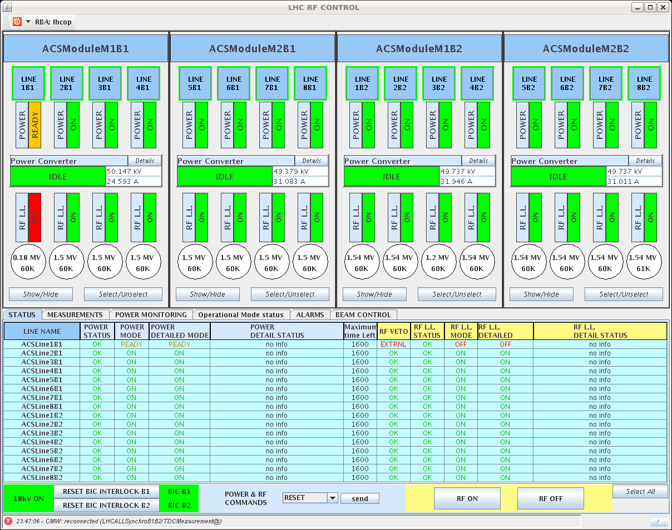
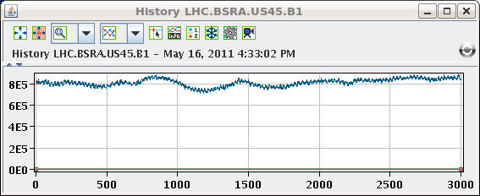
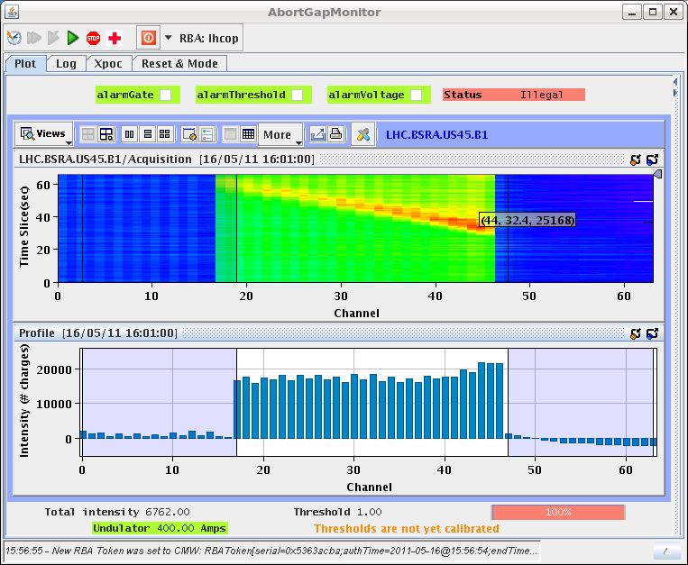
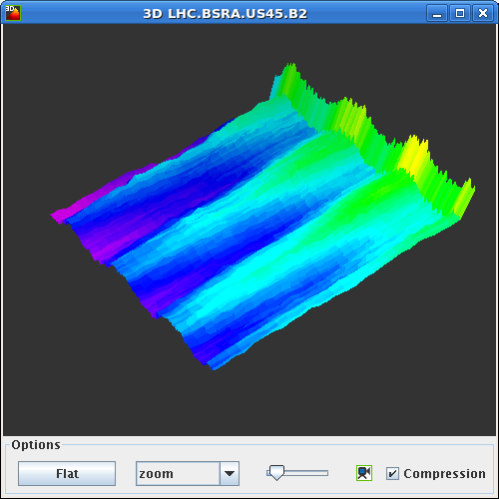
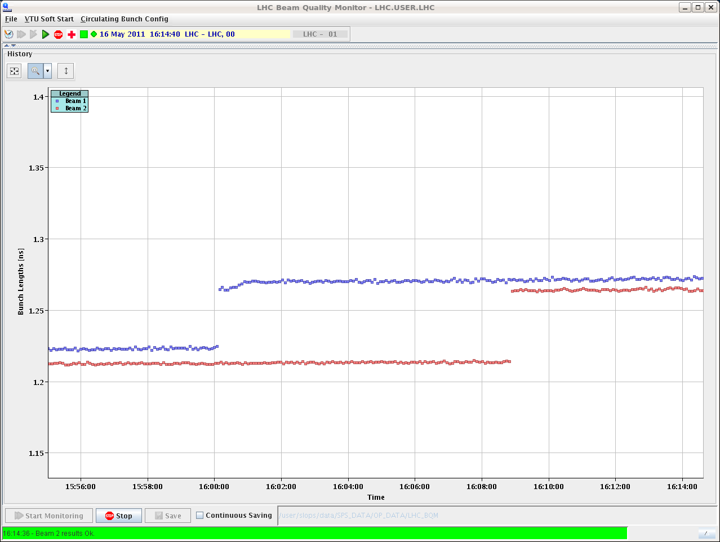
Mo afternoon
14:52h Philippe and his Klystrons
dedicated switch off of Klystrons in beam 1 & 2
Cavity off
some intensity in the abort gap
some bunch lengthening

Slide 5
Mo afternoon:
17:24h preparing for injection, abort gap keeper and loss maps
trip, of triplet circuits in Pt 8
18:30h Access needed for the converters in point 8
...
20:04h The intervention on the IT.L1 is over: a diode on
short circuit was found on the output module on RTQX2.L1.
22:16h preparing restart
22:19h CMS operator switch activated by error
... costs a beer !!!
22:39h Beginning the abort gap keeper test
Bunch 31181 Beam 1 Ok
Bunch 31181 Beam 2 Ok

Slide 6
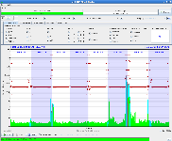
Mo night / Tue morning:
00:30h preparing loss maps
00:49h We had re-injected a nominal bunch in B1 when it was dumped. From the preliminary analysis it looks like self triggered by the LBDS
We tried to rearm the LBDS but the task fails. It seems something is wrong with one of the dump kickers.
→ Access in the UA63 to change a Power trigger unit module

Slide 7
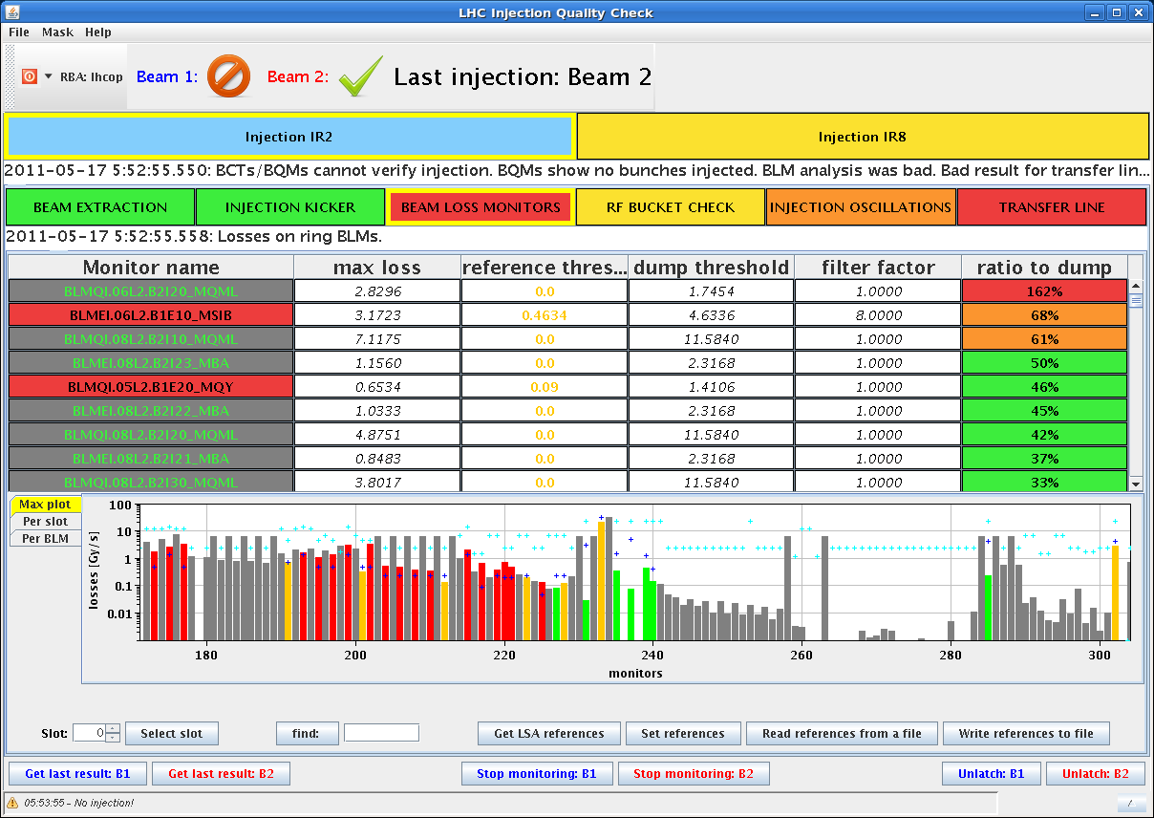
Mo night / Tue morning:
05:50h restart injection
Losses at injection of beam 1,
probably the cause of the dump.

Slide 8
Tentative Planning
Mo morning | set up 228 bunch injection (36 bunch trains), ramp, squeeze, collisions 1... 2 h luminosity (depending on experiments) ATLAS length scale calibration
Mo late | Abort Gap keeper Checks Loss Maps at Injection
Mo night | 480 bunches: injection (72 bunch trains), ramp, squeeze, collisions, luminosity run until Tue morning, 7:00h
Tue morning | 8:00h TOTEM / ALFA alignment studies,special fill pattern, scheduled time: ... until 20:00h
... | tcdi adjustment (beam 1) set up 108 bunch transfer
✔
✔
➔
➔

