Slide 1
May 2011 VdM scans
15.05.2011
Fill 1783
SPECIAL THANKS TO
Louis & Mirko
For the nice fill

Slide 2
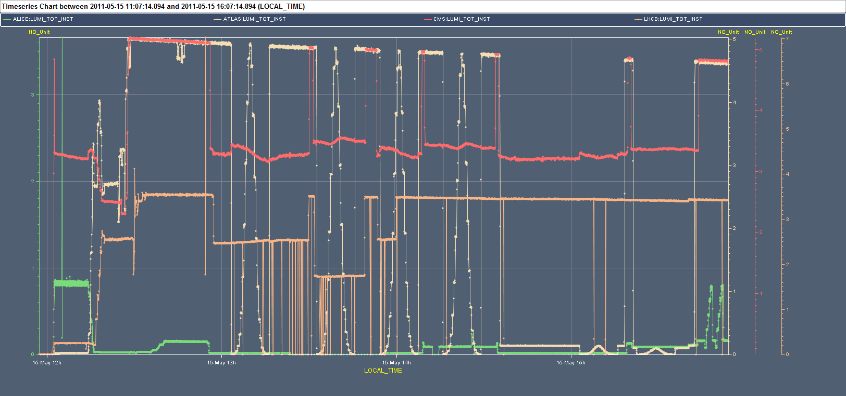
ATLAS scans
X, Y, X, Y, X with Y separation*, Y with X separation* (*Chose 0.16mm)
All two-beam symmetric, +/-6 sigma, 25 steps, 20s/step
X1
Y1
X2
Y2
X3
Y3
reoptimized ALICE to find head-on
During the ATLAS scans: IP5/2/8 separated by 0.05/0.128/0.088 mm in the scanned plane (but IP8 only for first X/Y pair, then moved head-on in middle of 2nd X scan).
Error: ALICE should have been head-on but wasn't (not optimized in X), hence the separation in X was ontop another one

Slide 3
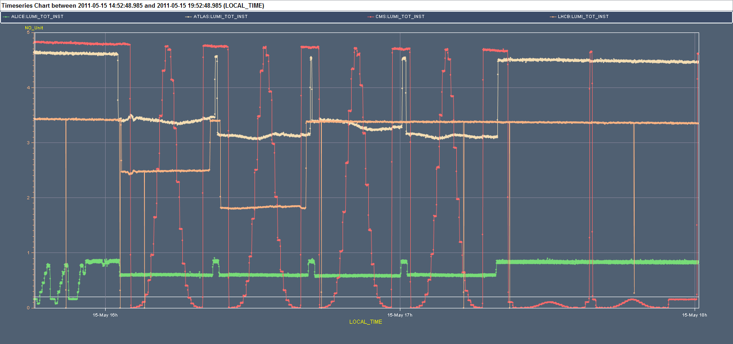
CMS scans
X, Y, X, Y, X with Y separation*, Y with X separation* (*Chose 0.16mm)
All two-beam symmetric, +/-6 sigma, 25 steps, 20s/step
X1
Y1
X2
Y2
X3
Y3
During the CMS scans: IP1/2/8 separated by 0.05/0.128/0.088 mm in the scanned plane (but IP8 only for first X/Y pair)

Slide 4
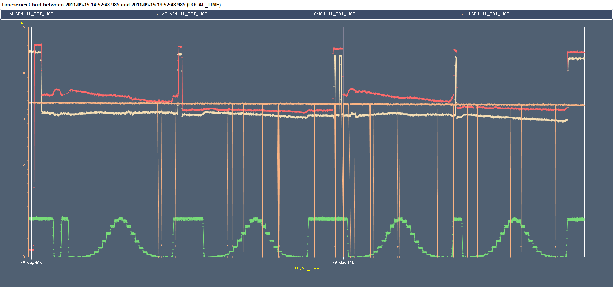
ALICE scans
X, Y, X, Y
All two-beam symmetric, +/-6 sigma, 25 steps, 30s/step
X1
Y1
X2
Y2
During the ALICE scans: IP1/5 separated by 0.05/0.05 mm in the scanned plane

Slide 5
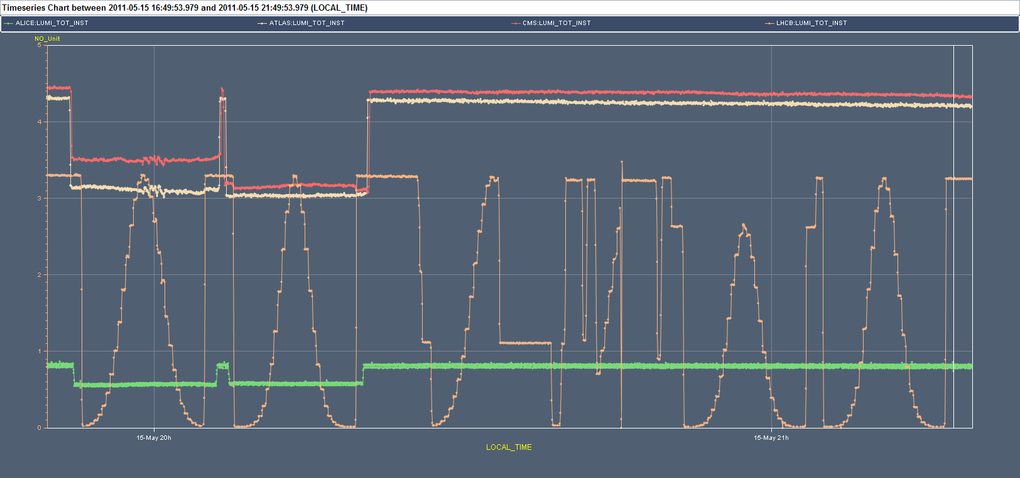
LHCb scans
X, Y two-beam symmetric, +/-6 sigma, 31 steps, 15s/step
X, Y one-beam, +/-3 sigma active beam, 16 steps, 15s/step FAILED
Y with x sep, Y two-beam symmetric, +/-6 sigma, 31 steps, 15s/step
X1
Y1
X2
Y2
Y3
X sep
Y4
During the X1/Y1 LHCb scans: IP1/2/5 separated by 0.05/00.128/.05 mm in the scanned plane

Slide 6
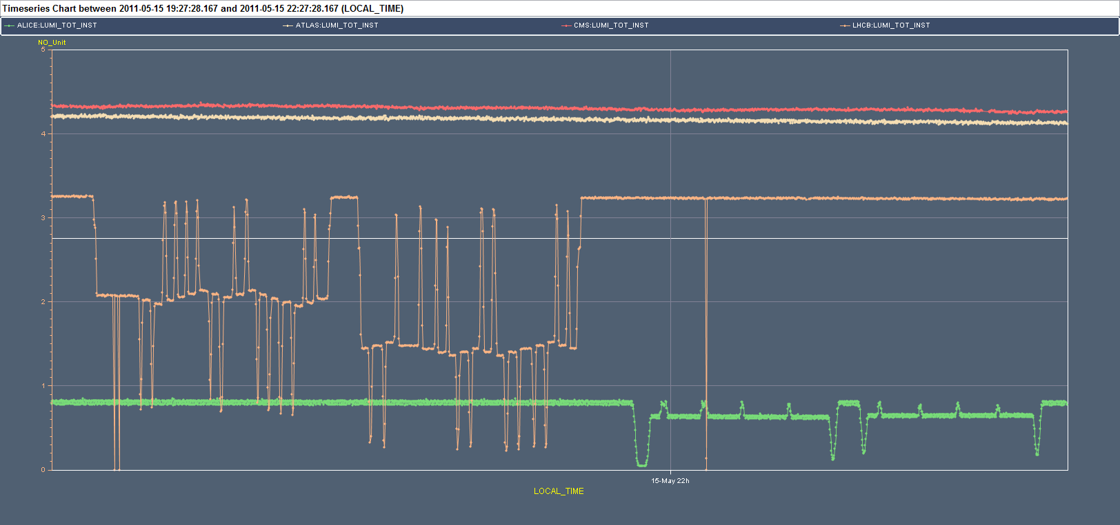
Length Scale Calibs
LHCb: 20 sec/step
ALICE: 120 sec/step

Slide 7
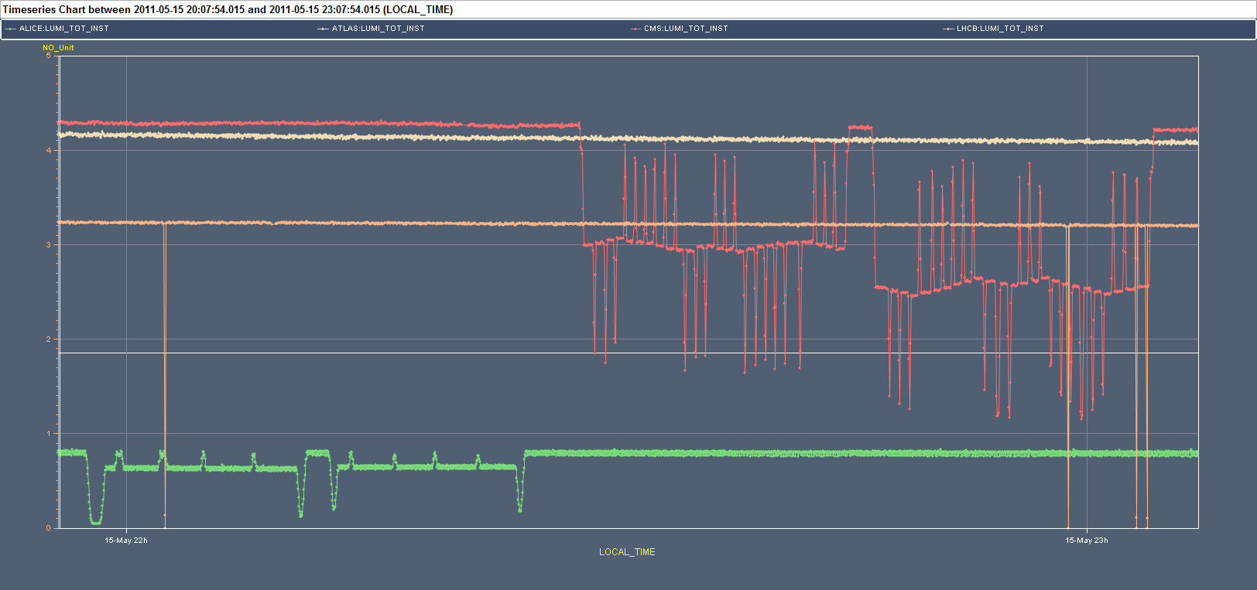
Length Scale Calibs
ALICE: 120 sec/step
CMS: 20 sec/step

Slide 8
LHCb LSC sequence
beam1 beam2 beam1 beam2
pos pos trim trim
0.000 0.000 +0.050 -0.050
0.050 -0.050 +0.080 +0.080
0.130 0.030 +0.080 +0.080
0.210 0.110 -0.080 -0.080
0.130 0.030 -0.080 -0.080
0.050 -0.050 -0.080 -0.080
-0.030 -0.130 -0.080 -0.080
-0.110 -0.210 +0.080 +0.080
-0.030 -0.130 +0.080 +0.080
0.050 -0.050 -0.080 -0.080
-0.030 -0.130 -0.080 -0.080
-0.110 -0.210 +0.080 +0.080
-0.030 -0.130 +0.080 +0.080
0.050 -0.050 +0.080 +0.080
0.130 0.030 +0.080 +0.080
0.210 0.110 -0.080 -0.080
0.130 0.030 -0.080 -0.080
0.050 -0.050 -0.050 +0.050
0.000 0.000 0.000 0.000

Slide 9
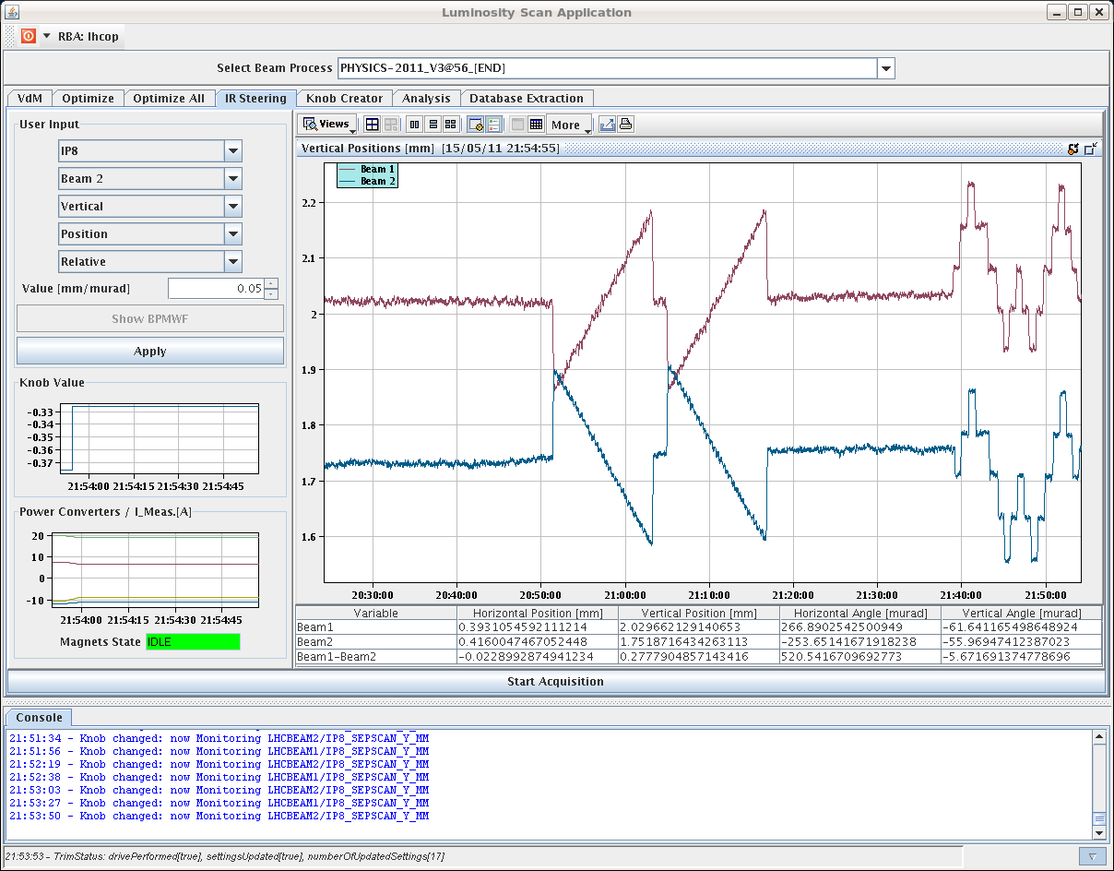
LHCb LSC

Slide 10
ALICE LSC sequence
Cap_sigma = 0.100 mm maximum single beam offset = 0.35 mm
========== SEQUENCE ===================
take data at | make trim on
beam1 beam2 | beam1 beam2
0.000 0.000 0.350 0.250
0.350 0.250 -0.150 -0.150
0.200 0.100 -0.150 -0.150
0.050 -0.050 -0.150 -0.150
-0.100 -0.200 -0.150 -0.150
-0.250 -0.350 0.250 0.350
0.000 0.000 0.000 0.000
All in millimeters

Slide 11
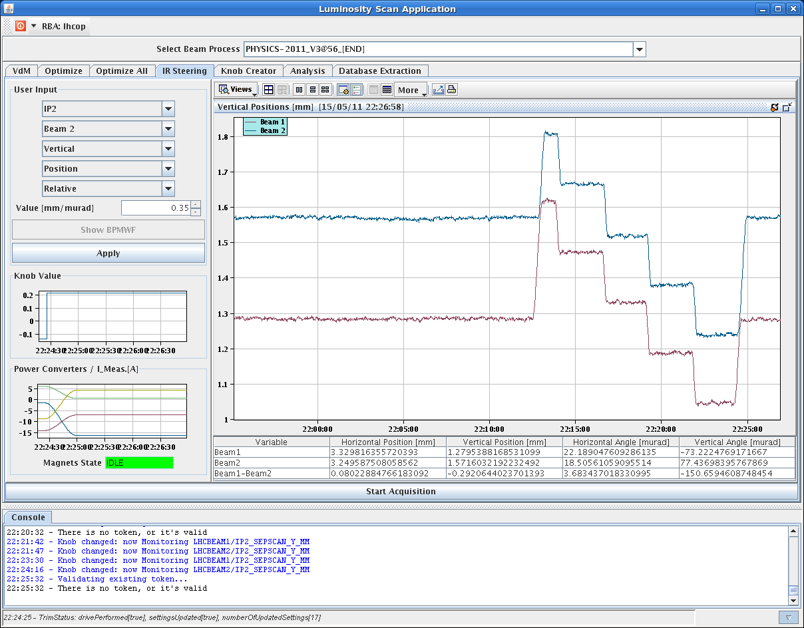
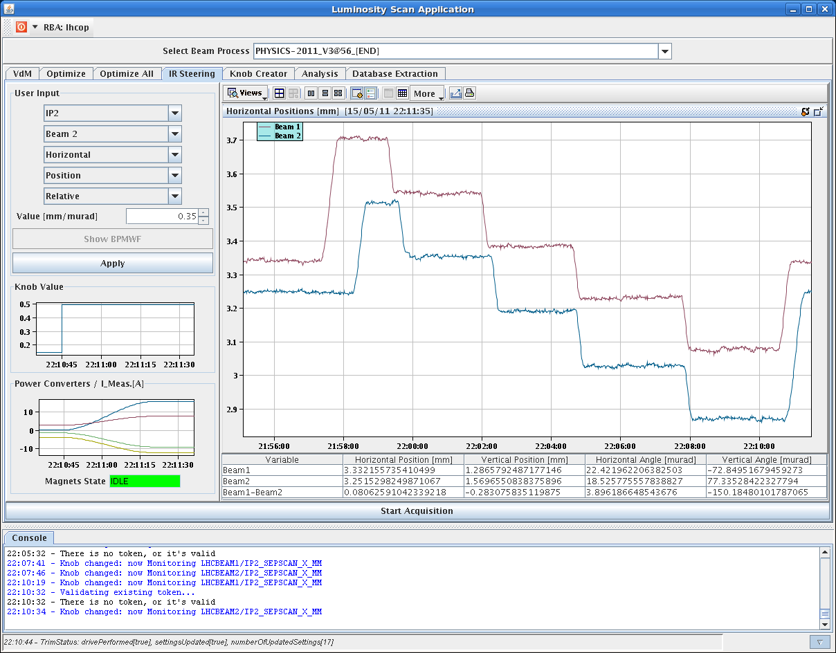
ALICE LSC

Slide 12
CMS LSC sequence
beam1 beam2 beam1 beam2
pos pos trim trim
0 0 0.03 -0.03
0.03 -0.03 0.035 0.035
0.065 0.005 0.035 0.035
0.1 0.04 0.035 0.035
0.135 0.075 -0.035 -0.035
0.1 0.04 -0.035 -0.035
0.065 0.005 -0.035 -0.035
0.03 -0.03 -0.035 -0.035
-0.005 -0.065 -0.035 -0.035
-0.04 -0.1 -0.035 -0.035
-0.075 -0.135 0.035 0.035
-0.04 -0.1 0.035 0.035
-0.005 -0.065 0.035 0.035
0.03 -0.03 -0.035 -0.035
-0.005 -0.065 -0.035 -0.035
-0.04 -0.1 -0.035 -0.035
-0.075 -0.135 0.035 0.035
-0.04 -0.1 0.035 0.035
-0.005 -0.065 0.035 0.035
0.03 -0.03 0.035 0.035
0.065 0.005 0.035 0.035
0.1 0.04 0.035 0.035
0.135 0.075 -0.035 -0.035
0.1 0.04 -0.035 -0.035
0.065 0.005 -0.035 -0.035
0.03 -0.03 -0.03 0.03
0 0 0 0

Slide 13
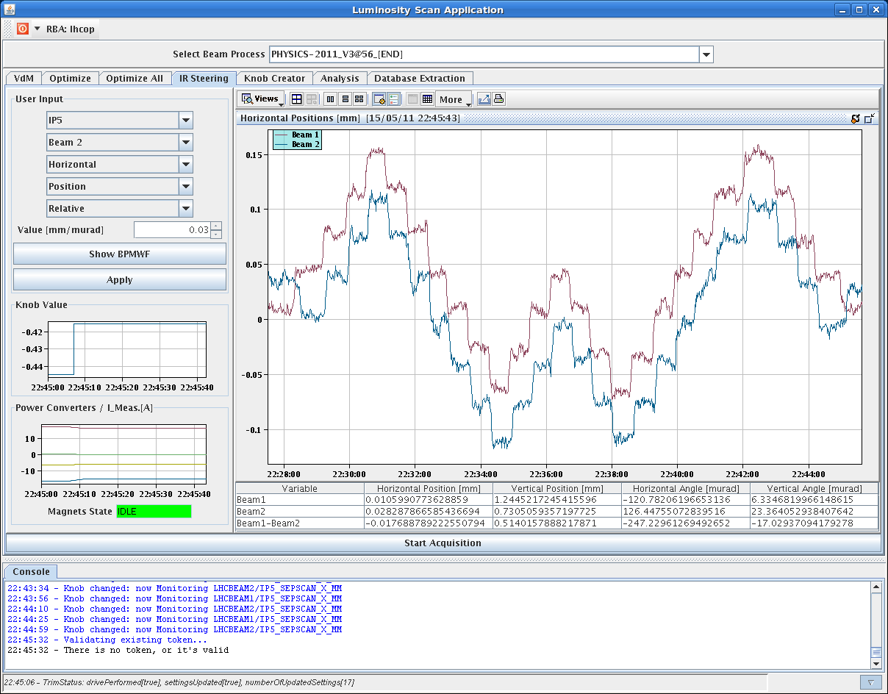
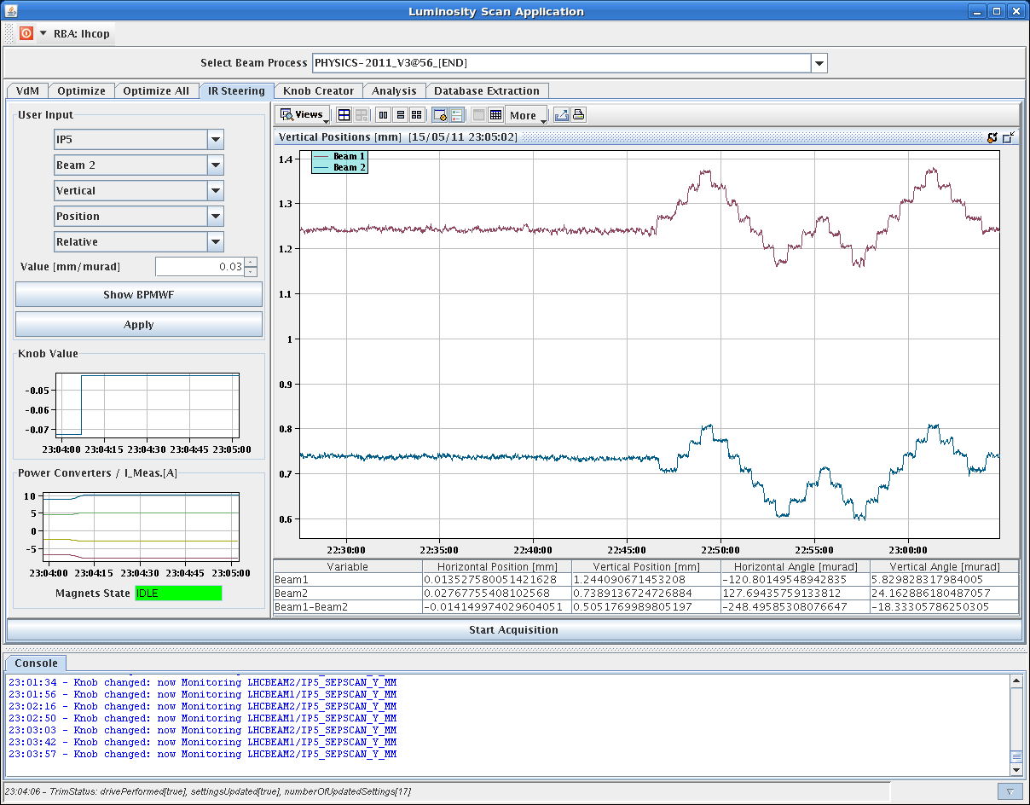
SPECIAL THANKS TO
"MAGIC FINGERS"
Stephane & Walter

Slide 14
And of course
Many thanks to OP / BI / ABP
And, special thanks:
LDM: Adam Jeff / Enrico Bravin
"continuous" mode
BCTs: Jean-Jacques Gras
WS: Ana Guerrero
WCM: Ralph Steinhagen
BSRT: Federico Roncarolo / Enrico Bravin
MC + Orbit: Jorg Wenninger, Mike Lamont

