Slide 1
MD Wed – Sat
Status 6.5.2011, 08:00
Day | Time | MD
Wed | 06:00 | UPS repair, ATS optics checks w/o beam
 | 12:00 | Cycle, test ATS optics w/o beam
 | 16:00 | 0.45 TeV: BPM offset determination for triplet BPMs
Thu | 00:00 | 0.45 TeV: Alignment TCDQ/TDI and injection losses (other beam)
 | 08:00 | 0.45 → 3.5 TeV: RF single-bunch instabilities
 | 14:00 | Ramp down, cycle.
 | 16:00 | 0.45 → 3.5 TeV: 90 m optics unsqueeze
Fri | 00:00 | Ramp down, cycle
 | 02:00 | 0.45 → 3.5 TeV: Cross calibration of BSRT/WS/BGI
 | 10:00 | Ramp down, cycle
 | 12:00 | 0.45 TeV: Collision tunes at injection + ramp down, cycle
 | 20:00 | 0.45 TeV: Beam-beam limit
Sat | 04:00 | 0.45 TeV: Investigation on CODs

Slide 2
MD Sat – Mon
Status 6.5.2011, 08:00
Day | Time | MD
Sat | 10:00 | 0.45 TeV: ATS (including cycle to new injection settings)
 | 20:00 | 0.45 – 3.5 TeV: Nominal collimation, single bunch tune shift
 | 04:00 | Ramp down, cycle
Sun | 06:00 | 0.45 TeV: RF multi-bunch instabilities
 | 10:00 | 0.45 → 3.5 TeV: Coupled-bunch instability rise times
 | 18:00 | Ramp down, cycle
 | 20:00 | 0.45 → 3.5 TeV: Quench test in the DS of IR7
Mon | 06:00 | Technical Stop
Lost | 6h | 3.5 TeV: Tune scan – beam-beam optimization, lifetime, losses

Slide 3
0.45 → 3.5 TeV: Cross calibration of BSRT/WS/BGI (Federico et al)
No summary in logbook…
Program completed at 450 GeV
B1 lost at ramp → ramp and 3.5 TeV data for B2 only.
To be analyzed offline.
Ramp with 2 trains of 12 bunches , but lost beam 1 at the very beginning of the ramp because of an energy interlock on the TCDQ.
Problem came form a glitch at the start of the movement which was converted into wrong energy reference (440 GeV whereas we were at 452 GeV).
bump scans around the BGI for beam 2 and did blow-up few bunches of the first train with the tune kicker. with collision tunes.

Slide 4
Collision tunes at injection
Local coupling corrections implemented from measurements at injection and at top energy.
Nominal tunes ramp for further coupling measurement and correction along the ramp with pilot bunch. Fine.
Tune scan from nominal to collision tunes at injection (plot 2). No effect on lifetime observed. Beam was ramped with collision tunes along the ramp.
A second ramp included coupling corrections computed from ramp 1. Improvement of about factor 2 observed in C- with the corrections along the ramp (plot 1). This coupling correction along the ramp is valid for nominal injection tunes too.

Slide 5
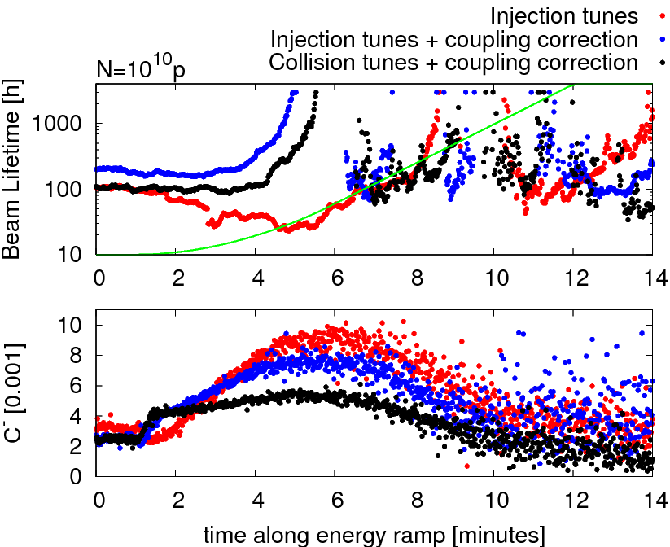
Coupling correction

Slide 6
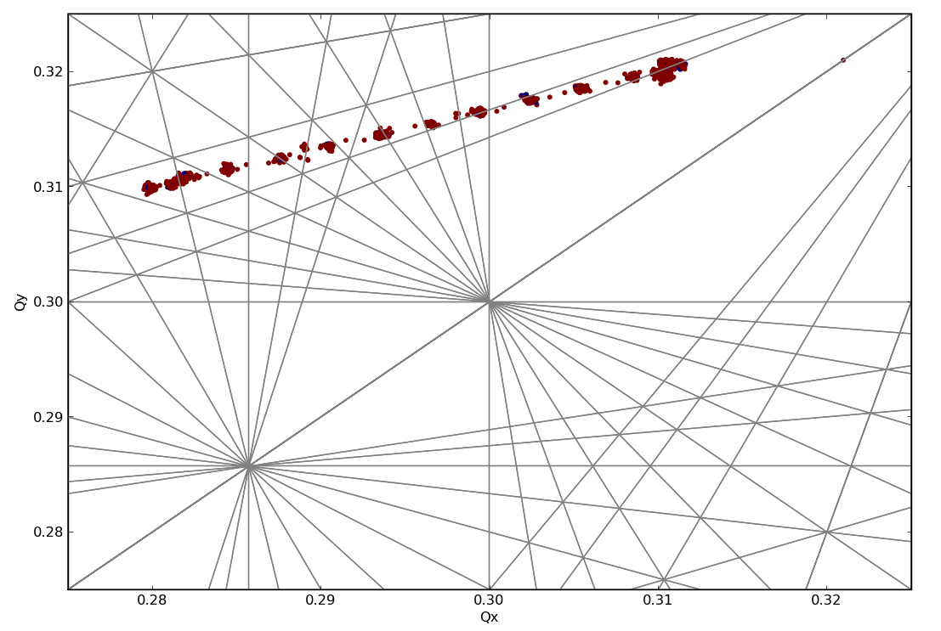
Tune scan

Slide 7
Collision tunes at injection
Tried a 3rd ramp with nominal bunch intensity, but lost about half the intensity right at the start of the ramp (see vertical amplitudes from BBQ plot 3). Speaking with collective effect experts it appears that chromaticity could be negative. Clear large vertical oscillations in both beams 1 minute after the start of the ramp. Transverse dampers were off.
No difference in beta-beat for collision and injection tunes.
Small difference observed in the beta-beat for injection compared with 4-4-2011 (for both beams).

Slide 8
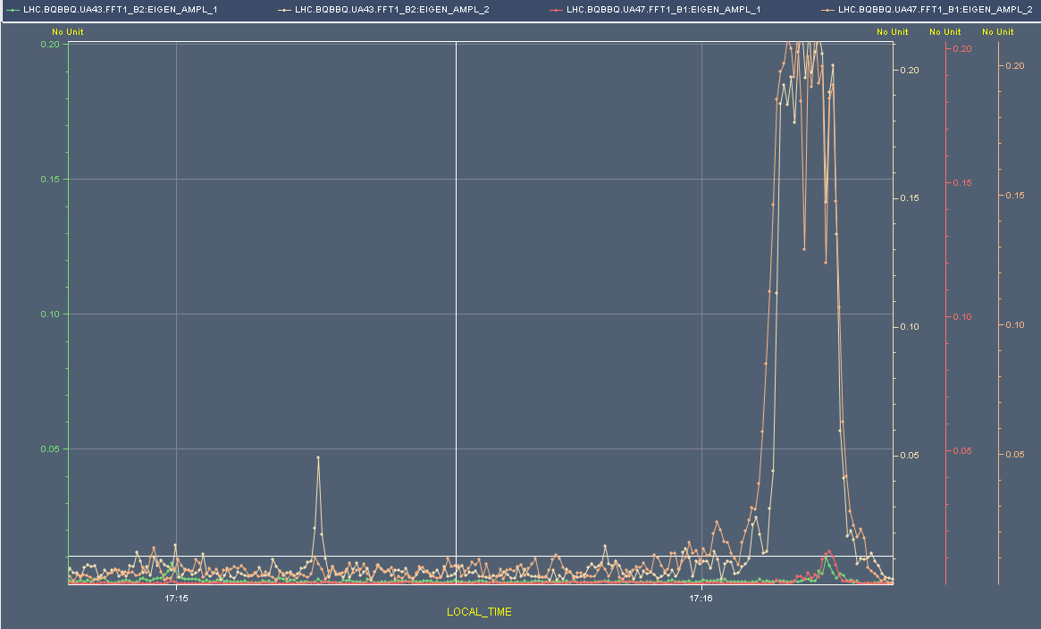
Tune Amplitude: Beam Loss Ramp #3

Slide 9
Beam-beam limit (Werner et al)
Collided high intensity beams (1.7 E11) and small emittances (smaller than 1.5 um) in IP1 and IP5.
First attempt achieved tune shifts 0.01 per IP, vertical blowup of emittance.
Blowup most likely due to 10th order resonance.
In final attempt reduced vertical tune to end up below 10th order after putting beams in collision. No more blowup observed, tune shifts per IP in excess of 0.015 (with initial emittance below 1.2 um).
Collisions in IP1 and IP5, optimized and no more blowup.
No limit found for head-on beam-beam effects for the intensities investigated so far (no long range yet).

Slide 10
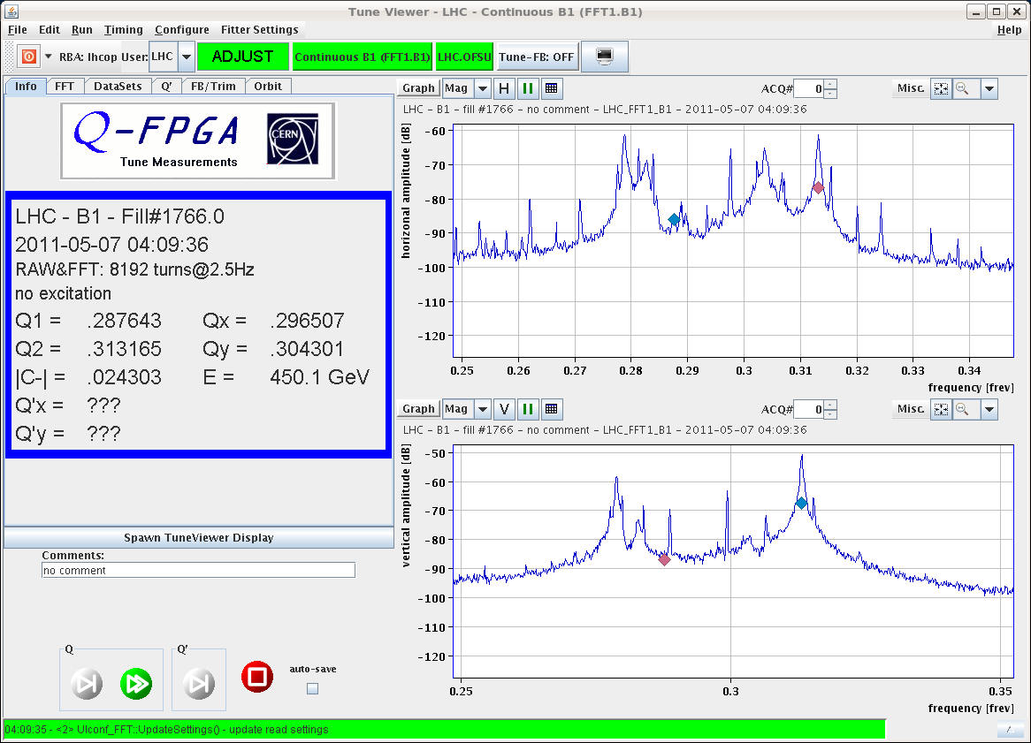
Tune Spectrum B1: Coll IP1, IP5, 450 GeV, tune shift > 0.015 per IP

Slide 11
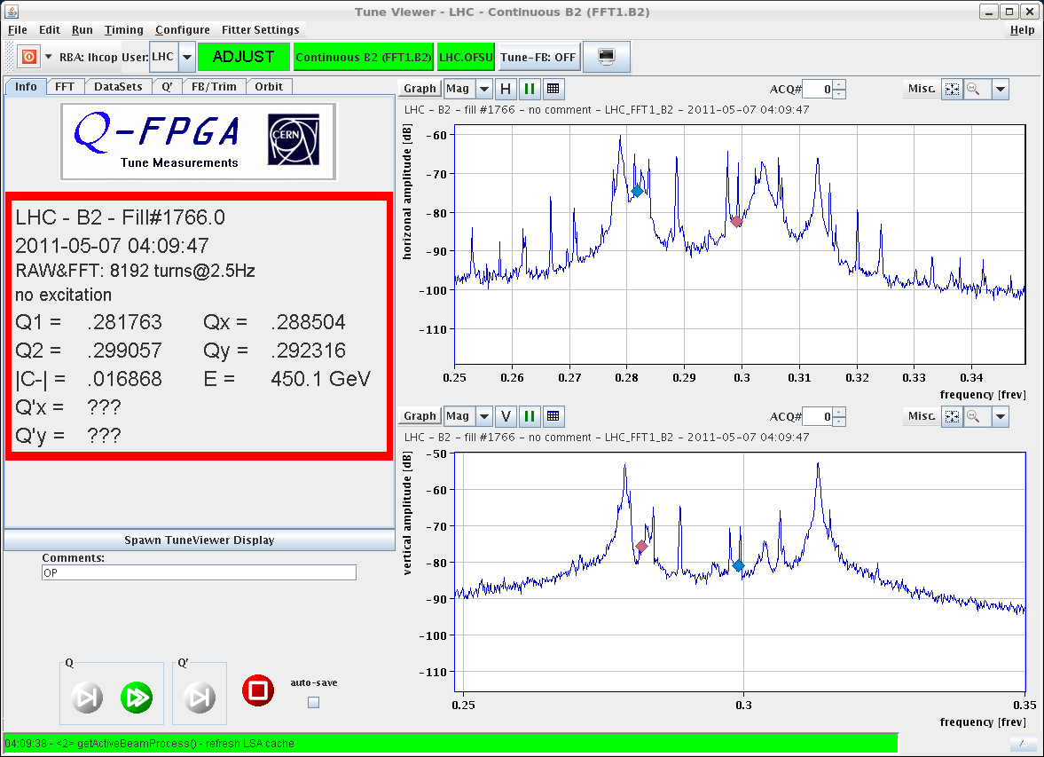
Tune Spectrum B2: Coll IP1, IP5, 450 GeV, tune shift > 0.015 per IP

Slide 12
0.45 TeV: Investigation on CODs
Ongoing
Program executed like planned. Moving correctors and looking at residual orbit changes.
Lot’s of data collected. To be analyzed in detail…

