Slide 1
Summary of Week 16
G. Arduini, J. Wenninger
Main aim: Consolidate operation with 50 ns and trains of 36 and 72 bunches for physics and luminosity production

Slide 2
Availability and performance
Machine available ~75% since last Monday morning:
Major stops:
Cryo compressor in point 8 (Tue 19/4 - 12 hours)
Power glitch (Sun 24/4 – 5 hours)
VIP visit (Wed 20/4 - 5 hours)
Cryo compressor in Point 2 (Tue 26/4 – ongoing)
Stable beams :
91.8 hours in 192 hours = 48% !!
Peak stored energy 33.1 MJ (average of the 2 beams). Maximum number of bunches at 3.5 TeV: 480
Integrated luminosity during the past 8 days: ~110 pb⁻¹
Integrated luminosity in 2011: 166.1 pb⁻¹ (ATLAS)

Slide 3
Machine Records (c/o ATLAS)
Peak Stable Luminosity Delivered | 5.04x10³² | Fill 1732 | 11/04/23, 05:47
Maximum Luminosity Delivered in one fill | 23955.67 nb⁻¹ | Fill 1732 | 11/04/23, 05:47
Maximum Luminosity Delivered in one day | 25597.99 nb⁻¹ | Saturday 23 April, 2011
Maximum Luminosity Delivered in 7 days | 107128.55 nb⁻¹ | Tuesday 19 April, 2011 - Monday 25 April, 2011
Maximum Peak Events per Bunch Crossing | 14.01 | Fill 1732 | 11/04/23, 05:47
Longest Time in Stable Beams for one fill | 17.9 hours | Fill 1732 | 11/04/23, 10:25
Longest Time in Stable Beams for 7 days | 87.5 hours (52.1%) | Tuesday 19 April, 2011 - Monday 25 April, 2011

Slide 4
Overview
Mon 18/4 | MKI conditioning in point 8 and TDI alignment check Test ramp after COD RT trim feed-forward for ramp and squeeze + periodic loss map Physics, 336 bunches, 36b/inj.
Tue 19/4 | Physics, 336 bunches, 36b/inj. Cryo problem in pt8 - PLC
Wed 20/4 | Loss maps in collision (-500 Hz) TDI alignment Test ramp 336b with 72b/injection. VIP visit. Physics: 336b with 72b/injection.
Thu 21/4 | Physics 480 bunches/beam (36 b/inj.) 23:55 STABLE BEAMS #1729 - 4.8(ATLAS)/4.4(CMS)x10³² cm⁻²s⁻¹ WORLD RECORD IN PEAK LUMINOSITY IN A HADRON COLLIDER
Fri 22/4 | Physics with 336 b(72 b/inj.) and 480 b/beam (36 b/inj.)
Sat 23/4 | Beam 1 kicker not firing due to missing pre-pulse Physics 480 bunches/beam (36 b/inj). Initial luminosity up to ~5.2x10³² cm⁻² s⁻¹ (ATLAS)/~4.8x10³² cm⁻² s⁻¹ (CMS).

Slide 5
Overview
Sun 24/4 | Power glitch. & recovery +Loss maps to injection to check collimators (4 had to be reset – resolver position) Physics 480 b (72 b/inj.). Outgassing of vacuum gauge close to Q3.R8 ➔ beam dump Physics 480 b (72 b/inj.)
Mon 25/4 | Physics 480 b (72 b/inj.). Still outgassing of vacuum gauge close to Q3.R8. Dump from BLMs
Tue 26/4 | Cryo problem in point 2

Slide 6
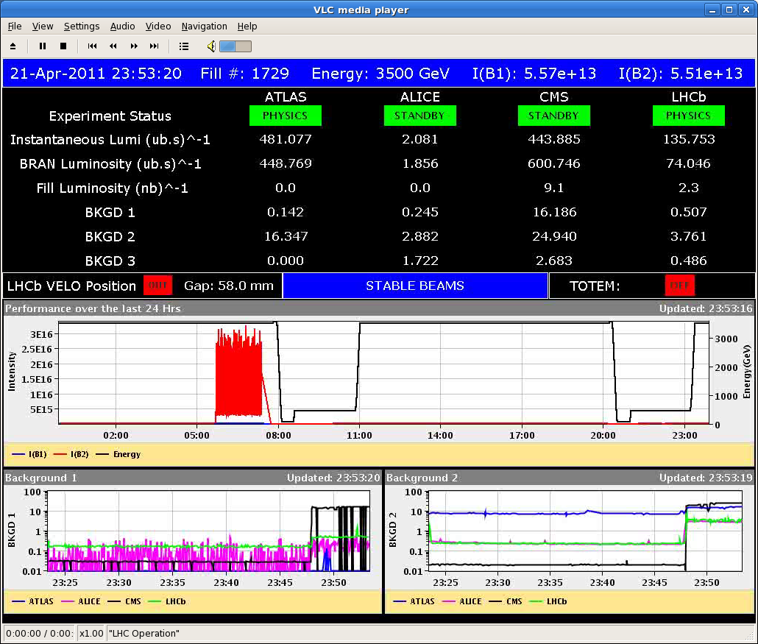
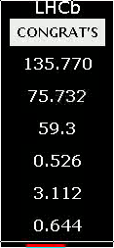
LHC luminosity world record

Slide 7
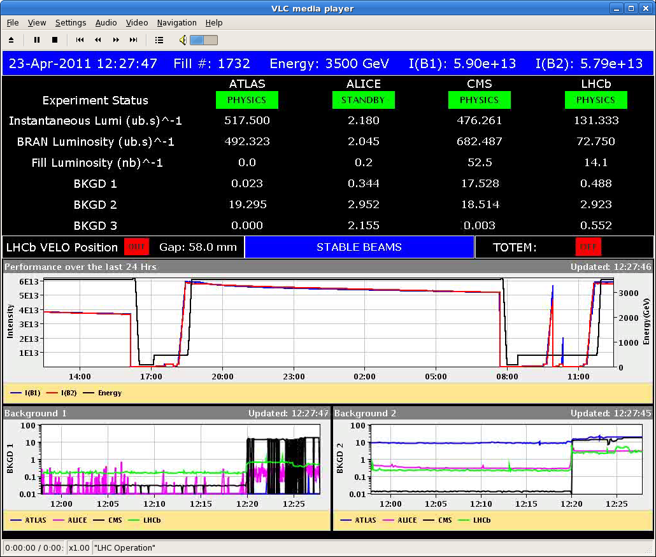
LHC top luminosity 2011 (#1732)
>0.5 x 10³³ cm⁻² s⁻¹

Slide 8
Instabilities - ramp
Coupled bunch instability in the horizontal plane cured with transverse feedback gain and octupoles
Losses observed in collision during the past week-end cured as well

Slide 9
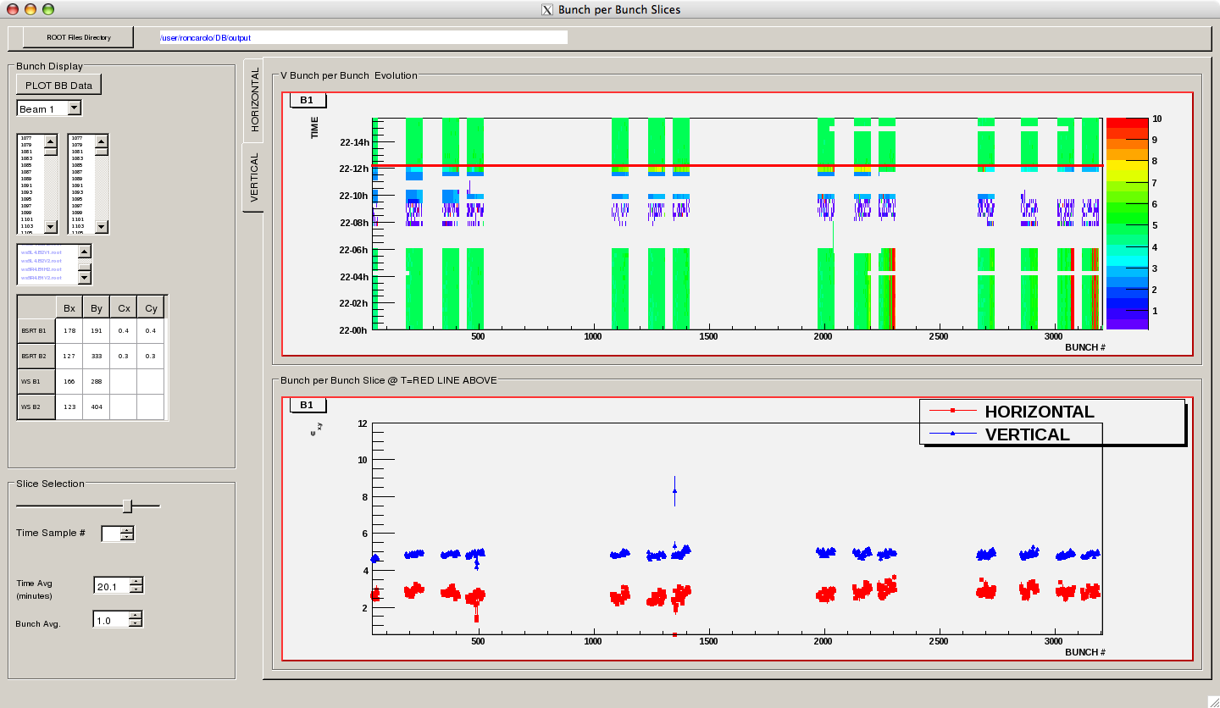
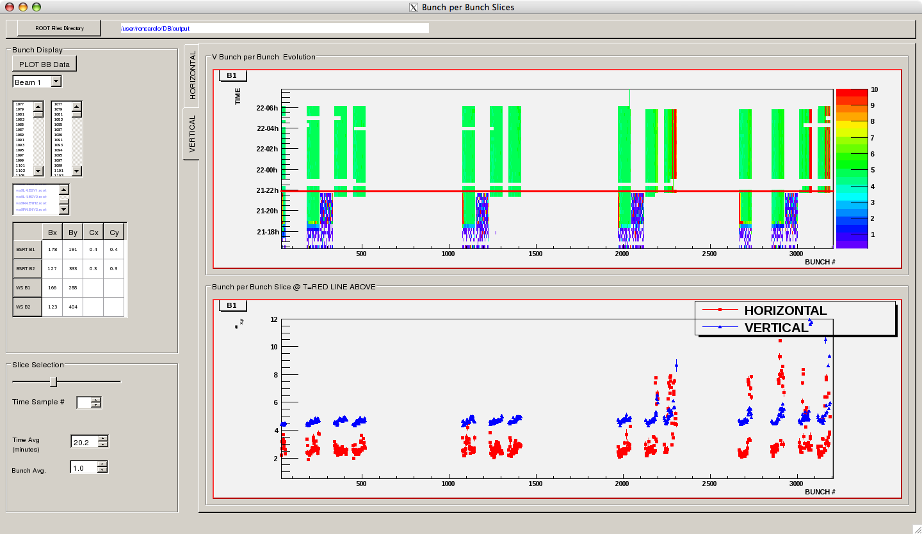
Beam stability at injection (1732 vs 1731)
Need tight control of the chromaticity at injection to <2 units ➔ Fidel chromaticity decay compensation
Need high damper gain (0.25)
Reason for tighter limits as compared to scrubbing and to the ramp not clear yet:
Different filling pattern?

Slide 10
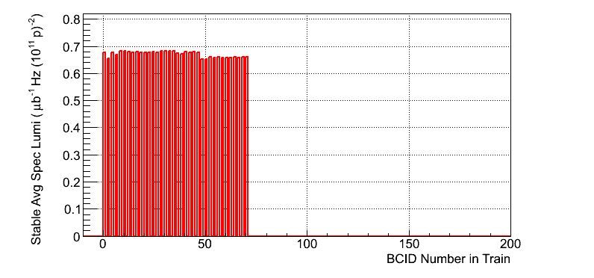
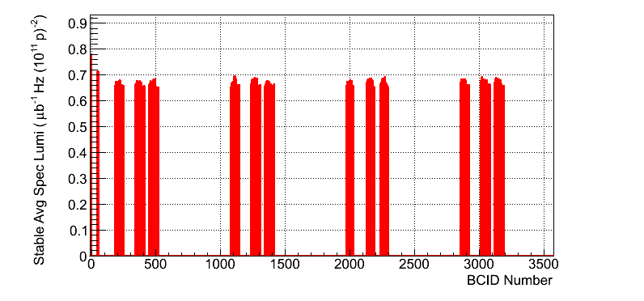
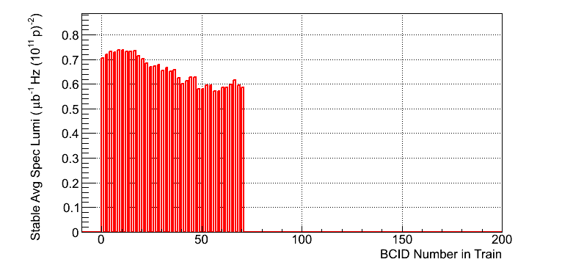
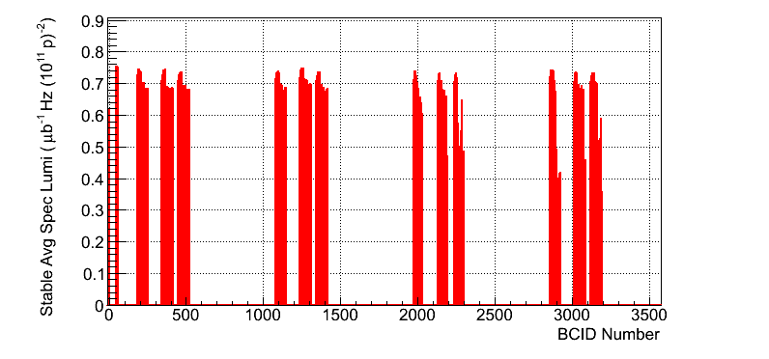
Effects on specific lumi. #1732 vs. #1731
ATLAS:
1732
1731

Slide 11
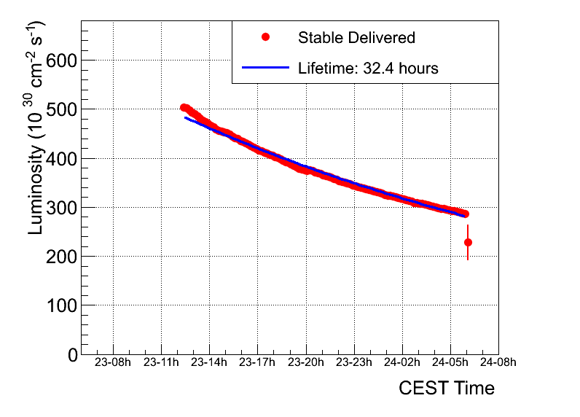
#1732

Slide 12
Lifetimes during a typical fill

Slide 13
Heat loads – 1732 (480 b – 36b/inj)
2 cells (out of 5) showing heat load above expectations but evolution consistent with ohmic losses. Bad RF contacts?

Slide 14
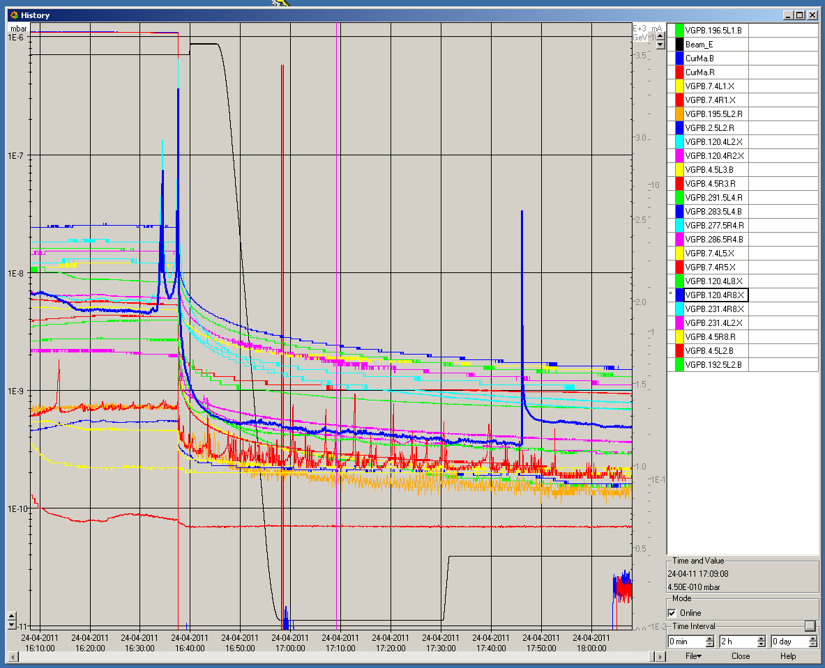
Vacuum spikes (1733)
‘Dumping’ spike
Spike during setup

Slide 15
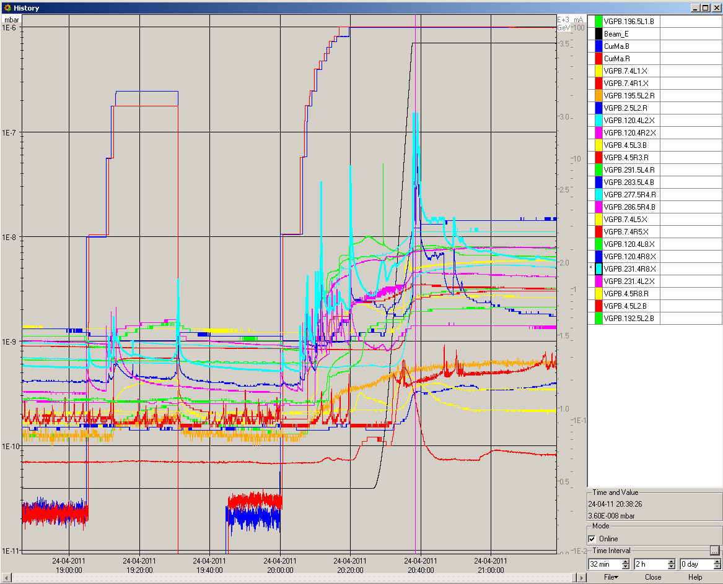
Vacuum spikes (1735)
No effect of the solenoids
Spikes observed in stable conditions and even without beam
Gauge outgassing (following the cryo problem last Tuesday)?
Interlock levels set temporarily to 4E-6.
Fill 1735

Slide 16
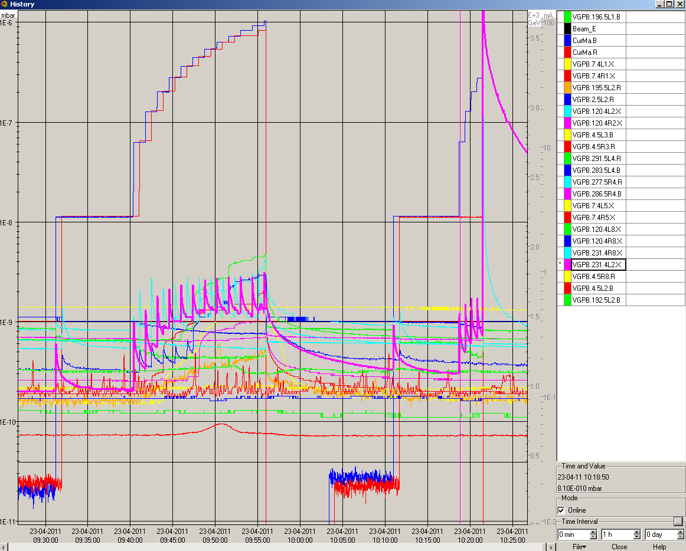
Failed injection
Missing pre-pulse form LHC RF distribution while injecting Beam 1 only ➔ logging to be implemented to understand behaviour in the future
Beam (36 bunches) on TDI ➔ ALICE detector triggered the beam dump+BLMs
Vacuum valves closing near to TDI due to outgassing. Fast recovery.

Slide 17
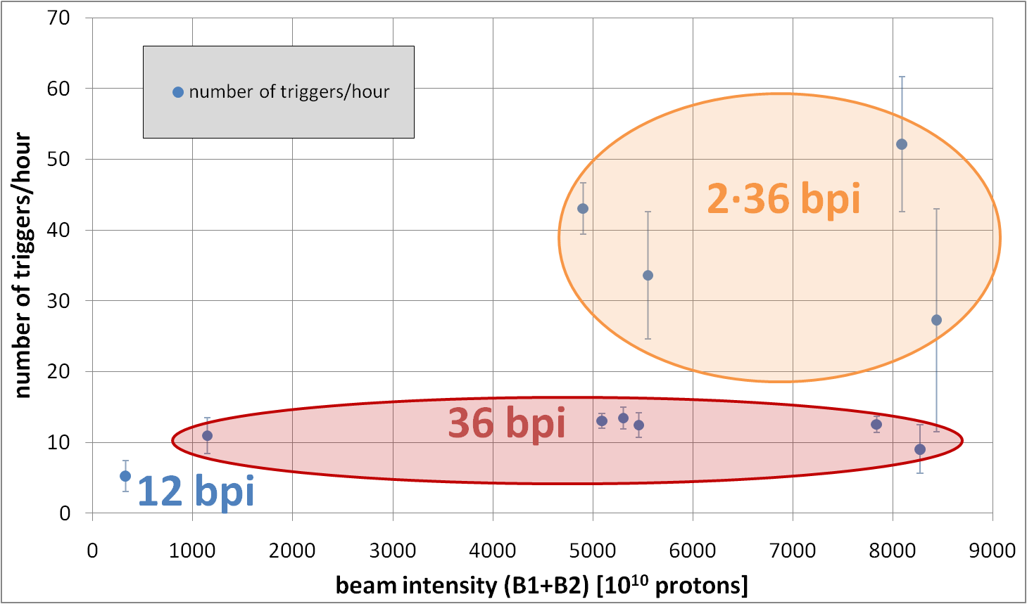
UFO rates versus intensity
T. Baer

Slide 18
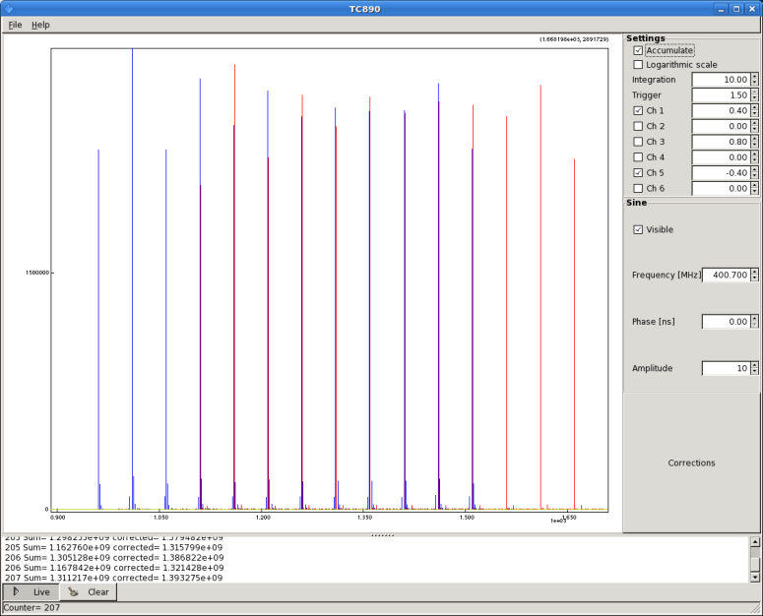
Satellites and intensity distribution
Adjustment of the extraction kickers in the PS on Friday ➔ no satellite visible after the 12/36 bunches train (should be the case for fill 1732). Some satellites close to main bunches (10 ns)
A lot of work done in the PS to equalize bunch intensities

Slide 19
Summary
The machine can work with high specific luminosity, good lifetime (>10 hours in all phases of the cycle), low losses even with 50 ns beam
High intensity was known to require more careful control of the machine parameters and systems. Most of the features expected. Some of them still to be fully understood (behaviour at injection)
Operational bunch-by-bunch diagnostics is now mandatory

Slide 20
Plan
Today:
Recovery from cryo stop
Physics with 624 bunches (72 b/inj)
To come:
Chromaticity decay correction
Transverse feedback tuning

