Slide 1
Wednesday - day
Off-momentum loss map validated.
TDI beam1 alignment.
New settings defined and applied for both TDIs.
Angles [urad] to be applied to have jaws parallel: left right B1 -70 -750 B2 -190 -110
13:30: Injection of 336b with 72b per injection.
No vacuum problems in MKIs ~ 1E-9.
14:15: Ramp.
Beam lost at 3 TeV.
Sudden horizontal instability (2-3 second risetime of losses) on beam2 leading to dump on BLM of TCSG in IR7 (too low threshold?).
VIP intermezzo…

Slide 2
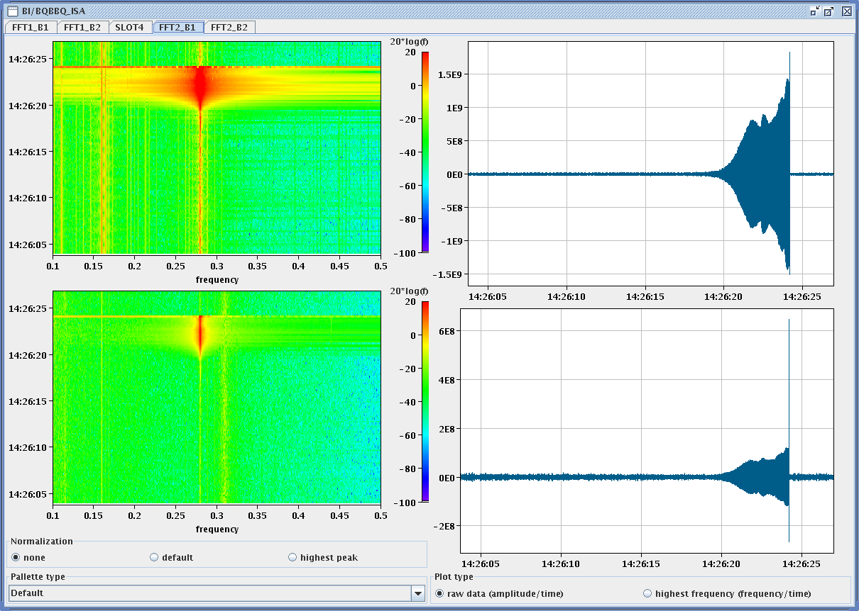
Beam 2 instability

Slide 3
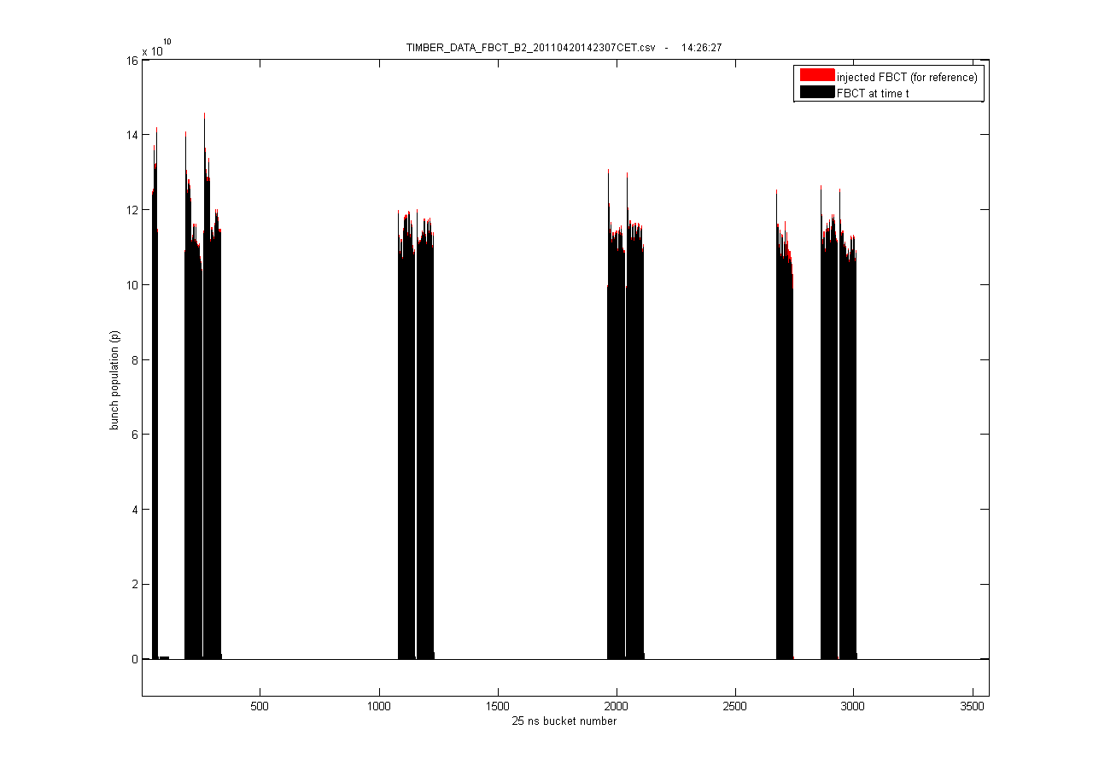
Loss only visible on 36b batch

Slide 4
Wednesday - evening
22:00: Injection of 336b with 72b per injection.
No vacuum problems in MKIs.
H damper gains increased, 20% stronger octupoles in upper part of ramp.
Ramp ok with signs of transverse H coupled bunch activity, lost QV signal for some time in early part of ramp. QV pushed onto QH for beam1 – ok for the ramp.
Increase octupoles for collisions by factor 2 wrt earlier fills.
Reduced H chromaticity for next ramp ~650 GeV.
23:55: First stable beams with 72b/train. Fill 1727.
Not a record, but it worked ! 1.1E11/b on average.
Vacuum ok.
06:00: FBCT B2 gives crazy readings…

Slide 5
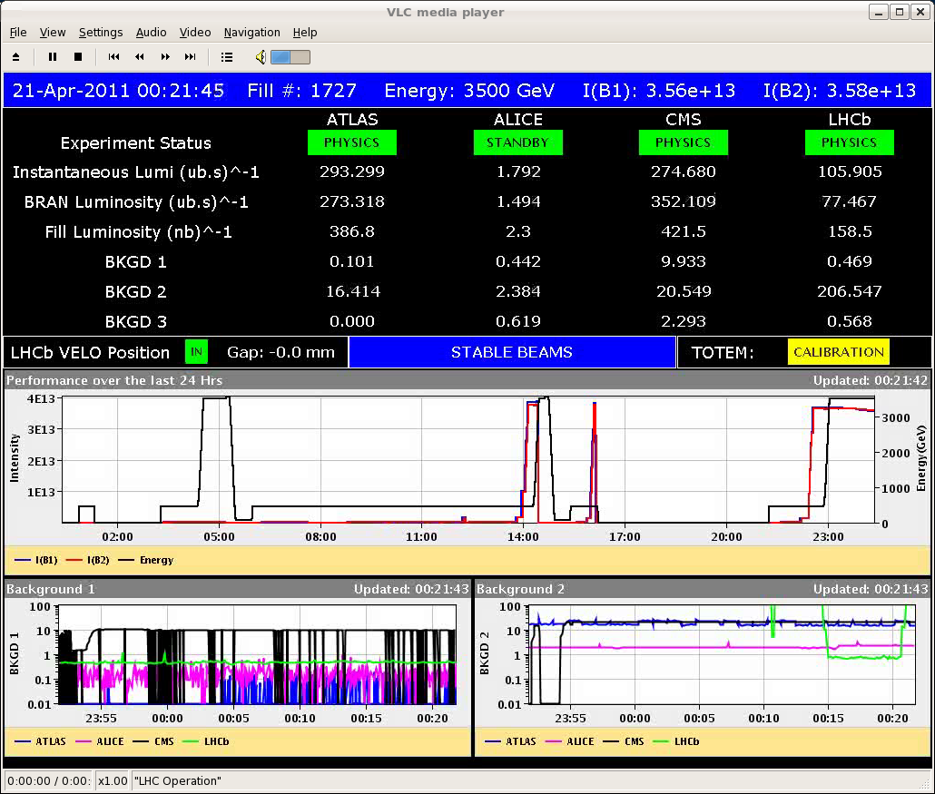
72b/train … finally

Slide 6
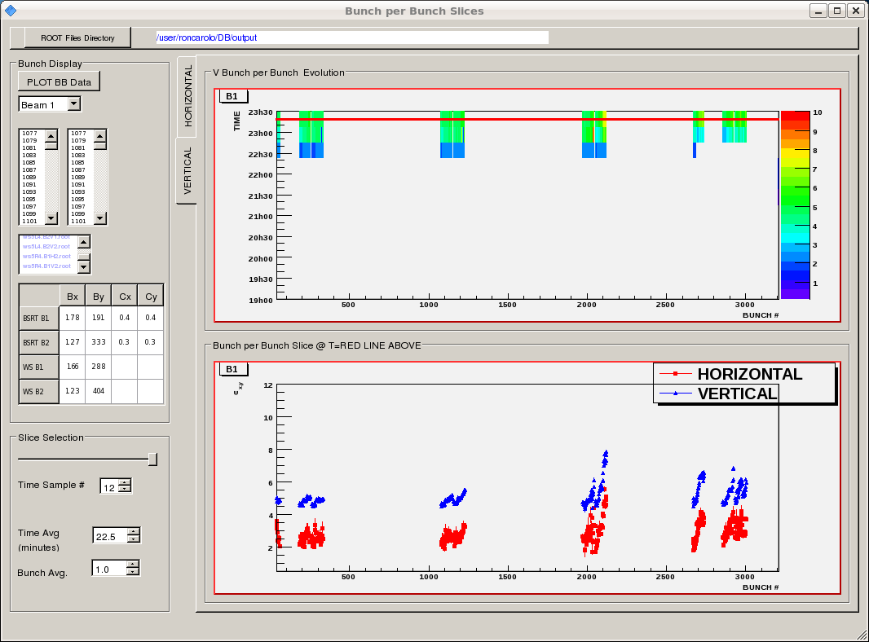
Beam1 emittances after ramp

Slide 7
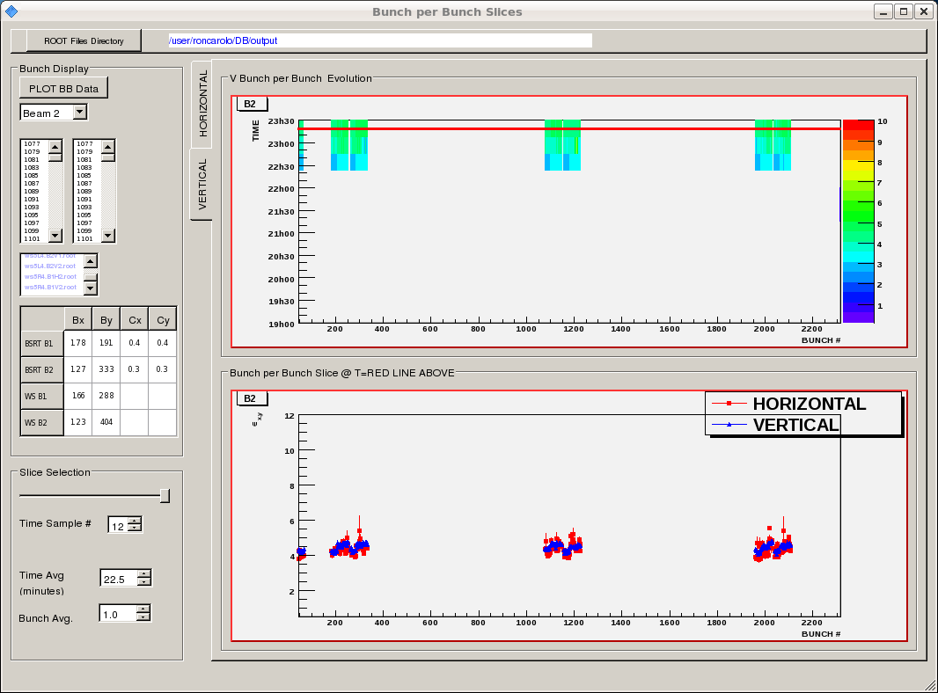
Beam2 emittances after ramp

Slide 8
Today
Physics with 480b / 36b per injection.
Coming days:
Physics 480 b/36 b per injection
Physics 336 b/72 b per injection – consolidate

