Slide 1
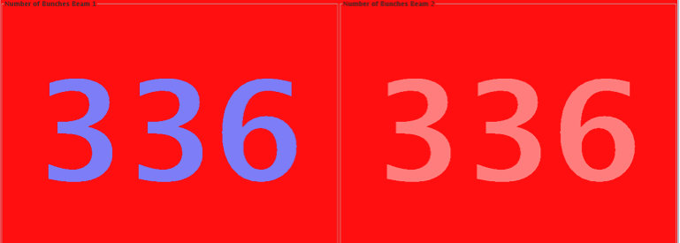
LHC Status Su Morning 17-April
R. Assmann, B. Holzer et al
1.) 00:14h successful collisions 228 bunches
2.) 05:15h / 06:24h / 07:33h Electrical Problem
We are switching off everything in point 2 before decoupling the active filter
3.) 10:34h injection 336 bunches, 72 bunch trains
beam loss due to orbit feedback
4.) 13:00h injection 336 bunches, ramp, squeeze ...
beam loss due to losses / BPM threshold / instabilities
5.) 16:00h injection 336 bunches: lumi
dump: water problem
6.) 23:00h injection 336 bunches: lumi .... dump: cod software interlock
7.) 03:00h injection 336 bunches: lumi, no dump yet !!!instabilities/ BPM threshold, beam lost,
luminosity23:00

Slide 2
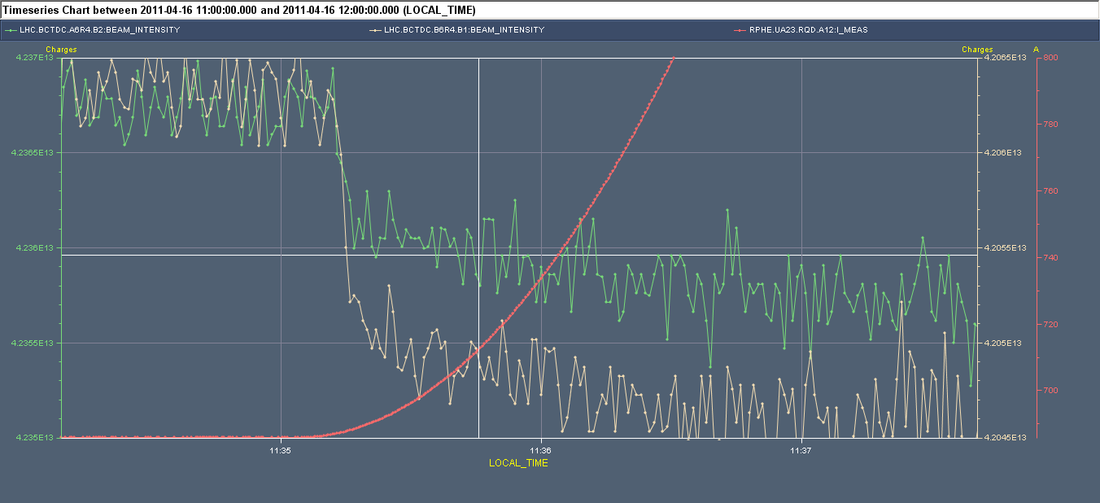
Saturday Morning:
capture losses / losses at beginning of ramp:
ΔI ≈5*10⁻⁴
current beam 2
current beam 1
improved capture & abort gap cleaning

Slide 3
Sa Morning: luminosity 228 bunches
0:14h
lengthy optimisation
needed ... settings should be stored

Slide 4
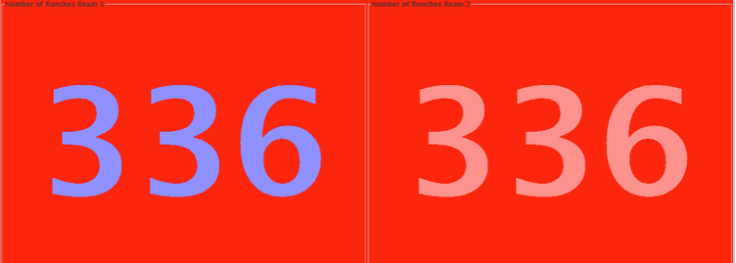
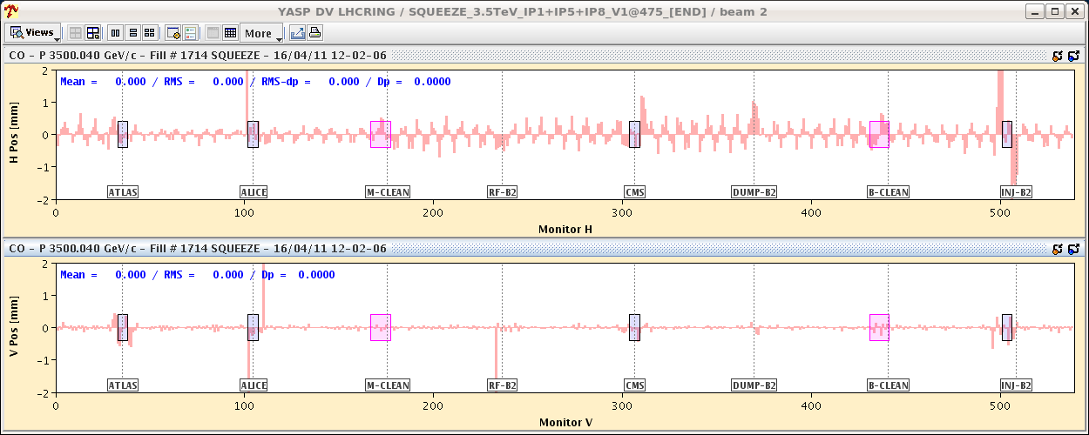
Sa Morning: preparing for 336 bunch operation
11:30h first attempt: injection
ramp,
squeeze -> beam loss
orbit feedback switched OFF in H because the time constant sent was 1s instead of 380s!!!

Slide 5
Sa Morning: preparing for 336 bunch operation
12:54h second attempt: injection
ramp,
squeeze
orbit feedback did not start on the timing event, we resend the scaling with YASP in a hurry, looks OK!!! OUFFFFFF
intensity distribution: ok

Slide 6
Sa Morning: preparing for 336 bunch operation
tunes look strange
.... a bit like Christmas in hor.
... and no tune in vertical

Slide 7
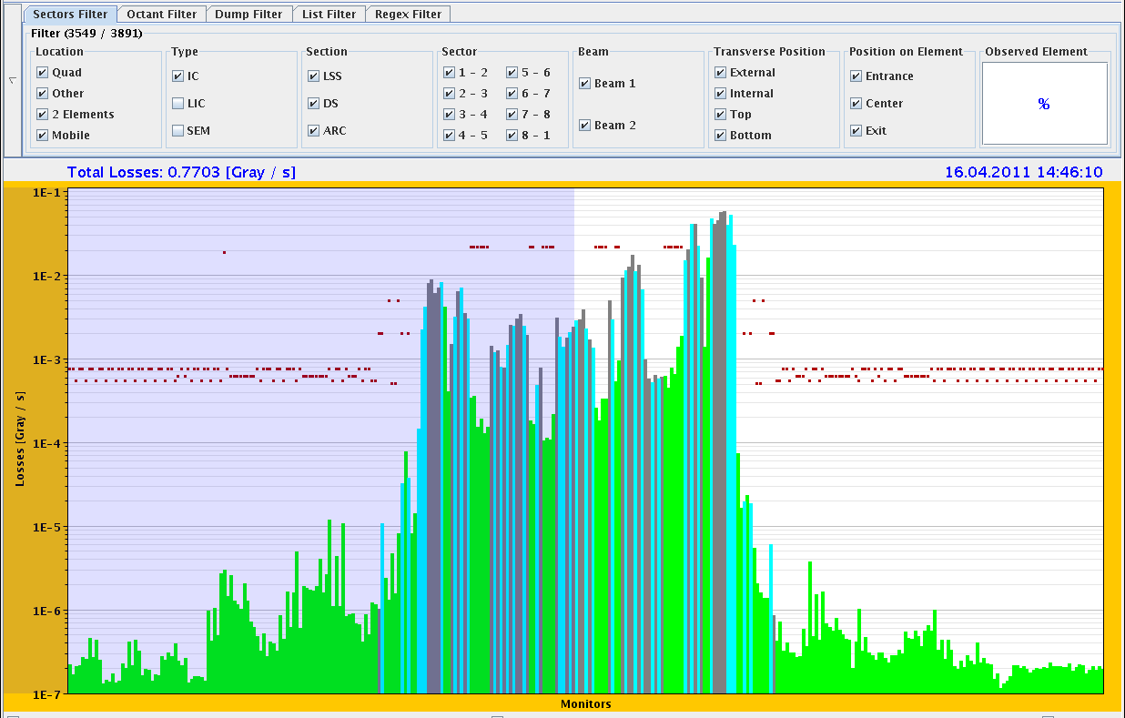
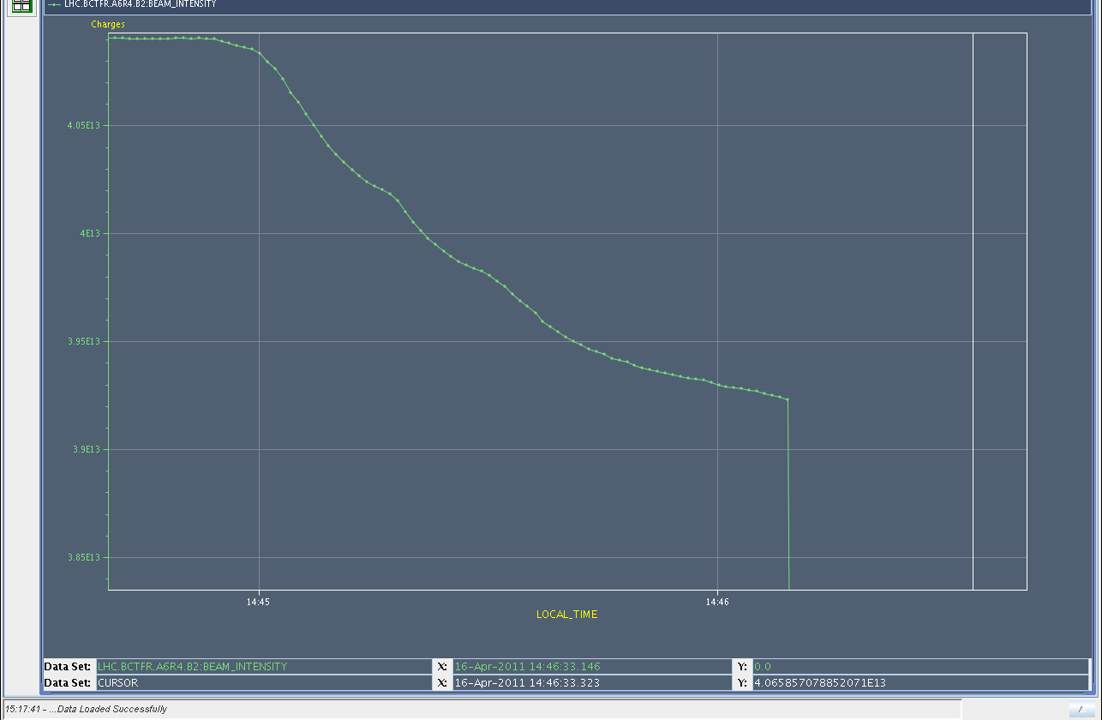
Sa Morning: preparing for 336 bunch operation
again: luminosity far off !
optimisation time consuming and difficult.
losses appearing for beam2: limiting in TCSG.A6R7.B2.
Reached ~95% of dump threshold.
14:34h beam loss due to BPM threshold
Dump Classification: Orbit excursion interlock (BPMs in IR6)

Slide 8
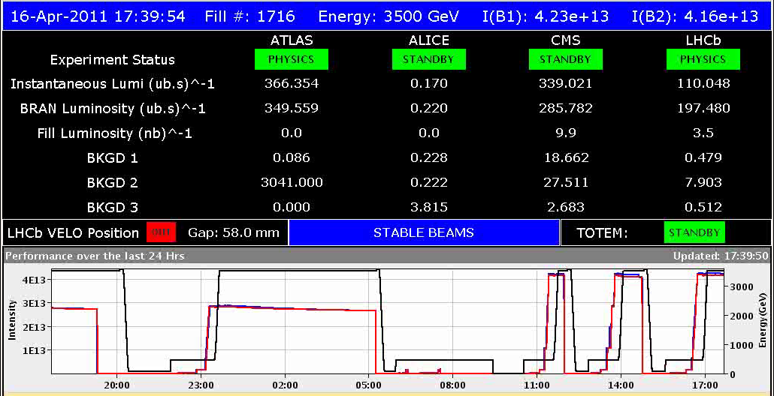
Sa Late: 336 bunch operation
switching to 36 bunch trains
16:55h injection / ramp
and nice intensity distribution
17:40h Luminosity

Slide 9
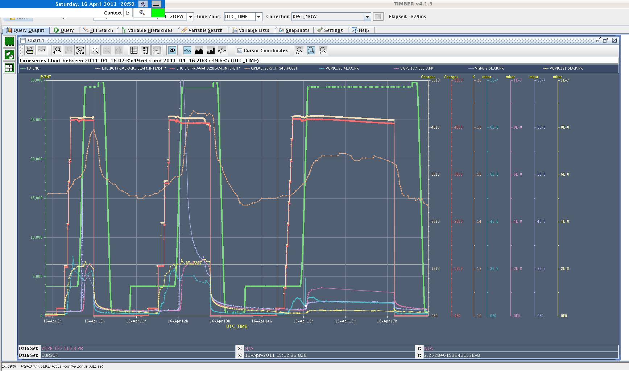
Sa Late: Vacuum
18:00h Vacuum during the three 336 attempts
beam screen

Slide 10
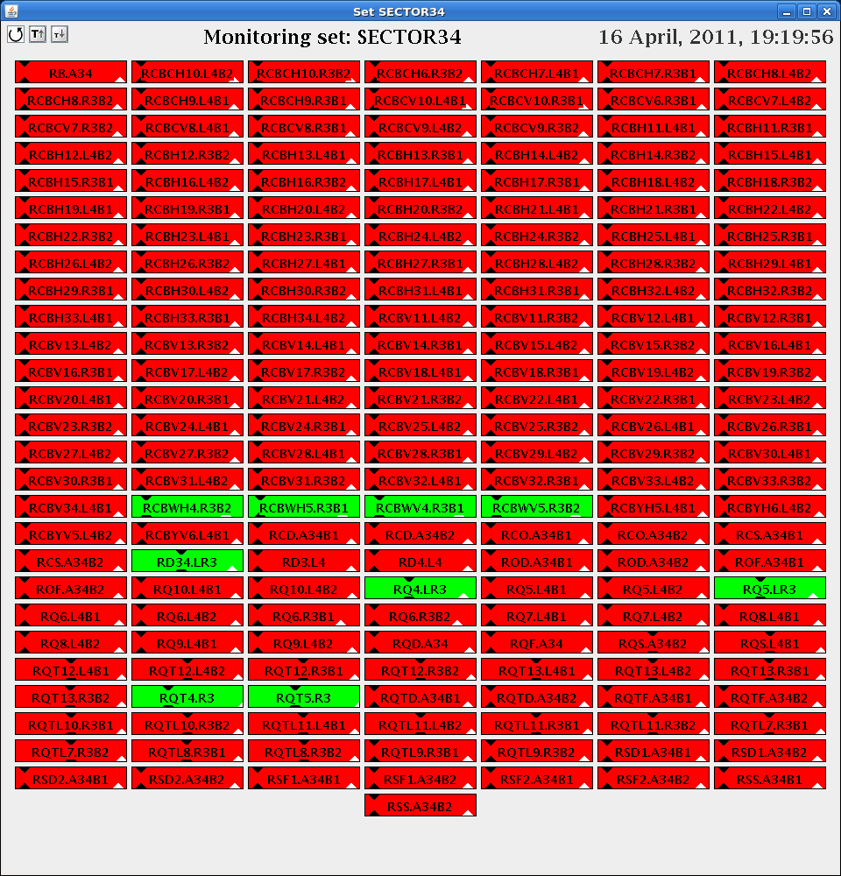
Sa Late: technical problem
19:09h Beam Dump Cut of demineralised water due to a faulty flow
meter triggered PIC to interlock in S34.Dump was clean,
but RU.L4 quenched afterwards and cryo maintain was lost
all the cold circuits of 34 tripped.

Slide 11
Sa Late: restart 336 bunches, lumi
23:00h set up 336 bunches, ramp, squeeze, lumi
... and dump after some minutes !! Probably software interlock on the
COD settings which became active in stable beams
03:25h and lumi run
again

Slide 12
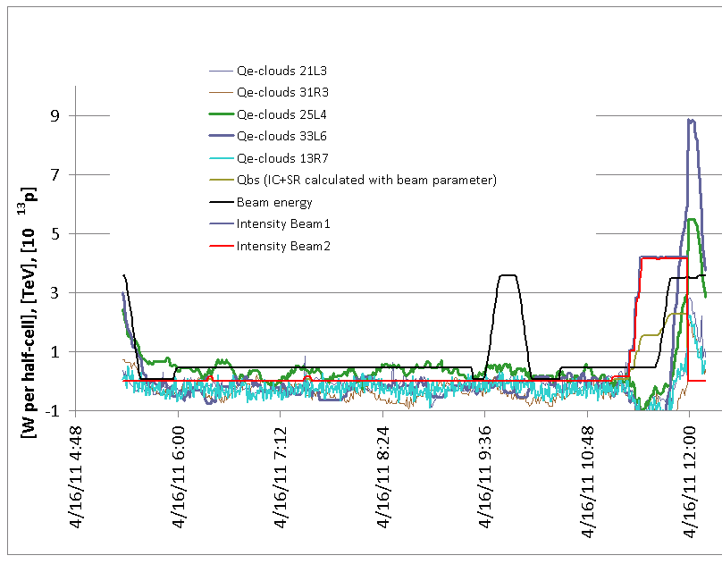
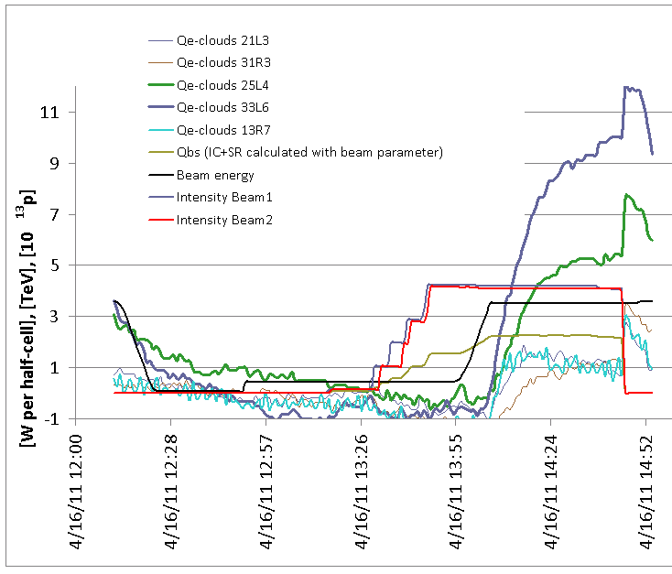
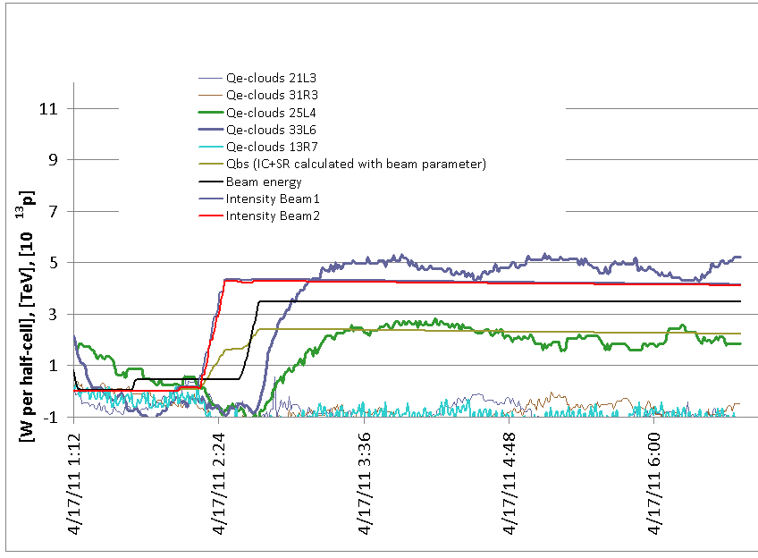
336 Bunches: Heat load ...preliminary
First experience with 336 buches:
The heat load with the filling scheme with 36 bunches at
injection is significantly less than with 72 bunches/injection.
72 bunch trains
36 bunch trains

Slide 13
Summary:
orbit feedback
beam loss due to BPM threshold
& instabilities
software interlock,
cod settings
demineralised
water
Problems with tune signal, water
orbit feedback settings, software interlock
instabilities ?
Solutions: 36 bunch trains,
feedback gain increased by (additional ) factor 2 before collisions

