Slide 1
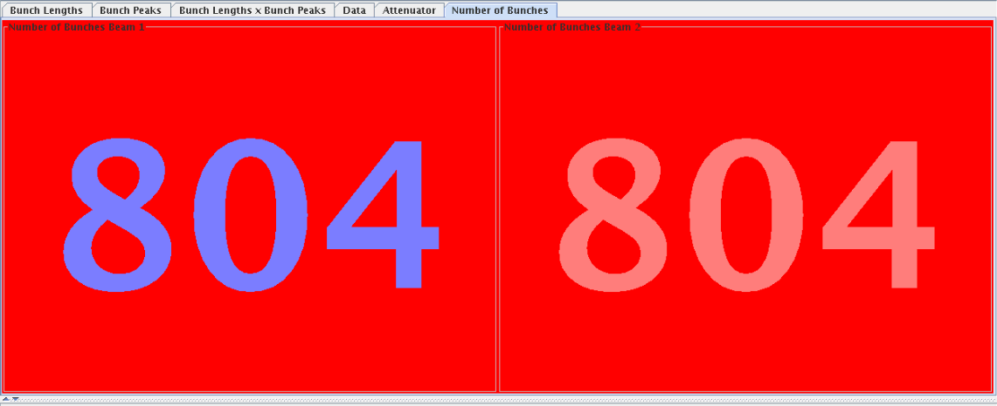
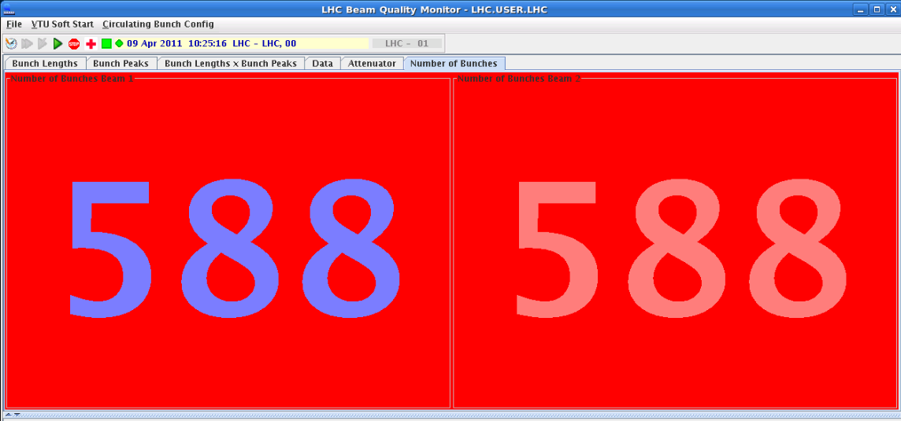
Saturday 9th April
10:24 Finally « 600 » bunches
14:30 Dump the 600 x 600
16:00 Loss maps
Green light for 800 bunches
18:40 Fill for 800 bunches
20:48 RQ5.R5 quench loop – SEU?– beams dump and recycle
23:30 Refill for 804 bunches:
Dumped with 732/660 due to an RF arc (so said the alarm)
Achieved 804/804! but B2 was very unstable. Eventually dumped by the SIS
Stopped at 804/732. Stayed like that for ~45 minutes but the dumped by BPM in IP6

Slide 2
Filling for 600 bunches was tough
Satelites after the 36 bunches Fill with larger spacing, also behind 36 bunches

Slide 3
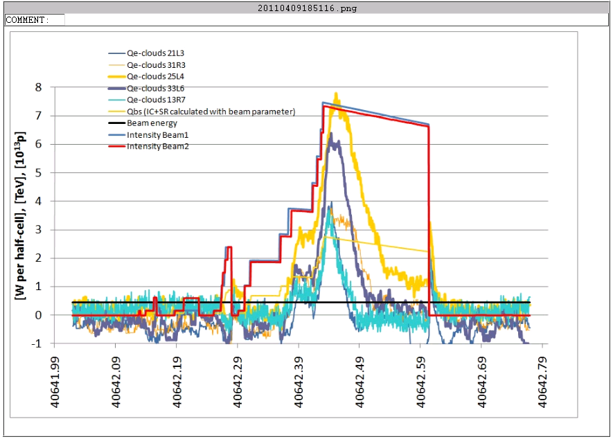
Scrubbing
Clear sign of heat load in the arcs and scrubbing
Temperatures on beam screen measurement points indicate e-cloud and the vacuum pressure is only going down slowly.
Up to 70 mW/m/aperture due to e-cloud – W. Venturini

Slide 4
Solenoid with 1 A
P. Chiggiato

Slide 5
BSRT – Beams are blowing-up
The vertical emittance grows along the train (especially for batches 4 and 5), while in the case of the horizontal the behavior depends on the batch
For horizontal emittance we see a big emittance growth in the middle of the batch for 3rd and 4th batches, while from the 5th one we see the big emitance growth mainly at the beginning of the trains.
Taking in consideration that the first bunches if each batch are more intense, the previous effect can be due to impedance issues, to be desentagled from e-cloud effects.

Slide 6
Energy loss form stable phase
Proposed by E. Shaposhnikova ➔ indications of scrubbing

Slide 7
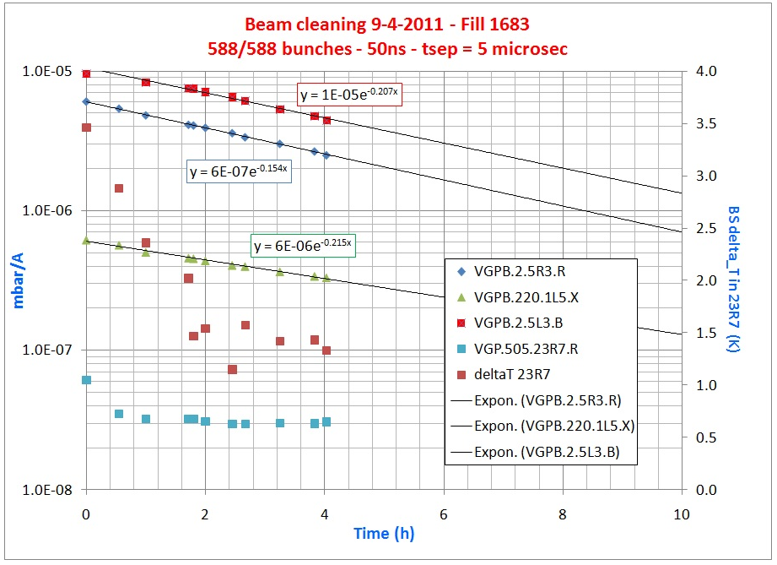
Pressure during scrubbing
V. Baglin

Slide 8
Bunches are too intense (filling for 800)
SPS called Thomas for help with the longitudinal blow up and possibly the 800 MHz...

Slide 9
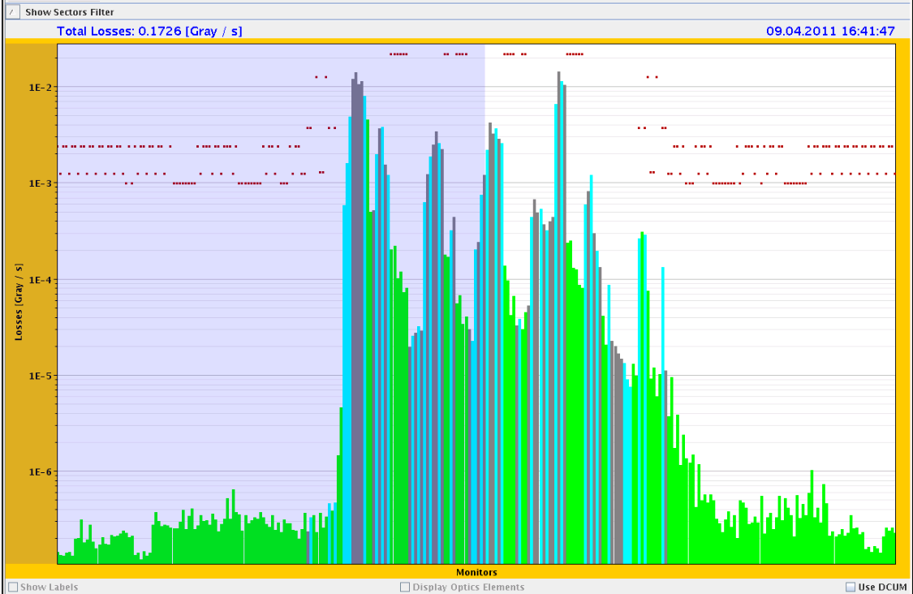
Loss maps – B1H is the problem again
First loss maps shows again large hierarchy breaking in B1H. A second loss map after recalibration for all the BPMs is good.
Problems with BPM calibration….
B1H +0.06:

Slide 10
Re-fill for 800 bunches – several attempts
Correlation Beam Loss and Vacuum

Slide 11
Vacuum during the 800 bunches

Slide 12
Plan
Scrub with 800 bunches
Check injection
If all goes well (incl. rMPP) – more bunches
Issues
BPM calibration
Set-up collimation in IP7 again?
Beam unstable if heavy e-cloud – ADT gain up and up
XPOC: Ring FBCT and MKB seeing the bunches

