Slide 1
Friday 8th April
Verification of U_HTS U_RES on all IPQs, IPDs, ITs using powering cycles.
Swapped all QPS boards for verification of board B.
Accesses were required for some circuits were the board switching failed (power cycle).
Late afternoon only RQ5.L6 exhibited a problem on board B.
Access to replace the board.
Circuit is now OK.
Green light for powering from TE/MPE.
Then EPC problems on RQTL7.L3B1 – access.
Finally pre-cyling around 22:30…
Problem with BPM calibration in the shadow – issue with storing the settings in the DB.

Slide 2
Friday 8th April – night-mare
Beam in around 23:30.
Comparing orbits with probe, indiv and 50 ns.
Issues in the PS with 12b. Satellites and unstable longitudinal position in the SPS.
02:00 Systematic problems with XPOC (BCT data). Trying to get hold of a BCT expert.
It seems that a SW release was made during the QPS intervention.
Finally gold of someone you can rollback the SW.
04:00++ Problems to fill the 36 bunches. Same problems as earlier in the week. Satellites after the 36 bunches.
Beams dumped when filling the 2nd train.
Filling with larger separation… OK.
Moving to injection of 72 bunches.

Slide 3
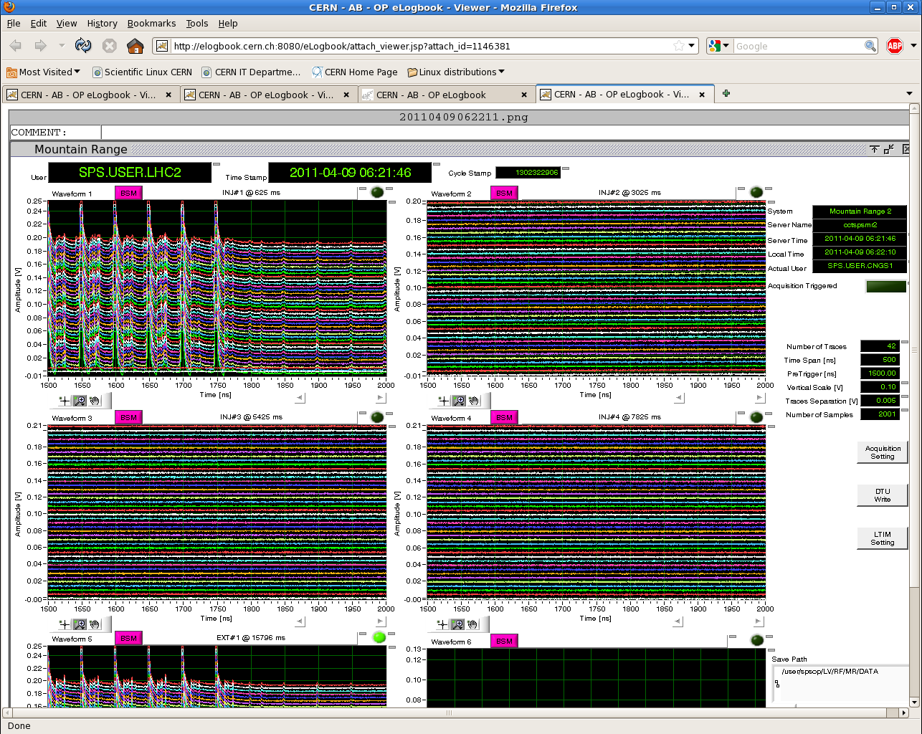
Satellites in the SPS

Slide 4
Today
Scrubbing up to 600.
Then stable period @ 600 bunches to decide for 800 (if we get there…).

