Slide 1
Tuesday 6th April
8:00 Injection studies
RF set-up 50 ns trains
Injection of 50 ns trains, 36 bunches
Scrubbing
16:00 RF studies
17:00 Collimation, loss maps at 450 GeV
23:00 Scrubbing with 50 ns trains

Slide 2
Injection studies 50 ns trains
Injection 50 ns up to 36 bunches operational.
Very clean: maximum losses from uncaptured beam - 10 % of dump threshold, losses on TCDIs maximum 1% of dump threshold.
Injection slot cleaning and abort gap cleaning always on.
Injection slot cleaning, reduced the losses on the TDI by a factor 3.
Correct scraping in SPS is essential.
Emittance does not change with scraping: emittances always between 2.2 and 2.3 um. Scraping really only tails.
Managed to inject cleanly bunch intensities up to 1.4e+11.
Satellites after first batch of intermediate intensity, 12 bunches.
Injection of batch 580 RF buckets after this first batch kicked out beam onto TDI and tripped ALICE BCM.
For the moment should not inject beam too close to intermediate intensity batch. Investigating on booster/PS side.

Slide 3
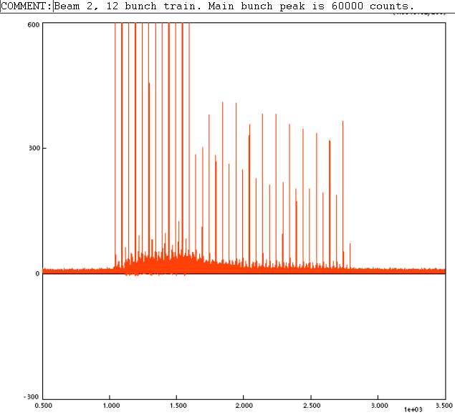
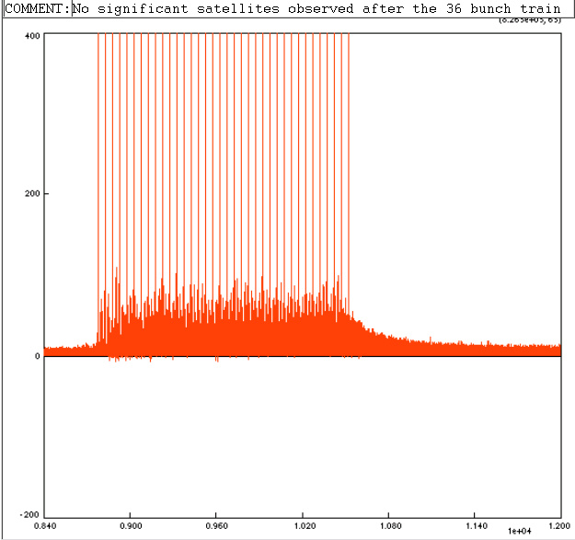
Satellites were confirmed by LDM.
First 12 bunches
36 bunches
Satellite < 1% of peak bunch intensity but get swept into experiment by the LHC injection kicker
Adam Jeff

Slide 4
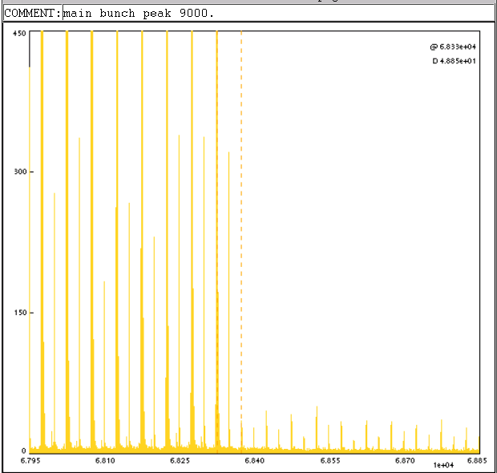
LDM measurements
Satellites are also seen with 25ns spacing between the bunches of the 12-bunch train up to 3% of main bunch, this is not seen between the bunches of the 36-bunch trains.

Slide 5
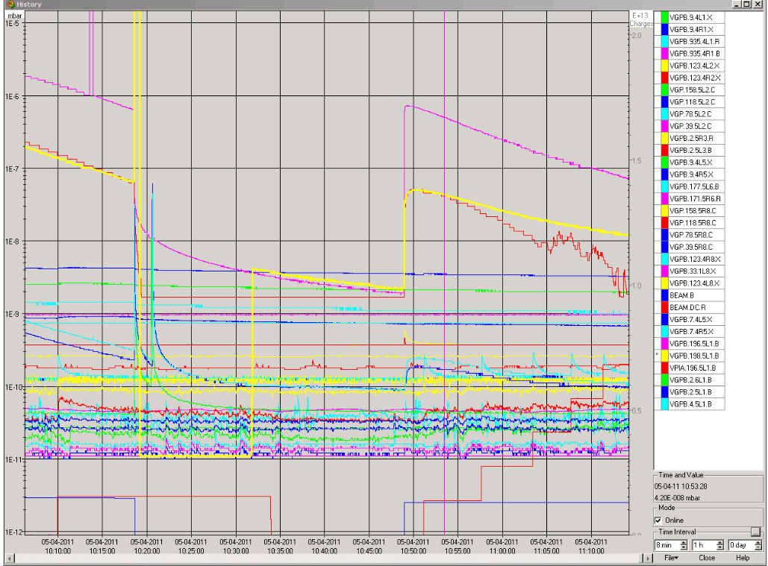
Scrubbing while performing injection set-up
Vacuum after 5th batch of 12 bunches, 50 ns

Slide 6
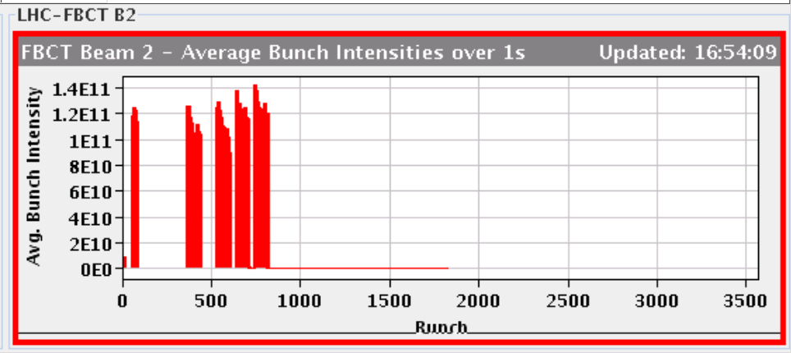
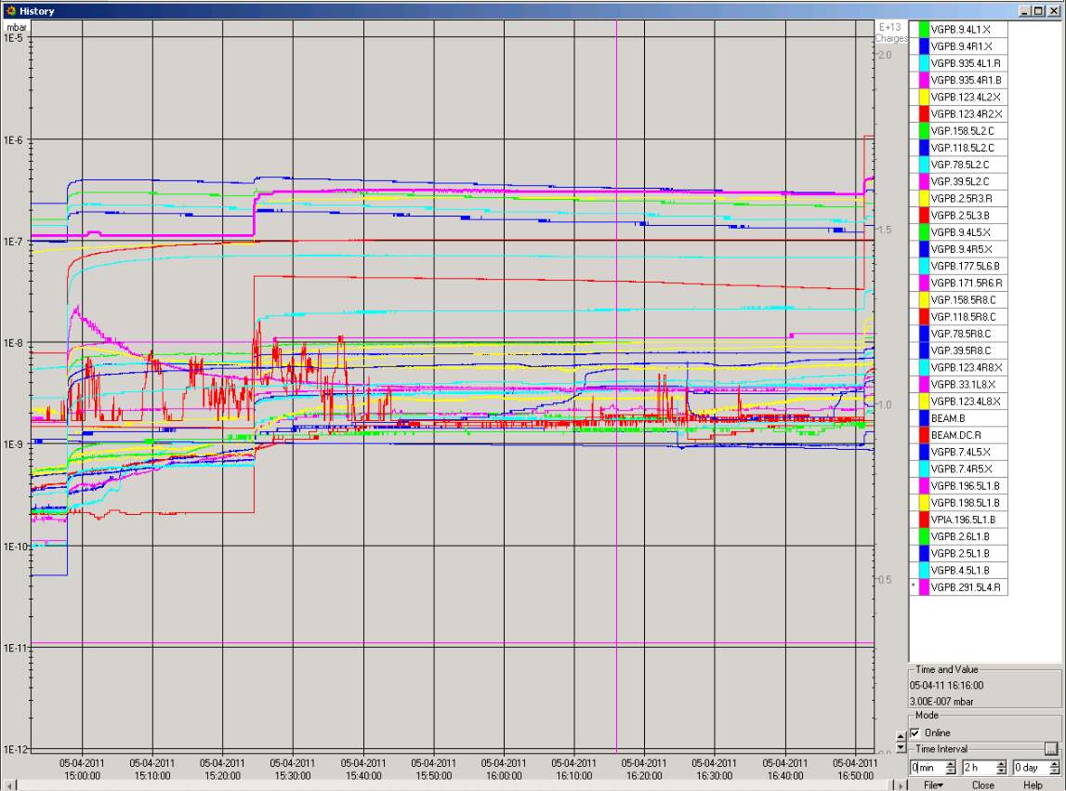
Scrubbing with trains of 36 bunches

Slide 7
Collimation checks at 450 GeV
Loss of hierarchy not understood for B1 H
Many, many loss maps at 450 GeV
Series of loss maps on B1 with different conditions to try and reproduce the leakage observed in the last days:
very high coupling (0.02)
kicks with a single corrector in-phase and out-of-phase with the TCSG in 7.
Conclusions:
Coupling seems to have no effect
As expected orbit has an effect above 0.5 -1.0 sigma excursions: OK
Loss maps under normal conditions were ok

Slide 8
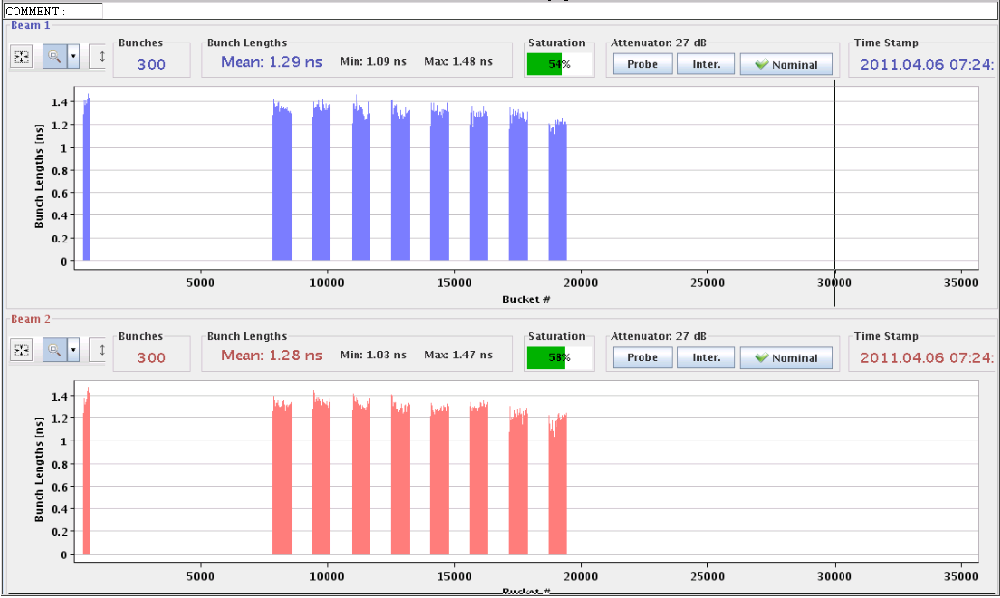
Scrubbing with 50 ns trains of 36 bunches
Finally scrubbed with 288 bunches, trains of 36
Started with e-cloud MD filling scheme(s)
Needed to inject with 2 us spacing between trains
Stopped in beam 2 because of a pressure rise in point 2 very close to the interlock limit after 3 injections.

Slide 9
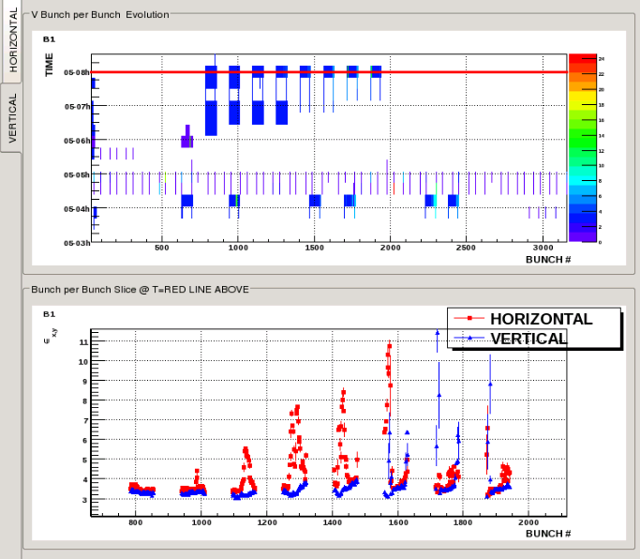
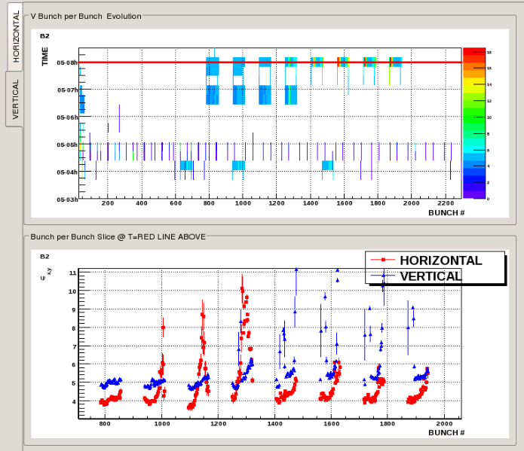
Bunch lengths – beams unstable
B1
B2
vacuum rise, coherent motion and emittance growth have been observed with several batches of 50 ns beam. More analysis is needed, but we can already say that the behaviour is very similar to what we observed last year (horizontal instability that affects the last bunches of the batches and also seems to cause large emittance growth at the end of the batches). The perturbation appears to build up with the number of batches until the motion and emittance grows really strong. For some reason, bunches and batches that are injected after these seem less affected.

Slide 10
Plan for Wednesday
Injection studies
Injection of 50 ns trains, 72 bunches ...
Collimation verification ?
Aim is to be able to increase the 300 bunch limit at 450 GeV
Scrubbing with 50 ns beams – longer trains

