Slide 1
Friday
Cyo (Thu. 22h)
Point 6
After the energy scan of yesterday afternoon, we have discovered generator B2/MKBH-A (One changed during this TS) has around 2% voltage less strong than others
10 minutes of access needed to put installations in REMOTE if Energy scan of the night was good.

Slide 2
TS#9 – 2011: in addition to regular activities
Solenoid wrapping at point 8 (the last one, and test of all points.
Modification of the faulty boards for RB circuit voltage measurement
Replacement of the power switches on quench heater power supplies (last sector)
X ray of QRL in sector 45.
Replacement of the compressor at point 4
Exchange of 4x 400 l/s ion pump at MKB 6R
Control cabling for the pump in sector 45
Trimming tests in sectors 56, 78 and 81
Power converter tests in sector 78 (following last week events)
Ventilation tests following the speed reduction (of air)

Slide 3
To be followed
Access mode versus Patrols
Would it be better to set the general mode in all machine except points 3 & 7, and patrol the last day (or last 2 days) ?
WAT is covering the control of activities
Operators won’t give keys during 4 days
Access will be easiest (intersite doors, time to get in)
But
Patrollers should be available
Plan for powering tests can be affected
Under discussion
Non planned lost of patrols due to:
Human errors
Problems with the closing system of some doors.. To be followed

Slide 4
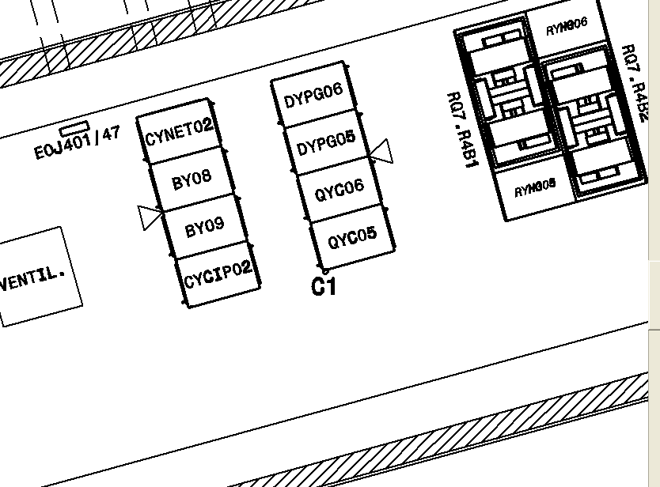
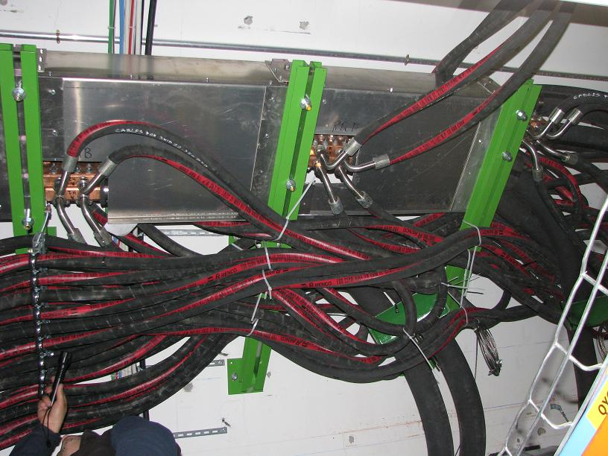
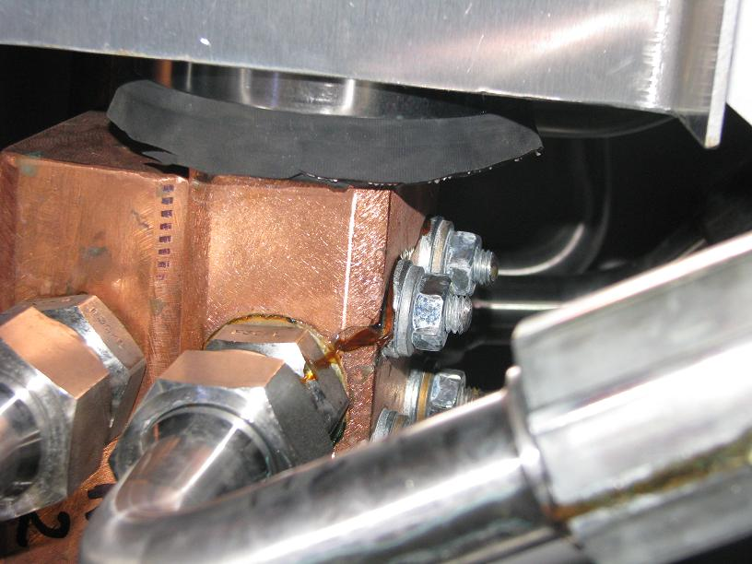
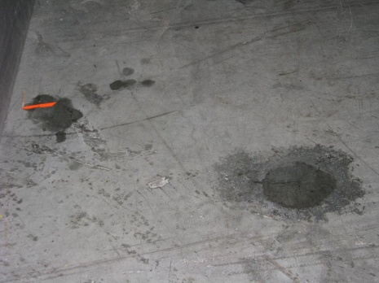
To be followed Water leak RB45:UA47
W.r.t. water signs on floor, leak is not new,
« Nous ne pouvons pas être précis sur l’origine de la fuite. Il s’agit vraisemblablement d’une fuite au niveau d’un bouchon situe sur la cosse. »
Intervention during next TS : 4 days
Courtesy : C. Goncalves Perez

