Slide 1
Summary of Week 13
G. Arduini, B. Holzer
Main aim: Recovery from Technical stop and start preparations for high intensity

Slide 2
Sun 3/4 – Mon 4/4
08:00-15:30: Collimation setting-up at 450 GeV and 3.5 TeV
15:30-17:30 Ramp-down and start injection setting-up with 75 ns beam
17:30 – 05:50: Electrical problem (400 V transformer tripped 3 times on temperature interlock) in UJ76 and recovery:
Collimator control expert working the whole night to recover the correct position of the collimators
Vacuum, current leads temperature controls, QPS, ....

Slide 3
Technical stop from Monday 28/3 (6 AM) to Thursday 31/3 (6 PM):
Anti e-cloud solenoid wrapping at point 8 and test of all points.
Replacement of the power switches on quench heater power supplies (last sector)
X ray of QRL in sector 45 ➔ confirming problem on bellow in line C
Replacement of the compressor at point 4
Control cabling for the vacuum pump in sector 45
Survey and alignment of 3 collimators following beam measurments during the start-up
Delay in the recovery of the Cryogenics for Sector 45 and problem on generator MKB.B2 ➔ End of technical stop on Friday 1/4

Slide 4
Friday 1/4
Cryo OK at 11:00 for Sector 45
Debugging the machine without beam in the shadow of the SPS recovery:
Collimator controls
TCDQ controls
QPS communication
Injection kicker control card (Beam 1) ➔ access
Short to ground detected on circuit RQTD.A45.B1 ➔ access
SPS recovery delayed by:
outgassing of MKDH and MKE kickers following interventions to replace magnets and install new scraper
Beam based re-alignment of a quadrupole replaced during the technical stop (likely issue in the fiducialization of the magnet)

Slide 5
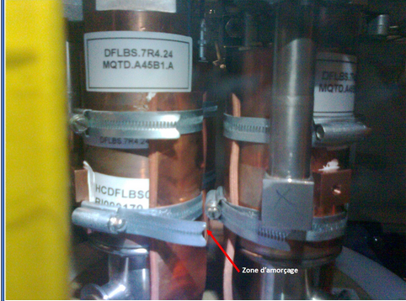
Problem with RQTD.A45B1
Installation of thermal protection of current leads of 600 A during TS

Slide 6
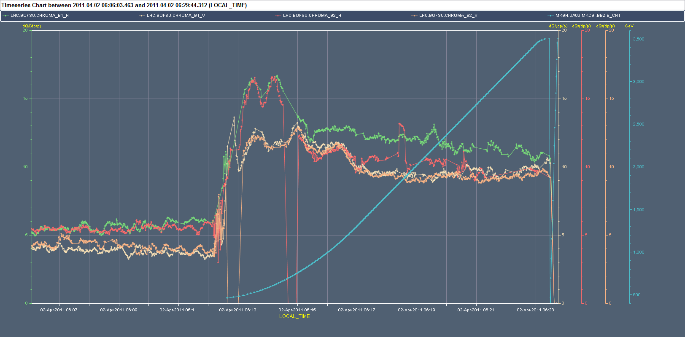
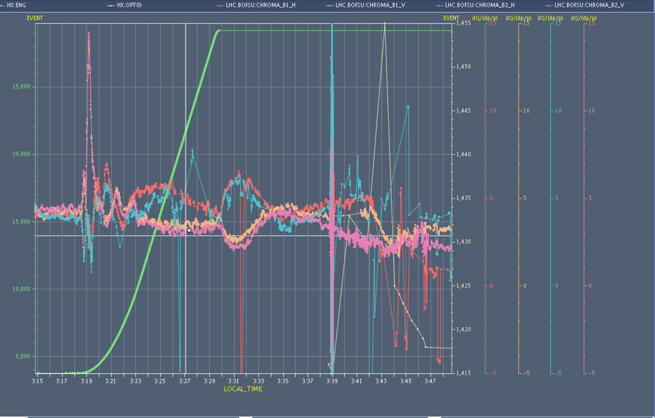
Verifications with beam
Finally beam on at 22:00 on Friday
New calibration curves for lattice sextupoles, measurement and correction of chromaticity
Before correction
After correction

Slide 7
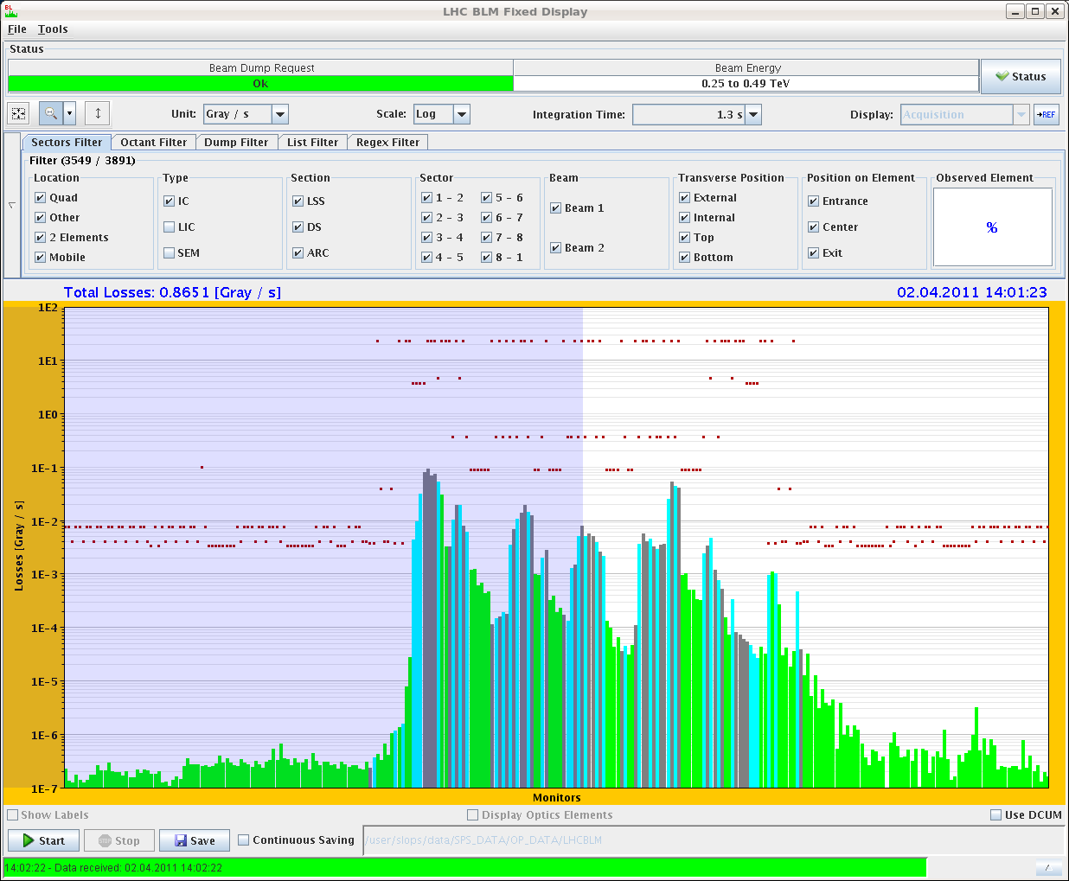
Collimation set-up (F. Burkart, G. Valentino, D. Wollmann)
Set-up of TCLA.A7R7.B1, TCTH.4L2.B1, TCSG.A5L3.B2 re-aligned during TS.
Loss maps: TGSG.D5R7.B1(BLM at the TCSM.D5R7.B1 behind) only factor 2 below TCP which causes a 0.5% leakage into the TCTs in IR8

Slide 8
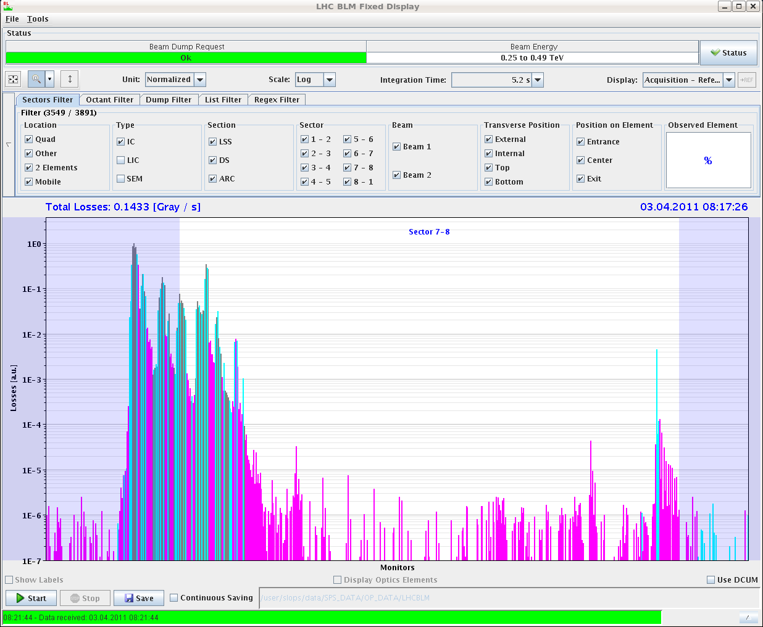
Collimation set-up (F. Burkart, G. Valentino, D. Wollmann)
Re-setup of skew B1 collimators: The main changes here were found in the beam sizes at:
TCSG.A6L7.B1 (delta -13%), which relates to a 0.76 mm smaller half gap after the setup.
TCSG.A4R7.B1 (delta -14%), which relates to a 0.95 mm smaller half gap after the setup.
Beta-beating? ➔ measurement at 450 GeV
Before set-up
After set-up

Slide 9
Collimation set-up (F. Burkart, G. Valentino, D. Wollmann)
TCTH.4L2.B1 (measured beam size ratio 121%/137% [new/old]) and TCLA.A7R7.B1 (104%/128%) seem to be parallel to the beam after the re-alignment during the technical stop. The TCSG.A5L3.B2 (126%/174%) seems to have still a misalignment of ~560urad.
We found changes of the beam offset at flat top for the 3 re-aligned collimators up to 404um. The measured beam size shrank from about max 229% to smaller than 140%.
Loss maps at 3.5 TeV (unsqueezed) with the new settings for the 3 collimators seem to be fine (no unexpected losses). The detailed analysis will be performed offline.
ToDo:
incorporate the new settings of the skew collimators and the re-aligned ones into the injection beam processes
re-setup the TCTH.4L2.B1 squeezed and at collision.
incorporate the new collimators settings into ramp functions
qualify the new settings at injection with B1V and off momentum (pos and neg)
re-qualify collimation at flat top (positive off-momentum), squeezed (all cases) and in collision (all cases)

Slide 10
Injection region aperture check (B. Goddard)
Scanned all vertical phases 0, 30, ...,330 deg B1 and B2
amplitudes upto 6-7 sigma (limited by losses on TDI and not wanting to put too large oscillations through arcs).
No sign of any aperture restrictions in area between MSI exit and Q5 where intermodule inserts were added in 2010/11 TS
Plots compare measurements end 2009 and today - solid points where aperture was reached, V error bars show where it was not.
In this regard OK for injection of higher intensity

Slide 11
Injection setting-up (V. Kain, J. Uythoven, D. Valuch)
Abort gap cleaning working and tested for both beams with 'first' and 'last' bunch in the machine and tests with debunched beams.
Tested BPMS with 3 nominal bunches in the machine: OK
Injection gap cleaning tested with a series of pilot injections for both beams: OK
Then tried injection of 24 bunches, as before TS. Losses much higher than before and needs to be sorted out before being able to take reference loss measurements of TDI BLMs with the different cleaning configurations.

Slide 12
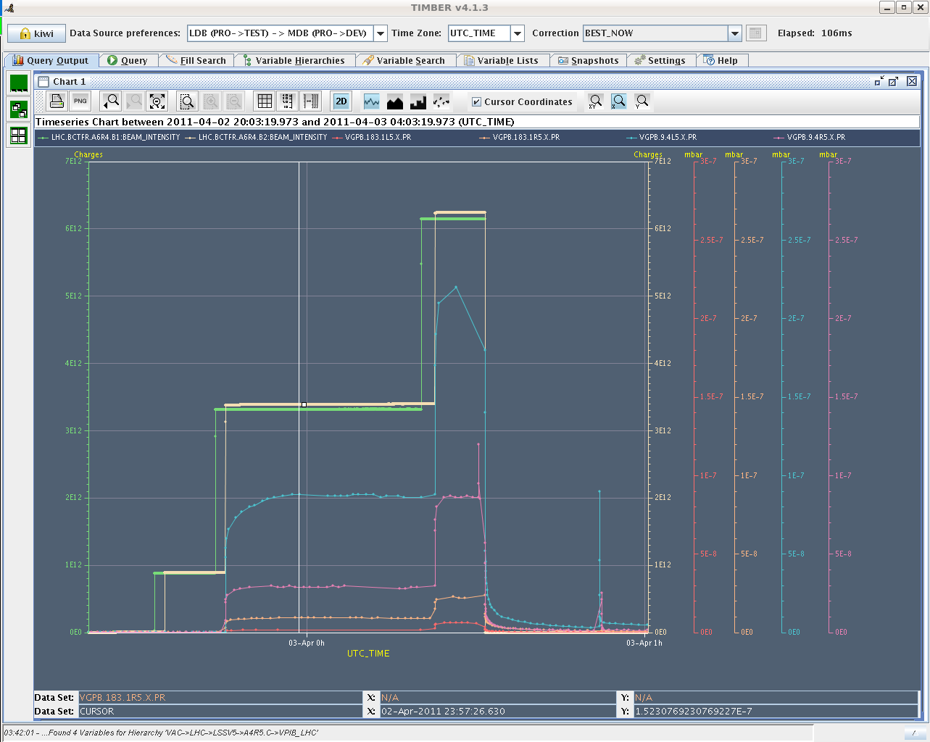
Effect of CMS solenoid OFF
Injection of 2 trains of 24 bunches each with 75 ns spacing in an unconditioned area (close to Q3) because of the presence of stray fields from CMS solenoid

Slide 13
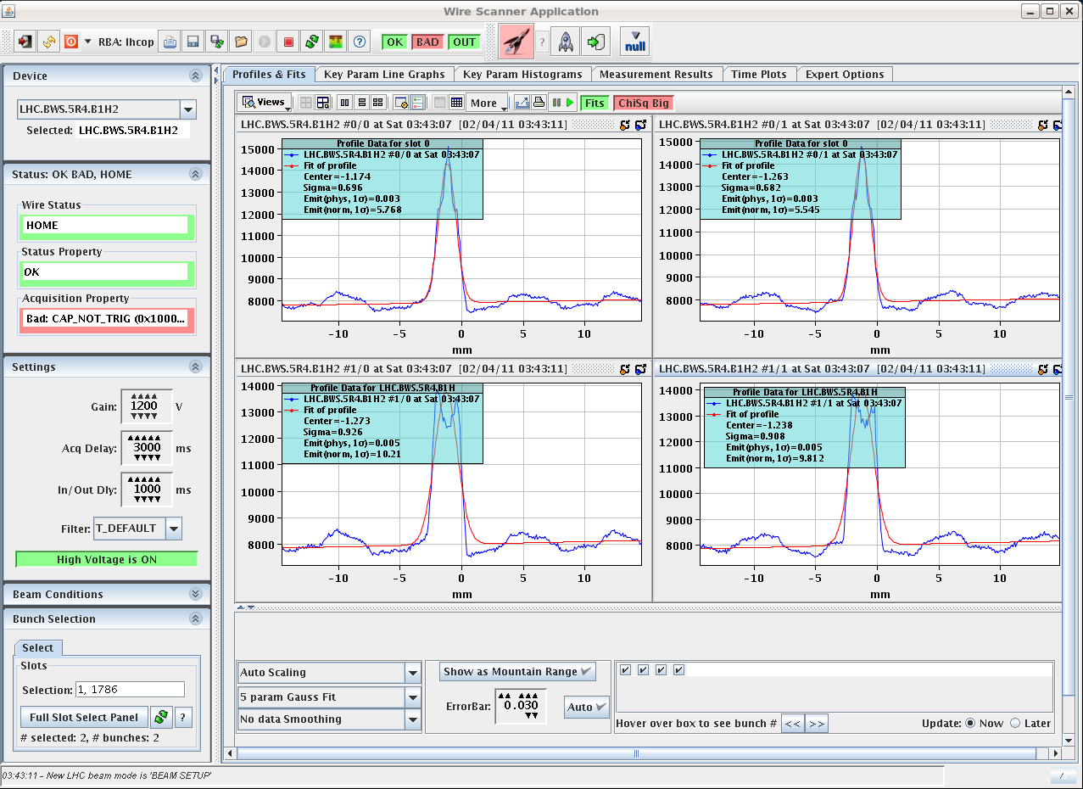
Issues
Still noise on wire scanners B1
Timing alignment errors between BICs observed. Being monitored
Trips of RF cavity 6B2 (power reflected from the cavity to circulator)
Orbit oscillations due to RT trim appear intermittently
Noise on 60 A power converter (RCBV16.L1B2)

Slide 14
SPS status
75 ns beam OK up to 4 trains (96 bunches)
50 ns beam OK up to 2 trains, still MKDH outgassing when 4 trains are injected (144 bunches)
25 ns to be re-tested today

Slide 15
Plan
Sun | N | Beta beating measurements at injection
Mon | M | Injection setting-up (24+ bunches - 75 ns)
Mon | A | Collimation setting-up (TCT) and loss maps
Mon | N | Scrubbing of IR5 with 75 ns beam
Next:
Completion of setting-up of the collimators (functions generation and validation)
Setting-up of injection with 75 (ongoing) and 50 ns beams
Scrubbing with 50 ns beam

