Slide 1
Monday 21.3.
06h00: End of fill #1640: 3.7 pb⁻¹.
06h14: RB S12 and S23 tripped before loading rampdown table, active filter. MPE piquet. Fip_Com_Lost for both RBs... Piquet called again.
09h18: Ramp down of LHCb and ALICE dipoles and compensators. Ramp down of ALICE solenoid.
09h27: Recovered from RB trips. Prepare for injection while magnets ramp down.
09h50: Problems in PS. Mains down in SPS.
10h30: Total voltage INTLK reduced to 3.5 MV (P. Baudrenghien).
10h33: Injection.
11h49: Start ramp. Beams dumped from false collimator interlock.

Slide 2
Total voltage INTLK reduced to 3.5 MV
The RF interlock on the local cavity voltage has been reduced to 3.5 MV (both rings).
It was set to ~1.5 MV before. That threshold is constant through the cycle.
Tested by Philippe: reduced the total voltage to 3.4 MV. Triggered the beam dump.
P. Baudrenghien

Slide 3
Monday 21.3.
12h34: Release of the new FGC software to fix the RF trip problem of two days ago (S. Page). Deploy fix for low level collimator controls software (A. Masi).
13h08: Problem with the ADT: the check for the injection settings is failing. W. Hoefle verifying.
13h18: Injection 136b. Large oscillations at the injection of SPS (PS not stable): larger emittances (2.3-3.8 murad-m) with respect to nominal.
14h38: Start ramp.
15h13: Stable beams.
15h13: LHC fast BCT phase tuning done (J.J. Gras).
21h45: Beam dumped by EIC.
21h49: Ramping up LHCb and ALICE magnets.

Slide 4
Collimator Software Issue
A. Masi
Worked since last Friday to understand problem that appeared last Thursday: postmortem data, review of the PRS (Position Readout and Survey system) code.
Possible source of problem: rare software state with duration 1us during which, if the trigger is received, the first interpolation of the limit functions is wrong providing limits much stricter with a consequent beam dump.
Probability estimated to about 10^-4. Higher in reality?
Workaround to avoid this case. New software version has been running all weekend on collimator test bench executing successfully a thousand of short profiles (i.e. no dump as soon the trigger were received).
After new Monday case: decided to deploy this.

Slide 5
LHC fast BCT phase tuning
Reduced significantly the effect of bunch length on measurement (image shows we stay within +/1 % now).
Fast BCT cross-calibrated with DC values after ramp.
J.J. Gras

Slide 6
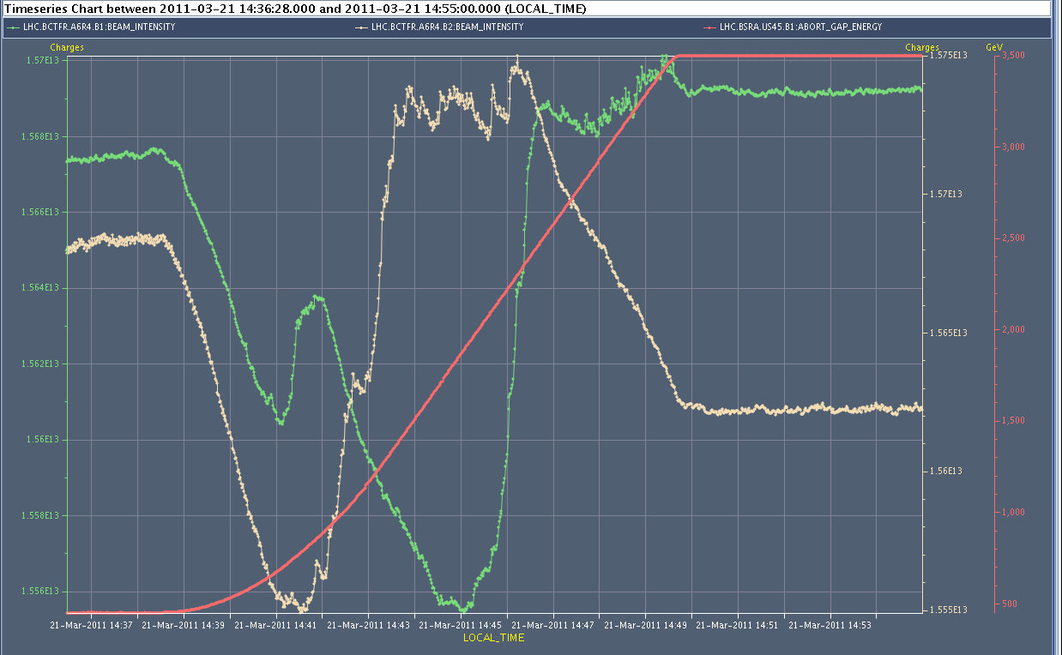
Monday 21.3.

Slide 7
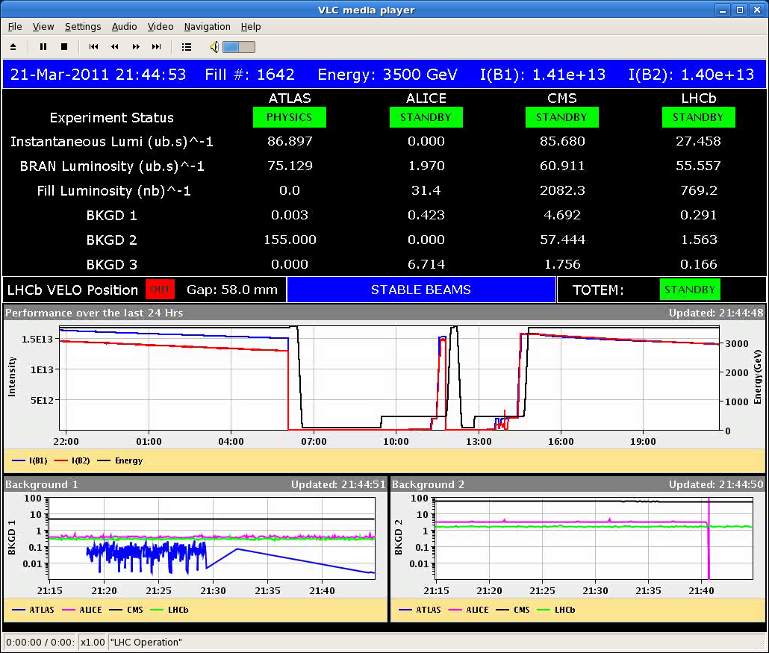
Luminosity

Slide 8
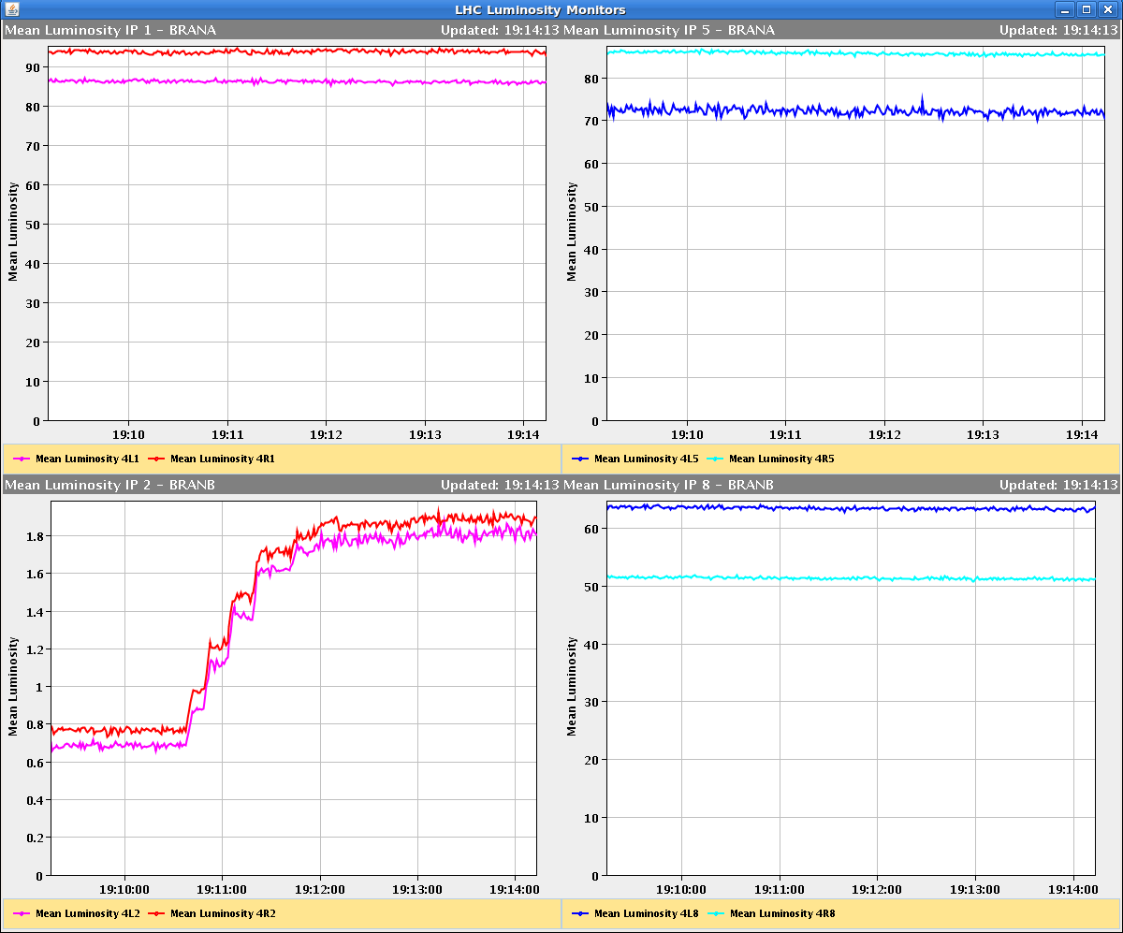
ALICE luminosity and background

Slide 9
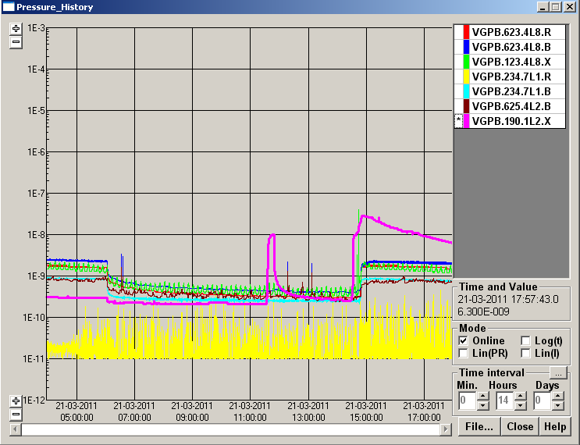
Higher IR2 Vacuum Pressure Magnets Off
IR2 pressure

Slide 10
Monday – Tuesday, 21 – 22.3.
22h39: Injection.
injecting difficult: PM from losses at pt 8, up to 94% of dump level.
context missing for XPOC b2 (verified with next dump ok)
the MKI waveforms b2 were not correct once
inj oscillations looked good, asked injectors to decrease intensity/emittance ,SPS to increase scraping and verify blow up.
Not verified yet with 24 bunch trains
23h19: SIS/controls problem
No SIS injection permits (IQC, XPOC, PM, vent.doors permits missing)
JMS (Java Message Server)
Experts: connection between the public JMS broker (JMS-PUBLIC-PRO) and the operational JMS broker for TN (JMS-CO-PRO1 & 2)
Still ongoing after intermittent fixes
05h05: BPM controls problem
Trips of BPM crates. Still ongoing.

Slide 11
Ahead
Tu am: Fix controls issues. Last 136b fill.
Tu pm: Go to 200 bunches.
Tu – Wed: Perform 2 fills with 200 bunches. End of fill test of IR8 separation (tbc).
Wed pm: Complete commissioning 1.38 TeV.
Wed pm – Fri: Stable beams at 1.38 TeV. 80b.
Sat am: Switch back to 3.5 TeV Test ramp nominal bunch. Third fill with 200b.
Weekend: Commissioning (3h for TL tests, 8h injection test with 96b, ...) Intensity step to 250b if time left
Monday 6am: Beam stop for TS

Slide 12
Outstanding
Injection of 96 bunches (→ weekend)
Timing distribution (→ technical stop)
FGC firmware update
Collimation system controls fix
1.38 TeV setting-up (→ Wednesday onwards)
Crossing angle all zero: OK
TCTs to set up & loss maps
Interlock tests for the roman pot (→ parasitic or TS)
RF voltage limit interlock
Longitudinal blow-up (→ if needed)
Wire scanners
Abort gap cleaning (→ with high intensity injection)
Injection gap cleaning (→ with high intensity injection)

