Slide 1
Sunday 28 Nov.
00h00: Stable beams #1525 121 x 121 b. Peak lumi 2.0e25 - 2.3e25 cm-2 s-1.
09h52: Dump fill #1525 - delivered 440 (mb)-1. RCBCH8.L5B1 trip.
10h49: Injection.
12h21: Start ramp.
13h22: Stable beams #1526. 121b x 121b. Turnaround: 3h30. Length: 5h35.
18h57: Beams dumped by request.
19h56: Injection. BPM orbit excursion interlock not reset with 2 low bunches in last batch -> dumped. Orbit feedback problem.

Slide 2
Monday 29 Nov.
00h48: Start ramp.
02h34: Stable beams #1528. 121b x 121b.
03h45: Beams dumped. RB.A78 in slow abort. PO piquet and MP3 called. Problem related to the new feature that superlocked circuits?
05h46: Injection.
07h16: Start ramp. 121b x 121b.
07h55: Beams dumped during squeeze. RB A67 is in slow power abort. In PIC application it is superlocked.

Slide 3
Summary Week 47
Coordinators: R. Assmann, J. Uythoven
Goals: Stable beams. Reach more than 6 μb⁻¹ for total.
Highlights:
Integrated lumi: > 6.4 μb⁻¹ for total.
New peak ion lumi: 2.9e25 cm-2 s-1
Fastest ion turn-around: 3h30
Time in stable beams: ~36% (61h / 168h)
Additional work:
ALICE polarity switched on Tuesday. New IR2 collimator settings.
ATLAS solenoid off run.
Switch to second ion oven. Injectors heavily tuning for LHC! Thanks.
Vertical B2 emittance at injection. Transverse damper on in collision.
RF diffusion MD. Beam Gas Ionisation monitor calibration (BGI).
Investigation of ghost bunches: DC vs. FBCT currents.
Improving turn-around with new sequences.

Slide 4
Integrated Lumi
Week 47
LPC (Massi)

Slide 5
Integrated Lumi
Week 47

Slide 6
Peak Lumi
LPC (Massi)

Slide 7
Peak Lumi

Slide 8
Un Grand Merci for the Injectors
Quite intensive tuning at the injectors to keep ion intensity at the very high levels we now got used to (above design).
Source.
Linac intensity.
LEIR transmission.
PS cavity.
SPS transmission.
Emittance blowup removed.
Several experts in to help: Django Manglunki, Christian Carli, Detlef Kuchler, …

Slide 9
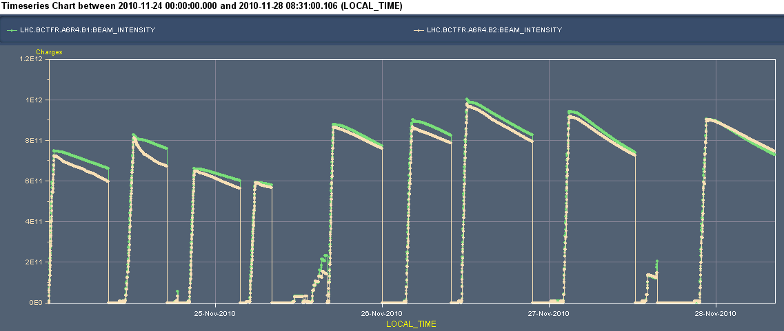
Beam Currents and Lumi’s since Wed
Can spend your time analysing the lumi’s...

Slide 10
New Record Lumi

Slide 11
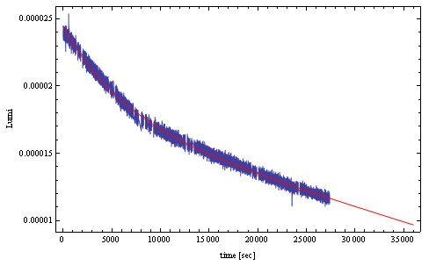
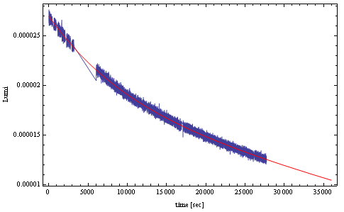
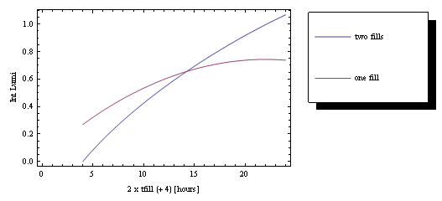
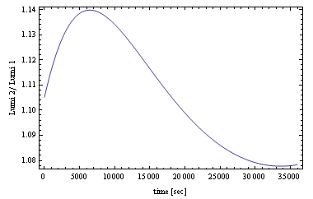
(ALICE) Lumi vs. time
Friday: Fill # 1522
Saturday: Fill # 1523
‘Elbow’
Fill # 1523 / Fill # 1522
For both fills optimum time to keep it in would be about 5 hours, for 4 hours refill….
Keep it for 6 hours, for an 8 hours refill.....
We tend to keep it longer: you know what you have Confirmed by yesterday’s experience
Jan Uythoven

Slide 12
A Few Details
Hardware issues
Ghost bunches
Turn-around
Emittance

Slide 13
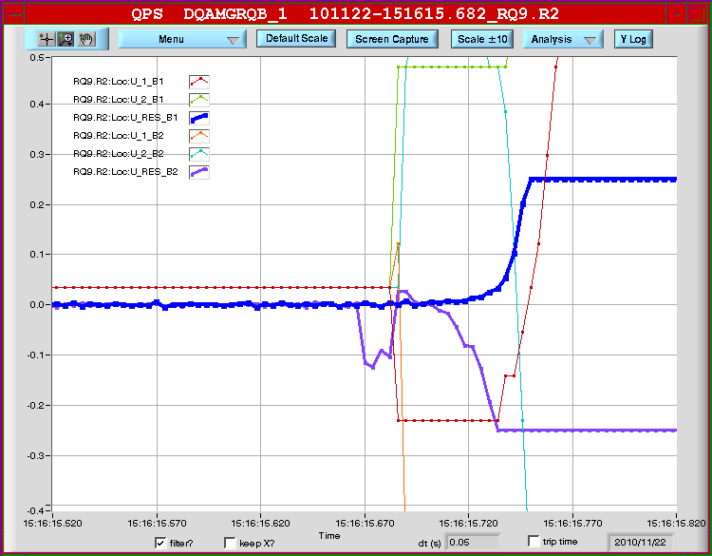
Q9.R2 trip #1: Noise?

Slide 14
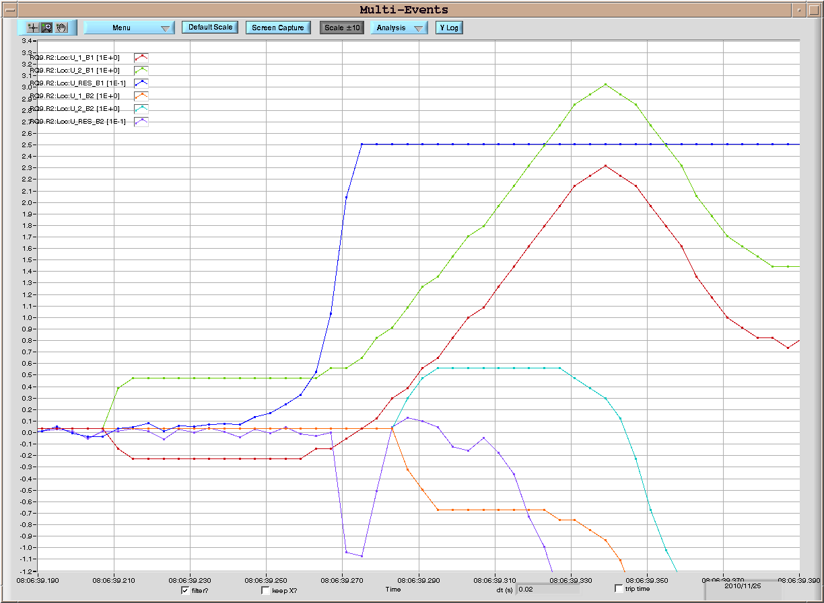
Trip #2 of RQ9.R2 on November 25, 08:06:39
As already noticed by A. Verweij, there is a symmetric development of a voltage signal in the two halves of RQ9.B1; the two voltage loops go from the current leads up to the magnet mid point
U_Res_B1
U_2_B1
M. Pojer
U_1_B1

Slide 15
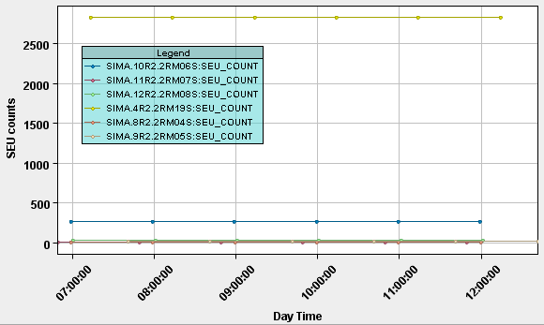
Trip #2 of RQ9.R2 on November 25, 08:06:39
1- Similar signals were observed during the symmetric quenches on the dipoles
2- An EM disturbance would have produced a much noisier signal
Could radiations be at the origin?
No counts were recorded on the RADMONs from 4.R2 up to 12.R2 in the
time frame from 6h30 e 12h00
M. Pojer
Courtesy of M. Calviani

Slide 16
SR7 Temperature – BPM Calibration

Slide 17
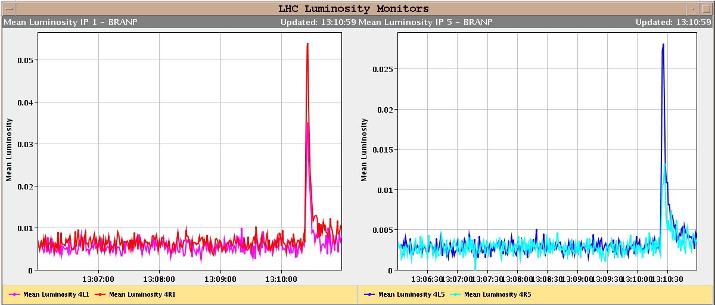
Lumi Spike During TCT Movement

Slide 18
A Few Details
Hardware issues
Ghost bunches
Turn-around
Emittance

Slide 19
Ghost Bunches
Difference seen between fast BCT (bunched beam) and DC BCT (total beam), even after ramp which should clean out unbunched beam.
Problem for vdM scan calibration: need to know intensity.
Follow-up by J.J. Gras, BI: Ghost bunches carry a few % of beam!
Look at longitudinal density after ramp (synchrotron light)
2 ghost bunches from injectors.
Many ghost bunches forming with time at injection: first injected bunch has most, last none…
Follow-up by Phillippe Baudrenghien, RF: Process of creation understood – RF modulation. Quick attempt at fix not successful.

Slide 20
Long. Density Monitor
Longitudinal density monitor = LDM (BI Resp: E. Bravin, A. Jeff) measurement integrated over 50 mn (from 15h46 to 16h36) during stable beam. We have a small residual phase shift, the last pulse on the right side is in fact the first bunch. We see that bunch peak is around 80000 counts.

Slide 21
Zoom Before Bunch 1 → Ghost Bunches
zoom just before bunch 1 (ie the last one on the previous plot). We see there 'islands' of ions. These islands are separated by 2.5 ns. Their peak is around 30 (40-estimated noise baseline), i.e. 2500 time less that real bunch peak.

Slide 22
Bunch in the Middle
zoom before a bunch in the middle (around us 50s). We see also there populated islands every 2.5 ns with peak around 30. Some of these beeing even more populated (~500 less than real bunch)

Slide 23
Last Bunch
surround of one of the last bunch injected. We see there no clear 400 MHz structure with an average level around 10 which is our estimated noise.

Slide 24
Abort Gap
zoom in the middle of the abort gap. Again there, mainly noise.

Slide 25
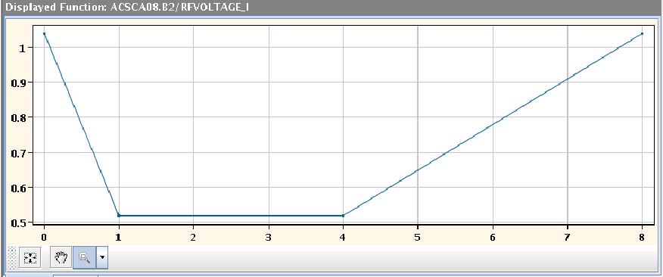
RF Voltage trim at injection – Ghost bunches
With the beams dumped, the RF voltage functions for injection were lengthened by 4.4 s to prevent the generation of ghost bunches. Unfortunately, this showed up an error in the injection sequencer logic with sent an abort to the RF FGCs while they were still running. This was eventually debugged.

Slide 26
Status Ghost Bunches (JJ Gras)
Just before ramp: ~8% difference between DC and fast BCT on both beams.
Loss of real debunched beam during the start of the ramp.
Remaining difference close to 6.5% per beam.
Lost ~1.5% of debunched beam during the ramp: roughly the same amount than with the previous RF injection schema.

Slide 27
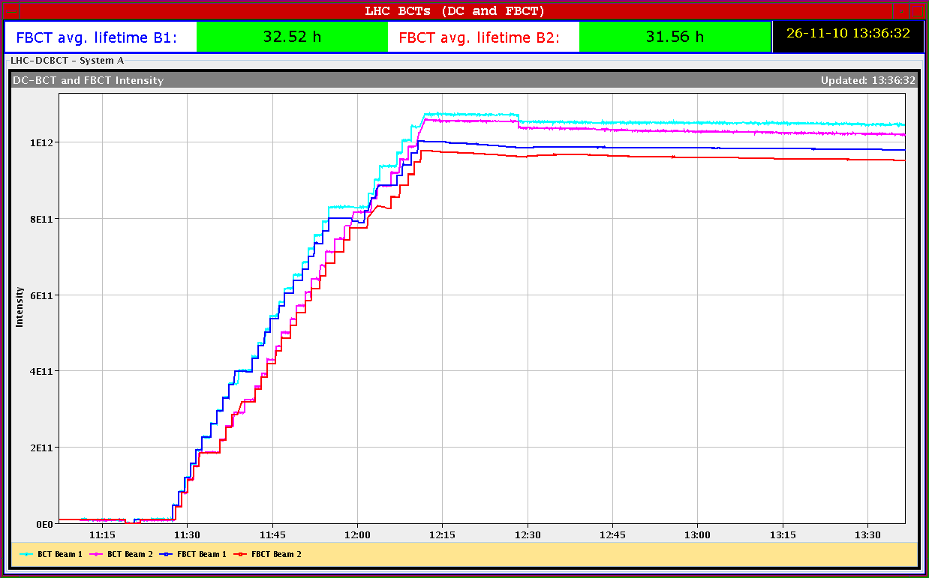
Fill 1522

Slide 28
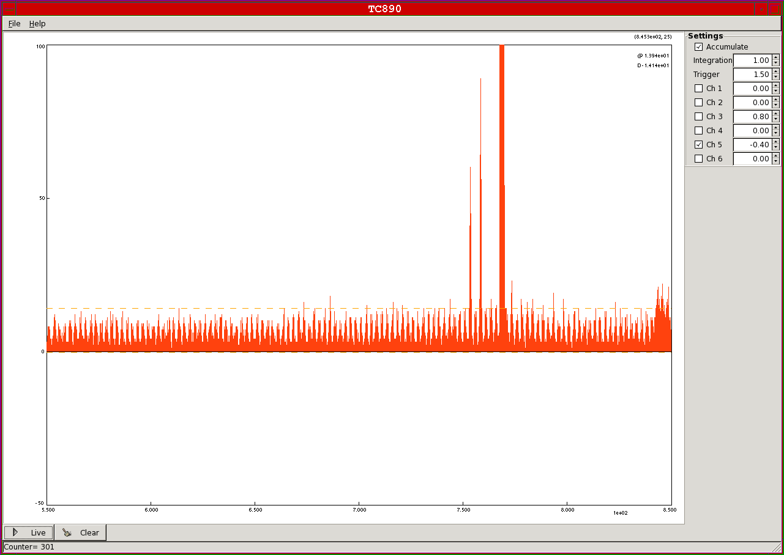
Ghost Bunches

Slide 29
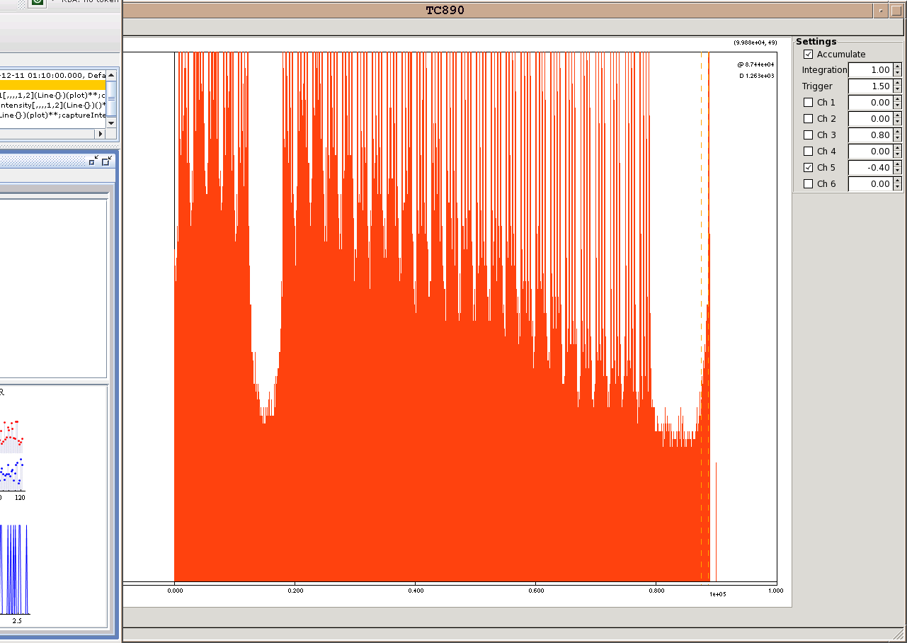
Ghost Bunches Full Turn

Slide 30
BSRT on Empty Slots
F. Roncarollo

Slide 31
A Few Details
Hardware issues
Ghost bunches
Turn-around
Emittance

Slide 32
Improving the turn around in LHC
Two new sequences have been created:
PREPARE LHC FOR INJECTION (ALL BUT PCS)
INJECTION PROBE BEAM
To improve the turn around in LHC.
Reyes Alemany
RAMP DOWN – PRECYCLE COMBO V01
PREPARE LHC FOR INJECTION (ALL BUT PCS)
1. RUN IN PARALLEL
INJECTION PROBE BEAM
2. RUN:
LHC equipment ready for injection in a bit less than 1 hour
Turn around of today’s morning shift with this new sequences and a smooth injection from injectors: 3.5 hours (new record)

Slide 33
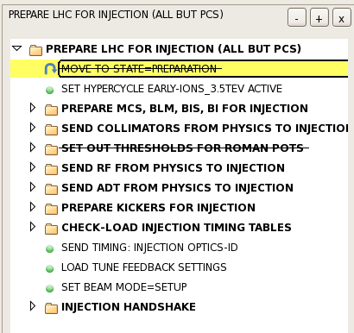
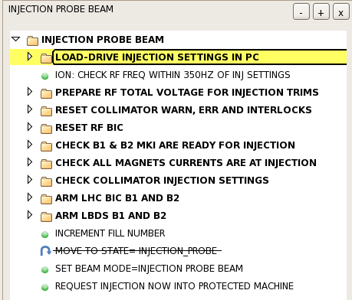
Tested today for the first time. Once well tested it will be included in the LHC Nominal Sequence
Reyes Alemany

Slide 34
A Few Details
Hardware issues
Ghost bunches
Turn-around
Emittance

Slide 35
Emittance Fill 1522
Emittances start injection:
B1-H: 2.5 B1-V: 2.3 B2-H: 2.6 B2-V: 3.2
Emittances end injection:
B1-H: 3.3 B1-V: 2.5 B2-H: 3.8 B2-V: 3.9
OK

Slide 36
Transverse Damper: Well Damped
Wolfgang Hoefle checked.
Already maximum gain at injection.
Nothing to gain more…
However, during 450 GeV at injection (Friday morning): interesting perturbation on beam 2 vertical

Slide 37
Damper Pickup B2
The “hump”?
1000 turns
89 ms

Slide 38
Damper Pickup B1

Slide 39
Plan
Issues:
Vertical emittance growth b2 for any delay at injection.
Short circuit at the ion sources, leading to lower intensities at LINAC3: 2 days work to fix this. If the injected beam intensity continues to go down, a fix of this short circuit needs to be considered.
This Week:
More stable beams
Tuesday: Van der Meer Scans
Thursday: Injection tests with 8 bunches
Discussing a few MD-style studies (IR aperture, …)

