Slide 1
Week 46
Week 46: Machine coordinators: Roger Bailey – Gianluigi Arduini
Main aims of the week:
Stable beams with ions
Scheduled stop for ion source refill Wednesday and Thursday
Proton MD (75ns and 50ns) "in the shadow" Wednesday to FridaySaturday
Monday | Ion physics with 121 bunches, Fills 1492, 1493
Tuesday | Ion physics with 121 bunches, Fills 1494, 1496
Wednesday | Setting up for 75ns protons all day and night
Thursday | 75ns high intensity studies at 450 GeV
Friday | 50ns studies at 450 GeV and ramp
Saturday | Setting up for ions and physics, Fill 1504
Sunday | Ion physics with 121 bunches, Fills 1505

Slide 2
Wednesday - 75ns setting up
06:00 Start proton MD
09:30 Pilot injection: LHC-SPS Re-synchronization problem
09:30-10:30 No beam from CPS (RF problem)
12:00 LHC-SPS Re-synchronization problem fixed. In the mean time test 75 ns beam in the SPS
14:00 Safe beam flag test done
14:30-15:00 Phase loop gain adjustment
15:00-16:30 PS Access (in the mean time first set of loss maps)
16:30-22:00 Issues with RF capture of single bunch with nominal intensity. In parallel final verification of loss maps.
22:00-23:00 Setting-up of single batch injection
23:00-06:00 Transfer line and injection setting-up with 75 ns
06:00-ongoing: Start injection of more trains of 24+24 bunches

Slide 3
Thursday - 75ns
Filling while monitoring vacuum and cryogenics, all at 450GeV
680 bunches/beam (8+14*48) 9 10¹⁰ p/b, batch spacing 1.85 us
Kept this beam for 2 hours for UFO investigations
Hit problems with capture of Beam 2. Press on with Beam 1
680 bunches Beam1 (8+14*48) 11 10¹⁰ p/b, batch spacing 1.85 us
824 bunches Beam1 (8+17*48) 11 10¹⁰ p/b, batch spacing 1.05 us
In all cases, vacuum effects much reduced cf 50ns
Activity in the common beam pipes
In all cases, negligible heat load in the arcs

Slide 4
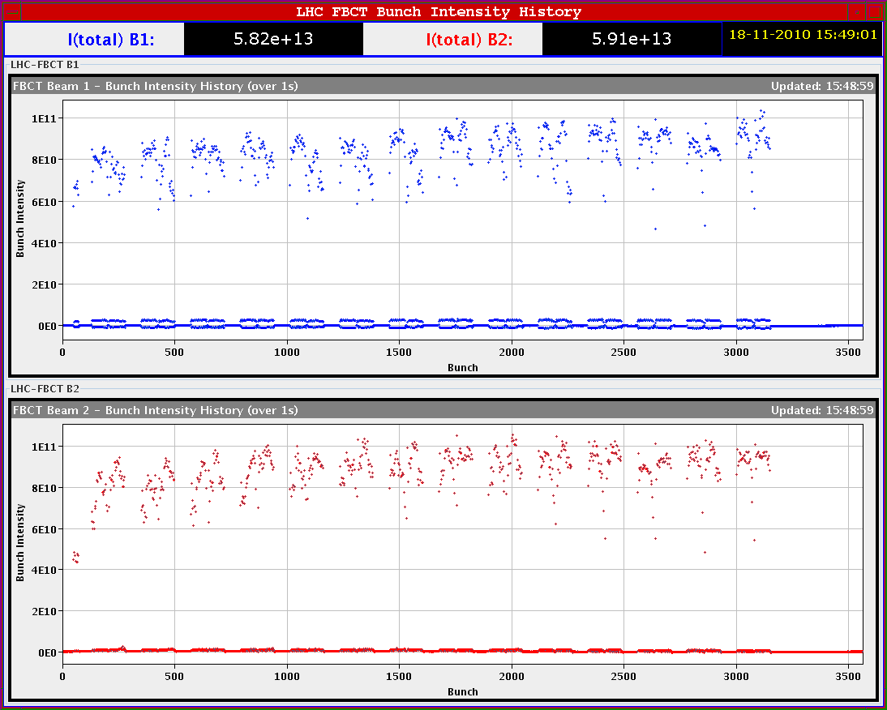
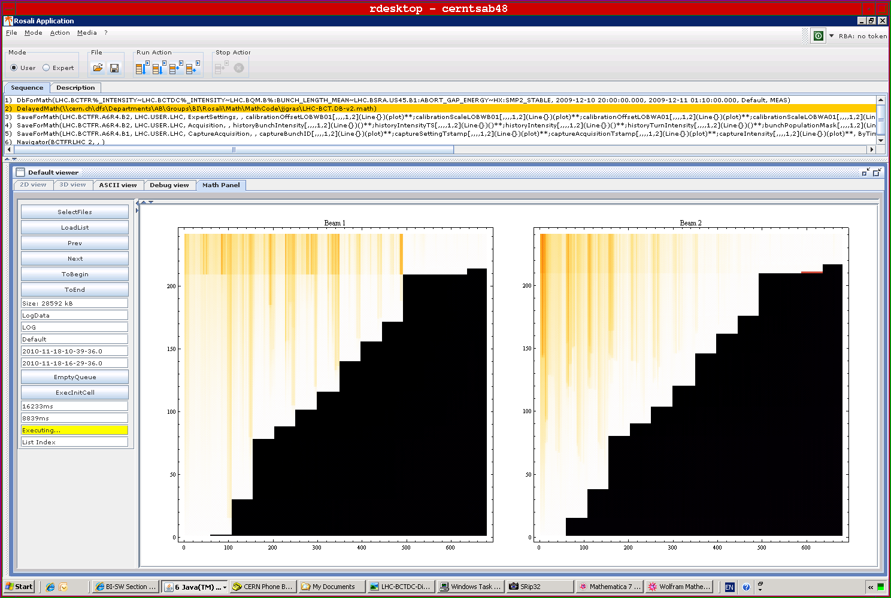
8+14*48 = 680 bunches
Finally got there....intensity slightly lower than nominal (~0.9x10¹¹ p/bunch). During the ramp in intensity measurements for vacuum and cryogenics

Slide 5
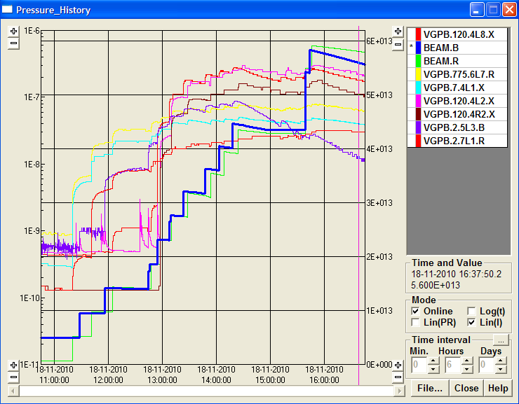
Vacuum with 680 bunches per beam

Slide 6
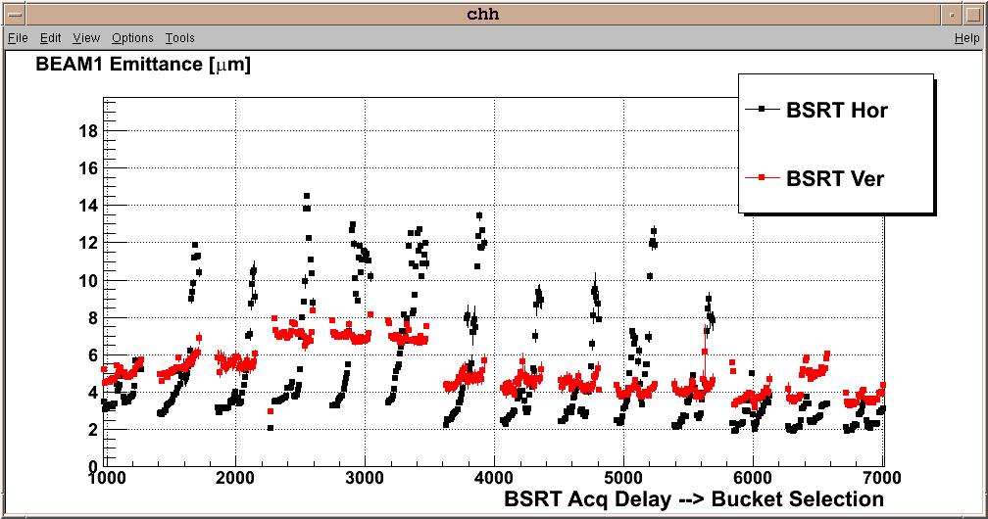
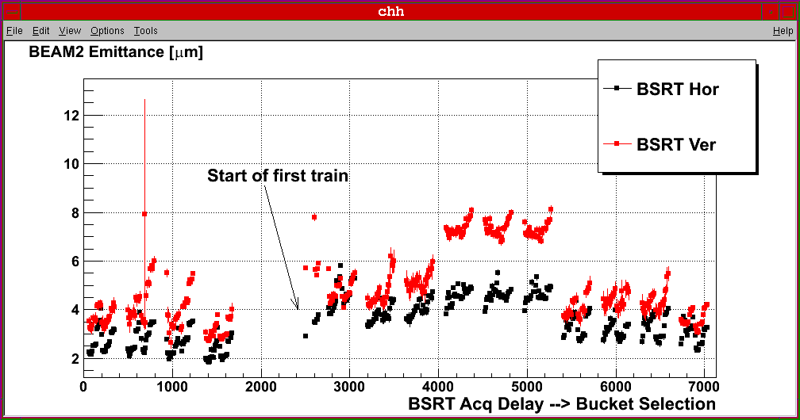
BSRT emittances of the 14 trains
Still blow-up observed in particular for B1 horizontal ➔ investigations on feedback side ➔ horizontal oscillations observed ➔ can be damped by higher chromaticity

Slide 7
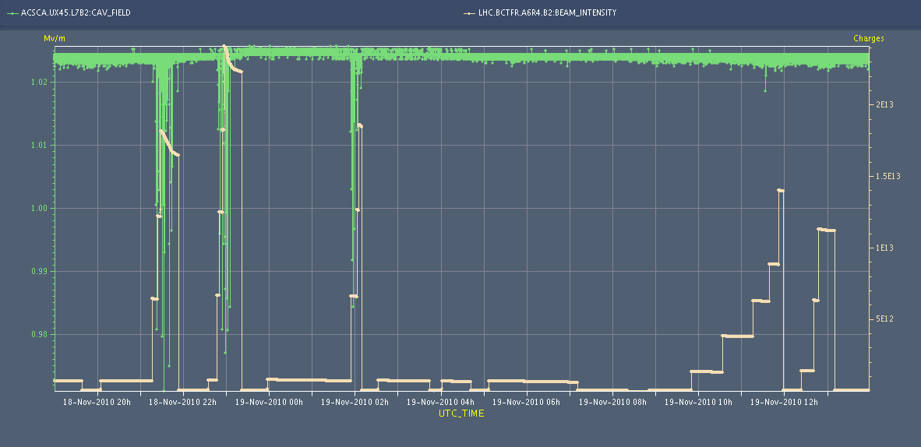
Thursday - 75ns – high intensity
Capture losses observed on beam 2 during Thursday are understood ➔ Cavity 7B2 is showing some noise on the accelerating voltage. It seems to be correlated with high beam intensity ➔ solution ➔ conditioning if running at higher intensity

Slide 8
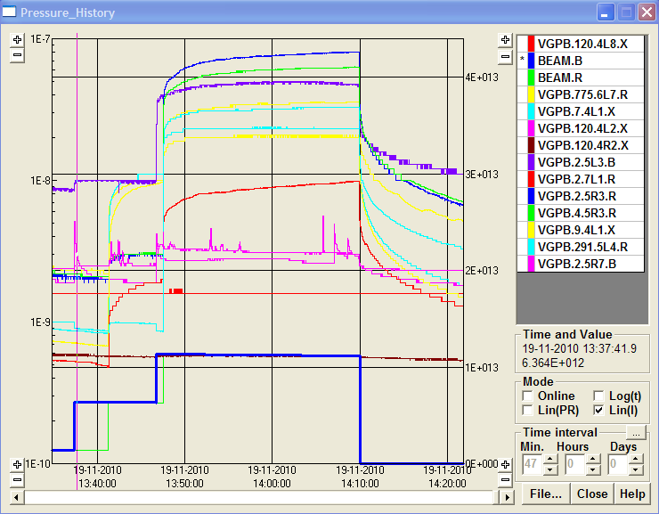
Friday – switch to 50ns
Setting up of 12, 24 and 24+24 bunch injection
Two trains of 24+24 bunches injected. Visible effect on vacuum ➔ there was no visible effect for two trains of 24+24 bunches for 75 ns spacing

Slide 9
Friday – 50ns ramps
IP6 BPM test OK with 108 bunches
Test ramp with single nominal bunches OK. Full set of loss maps
Set up for 'repeat' of fill 1459 (night of Oct 30/31)
Fill 1500 - 1+9*12 bunches of 1.1e11
Lost at 3.5 TeV because of trip of power converter (RQTD.A12B1)
22:30 Issues with MKD Beam1 - access needed
Ramp with 1+9*12 bunches of 1.1e11 (Beam 2 only) for cryo and vacuum measurements

Slide 10
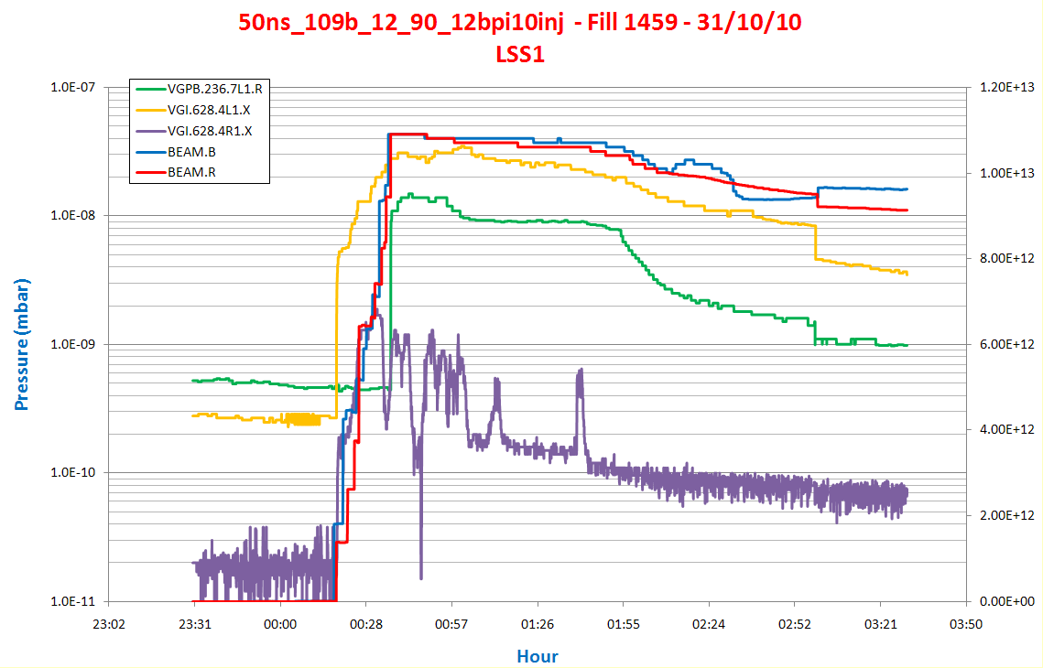
Fill 1459 – 31st October
50ns_109b_12_90_12bpi10inj - Trains well separated
Pressure up to 2e-8 mbar

Slide 11
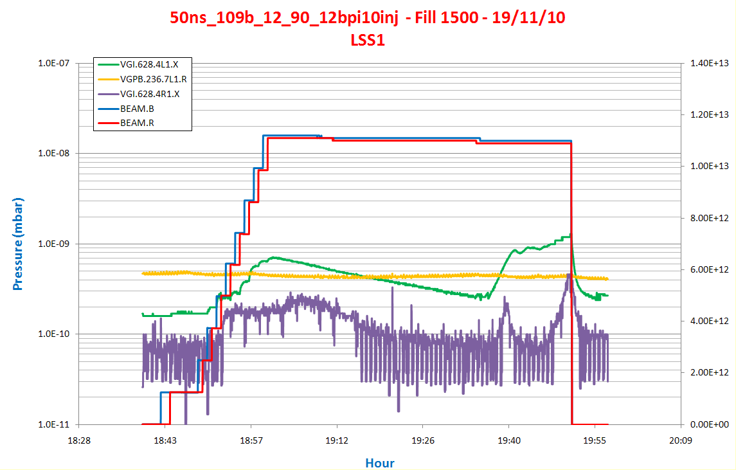
Fill 1500 – 19th November
Pressure increases at VGI in A4L1
But much lower than before

Slide 12
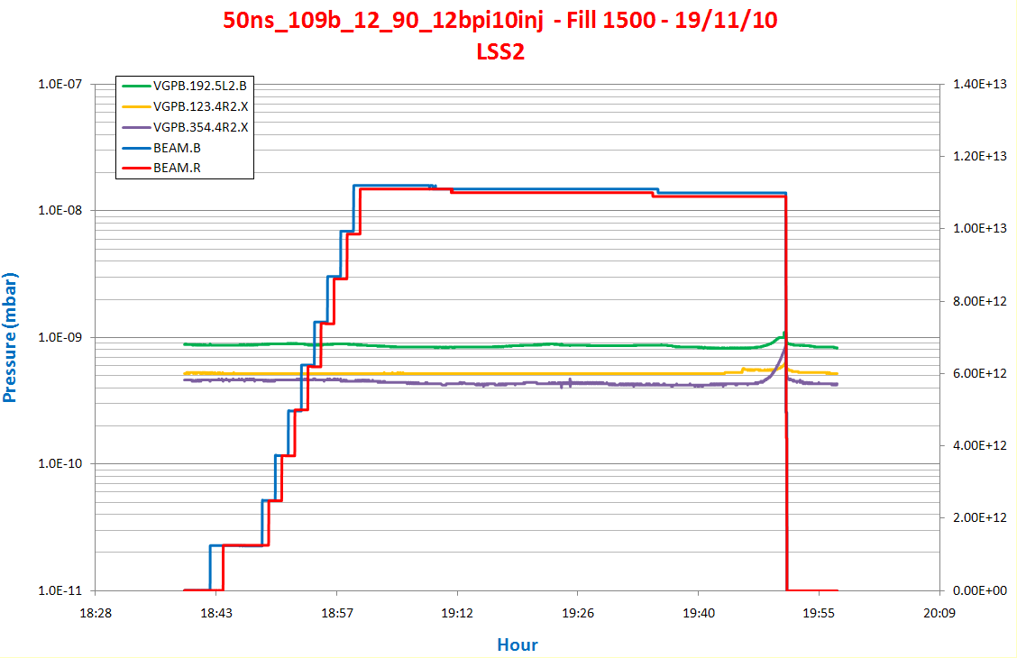
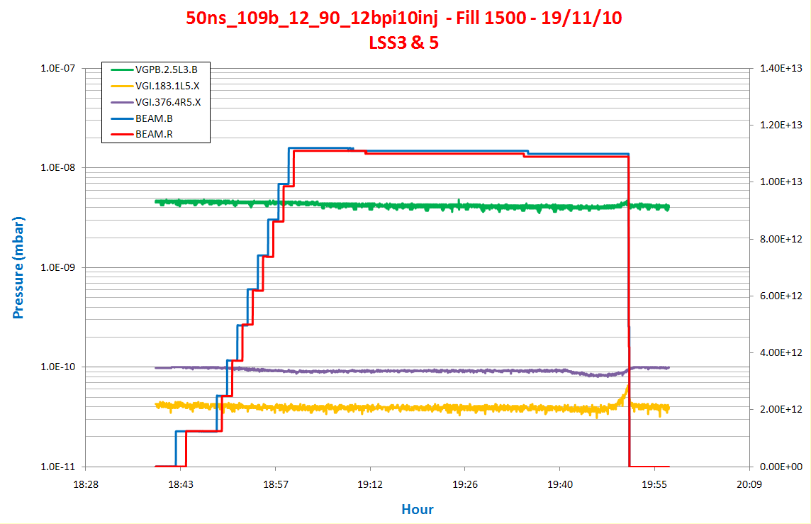
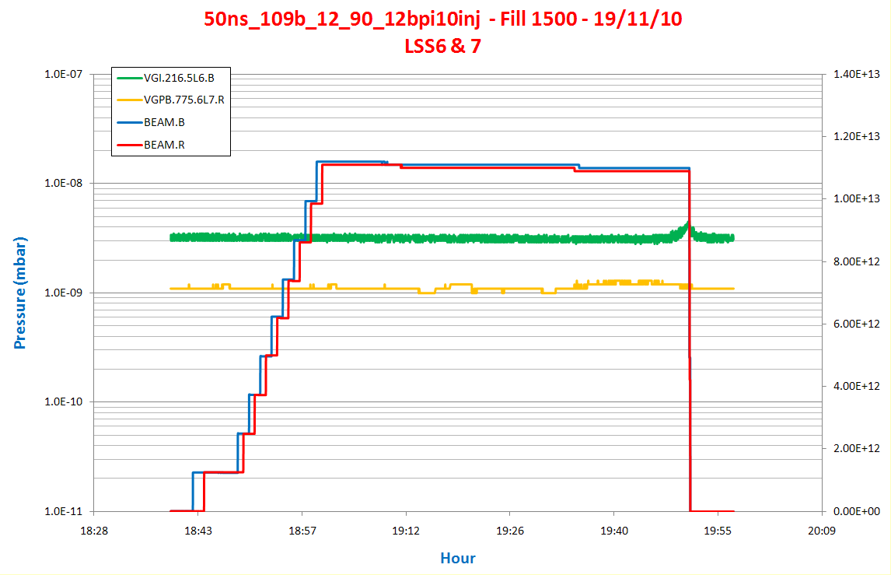
Fill 1500 – 19th November
Only SR desorption
in LSS2
in LSS3&5
In LSS6&7

Slide 13
Friday – 50ns – 450 GeV
After the access: Injection of trains of 48 bunches spaced by 1.85 microseconds (similar to what was done with 75 ns) for comparison purposes
Go with Beam 1 to speed up. Managed to inject 444 bunches with ~1.2x10¹¹ p/bunch
Clear effects on the vacuum
Clear sign of heat load on the cryogenics. Not visible with 75 ns spacing.

Slide 14
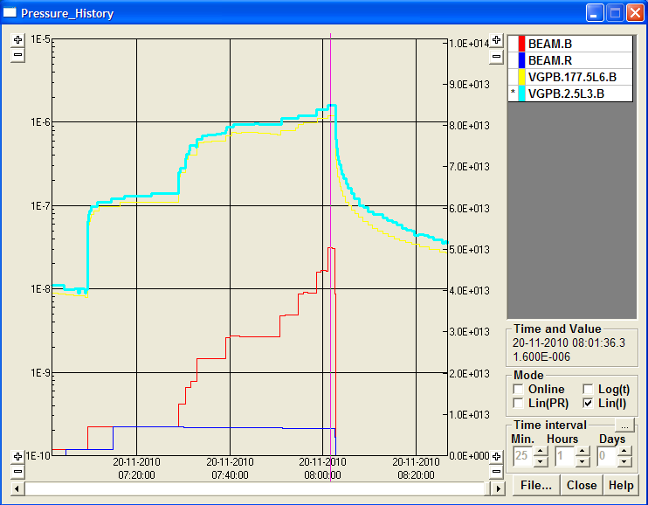
Fill 1502 – 50ns – 450 GeV
Beam1 = 444 Bunches Beam2 = 60 Bunches
Highest Pressure on LSS3 and LSS6
1E-6 mbar
LHC beam commissioning 20 nov 2010

Slide 15
Preliminary and qualitative
Much less vacuum activity and heat load with 75ns spacing
Comparison of 50ns before and after many hours of scrubbing clearly shows that the situation has improved significantly
Comparison of similar trains of 75ns and 50ns spacing clearly shows that 50ns is significantly worse
Analysis ongoing
See BCWG, LMC, Evian, Chamonix

Slide 16
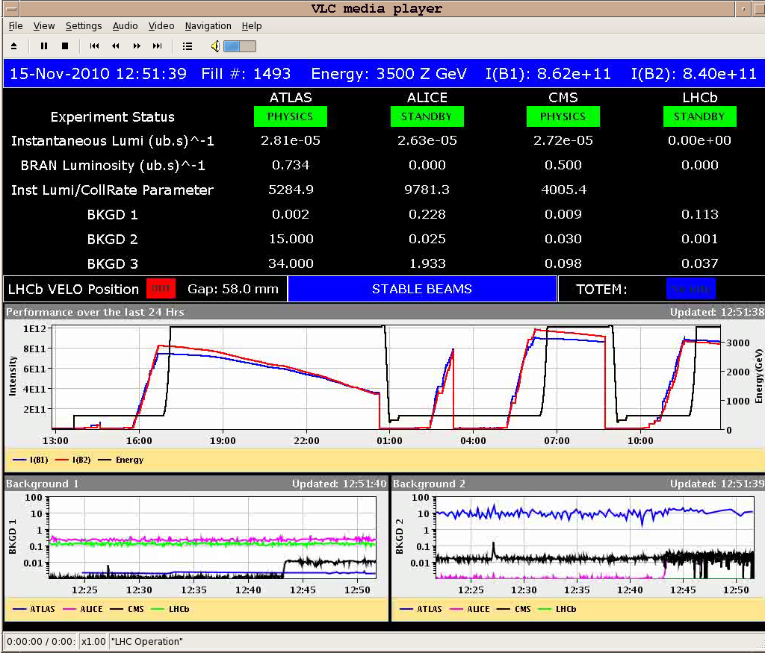
Monday - ion physics
Fill 1492 into physics around 07.30
500ns_121b_113_114_0_4bpi31inj_IONS
Initial luminosity 2.5 10²⁵ cm⁻² s⁻¹
Lost at 08.45 - network instability triggered the FMCM for the D1 in P5
Refill for physics
Same configuration
Fill 1493
450 Z GeV emittances B1-H: 2.6 B1-V: 2.1 B2-H: 3.5 B2-V: 3.3
Beam intensities ~ equal
Stable beams from 12.50

Slide 17
Saturday Nov 20 – back to ions
08.00 Stop proton operation. Switch back to ions
Interlocks, thresholds, synchronisation etc
10.00 Both beams circulating
10.30 PS RF problem (80 MHz cavity. No beam for 1 hour)
11.30 – 13.00 RF capture optimisation
13.30 Test ramp, 2 bunches per beam
Ramp, squeeze, collide
Also used for qualification of luminosity scan range
Fill for physics from 17.00
Bunch intensities some 30% down on those before the stop
Some delays due to SPS RF and PS RF (80 MhZ cavity)
21.50 Ramp 121 and 120 bunches
23.00 Stable beams. Fill 1504. Initial lumis around 2 10²⁵

Slide 18
Sunday – ion physics (well sort of)
Dump at 06.00
Refill with difficulties in the injectors
Uncertainties on BCT measurements, but lower than before
Losses on beam 2 (10-20%) during the squeeze
11.00 Stable beams. Fill 1505. Initial lumis around 1 10²⁵
Dump at 13.00
Damper studies through the afternoon
Back to physics in the evening with interruptions from PS MPS and PS RF
Filling for physics from 23.00 or so, damper ON through the flat bottom
01.30 Stable beams. Fill 1506. Intensities (and BCT) better. Lumis 2.2 10²⁵

Slide 19
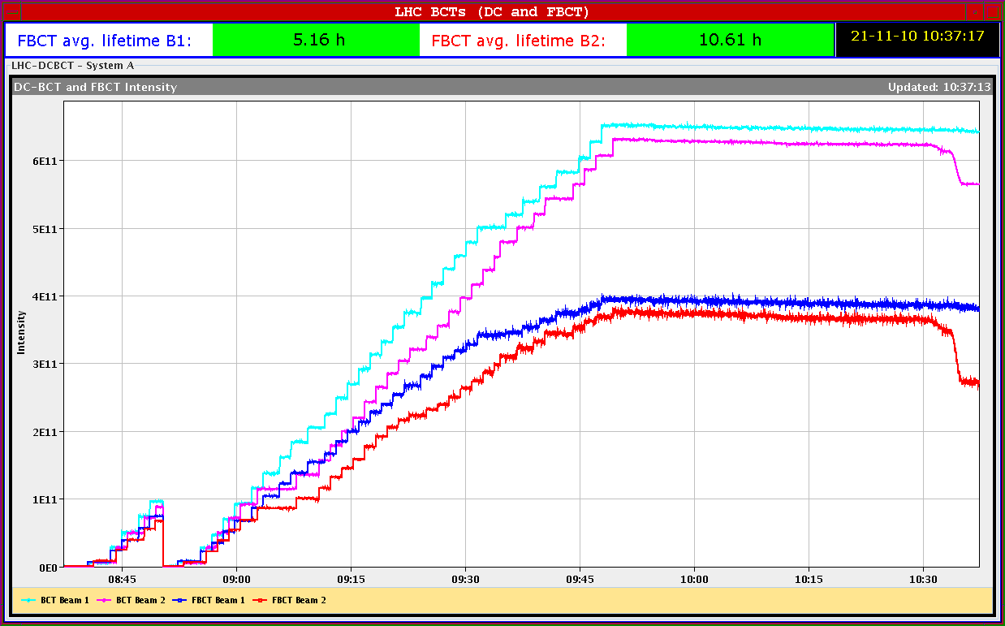
BCTs during filling for 1505

Slide 20
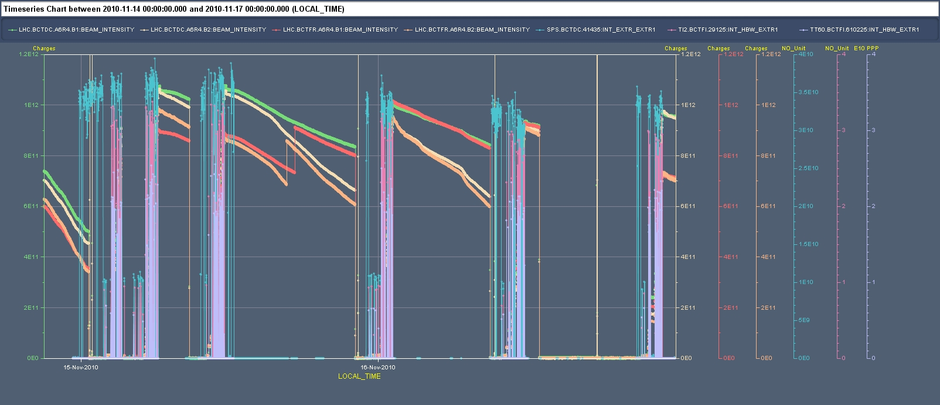
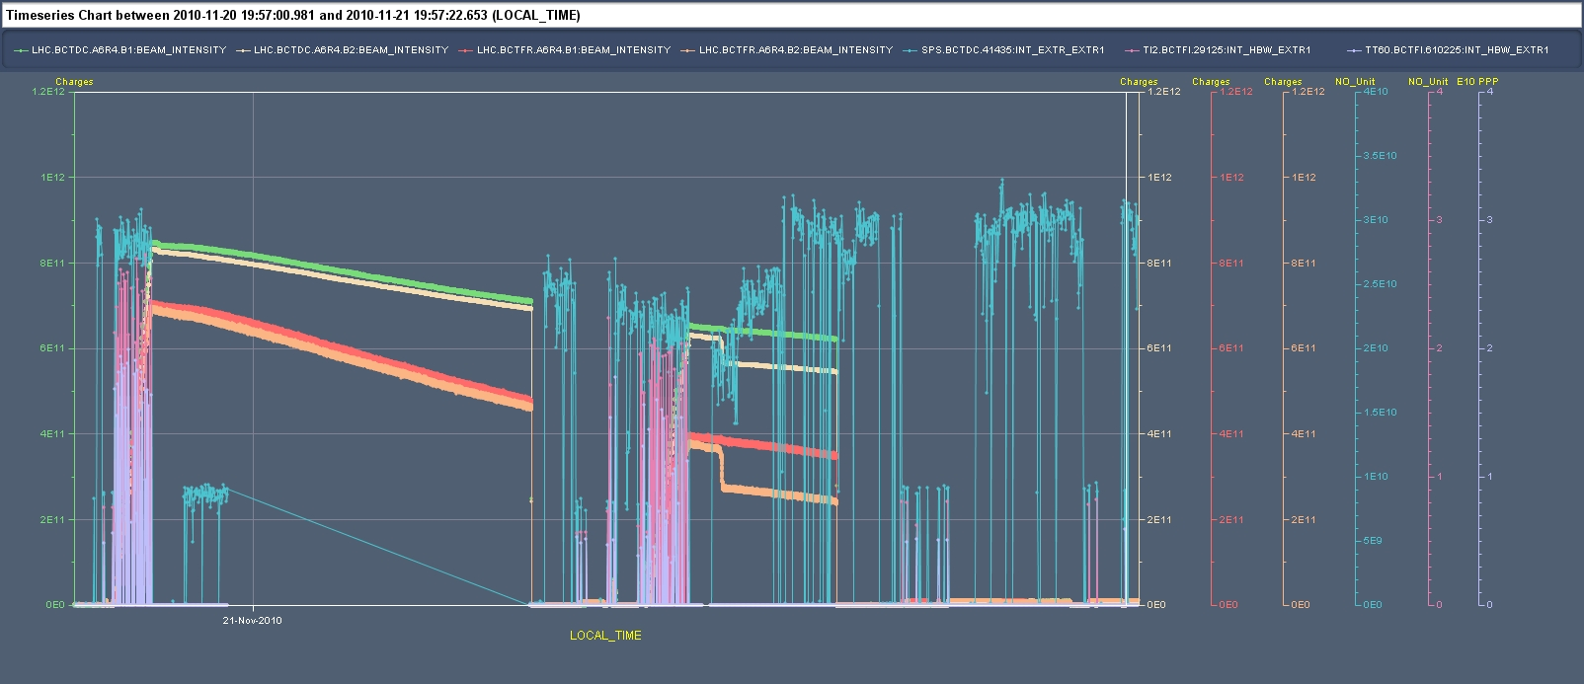
Intensities b4 and after source refill

Slide 21
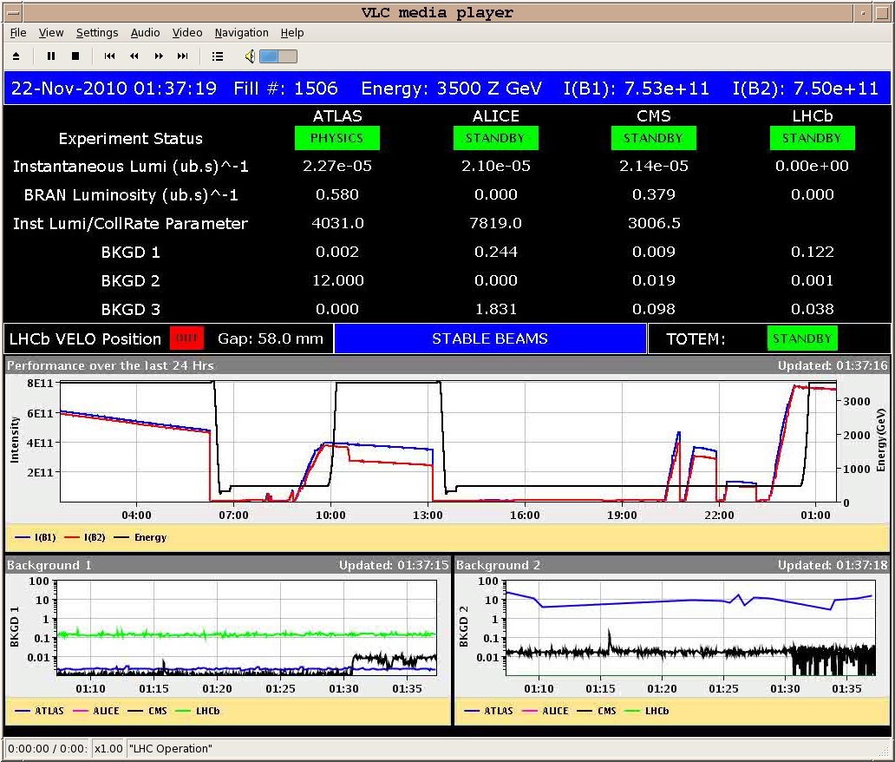
Fill 1506

Slide 22
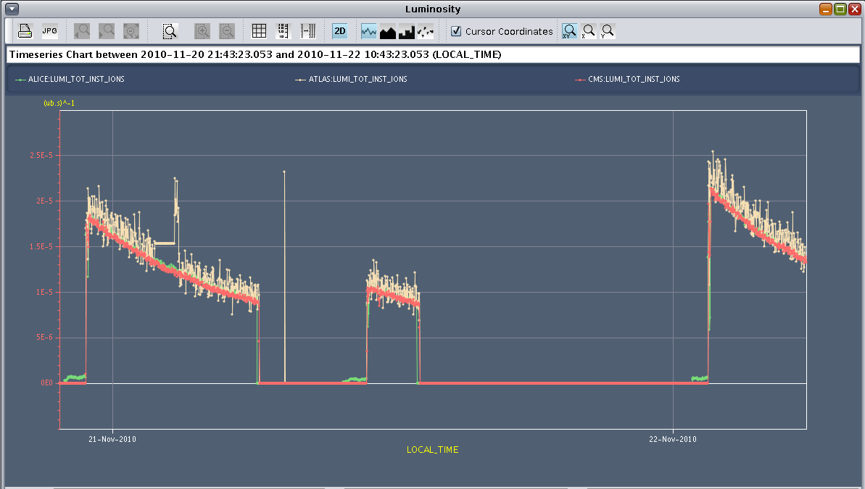
Fills since the restart – getting there

Slide 23
Fills in week 46, all with 121 bunches
When | Fill | Peak | Integrated | Length | Dumped by
Monday | 1492 | 2.5e25 | < 0.1 ub-1 | 1h | EL network perturbation
Monday | 1493 | 2.8e25 | 0.45 ub-1 | 9h | OP
Tuesday | 1494 | 1.7e25 | 0.25 ub-1 | 6h | OP
Tuesday | 1496 | 2.2e25 | 0.3 ub-1 | 6h | OP
Saturday | 1504 | 2.0e25 | 0.3 ub-1 | 7h | OP
Sunday | 1505 | 1.0e25 | < 0.1 ub-1 | 2h | OP
Sunday | 1506 | 2.2e25

Slide 24
Coming up
Stabilize/optimize source and injectors
Luminosity running to push over 3 ub-1 and beyond
Luminosity scans
ALICE polarity switch

