Slide 1
Preliminary
Results of MD wk46
V. Baglin, G. Bregliozzi, P. Chiggiato,
J-M. Jimenez, G. Lanza
CERN TE-VSC, Geneva
On behalf of TE-VSC

Slide 2
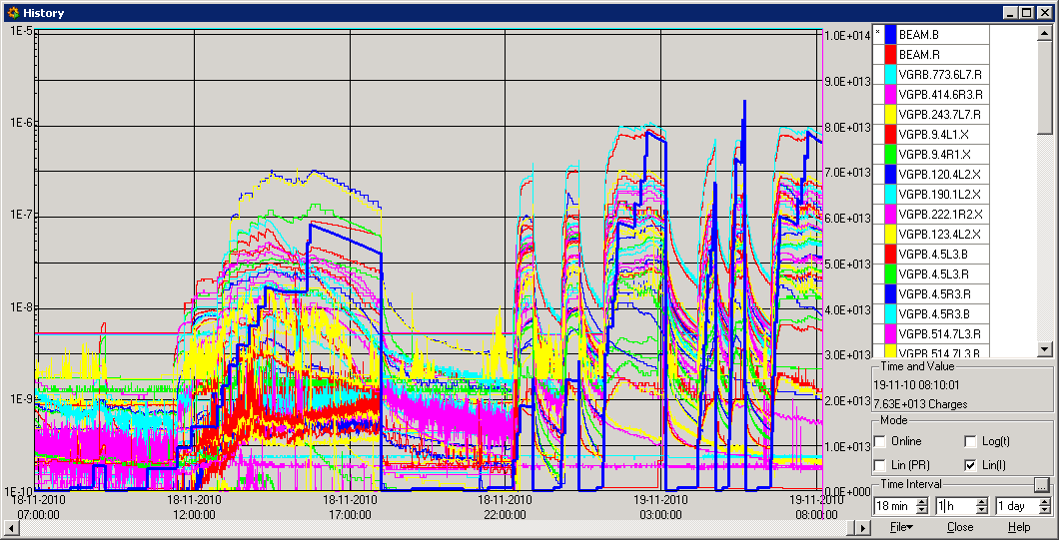
Last 24h
B1+ B2 at 680 b with 9e10 p/bunch with 1.85 micros
152 + 152 with 11e10 p/bunch => more vacuum activity
248 + 200 and 680+152 with 13e10 p/bunch
632B1 and 824 B1 with 11e10 p/bunch and reduced train spacing to 1.005 micros
680 B1 with 13e10 p/bunch and reduced train spacing to 1.005 micros

