Slide 1
Wednesday
06:00 Start proton MD
09:30 Pilot injection: LHC-SPS Re-synchronization problem
09:30-10:30 No beam form CPS (RF problem)
12:00 LHC-SPS Re-synchronization problem fixed. In the mean time test 75 ns beam in the SPS
14:00 Safe beam flag test done
14:30-15:00 Phase loop gain adjustment
15:00-16:30 PS Access (in the mean time first set of loss maps)
16:30-22:00 Issues with RF capture of single bunch with nominal intensity. In parallel final verification of loss maps.
22:00-23:00 Setting-up of single batch injection
23:00-06:00 Transfer line and injection setting-up with 75 ns
06:00-ongoing: Start injection of more trains of 24+24 bunches

Slide 2
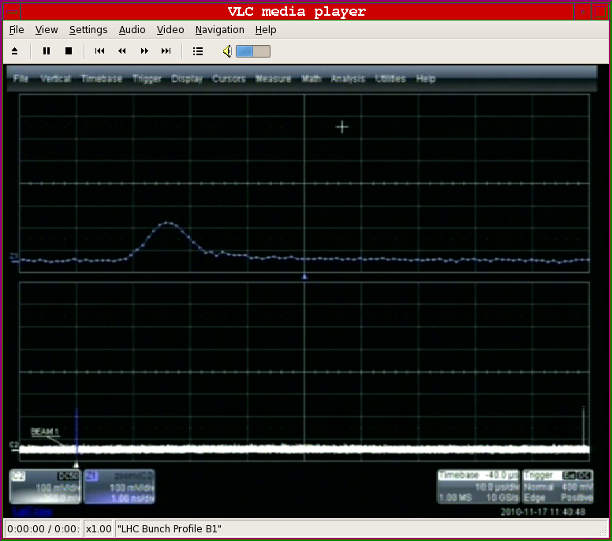
RF Issues
Issues with SPS-LHC synchronization after moving to protons ➔ reboot of RF server required.
Not all RF settings are “plug-and-play” as claimed, e.g. Injection phase

Slide 3
RF Issues
Issues with capture of single nominal bunch: When going from ions (1E10/bunch) to p+ (1.1E11/bunch) we change the RF attenuation of the Beam Phase measurement by 21 dB. The signal is then demodulated and sampled at the 40.08 MHz bunch synchronous freq. A fine-delay is foreseen to adjust the position of the sampling with respect to the precise bunch passage. As the change of attenuation has an influence on the Bunch-to-sampler delay, this fine-delay is different for p+ and ions.
The fine-delay setting is not an LSA parameter. The result is a poor sampling of the phase loop that wrongly sees two ghost bunches: it samples first on the edge of the bunch impulse response and then on the tail of the response.
Ph. Baudrenghien

Slide 4
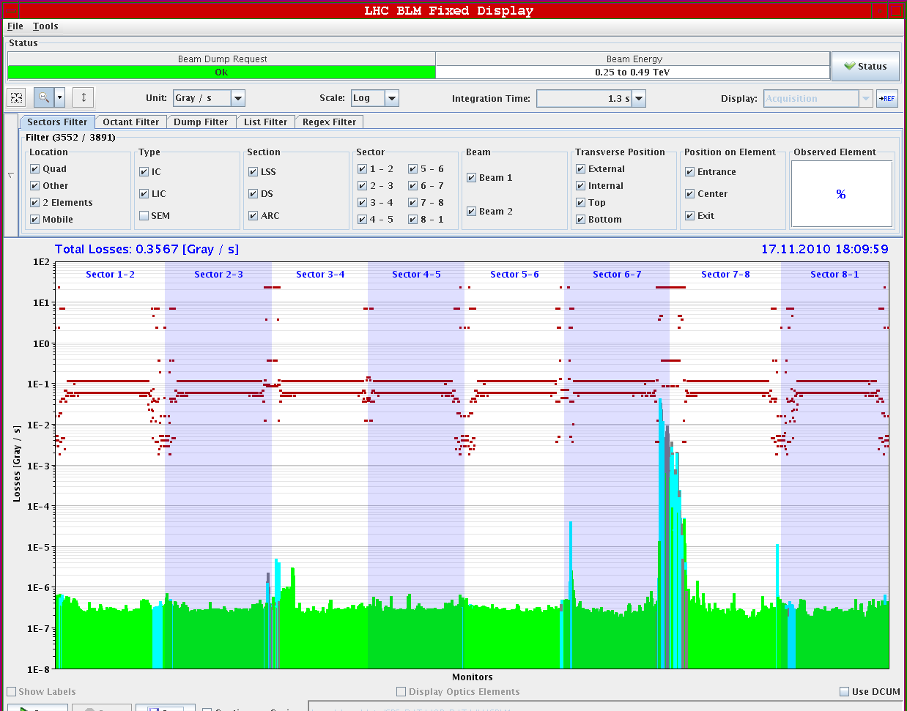
Machine protection checks
RF interlock checked
Beam presence flag verified (it is low ~2x10⁸ p – already observed in the past)
Loss maps done and OK

Slide 5
Issues with the injectors
Problems with distributor of PS-Booster affecting the 75 ns set-up in the SPS during the first part of the morning.
RF in the PS (2 accesses required for 10 MHz cavities). An additional one might be required today.
Problems with non-PPM settings for the longitudinal blow-up when going from single nominal bunch to 75 ns.
Quality not yet reproducible (bunch-to-bunch intensity uniformity and satellites)

Slide 6
Instrumentation issues
Important (unphysical) offsets observed in BPMs with nominal intensity. Giving interlocks at injection (SIS check on orbit: tight settings for high intensity). Finally corrected after several re-calibrations (issue with temperature correction?).

Slide 7
Injection set-up
TI2 steering in both planes with 8b onto the TED, no steering in TI8
injection into LHC looked good with 8 b for trajectory, losses and oscillations --> no corrections performed, no TCDI adjustment necessary and they were left at 4.5 sigma settings
went on with 24 and 48 bunches: trajectory in TLs stable; losses went up scaling with the injected intensity, IQC latches for losses in injection area and no BPM data, after restarting BPM proxy and LHCBLM process on BPM servers checked again with 8b --> OK, however failing for the next 48 b injection again
performed P6 BPM IL test with 48 b
With 48 bunch injection there is about a factor 2 margin left before the ring BLMs interlock for B1. For B2 there is about a factor of 3 margin on the BLMs. IQC will latch for 48 bunches. For last injections B2 got worse, only factor 2 left to dump threshold.
Continuous problems with BPM readings, checked injection oscillations with the damper readings - 48 bunches should ONLY be injected when the problem is solved! ➔ now understood (issue when going above 40 bunches
W. Bartmann, B. Goddard, M. Meddahi, J. Uythoven

Slide 8
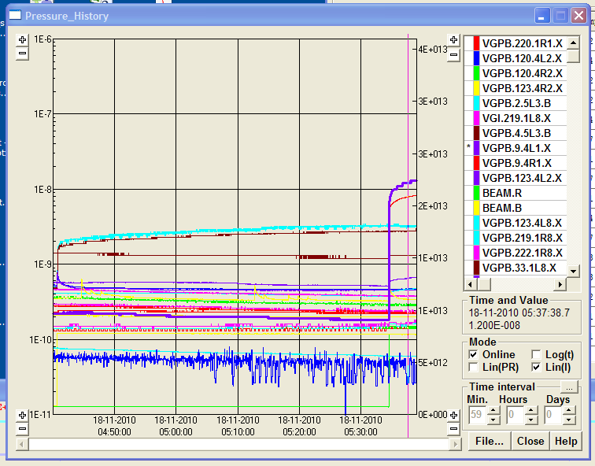
First vacuum observations
Activity observed with 48 (24+24) bunches in the triplet area when both beams are injected although still well below interlock levels...ongoing

Slide 9
Proton MD program
 | Start time | Duration [h]
Thu 18 | 06:00 | 16 | Injection of trains of 24/48 bunches and e-cloud measurements
 | 22:00 | 4 | Switch to 50ns (12 bunches), injection and damper checks
 | 02:00 | 6 | Test ramp with pilots
Fri 19 | 08:00 | 10 | Ramp 9x12 50ns bunches
 | 18:00 | 4 | Interlock checks
 | 22:00 |  | Back to ion physics

