Slide 1
Tuesday
Fill 1494 dumped by operations at 09.00 (~ 0.25 ub⁻¹ in ~6.5 h): LSS6 BPM interlock test
13:00 Fill 1495 dumped by RF dump (cavity quench)
14:00-17:30 Access for flooding alarm in point 4. In parallel:
BI
Vacuum to replace controller for 2 vacuum gauges for injection kicker
18:30 Power converter problem during pre-cycle (RQT13.L2B2), already occurred several times ➔ Access
20:00 Pre-cycling
21:30 injection
00:30 STABLE BEAMS #1496
06:00 Beam dump and Start preparation proton MD

Slide 2
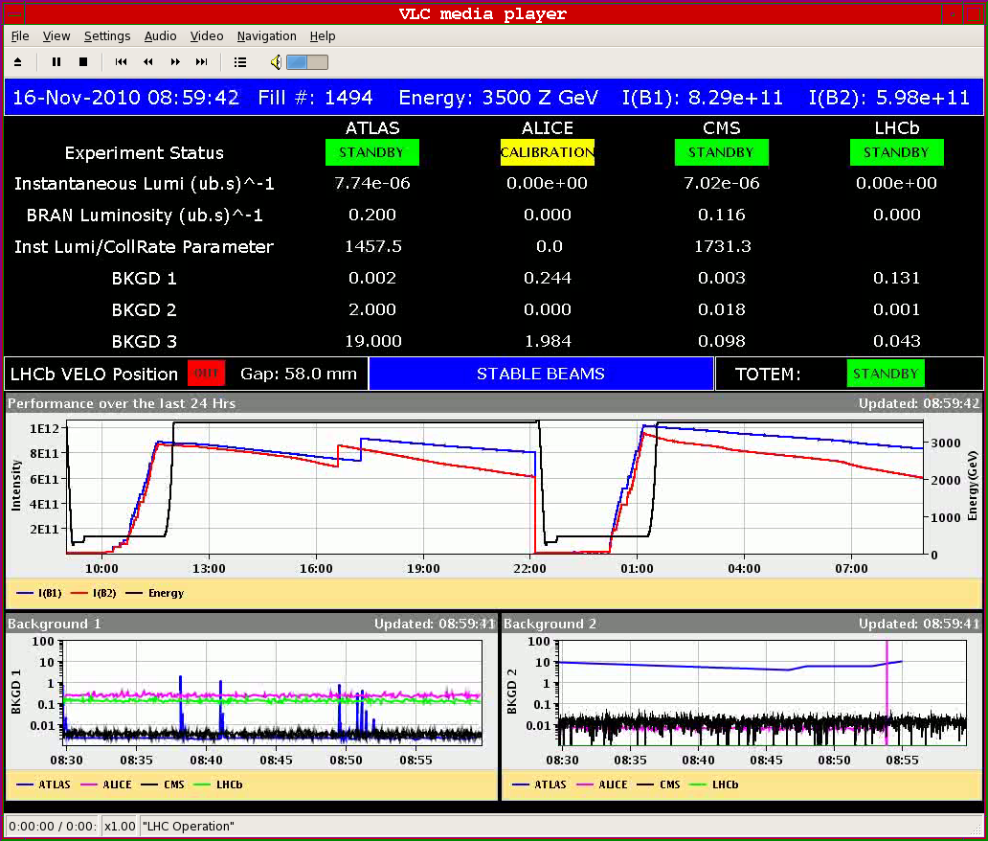
Fill 1494
End of physics 1494: 0.25 μb⁻¹ in 6.5 hours

Slide 3
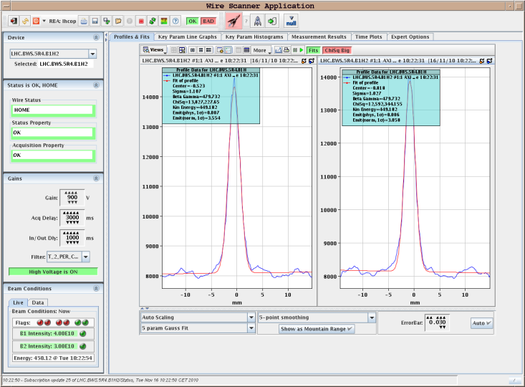
Fill #1495
Injection starting at 10:00
Large emittance in the V-plane B2 particularly ➔ correlated with V- injection oscillations B2 ➔ Corrected ➔
B1-H: 2.4 μm B1-V: 2.9 μm
B2-H: 3.0 μm B2-V: 4.0 μm
B1H: 3.2 μm
B2H: 3.7 μm
B1V: 3.2 μm
B2V: 7.0 (!) μm

Slide 4
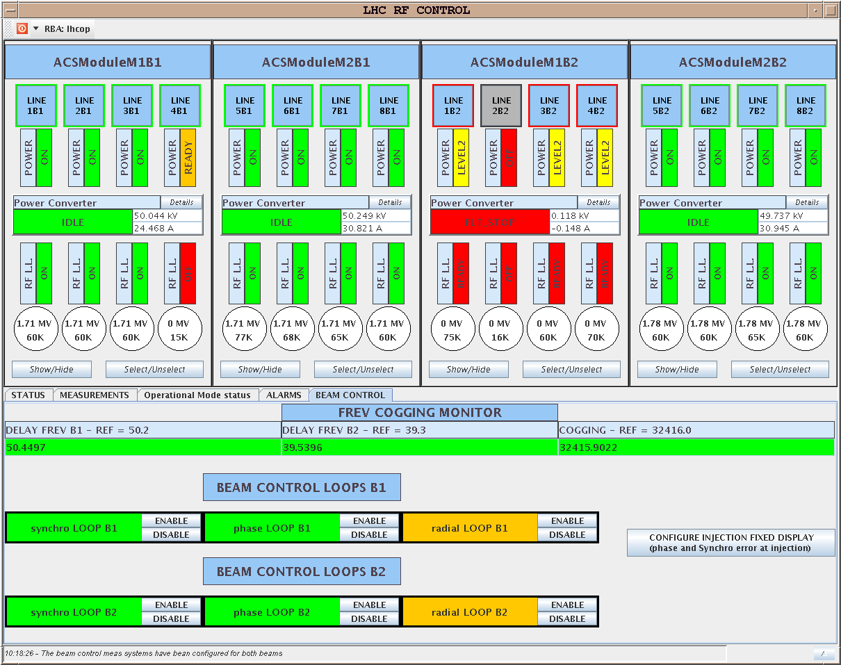
Fill #1495
13:00 RF beam dump due: ACSModuleM1B2 :: He tank Pressure interlock Level 2 exceeded (Quench)
Decided to give access for flooding alarm at the bottom of PZ45 appeared at ~12:30 and after verification by TI and CV ➔ Problem was real (water level in the sump reached high level because the water pump did not start - float was stuck) but no flooding.

Slide 5
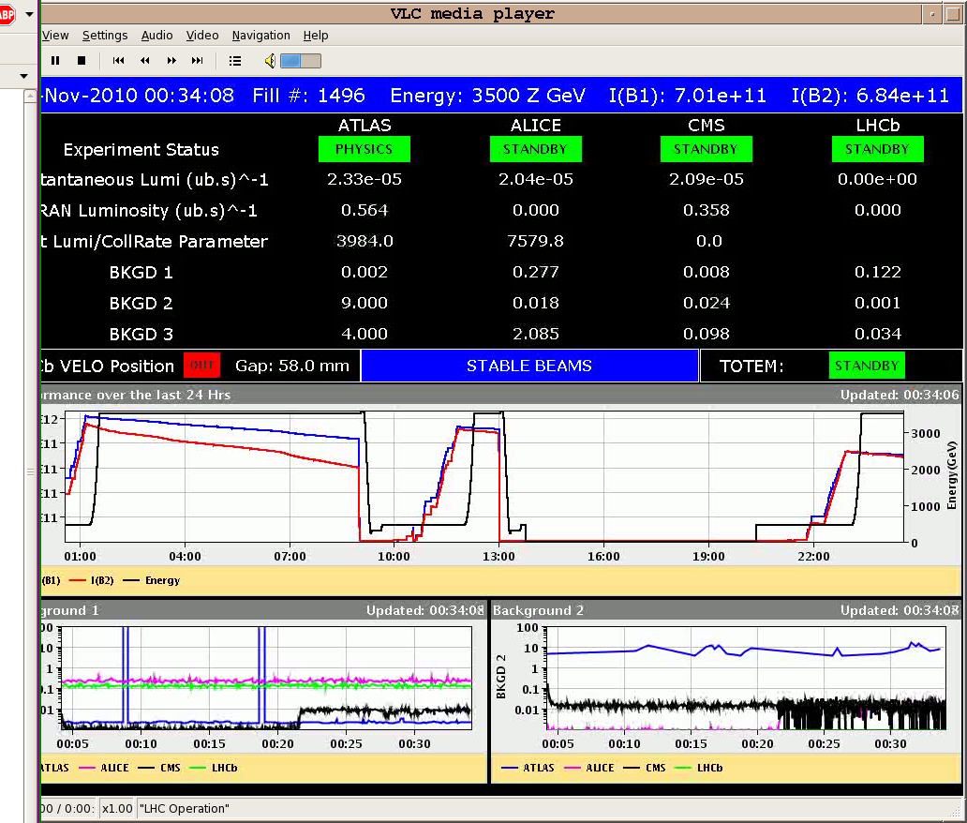
Fill #1496
00:30 Stable Beams #1496
Intensities on Fast BCT displayed in Page 1 underestimated after installation of the attenuators and expert intervention ➔ to be followed up today
06:15 Beams dumped to start switch-over to protons: ~0.3 μb⁻¹ delivered in ~6 h. In total ~2 μb⁻¹

Slide 6
Proton MD program
 | Start time | Duration [h]
Wed 17 | 06:00 |  | Dump and precycle – Switch to protons
 | 08:00 | 4 | Interlock checks
 | 12:00 | 7 | Injection and damper checks for 75ns
 | 19:00 | 22 | Injection of trains of 24/48 bunches and e-cloud measurements
Thu 18 | 17:00 | 4 | Switch to 50ns, injection and damper checks
 | 21:00 | 6 | Test ramp with pilots
Fri 19 | 03:00 | 10 | Ramp 9x12 50ns bunches
 | 13:00 | 5 | Stability measurements, 50ns and 75ns beams
 | 18:00 | 4 | Interlock checks
 | 22:00 |  | Back to ion physics
Total MD time |  | 64

